Slide 1
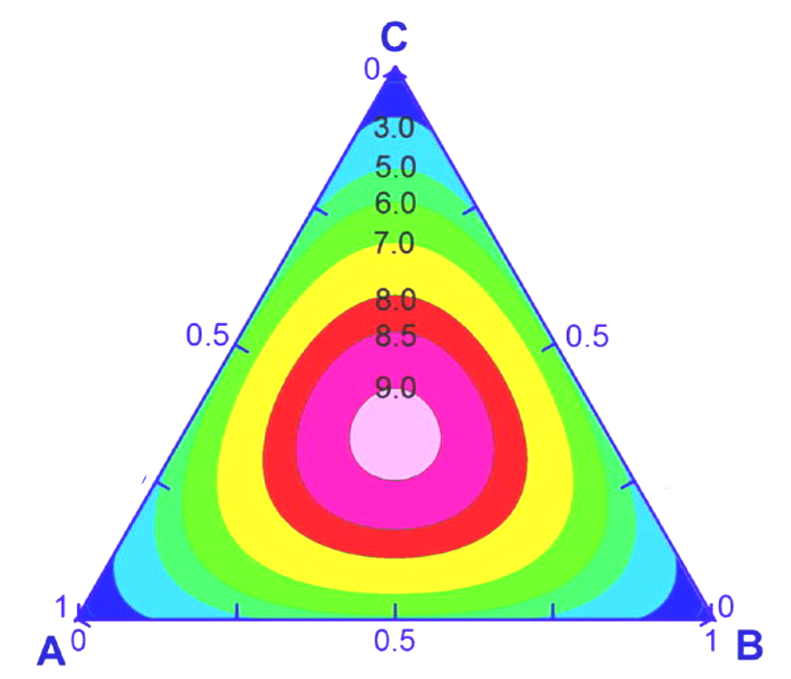
courtesy of T. DebRoy

Slide 2
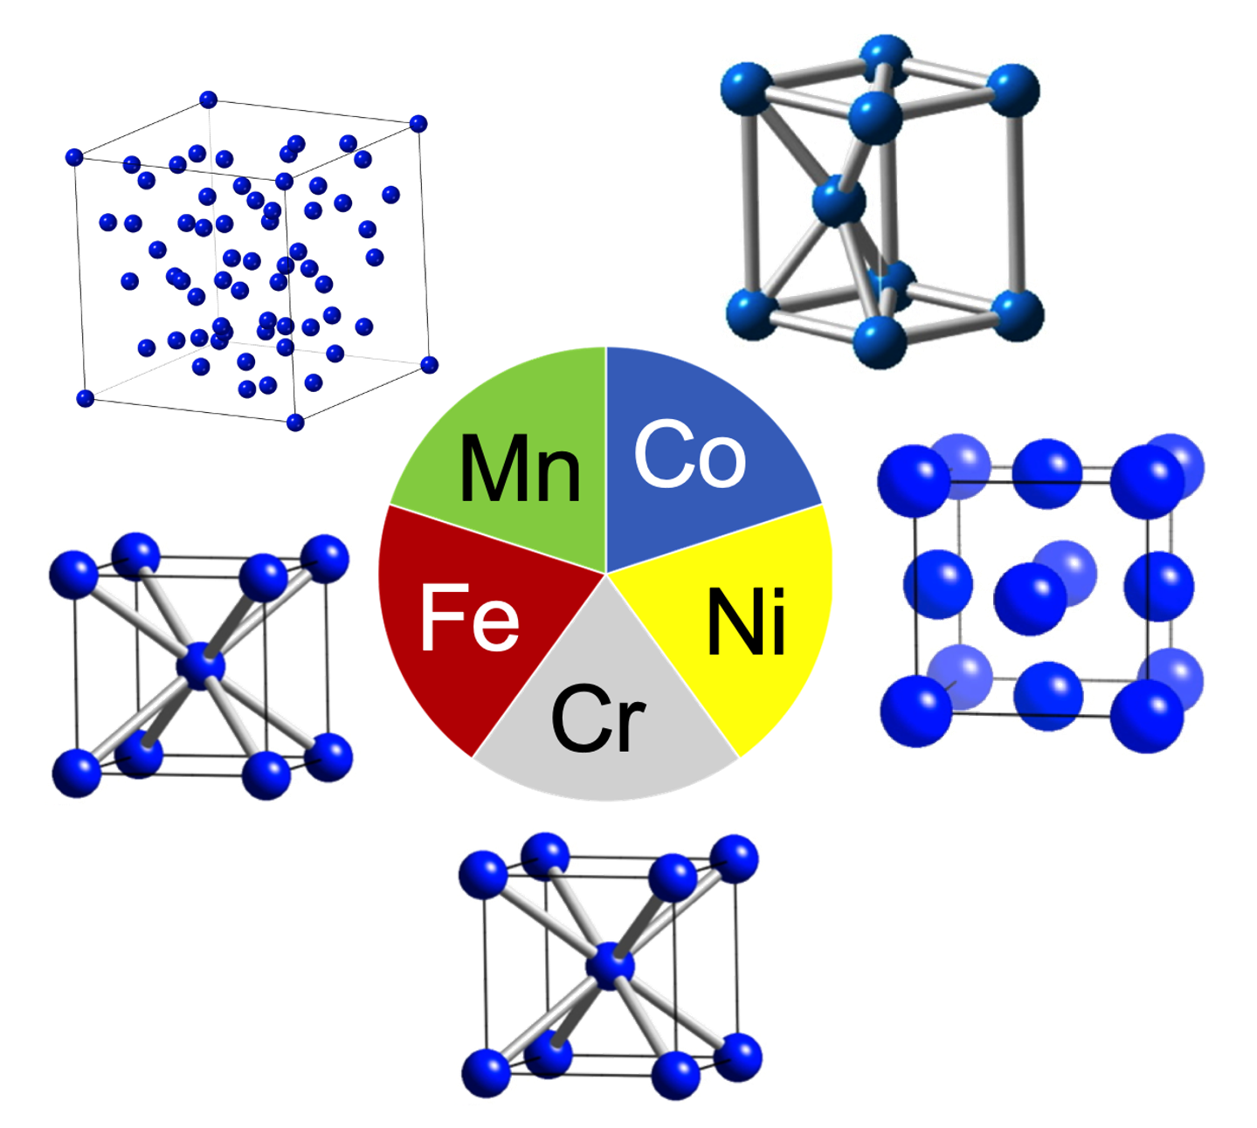
Crystal structure?
equiatomic Cr Mn Fe Co Ni

Slide 3
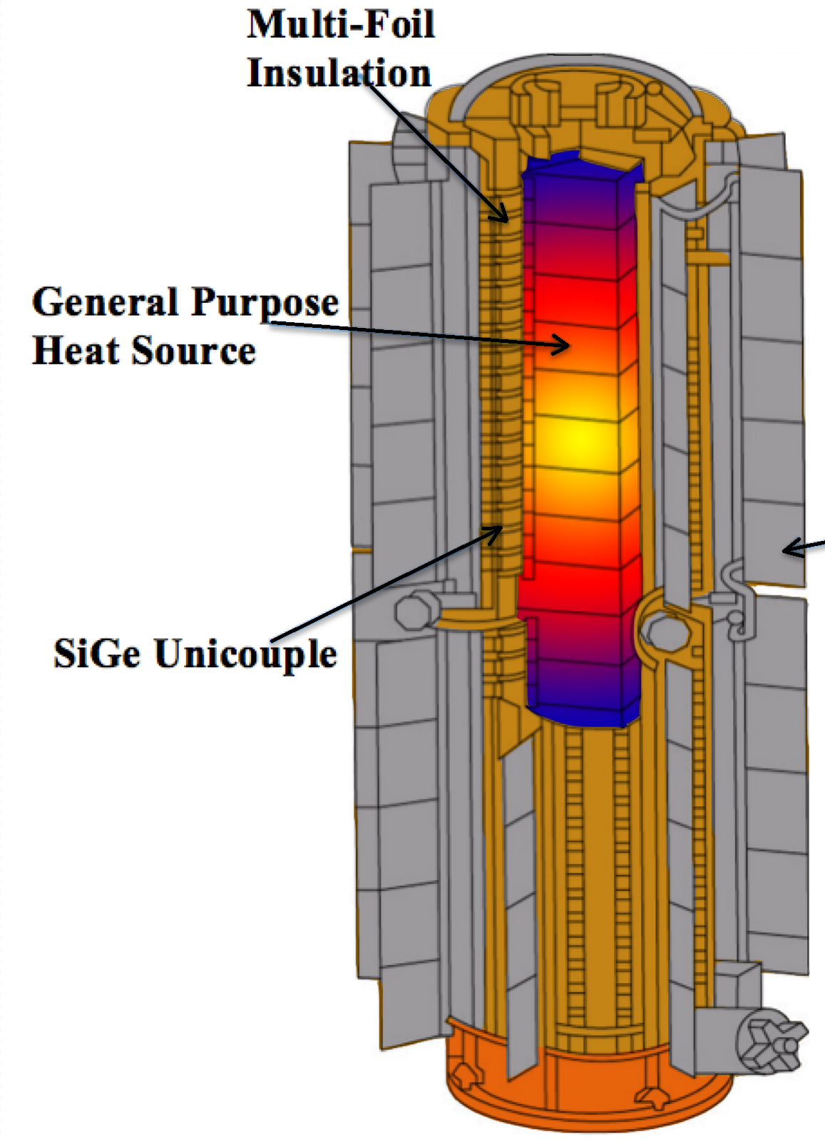
Parker Beatty
Creative Commons Attribution-Share Alike 4.0 International

Slide 4
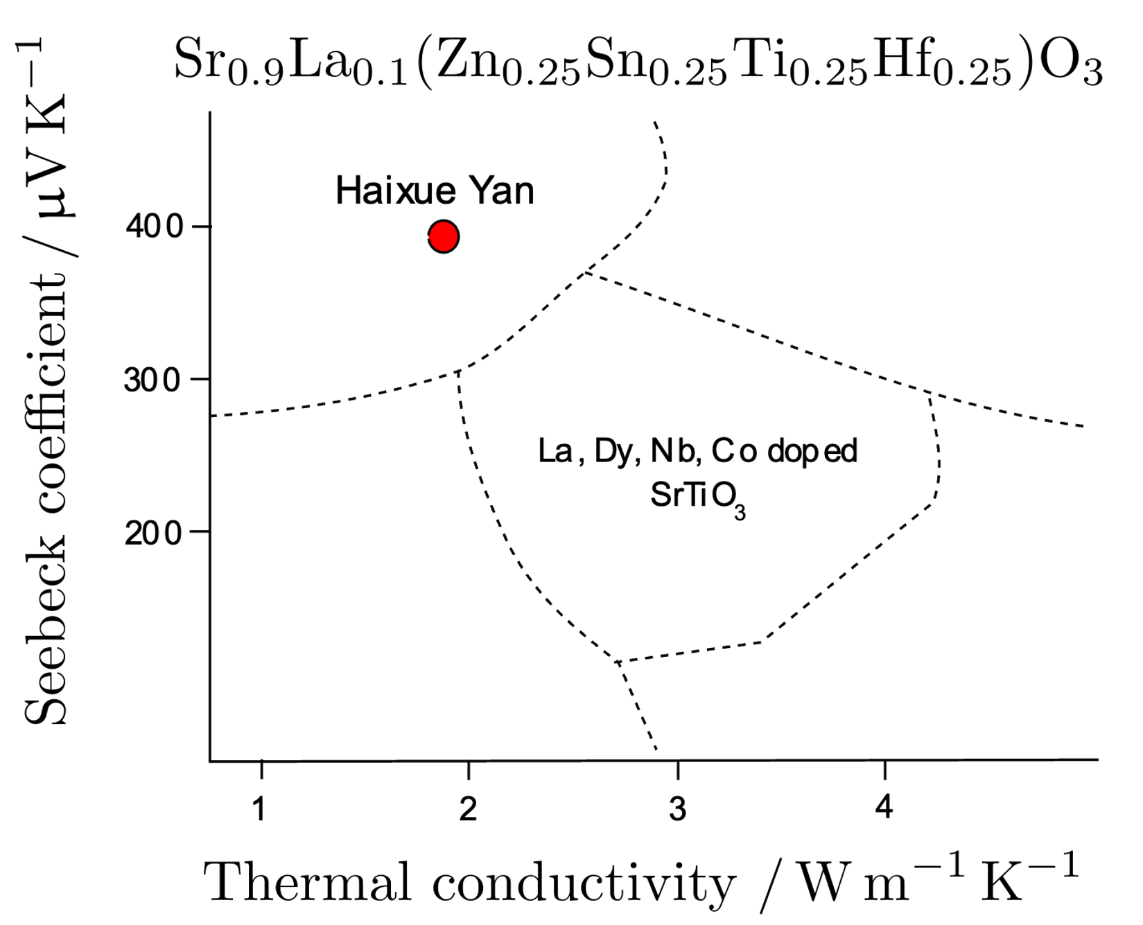

Slide 5
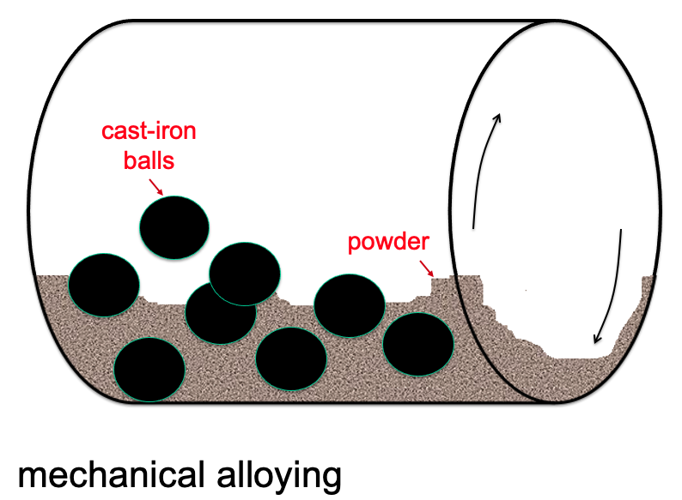
There are many industrial processes where we mix powders rather than atoms.
Ball milling is used to make strange alloys where powders really don’t want to mix, but we force them to do so and form an atomic solution.
The purpose is to achieve properties never before achieved.
an application of thermodynamics

Slide 6
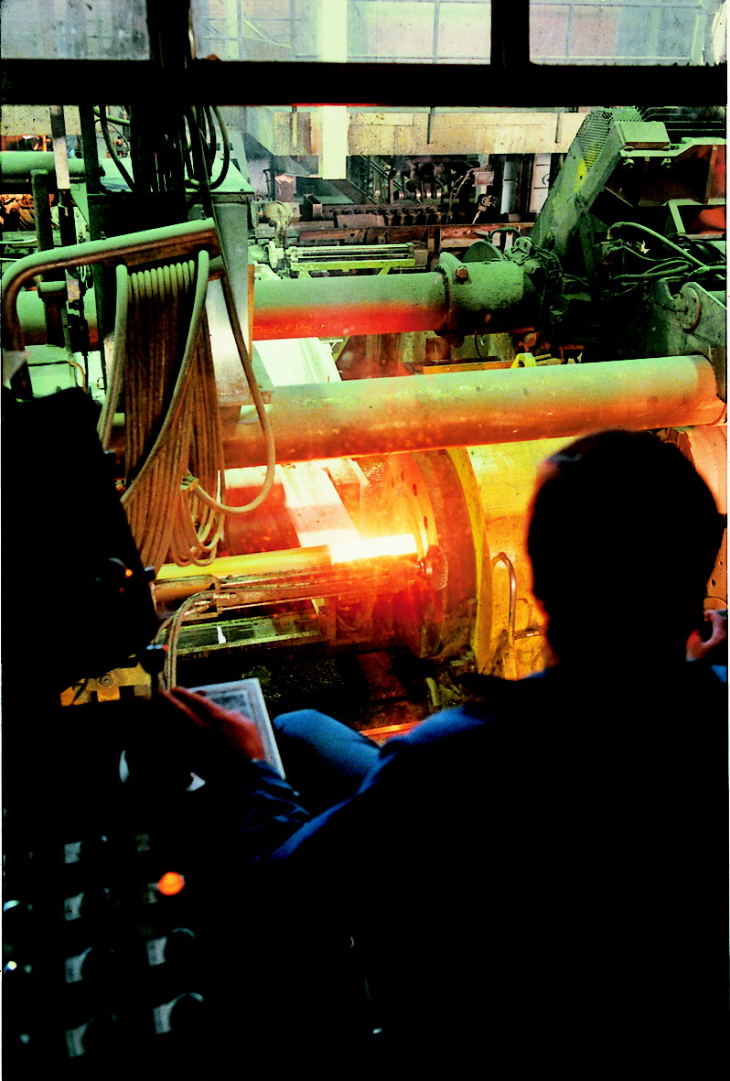
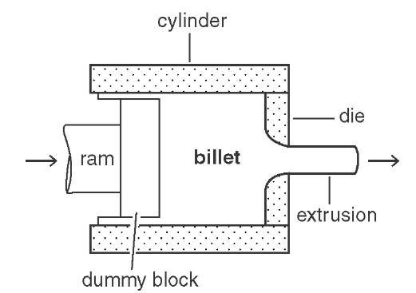
extrusion of canned powder
image courtesy of Jan-Olof Nilsson
Sandvik Materials Technology.
Extrusion of stainless steel.

Slide 7
an application of thermodynamics
Suppose that instead of atoms, we mix particles of A and B, each containing many atoms
What is the configurational entropy of mixing?

Slide 8
For a random mixture of particles, number of configurations given by:

Slide 9
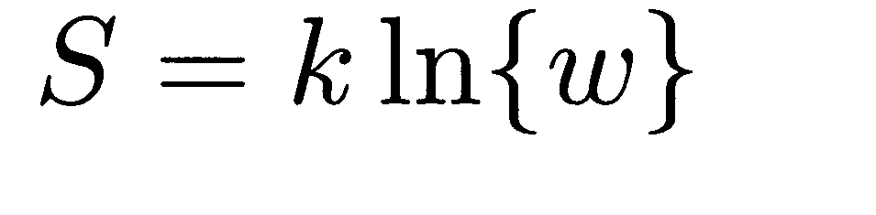
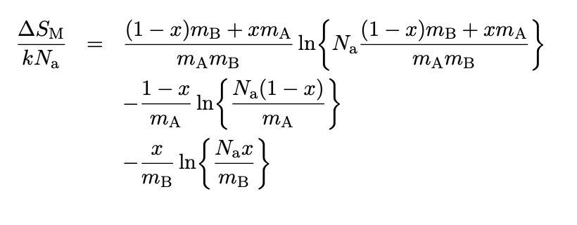

Slide 10
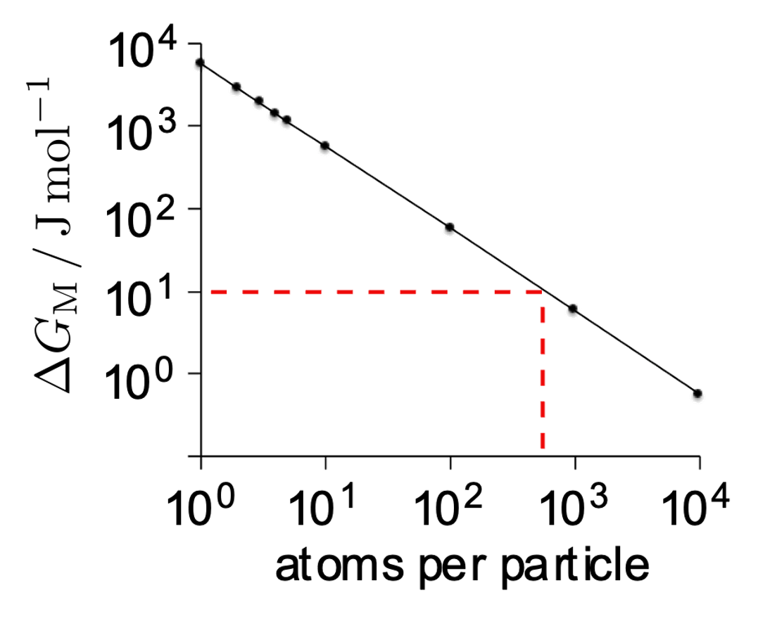
Solution-like behaviour when particles about 1000 atoms in size
Free energy of mixing due to configurational entropy alone

Slide 11
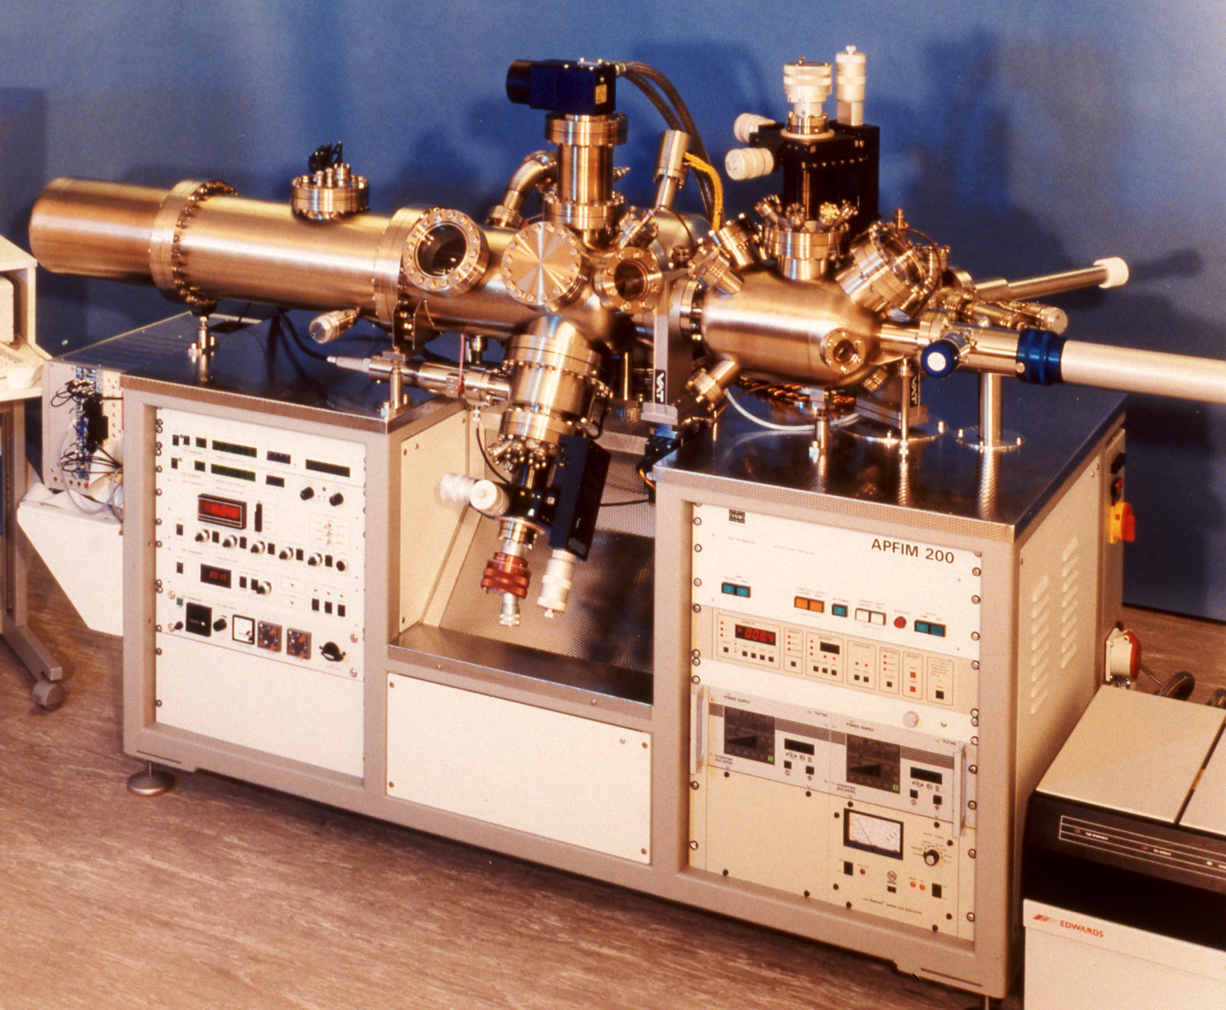

How do we know that an atomic solution has formed?

Slide 12
Chou & Bhadeshia

Slide 14
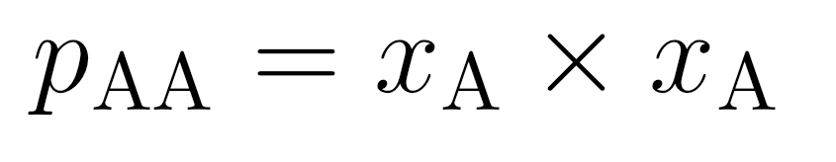
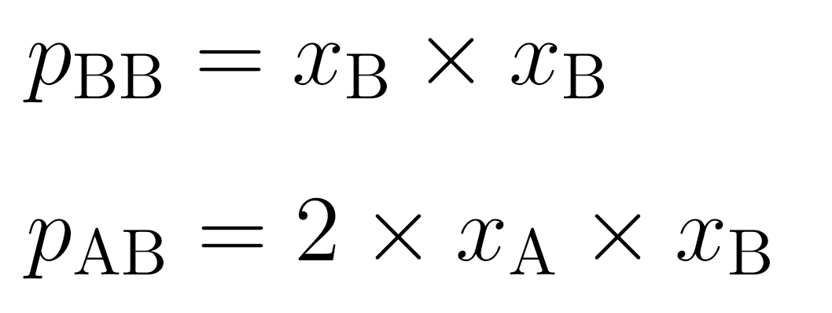
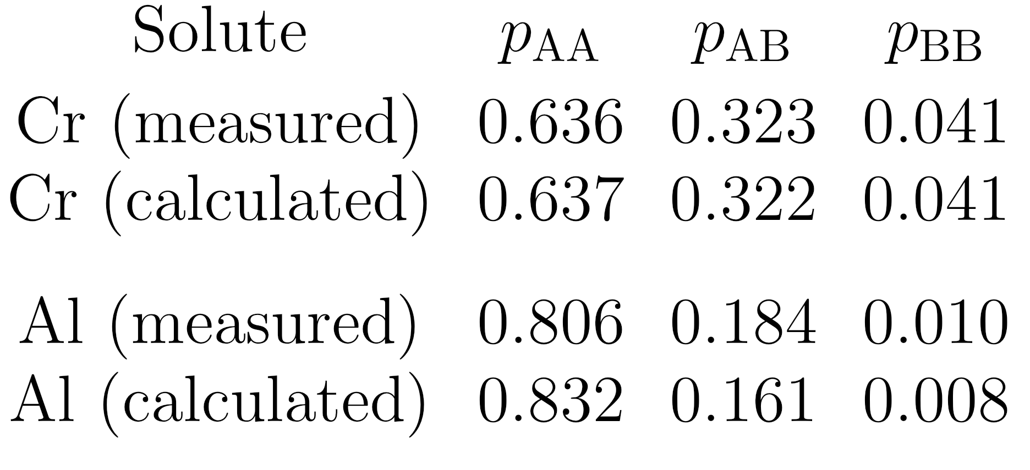
Probability of pairwise bonds in random solution

Slide 15
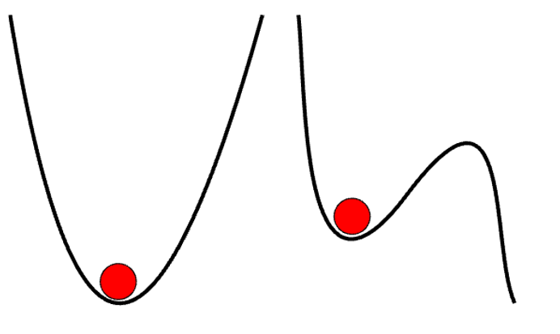
Phase transitions equilibrium state
“nothing changes, no matter how long it is observed”
stable to infinitesimal perturbation
photograph courtesy of Sunita Hansraj from her Antarctica expedition

Slide 16
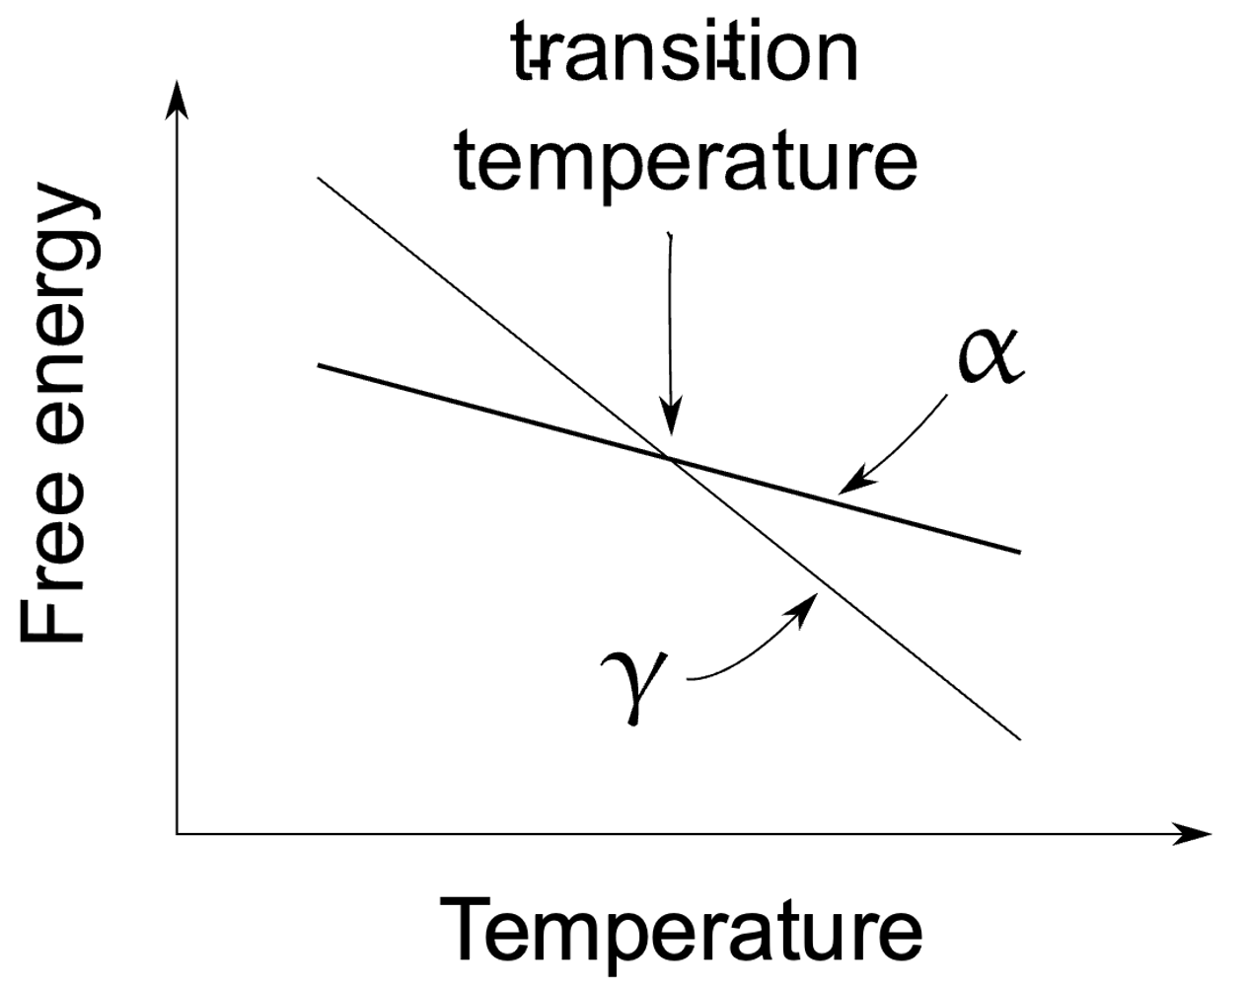
transformation without composition change

Slide 17
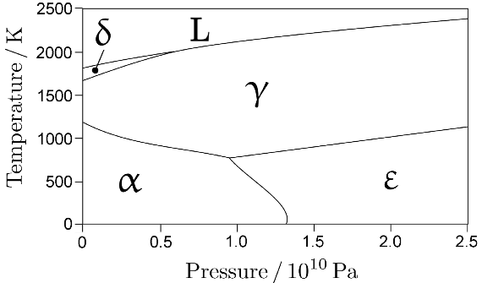
pure iron

Slide 18
Solutions

Slide 20
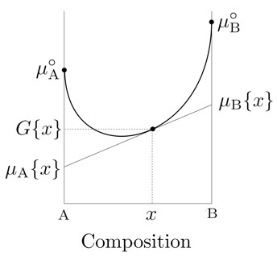
chemical potential

Slide 21
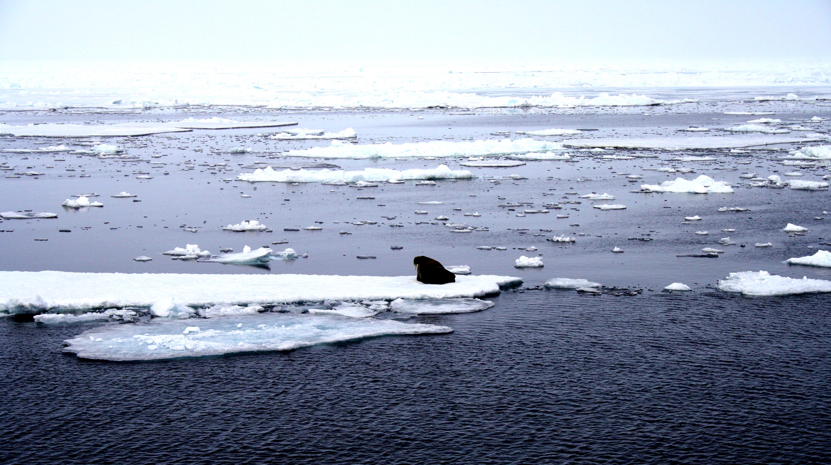
two solutions in contact
compositions different, yet in equilibrium
ice: pure
ocean: salty water
photograph courtesy of Sunita Hansraj from her Antarctica expedition

Slide 24
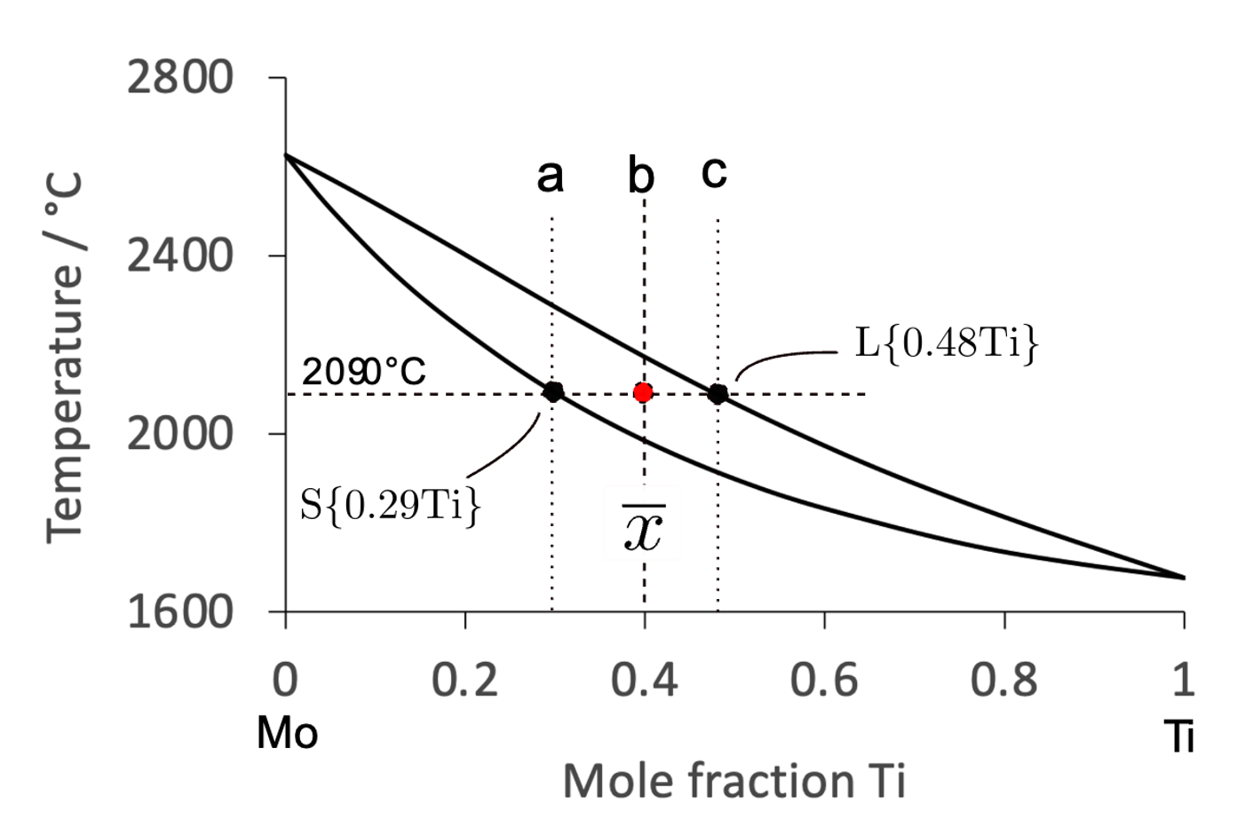
proportions of phases: lever rule

Slide 25
Liquid can decompose simultaneously into two solids

Slide 26

Simulation, Britta Nestler, RWTH Aachen

Slide 27
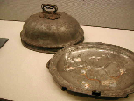
eutectic
Melting temperatures
Lead 328°C
Tin 232°C
Pb-62Sn wt% 183°C
Edo Museum in Tokyo. Shogun era, about 130 years ago.

Slide 28
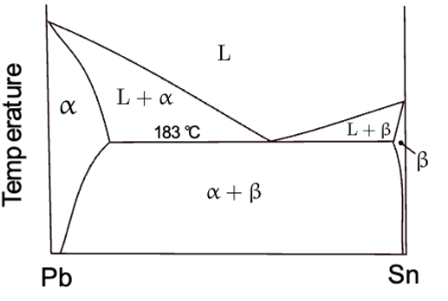
hypoeutectic
eutectic
hypereutectic

Slide 29
Why eutectic?

Slide 30
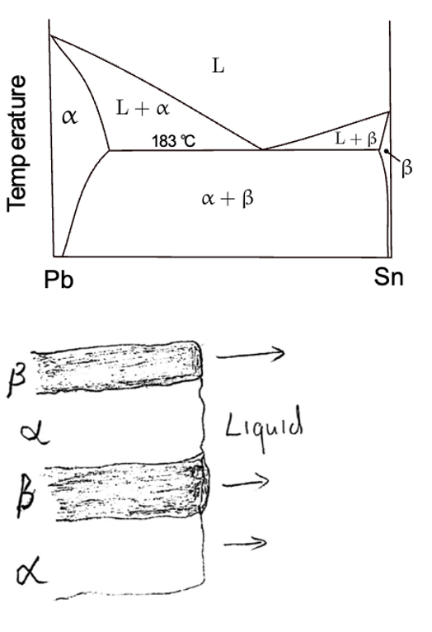
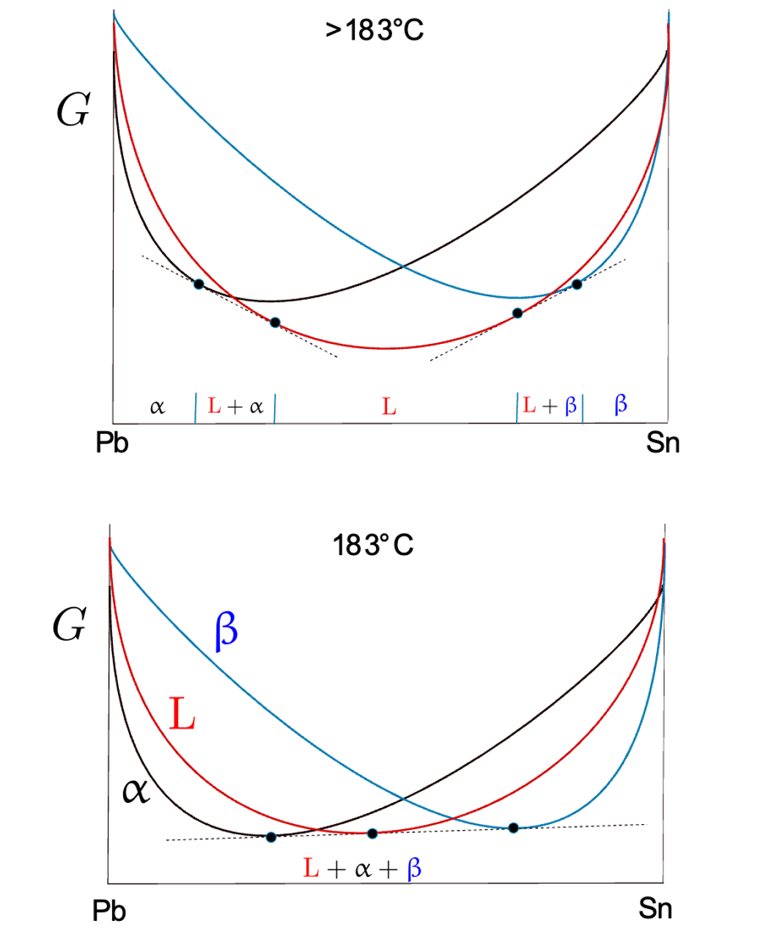

Slide 31

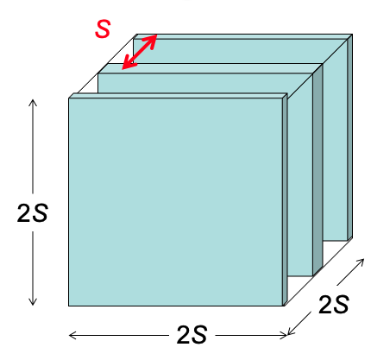

Slide 32
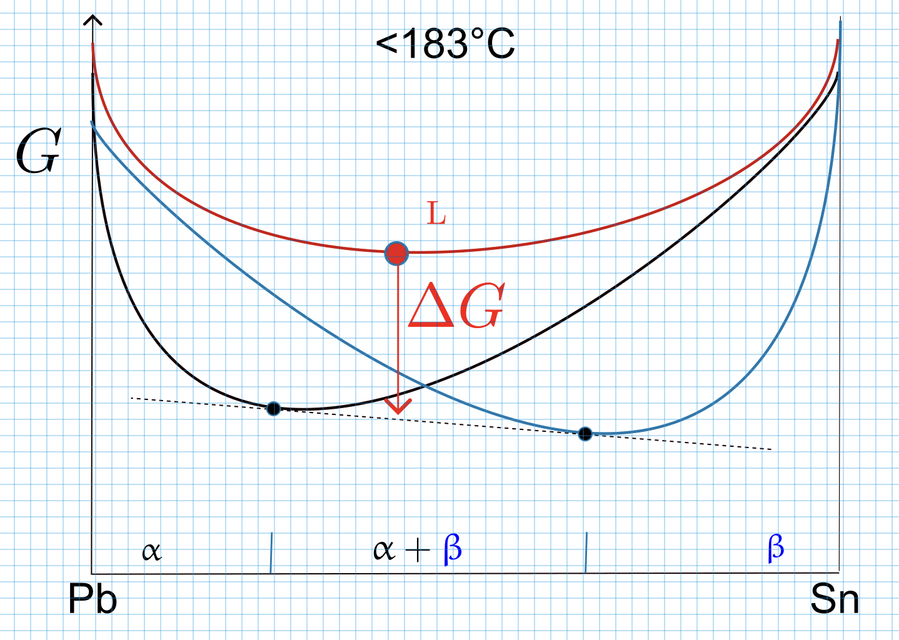

Slide 33
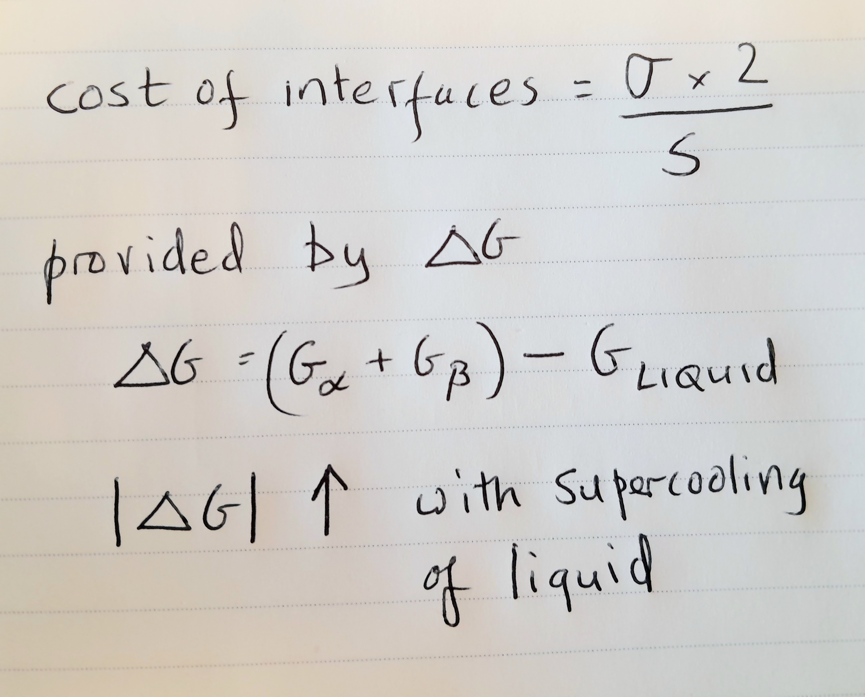

Slide 34
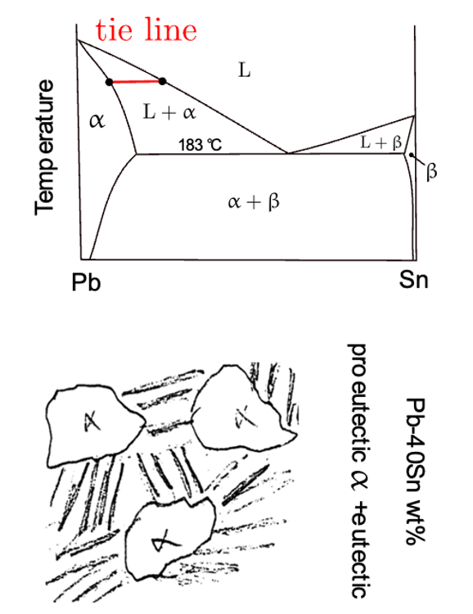

Slide 35
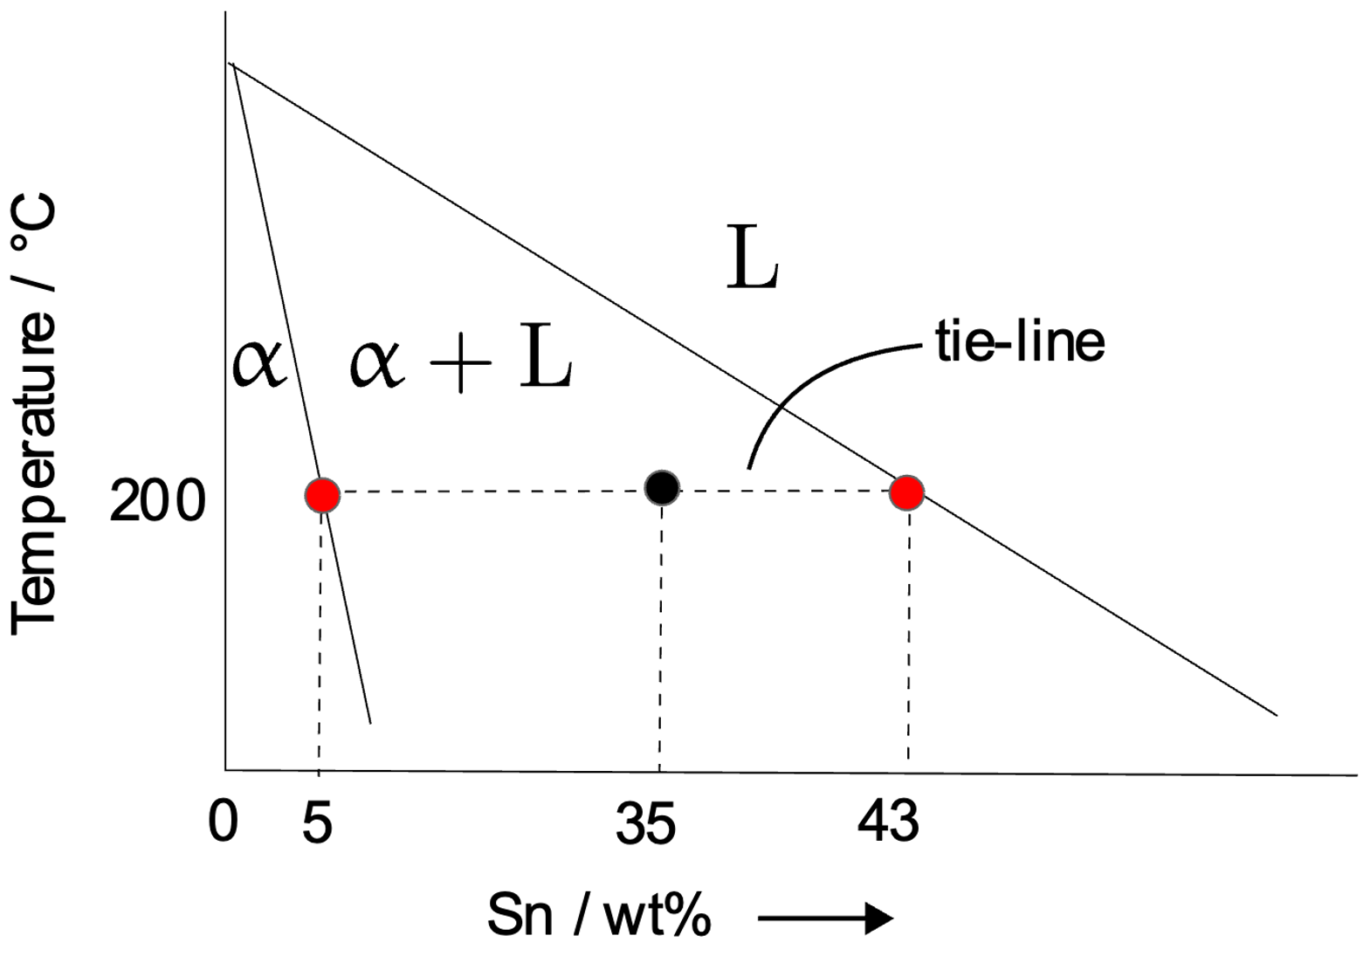
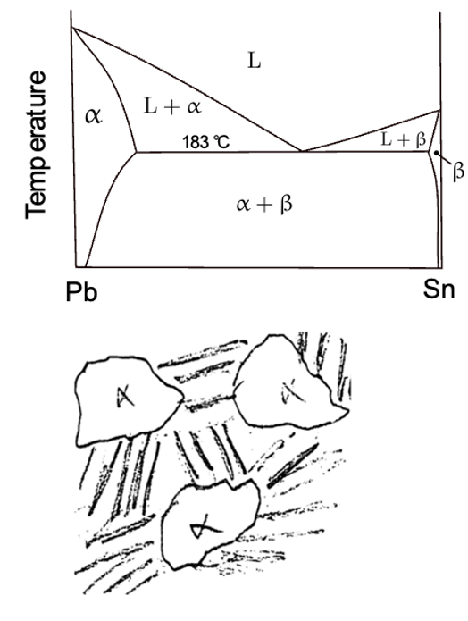

Slide 36
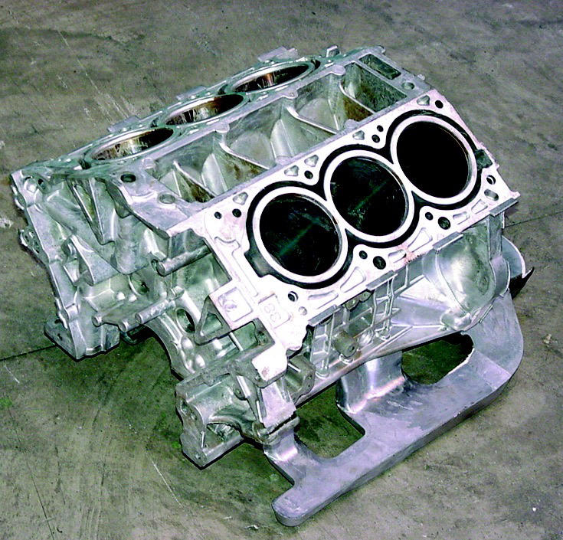
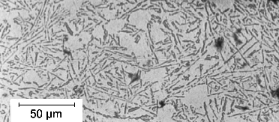

Slide 37
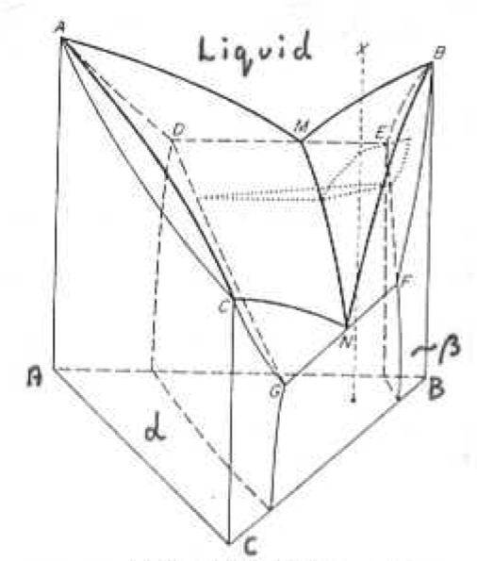
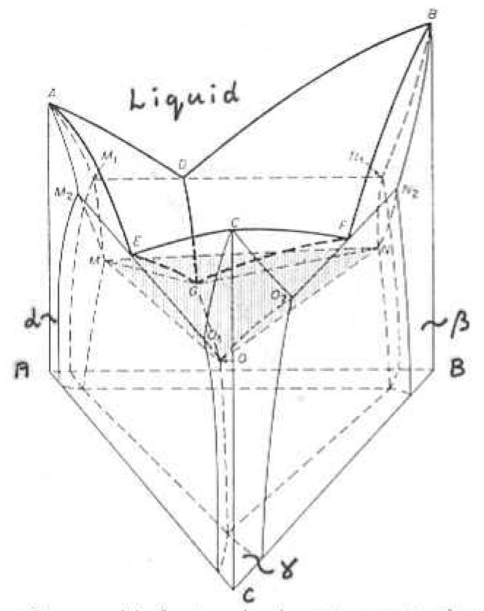
images courtesy of
Jane Weston

Slide 38
constant temperature section
ternary phase diagram

Slide 39
What do we need from phase diagrams?
stable phases
fractions of phases
compositions of phases
as a function of temperature, pressure etc.
consider 7 components (Fe, C, Si, Mn, Ni, Mo, Cr)
three phases BCC, Fe₃C, M₂₃C₆

Slide 40
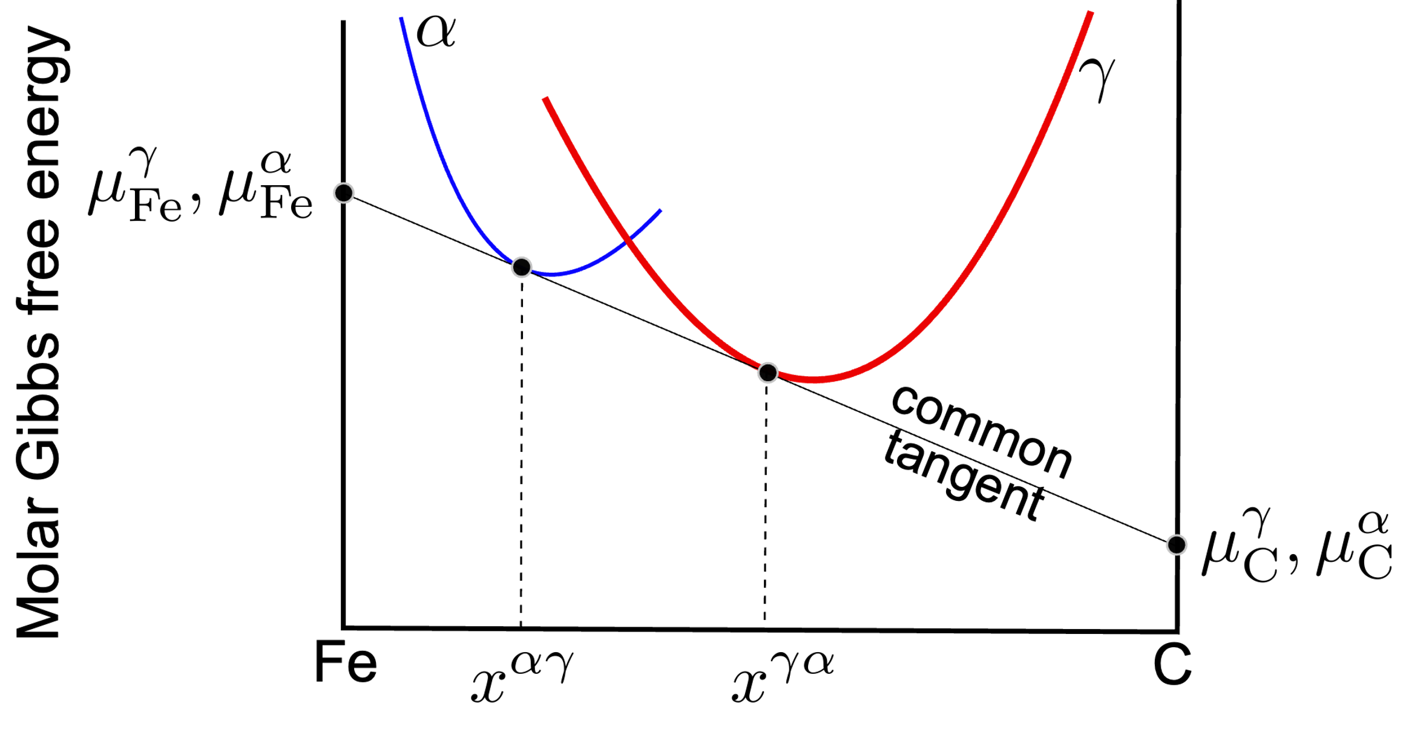

Slide 41
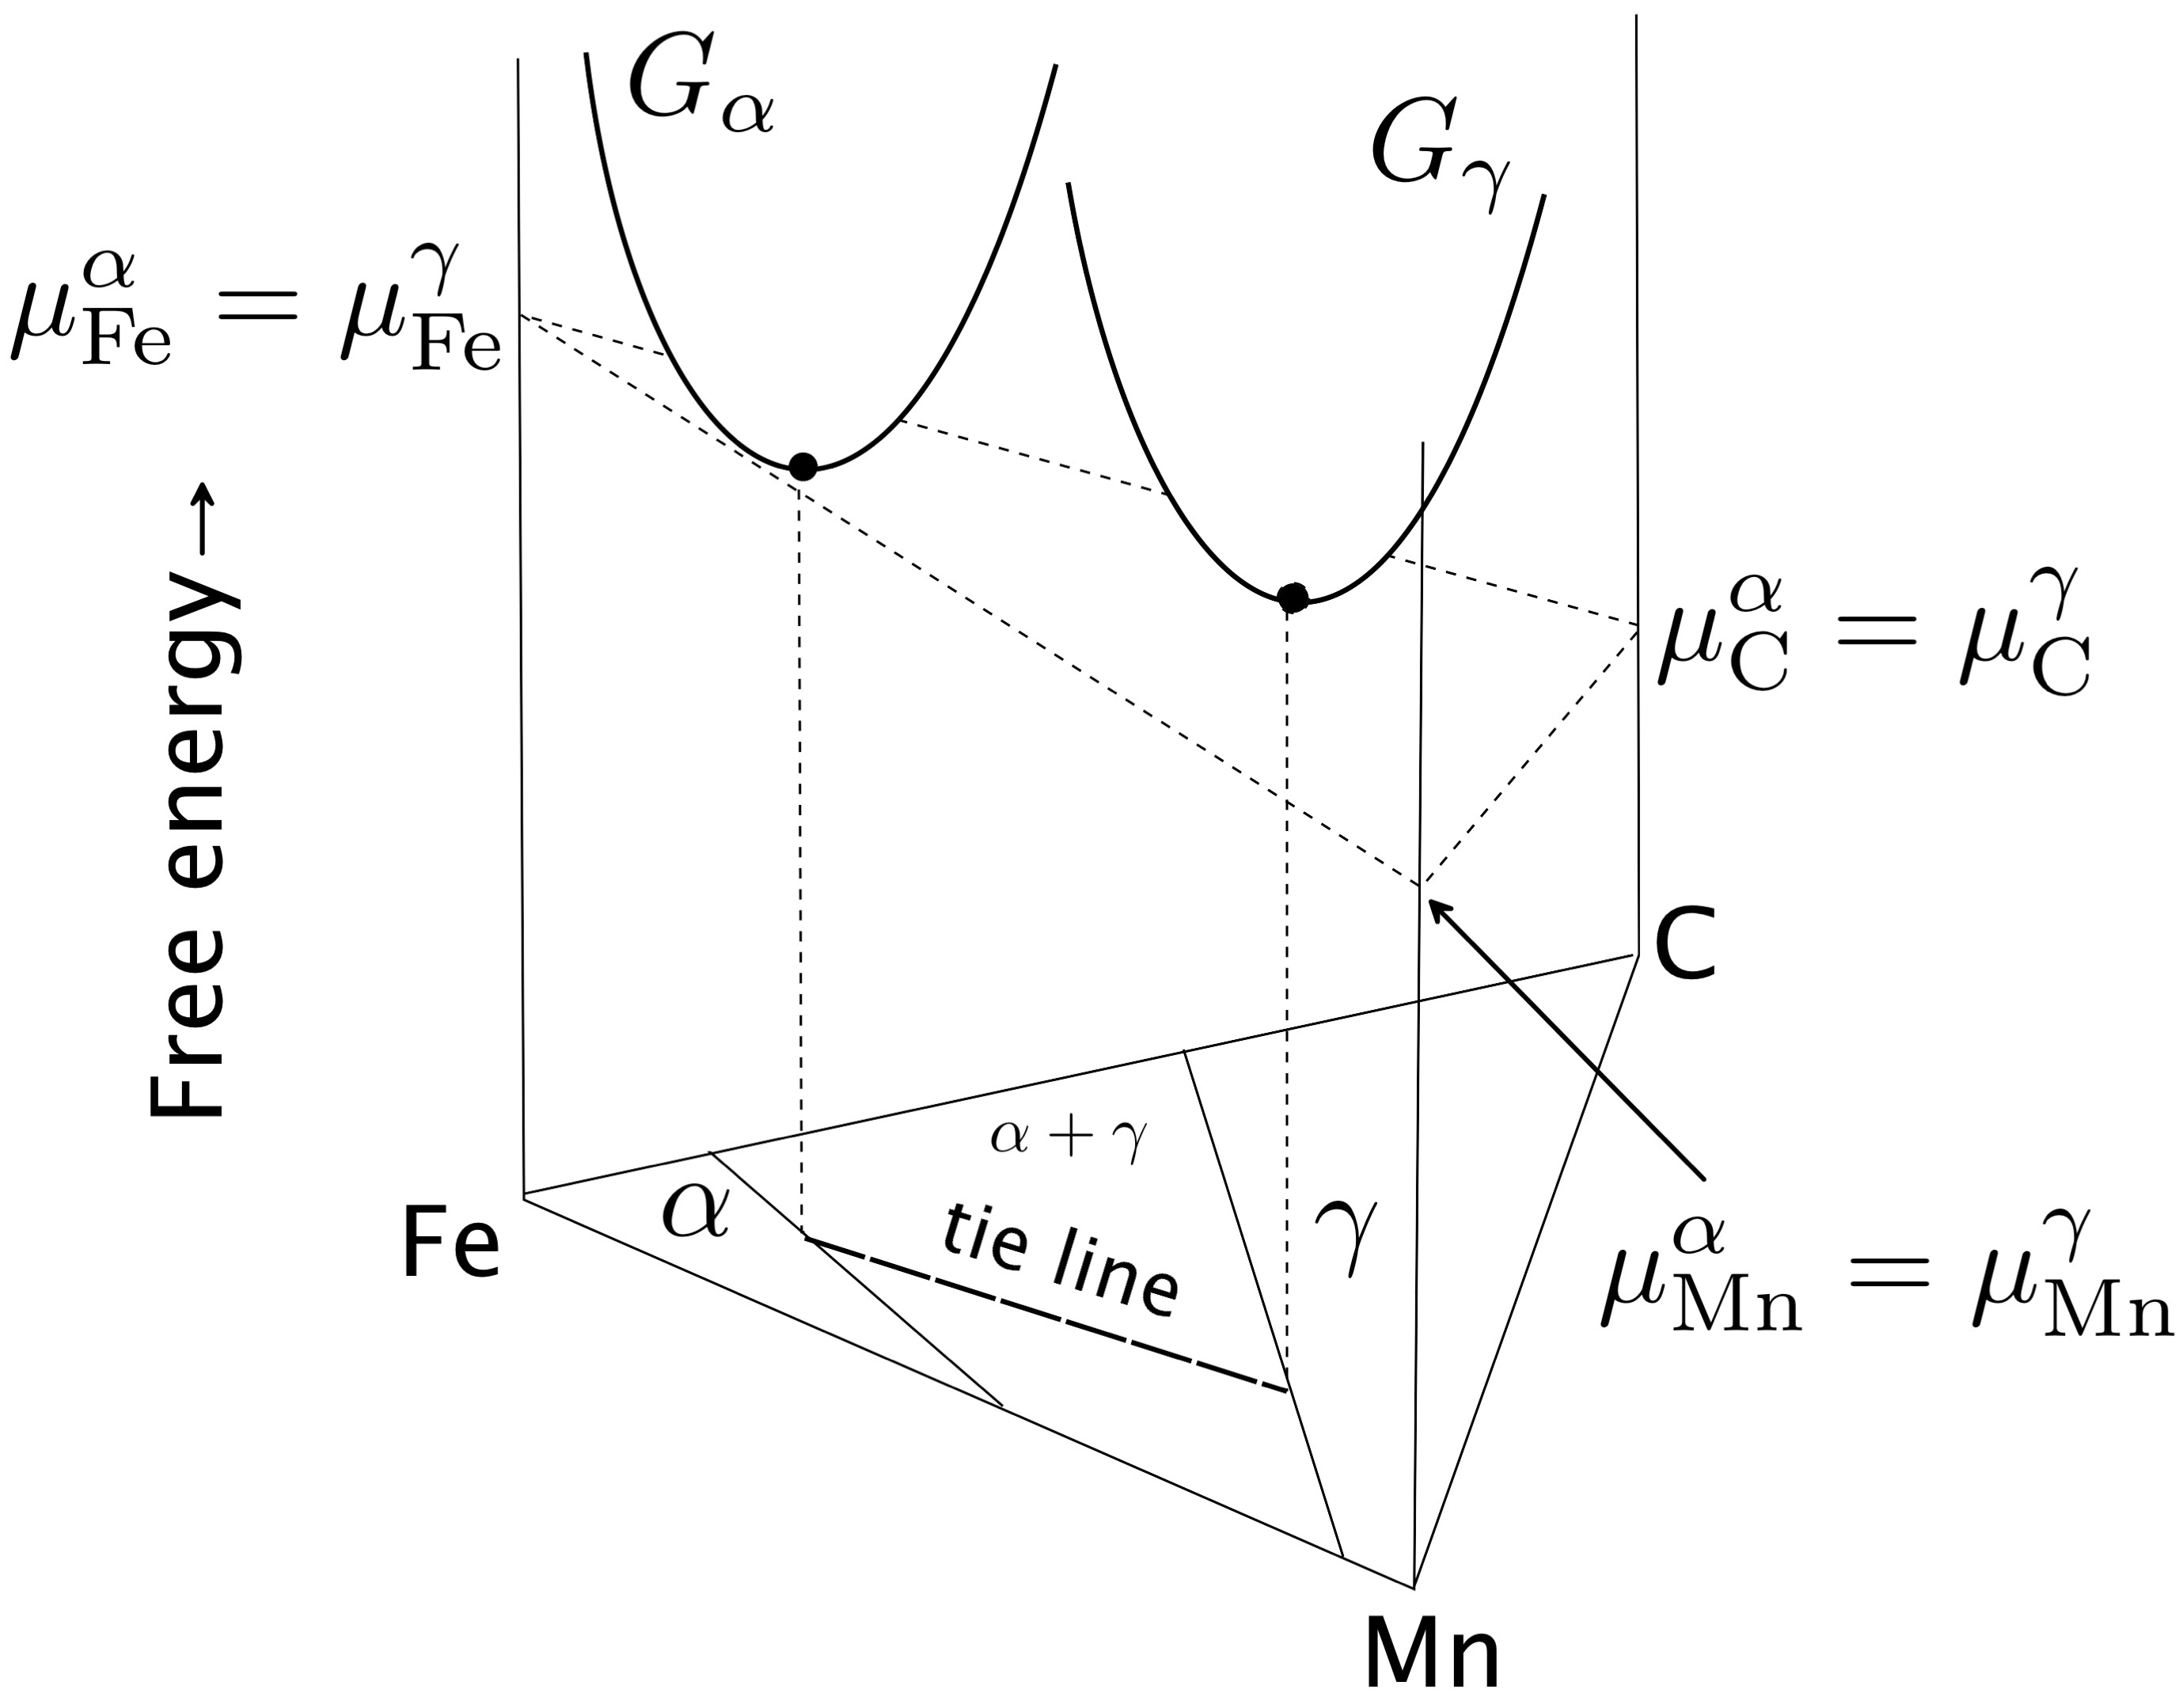

Slide 42
Condition for equilibrium is simple:
uniform chemical potential defines equilibrium

Slide 43
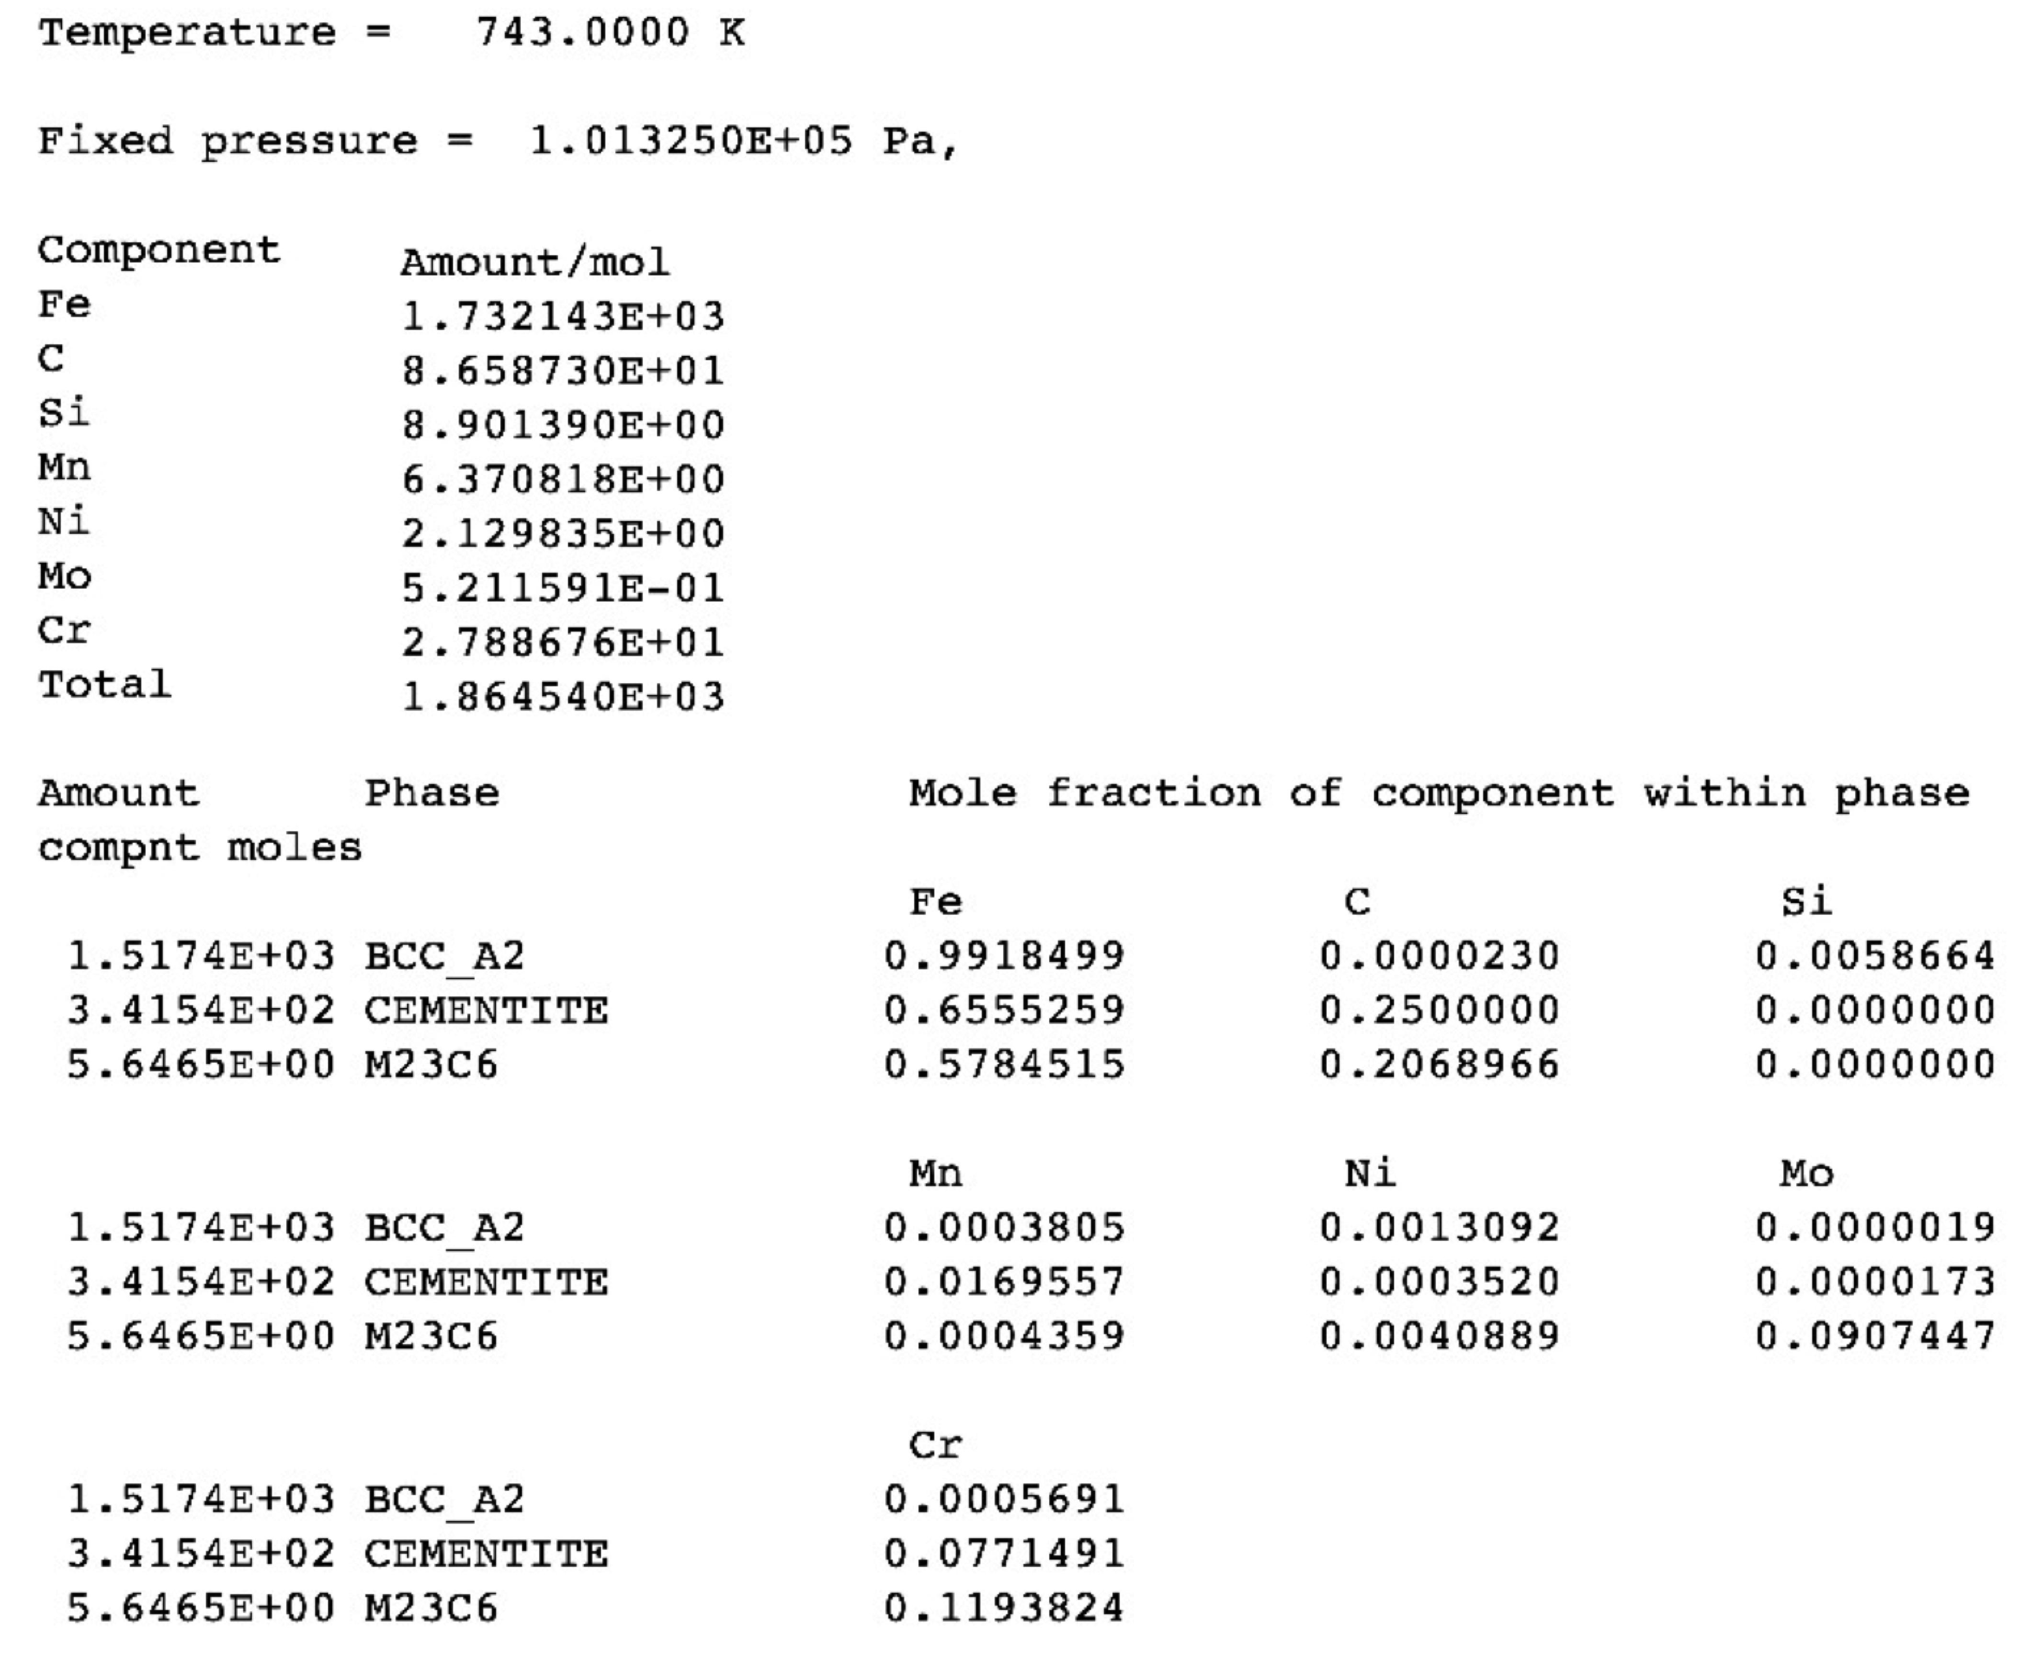

Slide 44
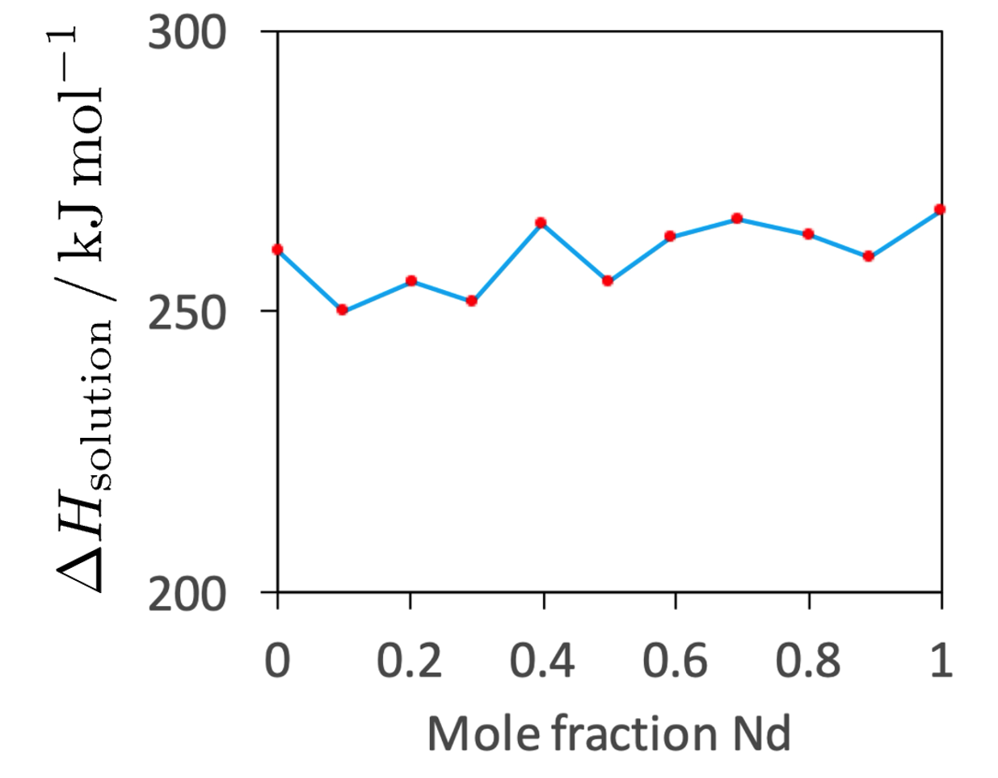
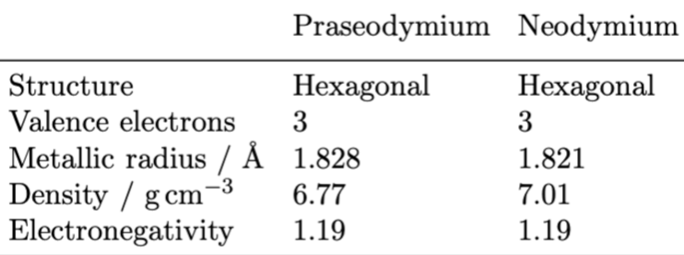
Praseodymium-neodymium solid solutions
Lundin, Pool: J. Less Common Metals 9 (1965) 48-53

Slide 45

configurational entropy maximum at equiatomic concentration
free energy minimum at equiatomic concentration, assuming only the entropy contributes to free energy
1000 K

Slide 46
“regular” solution
change in bond energy when AA and BB bonds replaced in part by AB and BA bonds

Slide 47
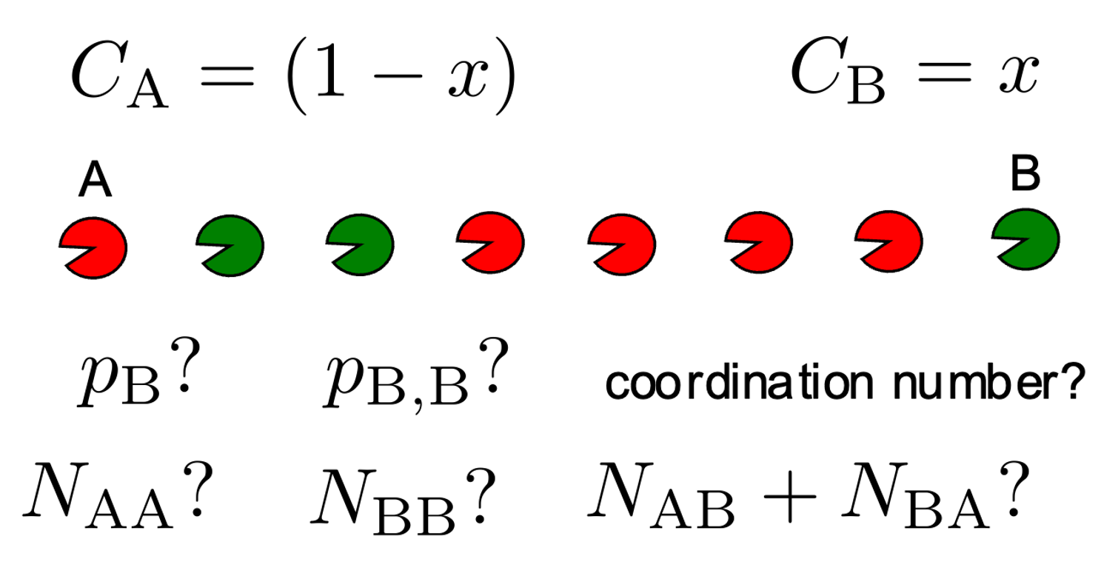

Slide 48
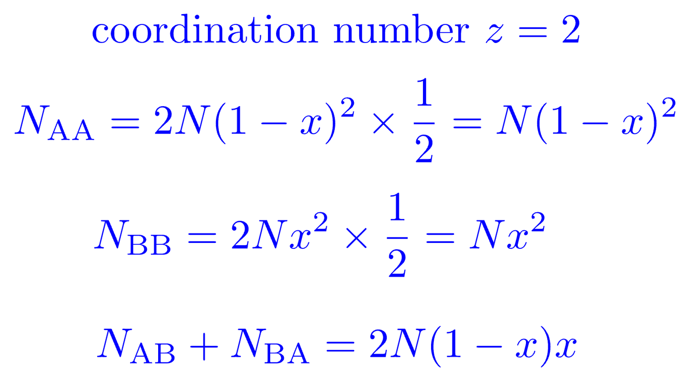

Slide 49
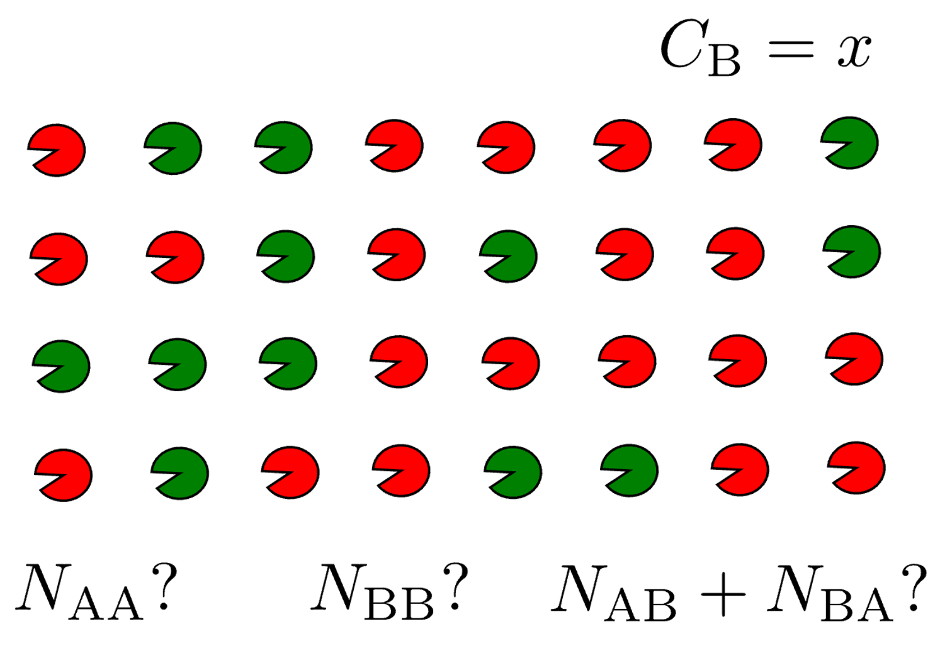

Slide 50
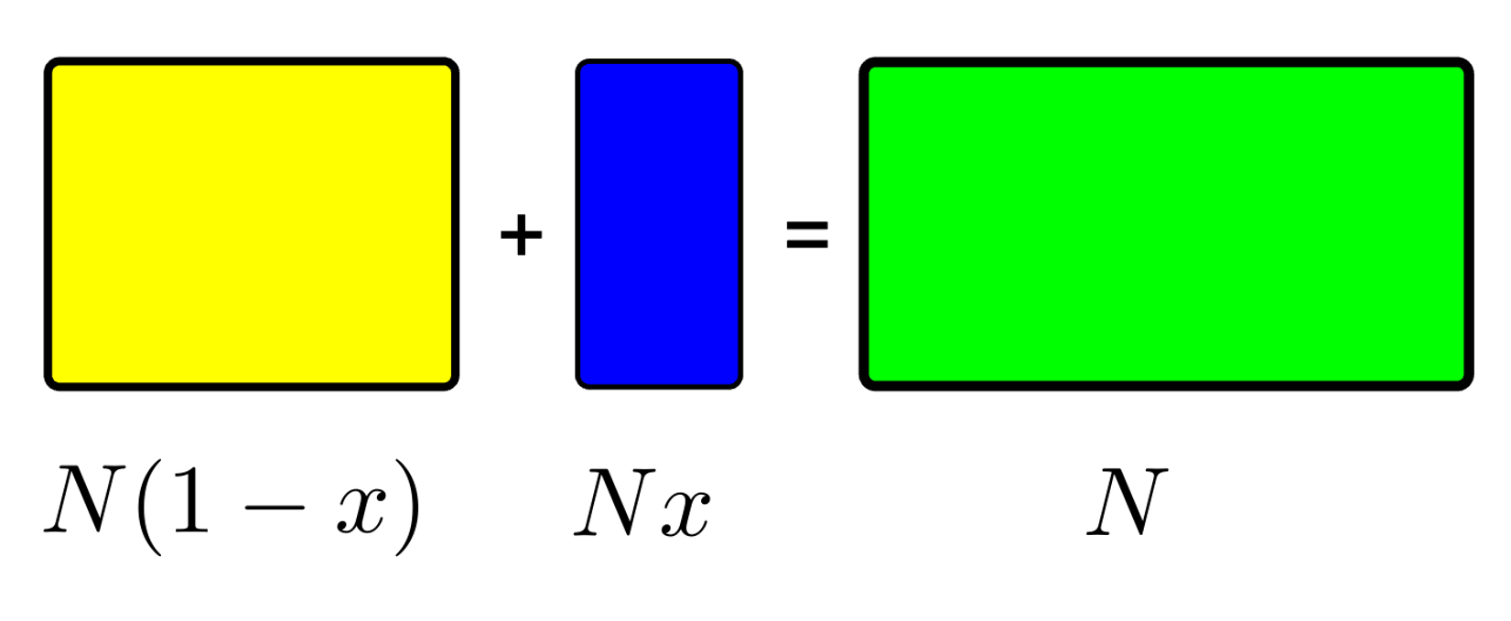
Create solution by mixing in proportion
A
B
solution
number of A atoms
total number of A+B atoms
number of B atoms

Slide 51
number
B-B bonds?
number
A-A bonds?
A
B
solution

Slide 52
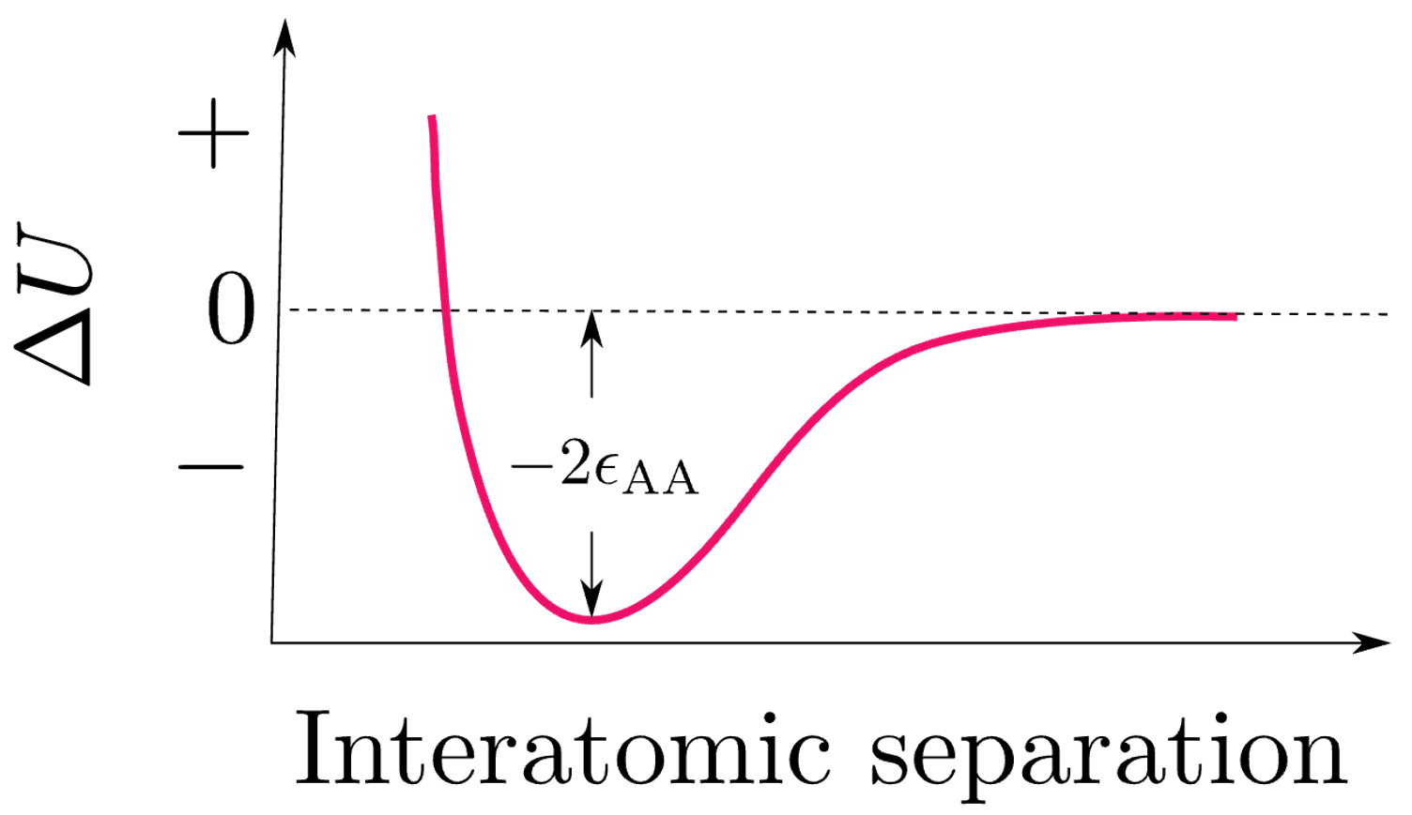

Slide 55
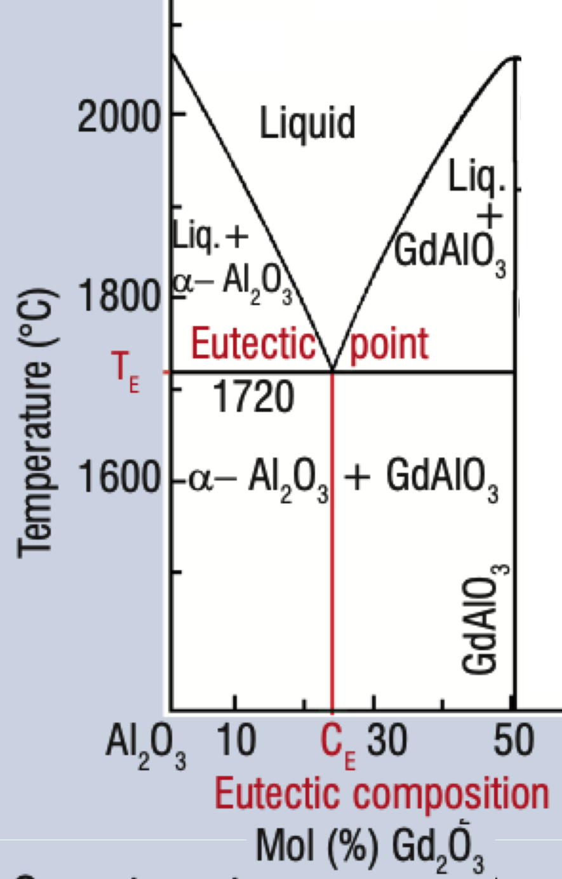
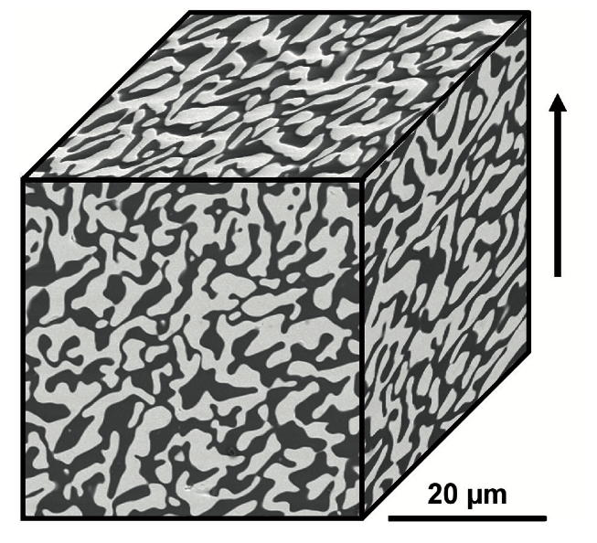
Parlier M, Valle R, Perrière L, Lartigue-Korinek S, Mazerolles L. Potential of directionally solidified eutectic ceramics for high temperature applications. Aerospace Lab. 2011 Nov 1(3):p-1.

