Slide 1
Phase transitions
Solidification
Harry Bhadeshia
Haixue Yan
photograph courtesy of Sunita Hansraj from her Antarctica expedition

Slide 2
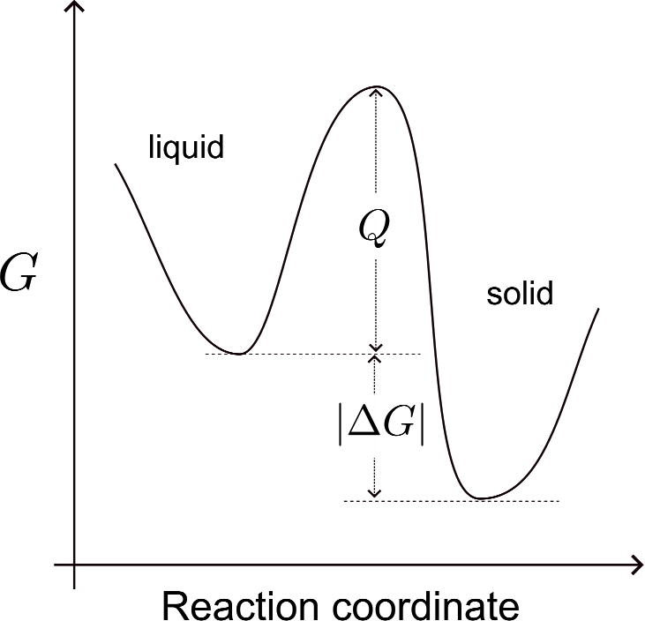
The velocity ν of the transformation from L to S
Below the equilibrium melting temperature Tm
ν (m/s) ∝ ΔT

Slide 3
Solidification of Pure Metals
T
G_{L}
G_{S}
Liquid & solid have only one possible composition. Thus crystal growth in a pure metal is controlled only by flow of heat away from the interface.
Temperature Gradient, G (K/m)
Case I: (G_{S} >) G_{L} > 0
Here the solid is a better conductor of heat than the liquid, leading to a positive G_{L}
Solid Liquid Interface
S
L
T_{local} > T_{m} & tip re-melts
Thus growth front remains planar: planar or columnar growth (the growth is relatively ‘stable)
The interface is usually at a temperature just below T_{m}. If a protuberance forms at a growth face,

Slide 4
Case II: (G_{S} > 0) G_{L} < 0
This situation exists during the initial stages of nucleation when a ‘large’ supercooling is involved to initiate nucleation.
T
T_{m}
G_{L}
If the melt is significantly supercooled, T_{melt} < T_{m} by many °C, then the latent heat of crystallisation warms up the interface so that G_{L} is negative.
G_{S}
Solid Liquid Interface
S
L
S
L
S
L
Stable protuberance
Dendritic growth by repetition

Slide 5
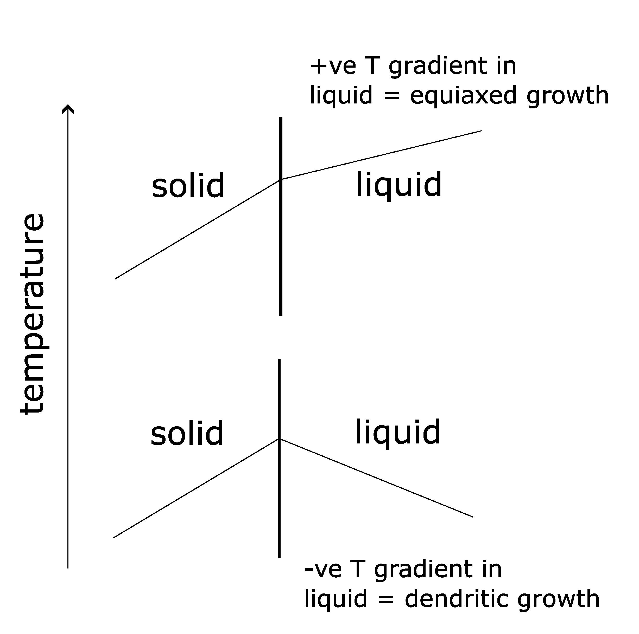

Slide 6
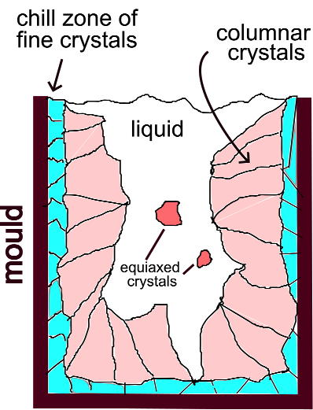
Effect of Casting Conditions
Alloy Content
Pouring Temperature
Cooling Rate

Slide 7
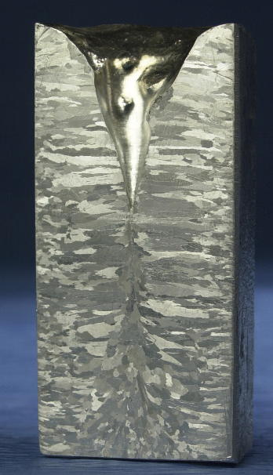
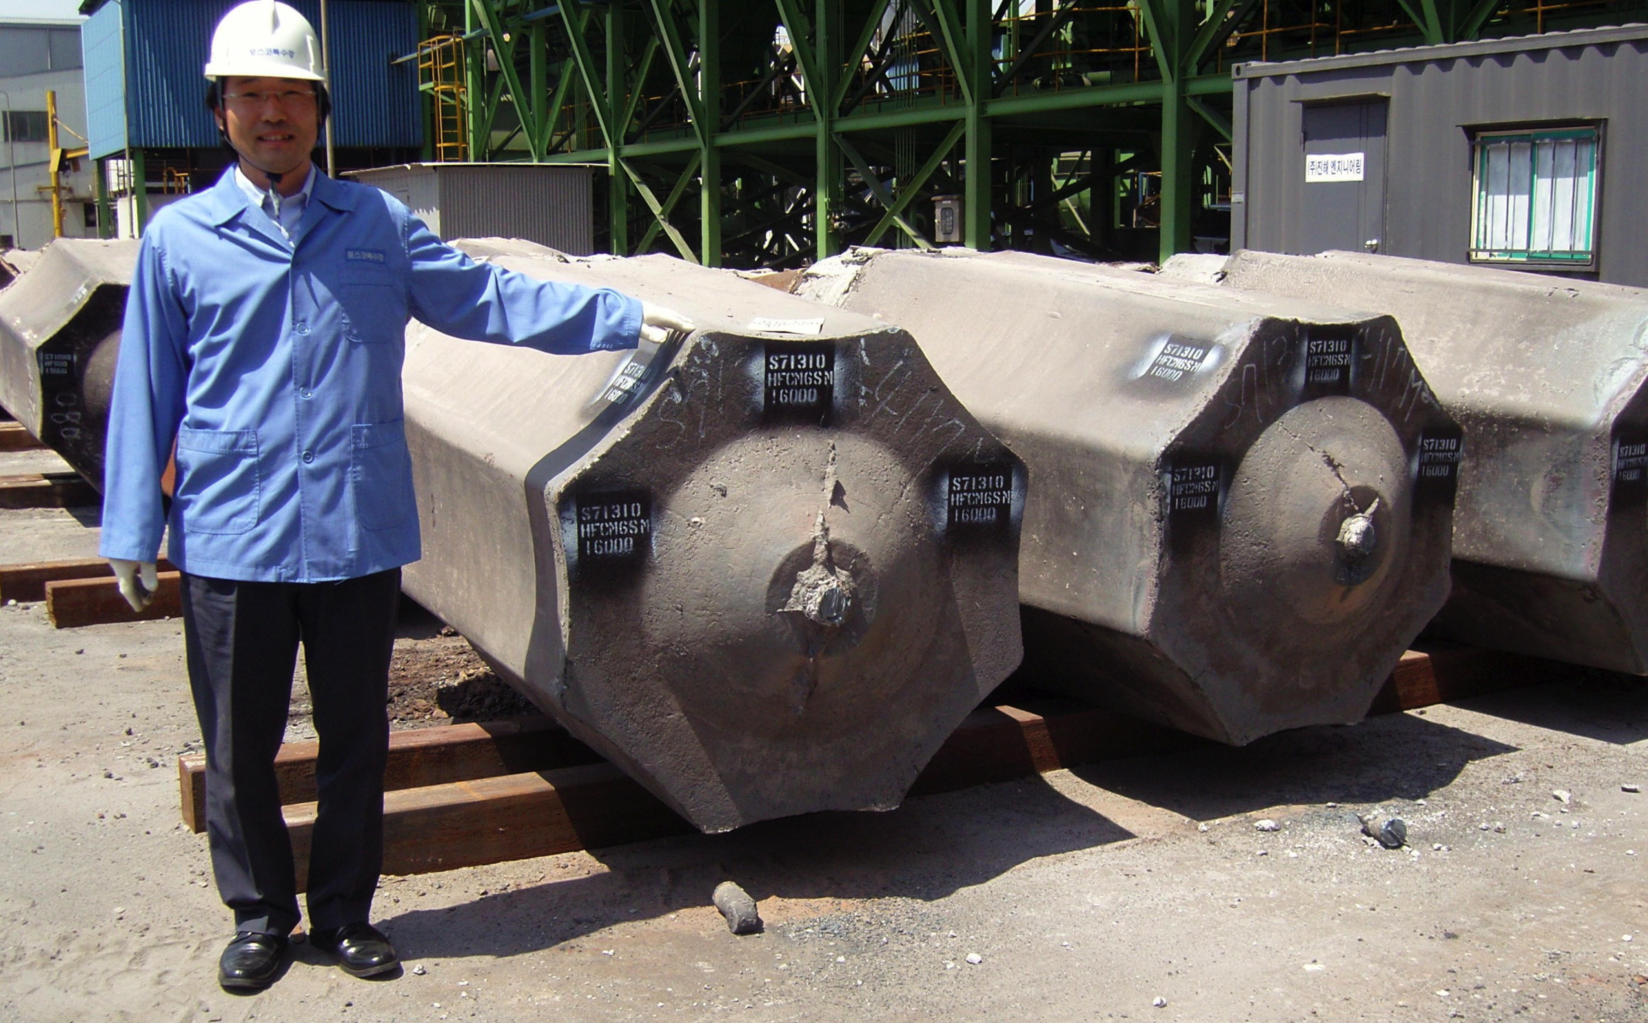

Slide 8
Ex: Cooling of a Cu-Ni Alloy
• Phase diagram:
Cu-Ni system.
T(ºC)
L: 35wt%Ni
L (liquid)
Cu-Ni
system
• Consider
microstuctural
changes that
accompany the
cooling of a
C₀ = 35 wt% Ni alloy
130
0
A
α
L
+
L: <35 wt% Ni
α: 46 wt% Ni
B
35
C
46
32
43
D
L: 32 wt% Ni
24
36
α
α: 43 wt% Ni
120
0
L
+
E
L: 24 wt% Ni
α
α: 36 wt% Ni
(solid)
110
0
20
3
0
35
4
0
5
0
Adapted from Fig. 9.4, Callister & Rethwisch 8e.
C₀
wt% Ni

Slide 9
Cored vs Equilibrium Structures
• C_{α} changes as we solidify.
• Cu-Ni case:
First α to solidify has C_{α} = 46 wt% Ni.
Last α to solidify has C_{α} = 35 wt% Ni.
• Slow rate of cooling:
Equilibrium structure
• Fast rate of cooling:
Cored structure
Uniform C_{α}:
35 wt% Ni
First α to solidify:
46 wt% Ni
Last α to solidify:
< 35 wt% Ni

Slide 10
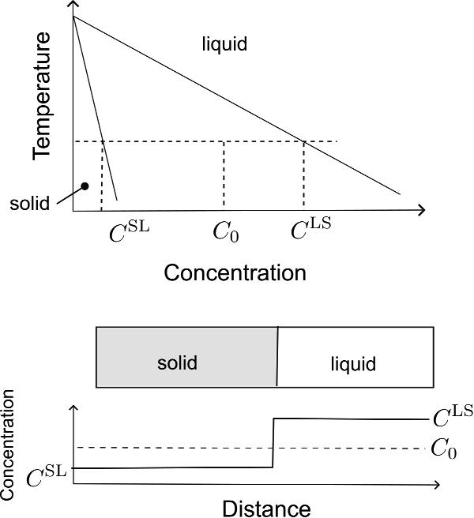

Slide 11
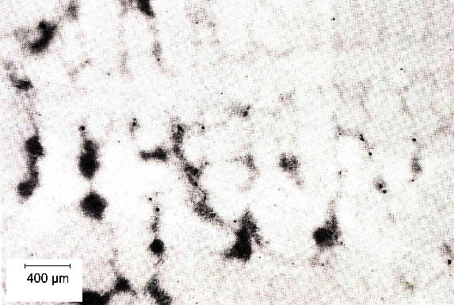
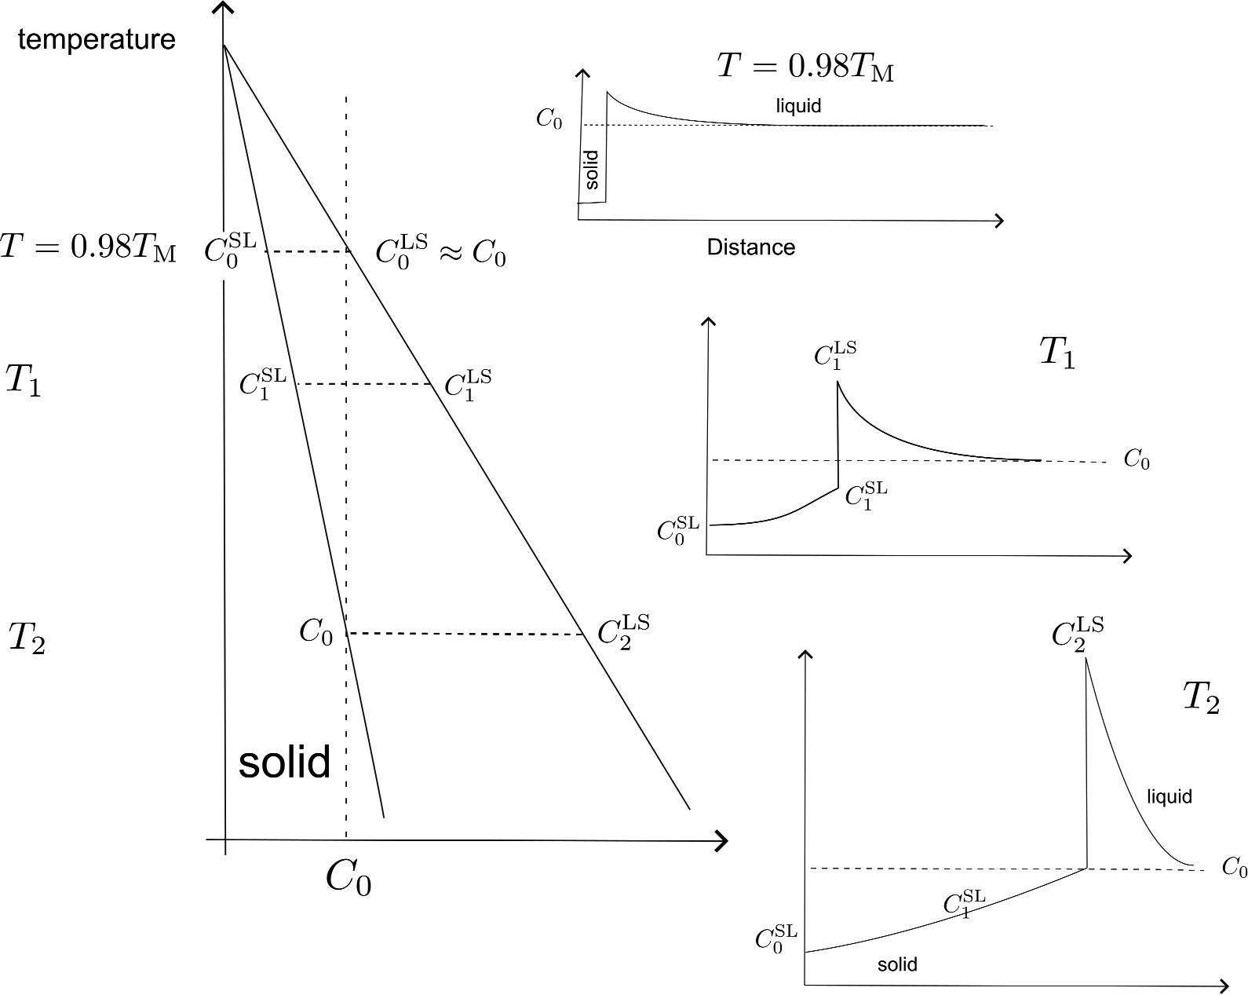
Non-equilibrium solidification

Slide 12
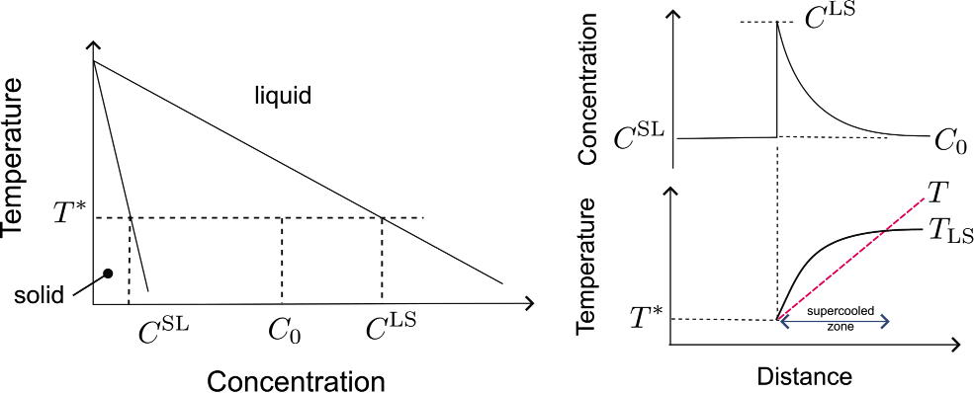
Constitutionally supercooling

Slide 13
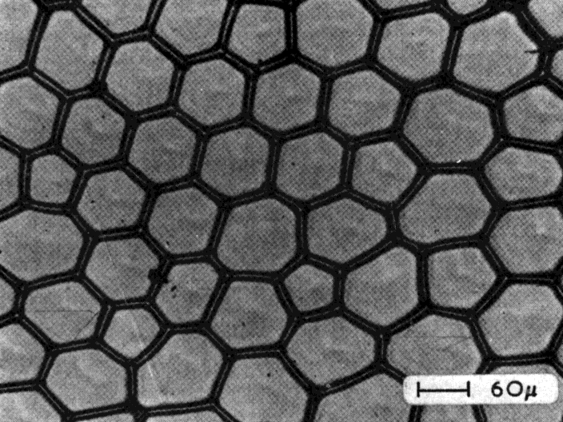
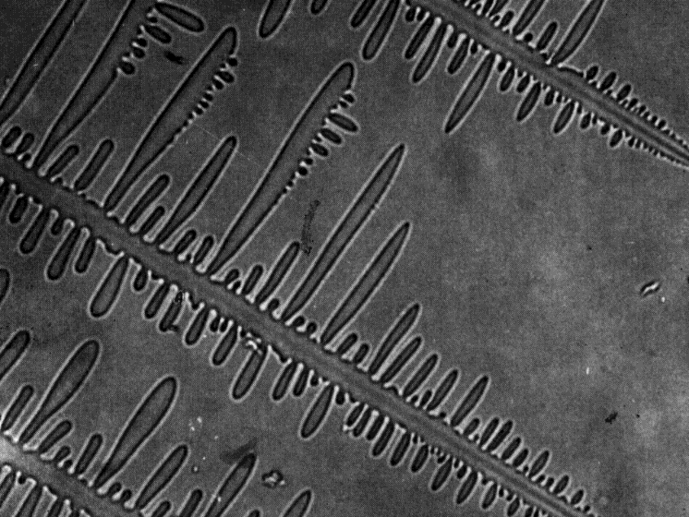
In the PRESENCE of C.S. planar interface become unstable due to an increase in the level of C.S. from the interface to a distance in the melt where max. C.S. in encountered. At relatively low C.S., a cellular growth front develops.
As C.S. increases, the cells ‘caps’ becomes extended & eventually branch to form dendrites. No clear transition from cellular to dendritic growth.

Slide 14
PBL two:
Show the equation below and discuss the effect of parameters on constitutional supercooling

