Slide 1
Steeling the show – creating exceptional alloys of iron
Professor Sir Harry Bhadeshia
Join us after the lecture for an immersive research
showcase and drinks reception

Slide 2
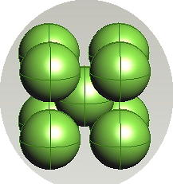
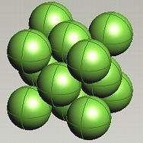
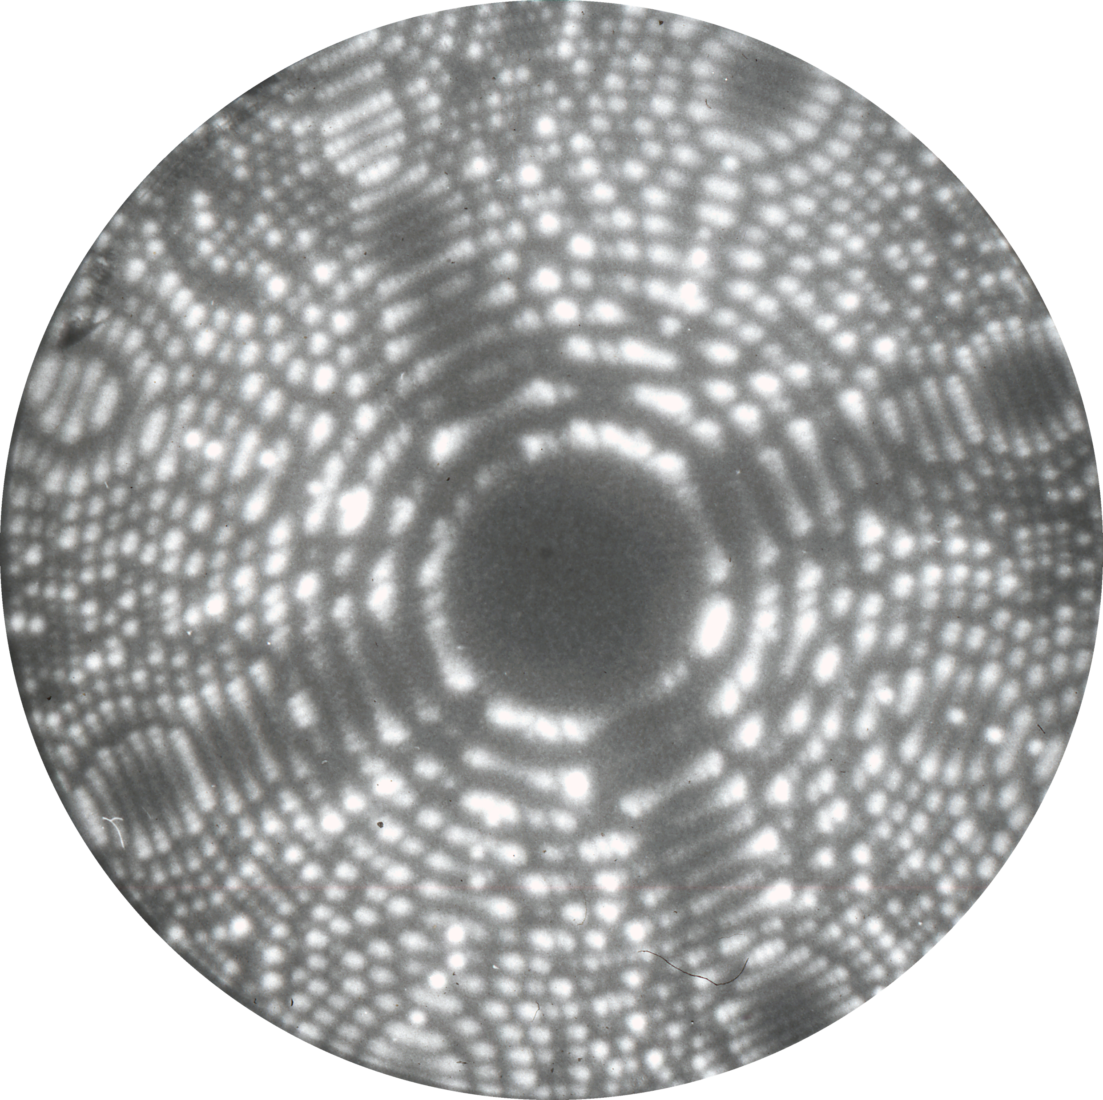
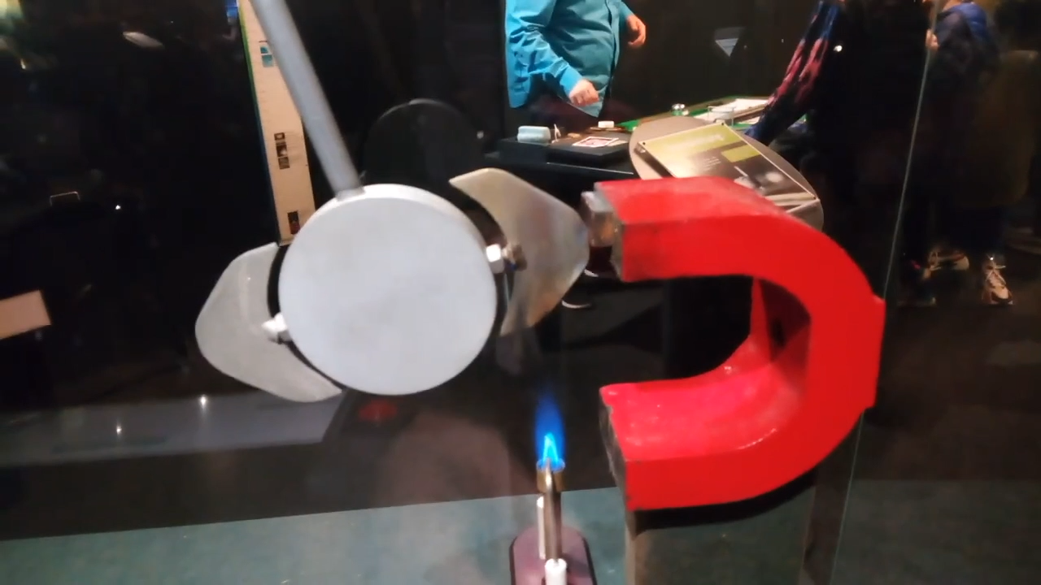
Pure iron
Waugh

Slide 3
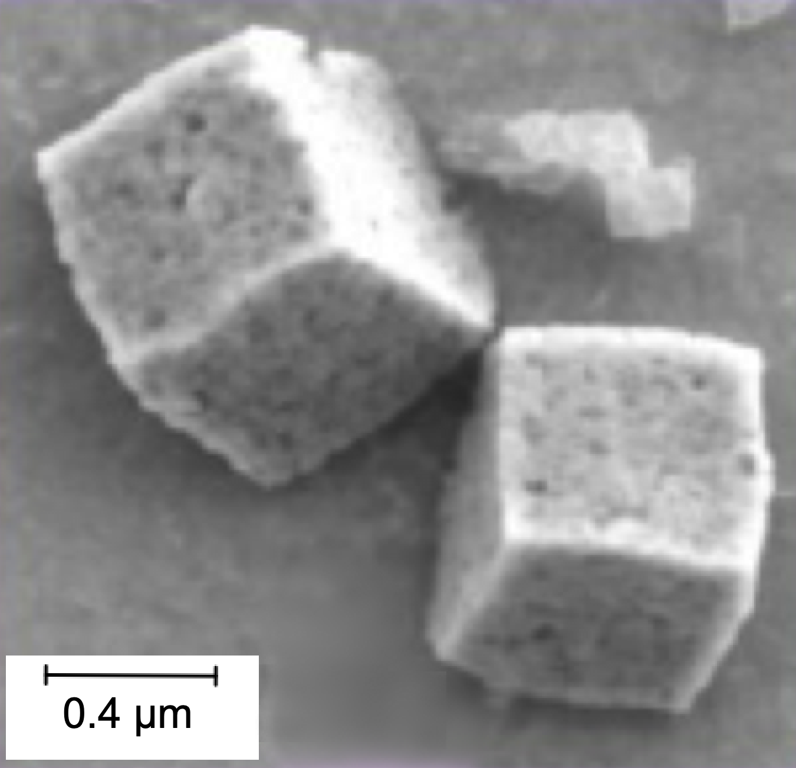
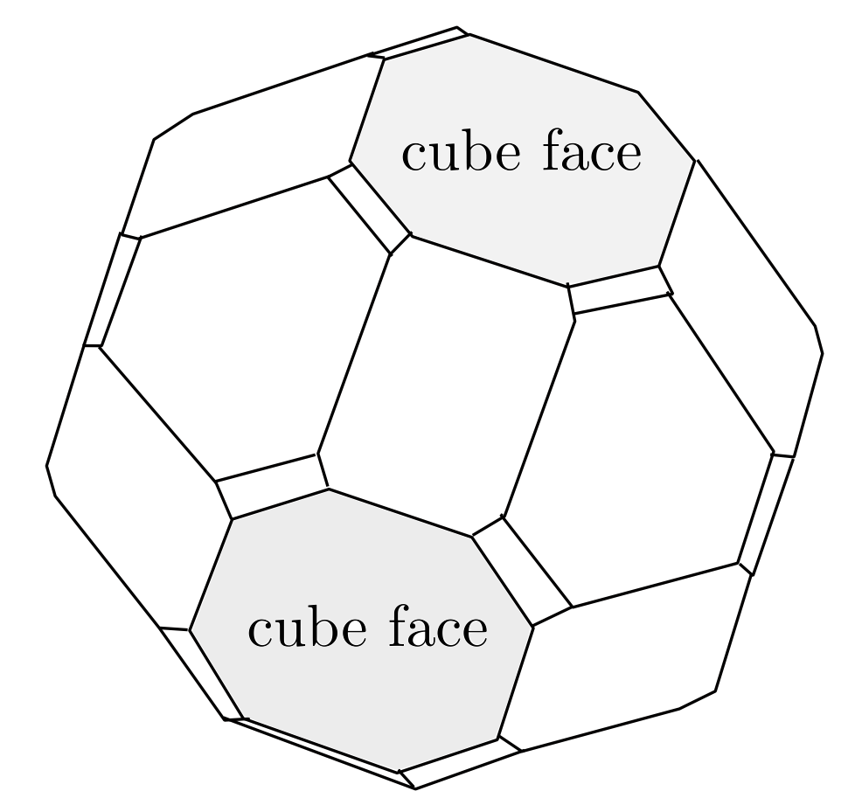
Monzon, Rode, Venkatesan, Coey.
Chemistry of Materials 24 (2012) 3878
https://pubs.acs.org/doi/10.1021/cm301766s
For further permission to use image, contact ACS.

Slide 4
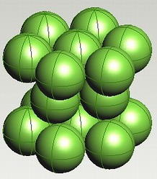
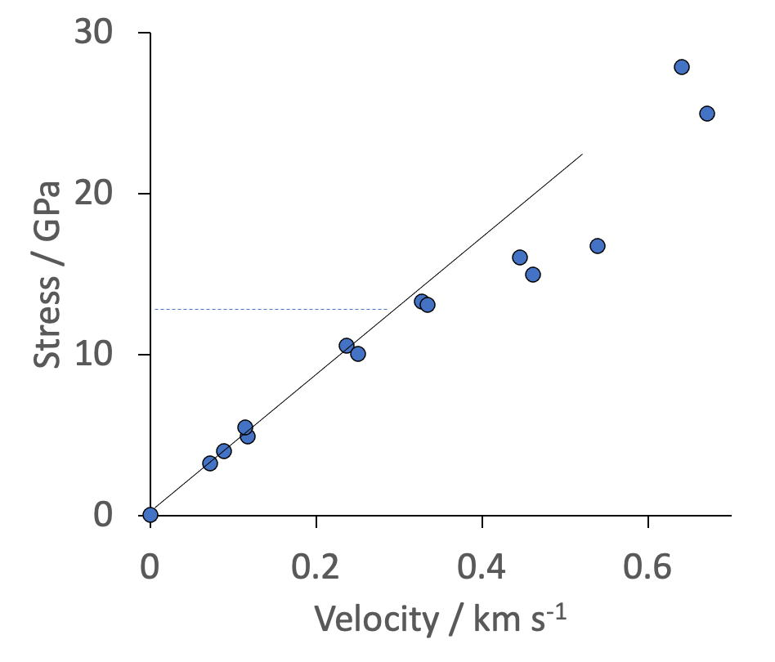

Pure iron
Hammond

Slide 5
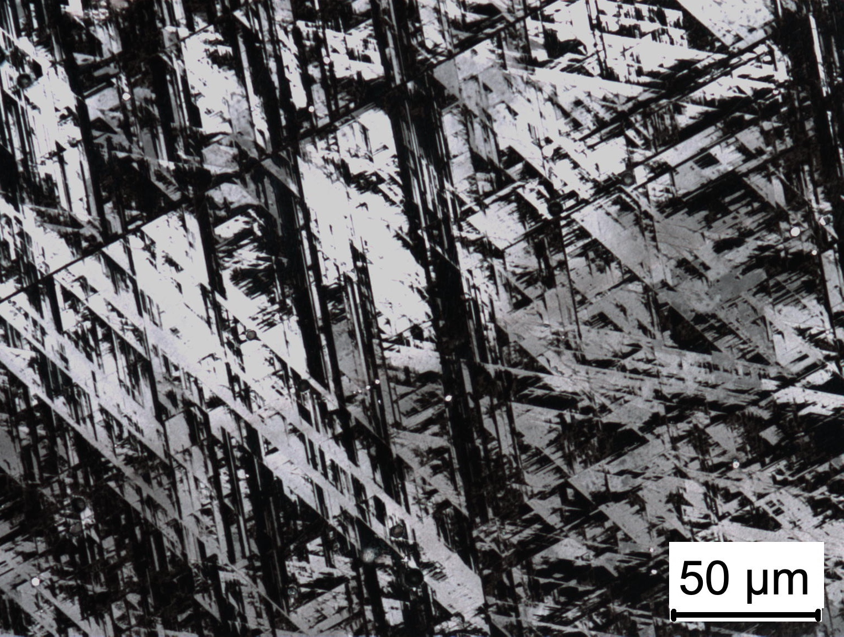
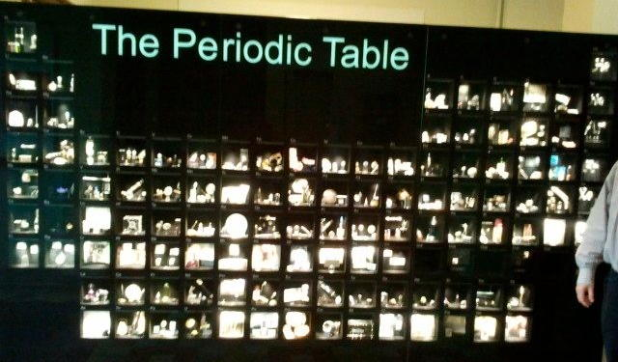
Fe-25Mn-5.2Si wt%
Yang, Jang, Bhadeshia, Suh
Calphad 36 (2012) 16
Notes:
Impossible for atoms to diffuse at this temperature over the time scale of the experiment. This is the ONLY mechanism to produce epsilon. Why thin plates?

Slide 6
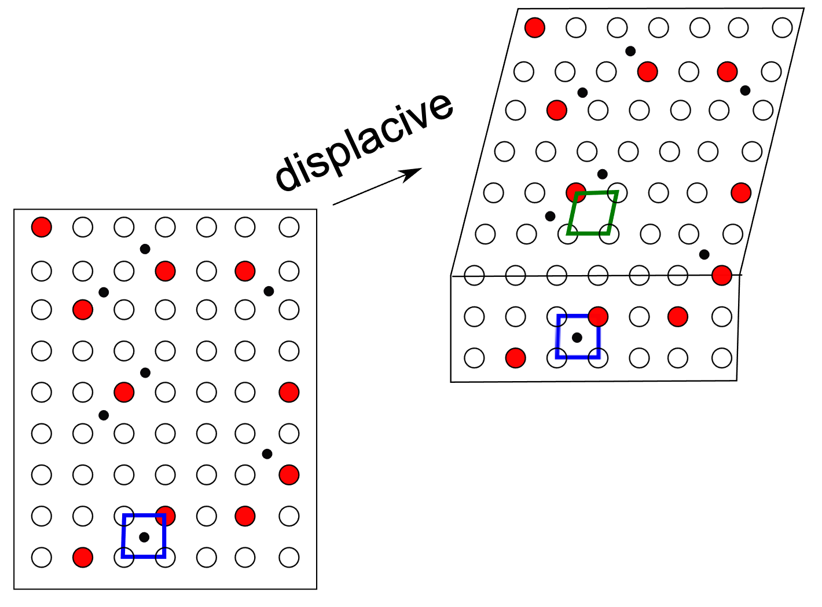
Low atomic mobility
thin plates
no composition change
memory of parent
fast
coordinated motion of atoms
Notes:
shape deformation, plates, composition

Slide 7

Birmingham Royal Ballet Company: ordered and symmetrical motion that leads to a predictable change in shape

Slide 8
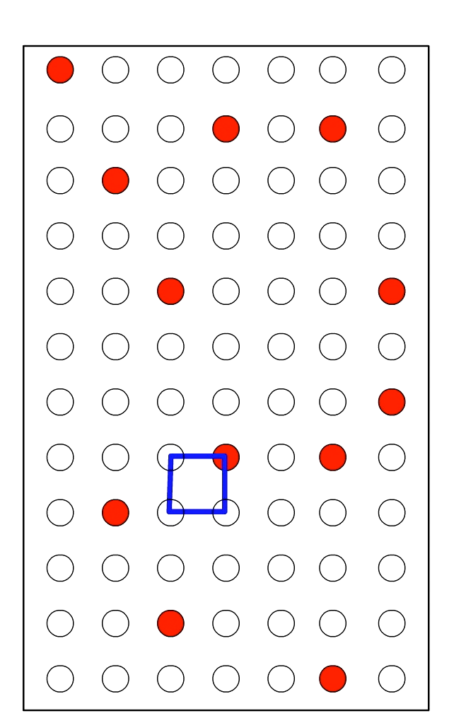
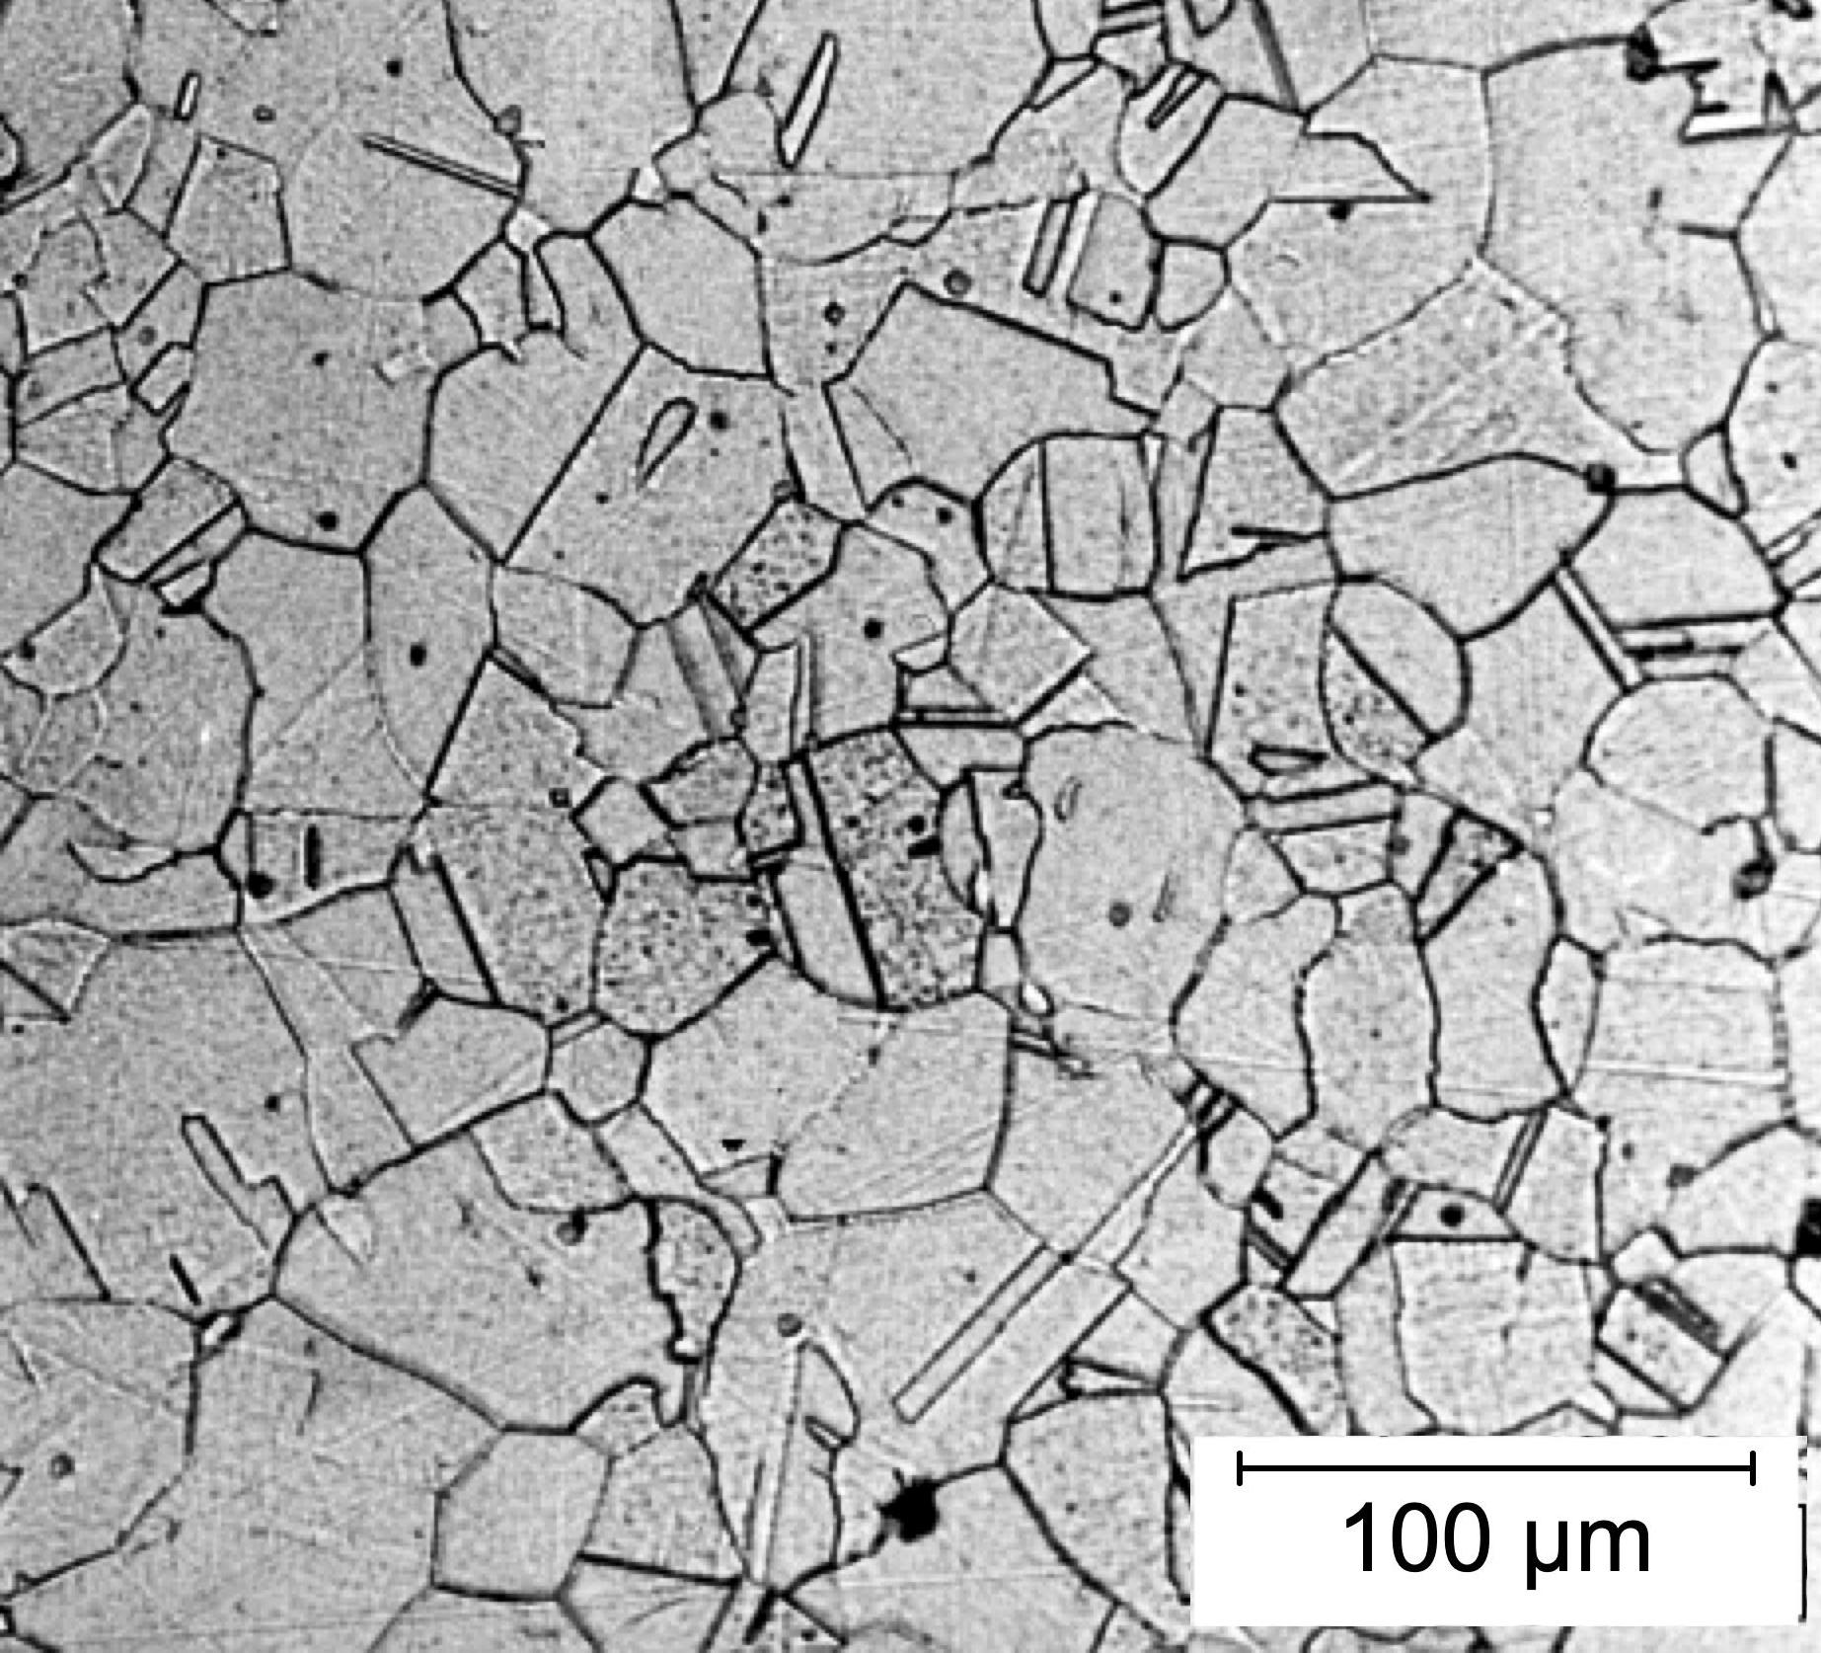
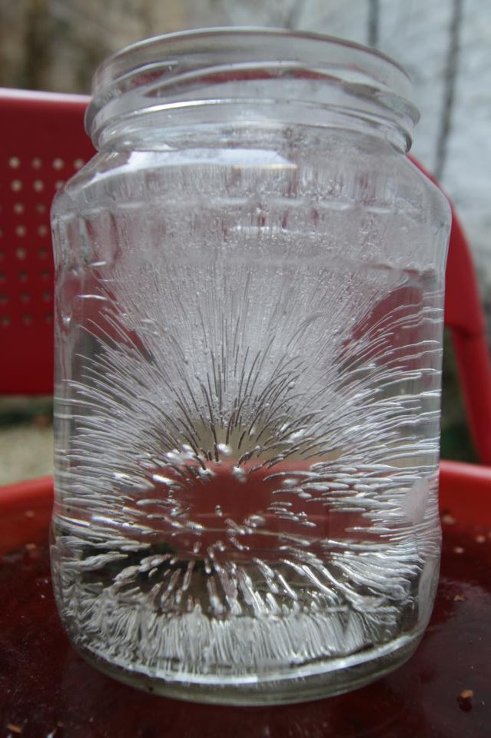
Reconstructive transformation

Slide 9
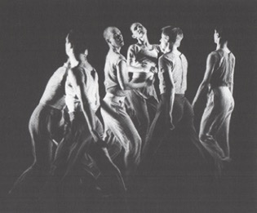
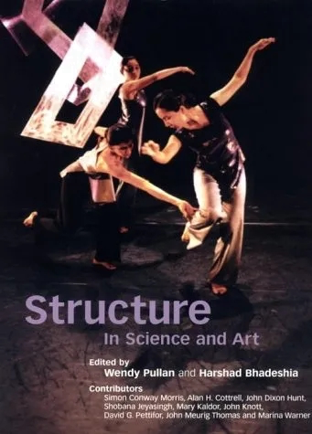
Siobhan Davies’ Dance Company: disordered equilibrium

Slide 10
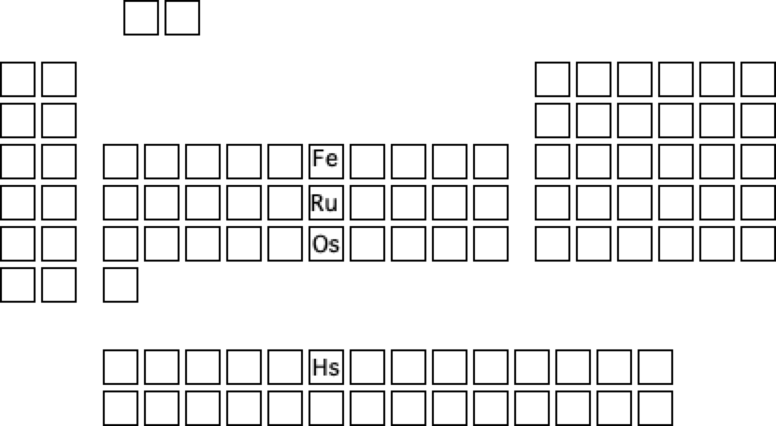
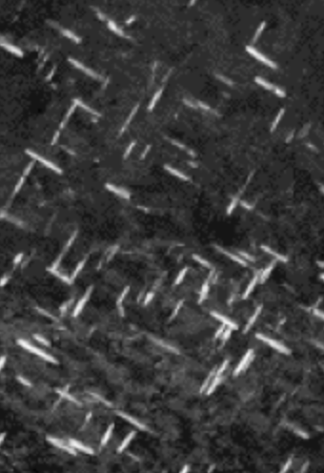
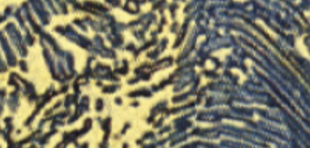
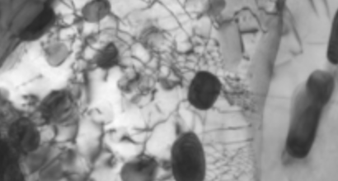

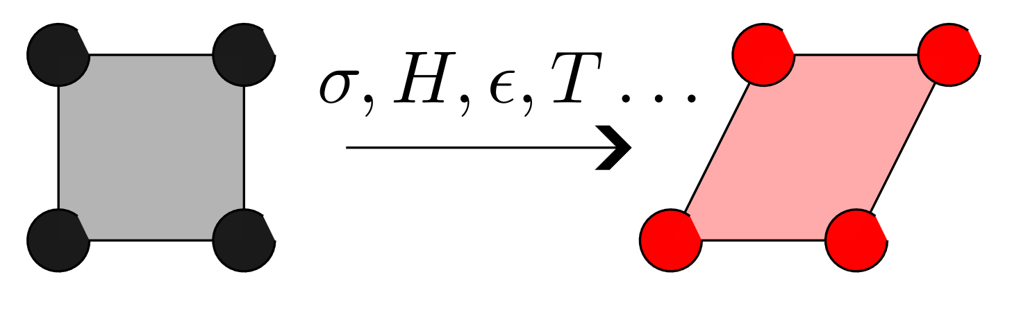
With solutes, thousands of crystal structures & arrays possible in iron systems.
Crystals can be manipulated.
Makes iron the 2nd most used material on Earth.
Notes:
how does a pattern like this change in the solid state? Have a chunk of iron to illustrate

Slide 11
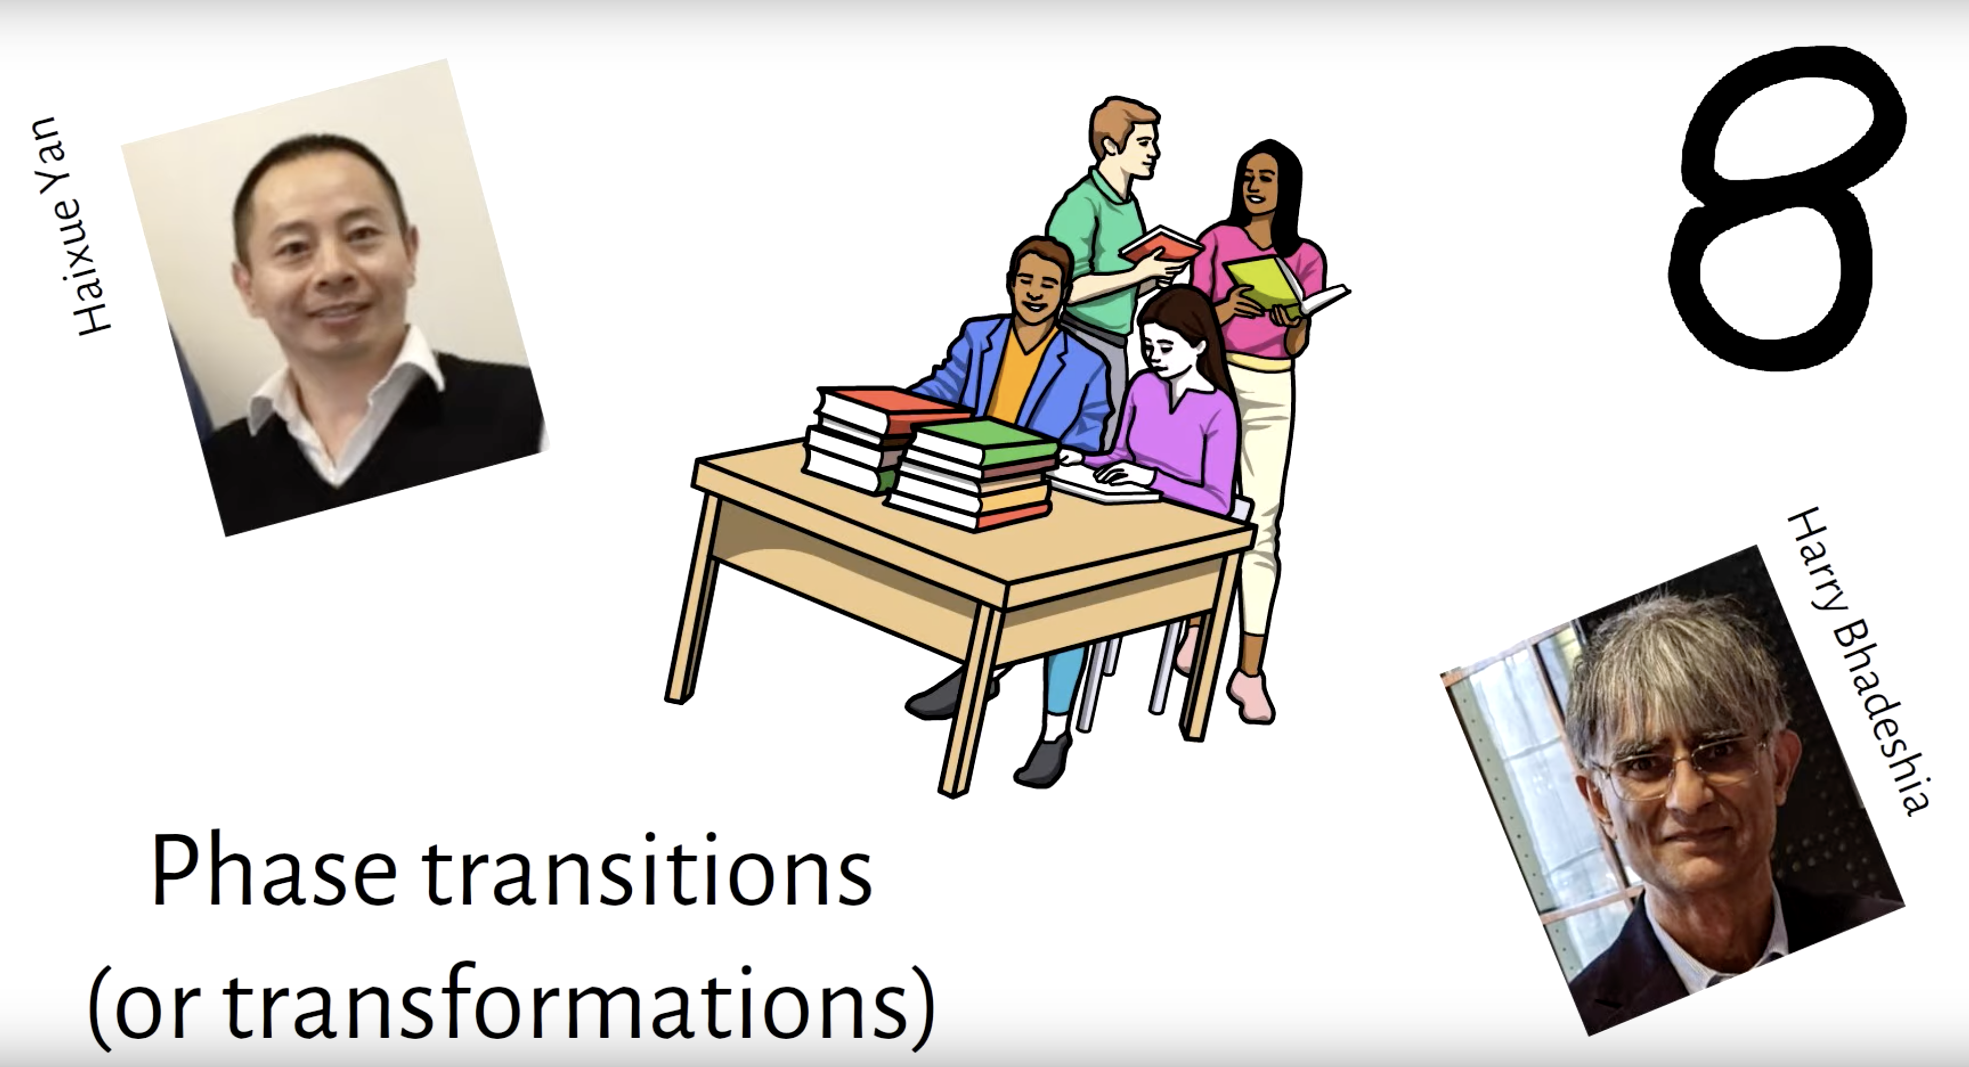
Condition for diffusionless growth

Slide 12
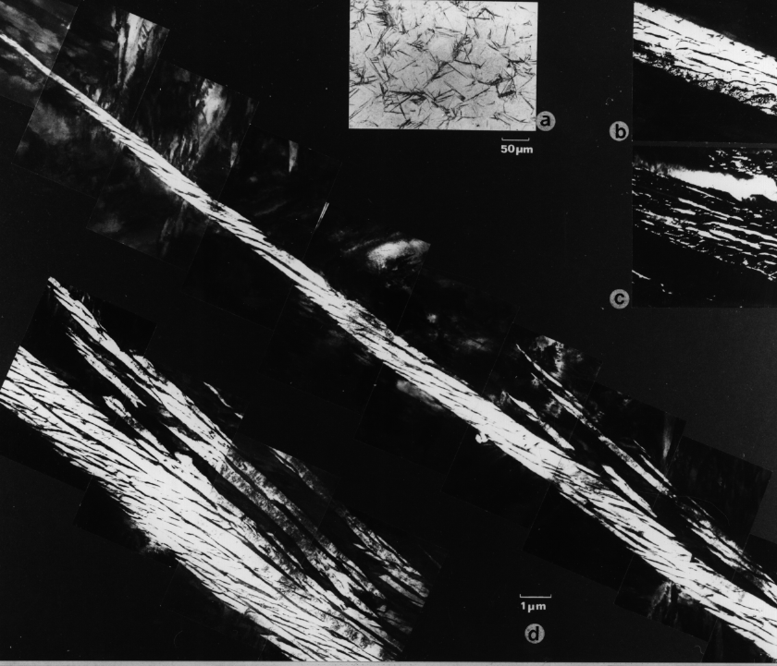
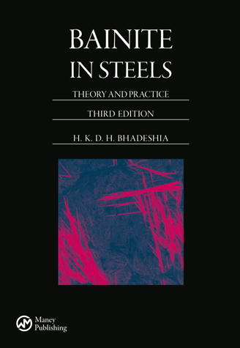
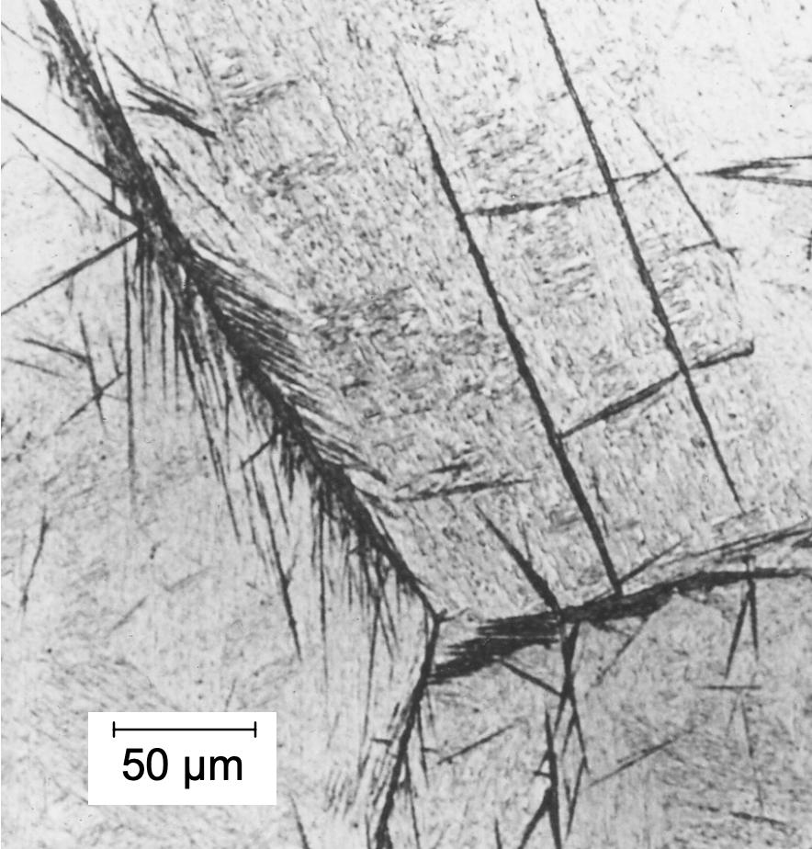

Slide 13
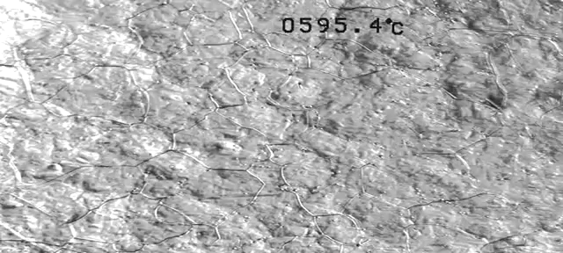
Real time
|
|
50 µm
J. H. Pak, D. W. Suh, H. K. D. H. Bhadeshia
Metall. & Mater. Trans A 43 (2012) 4520

Slide 14
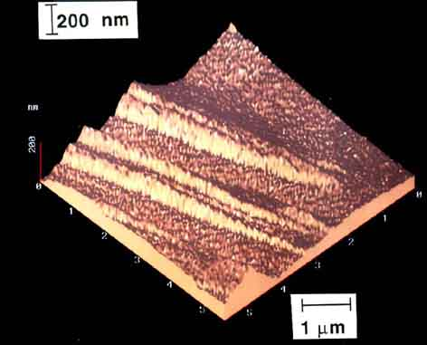
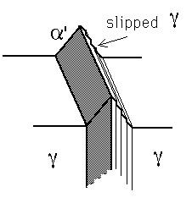

Swallow, Bhadeshia
Materials Science and Technology. 12 (1996) 121

Slide 15
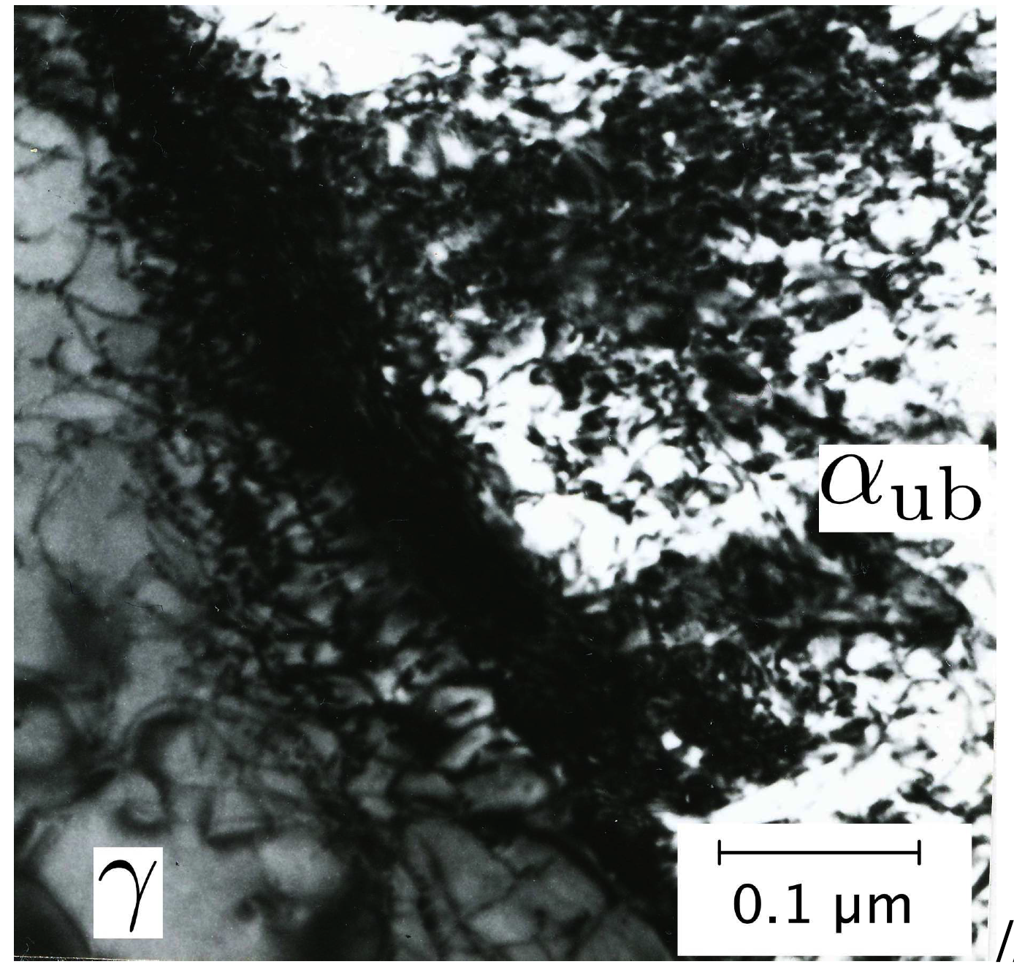
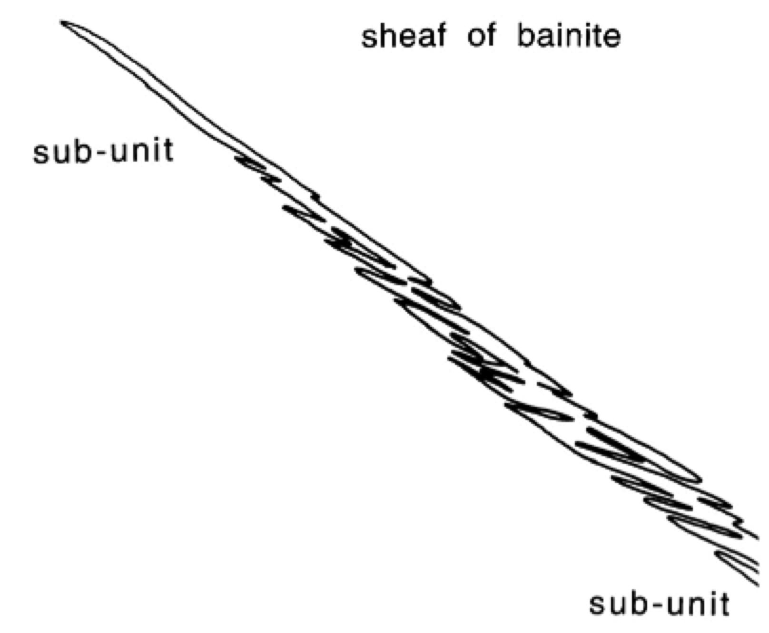

Slide 16
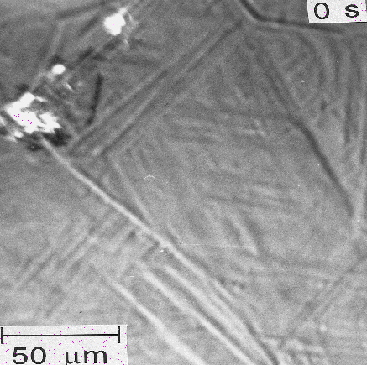
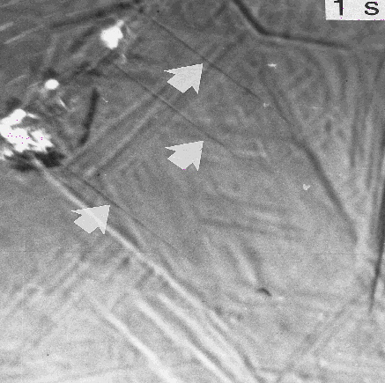
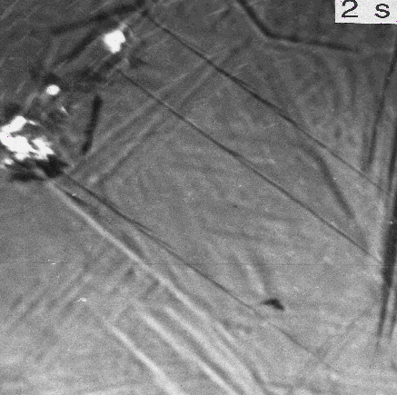
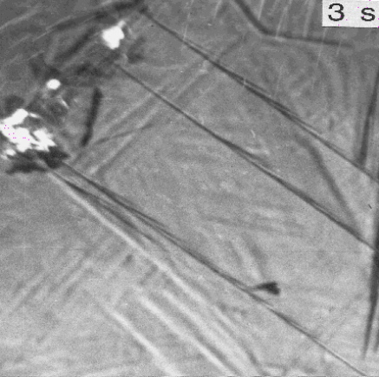
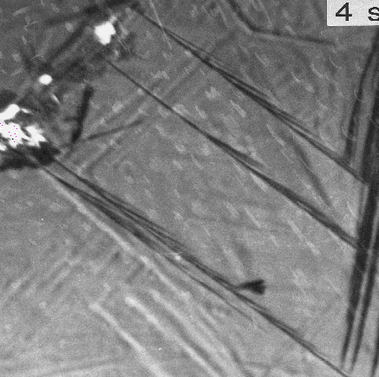
growth rate?
3 orders of magnitude faster than carbon diffusion-control
Photoemission electron microscopy

Slide 17
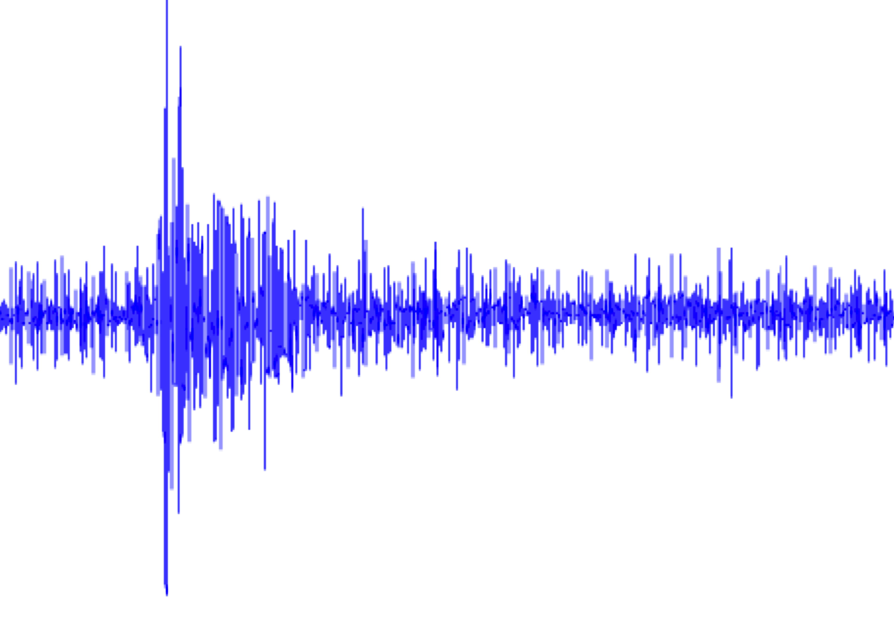
Acoustic emissions ....
... from bainite
Courtesy of Francisca Garcia Caballero

Slide 18
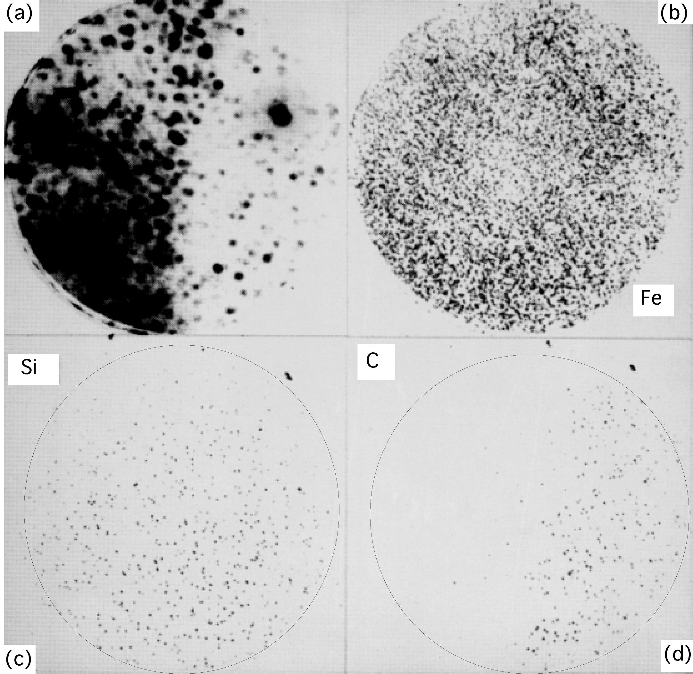

Bhadeshia HKDH, Waugh AR. Bainite: An atom-probe study of the incomplete reaction phenomenon. Acta Metallurgica. 1982;30:775-84.

Slide 19
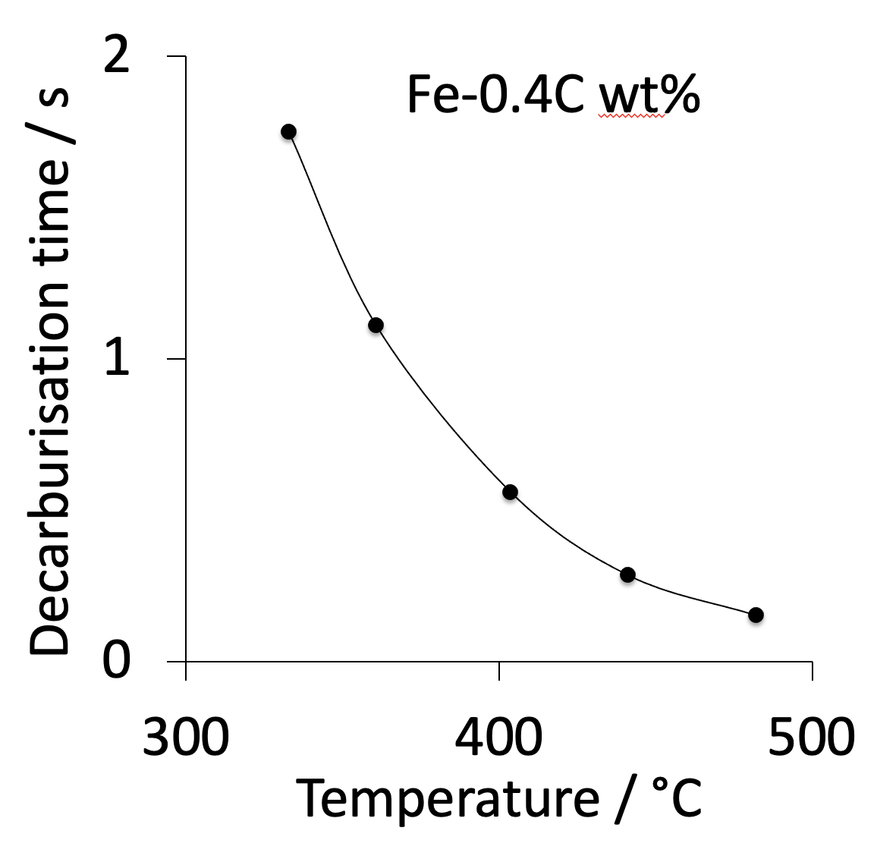
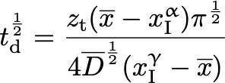
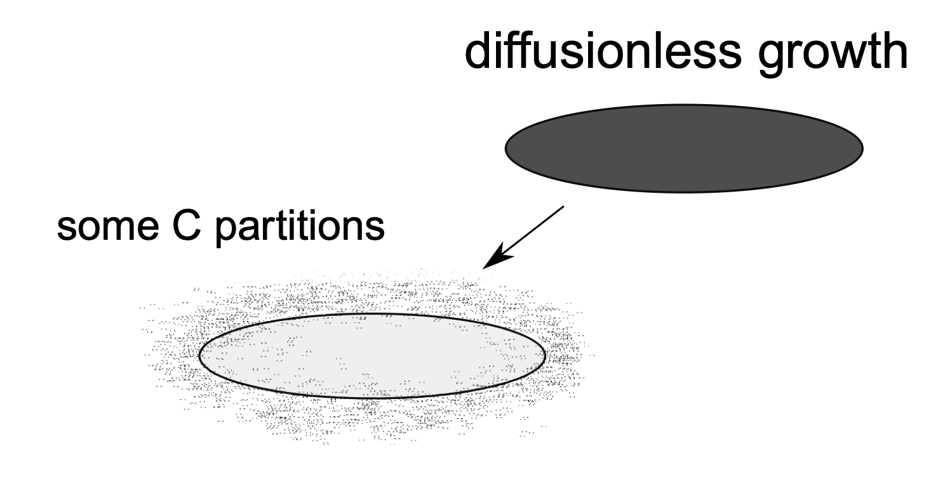
Bhadeshia HKDH. Theoretical analysis of changes in cementite composition during tempering of bainite. Materials Science and Technology. 1989;5:131-7.

Slide 20
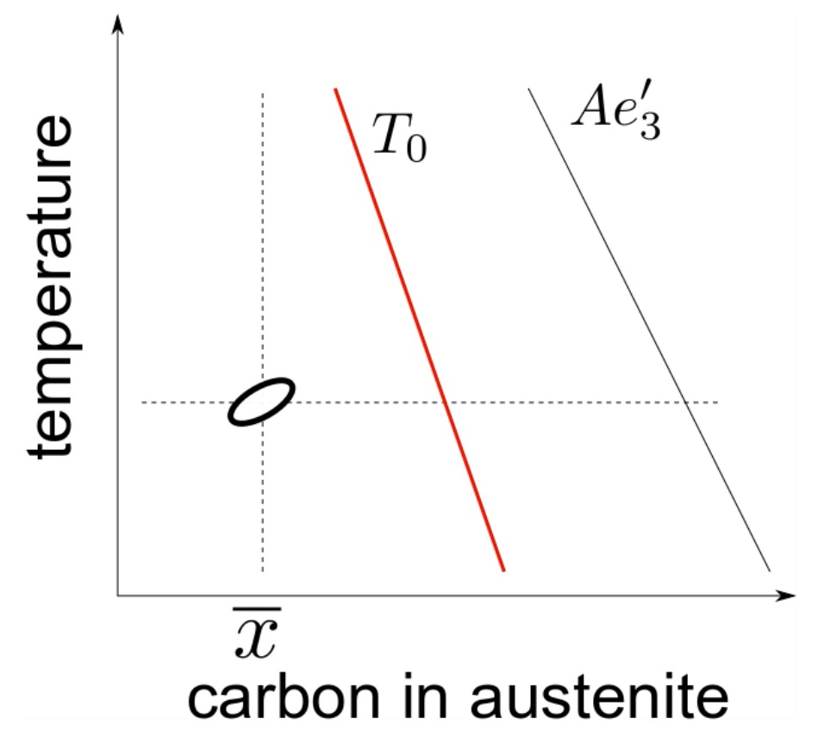

Slide 21
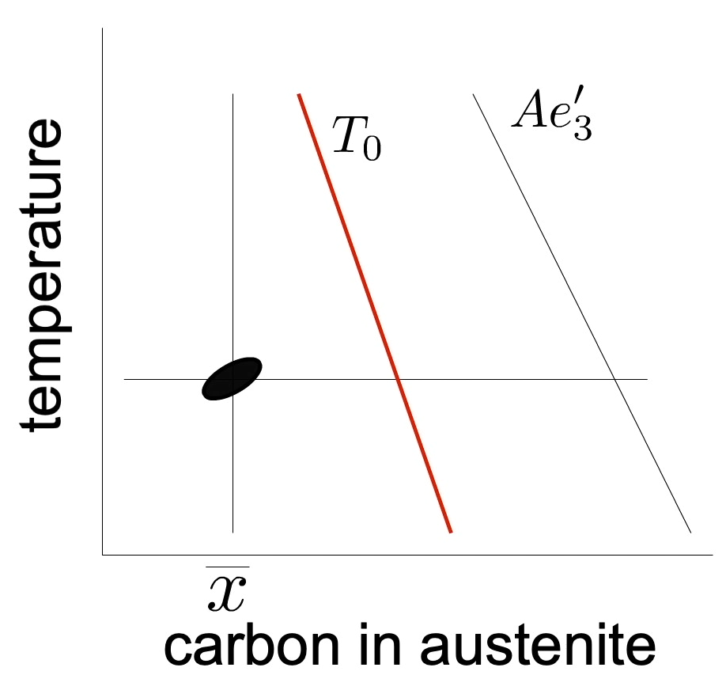
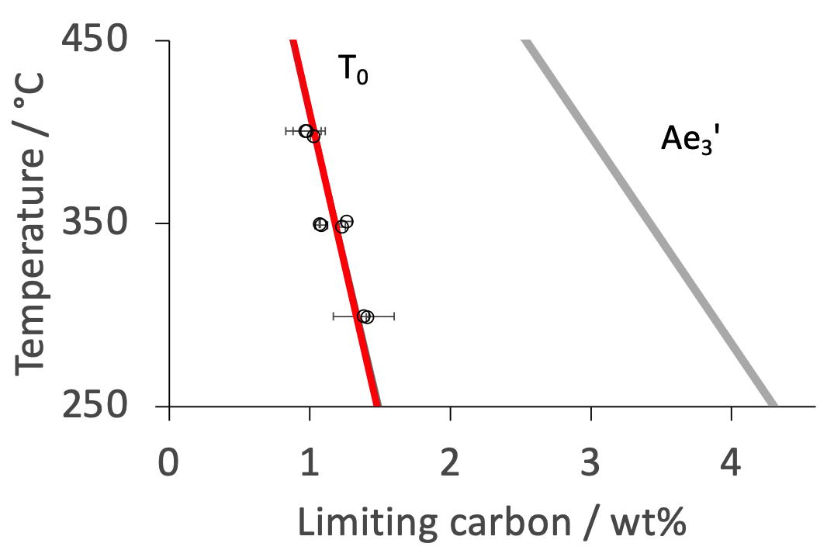
Growth is diffusionless
but plate decarburised shortly afterwards
Lin, Borgenstam, Stark, Hedström.
Materials Characterization 185 (2022) 111774

Slide 22
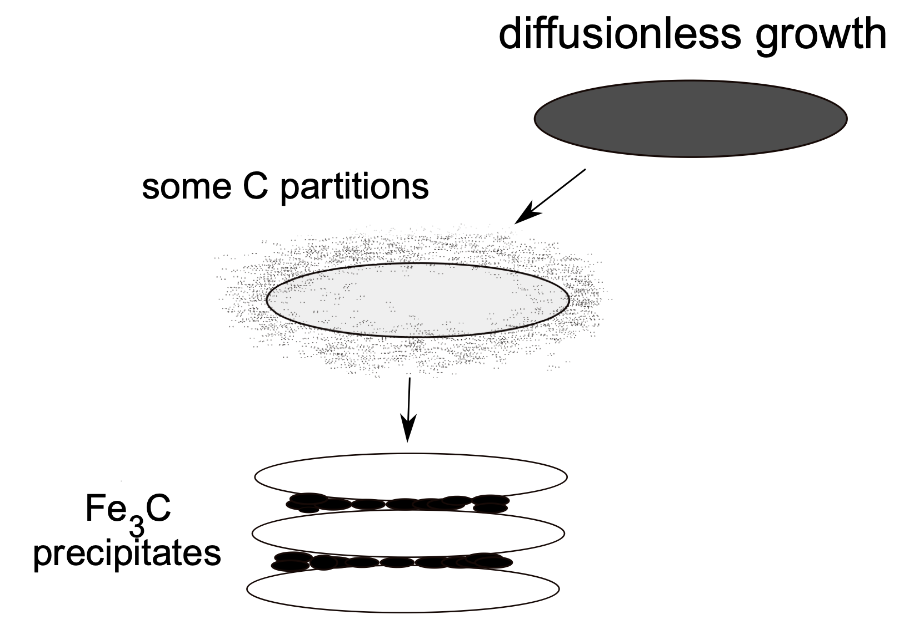
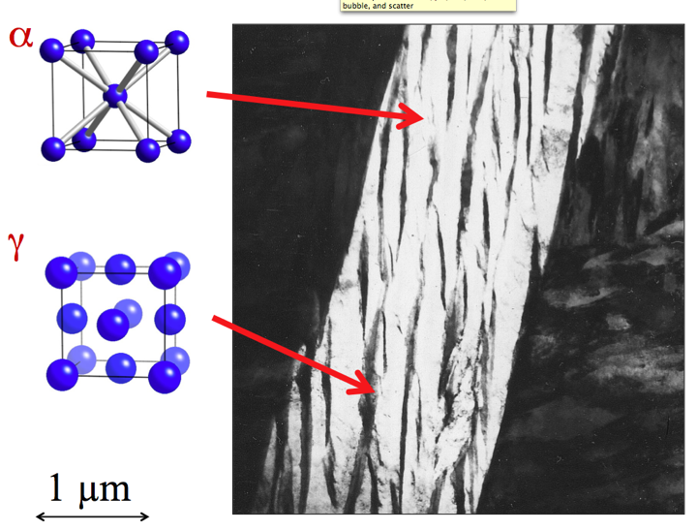

Slide 23
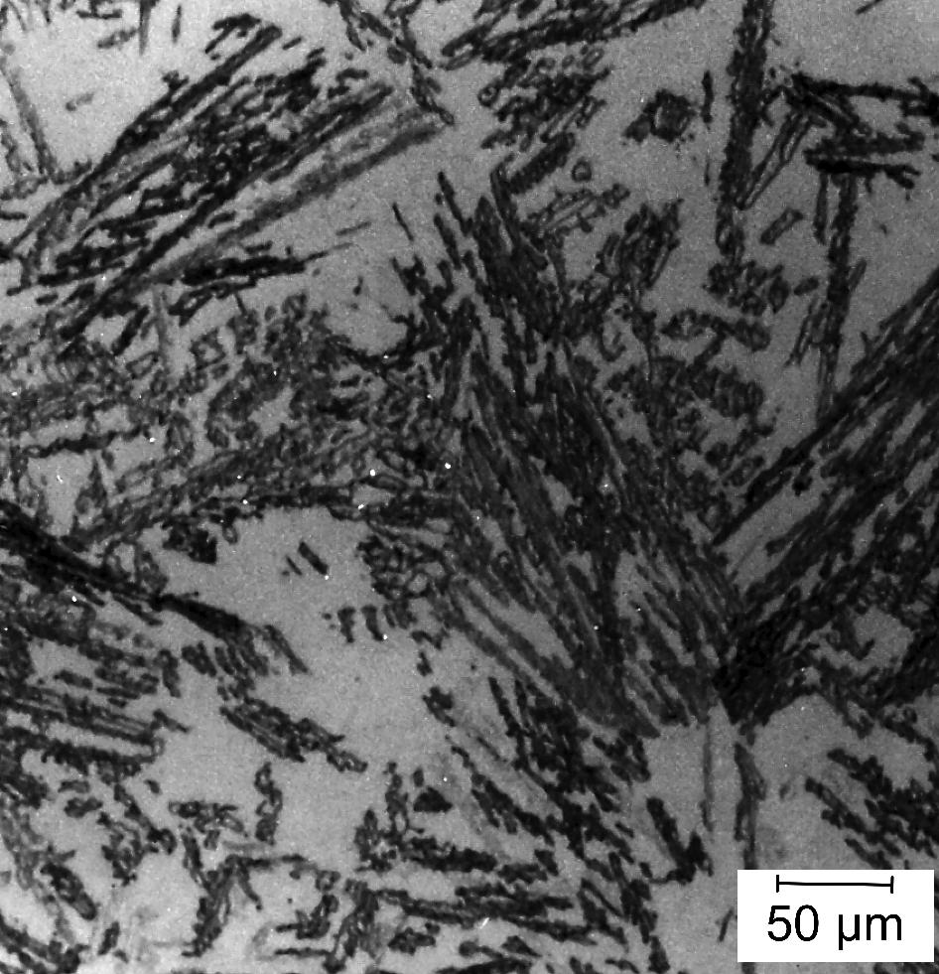
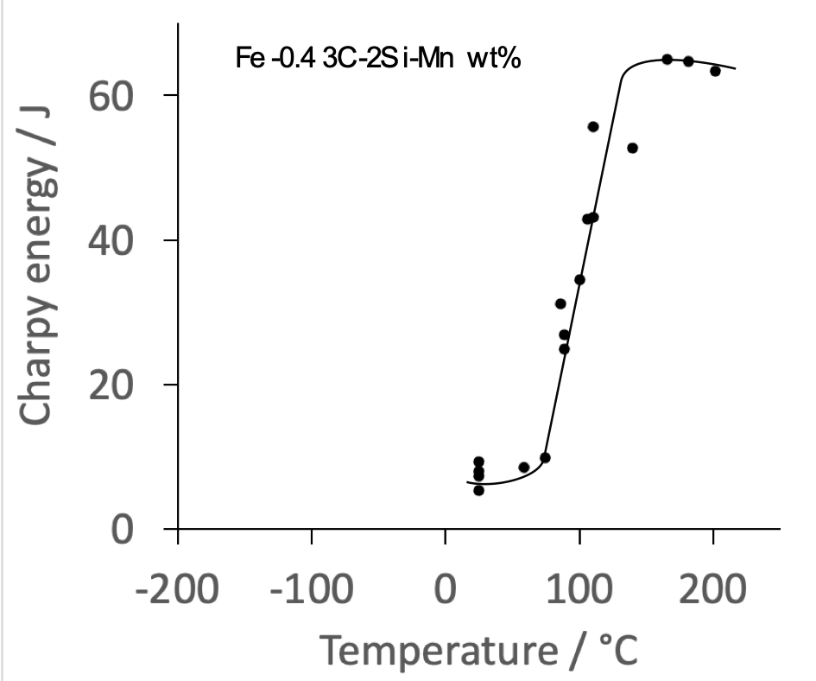
Very poor toughness!

Slide 24
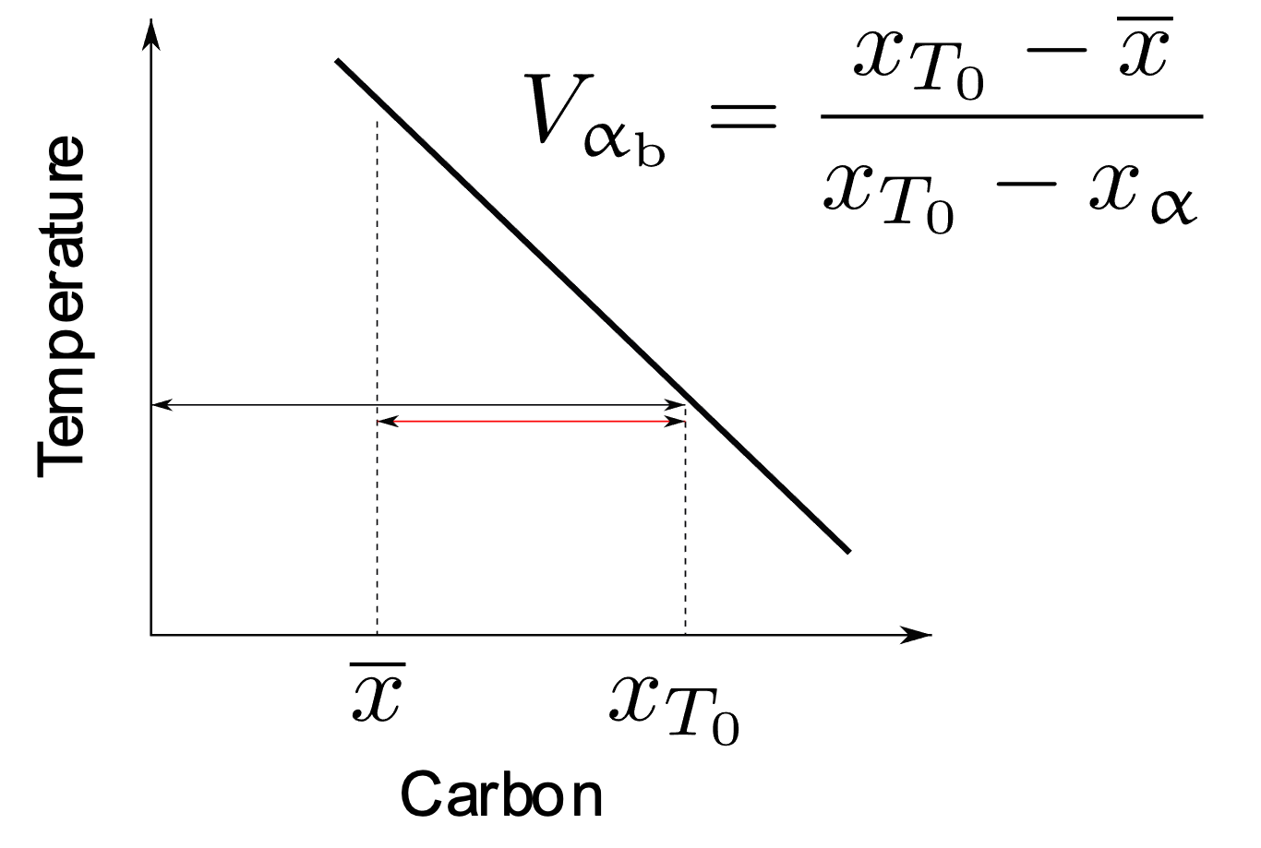

Slide 25
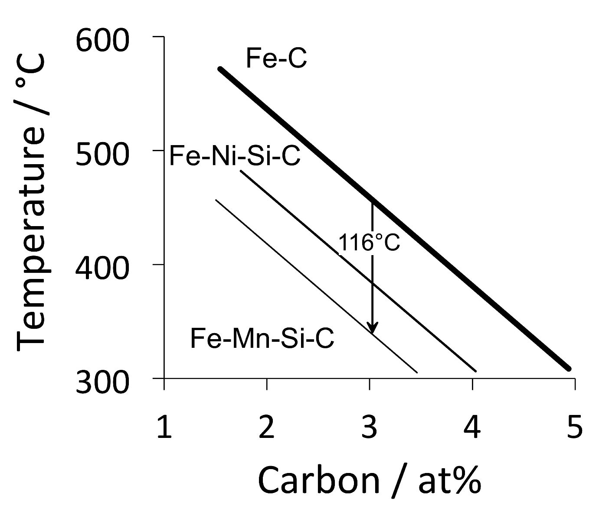
Carbide-free alloys
Fe-0.4C-3Mn-2Si
Fe-0.2C-3Mn-2Si
Fe-0.4C-4Ni-2Si wt%
Notes:
25

Slide 26
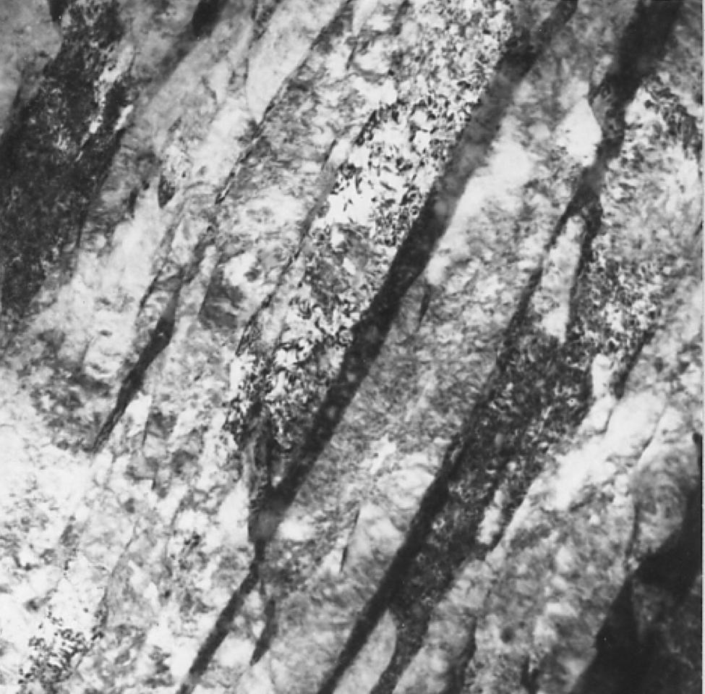



Fe-0.2C-2Si-3Mn wt%
Fe-0.4C-2Si-4Ni

Slide 27

0.4C-2Si-4Mn
0.2C-2Si-3Mn
0.4C-2Si-4Ni

Slide 28



carbide-free bainitic rail
November 2019: 1 billion gross tonnes of traffic achieved, without need for grinding
Kevin Sawley: 90 million gross tonnes of traffic on curve
Pascal Secordel (Francerail), Jay Jaiswal (Arrail) April 2020

Slide 29


“Bainitic low fatigue” (BLF) is mandated for all new French TGV high-speed moveable points.

Slide 30



Versatile
2104
Notes:
Theoretical minimum

Slide 31


Low transformation temperature
Bainitic hardenability
Reasonable transformation time
Elimination of cementite
Austenite grain size control
Avoidance of temper embrittlement

Slide 32





Slide 33



Real images of nanostructured bainite

Slide 34


Zhang & Yang, 2019
wind turbines +rolling mill, vibration machinery

Slide 35



Paul Hill, Rolls-Royce

Slide 36



Pure iron crystals
Apollo 15 mission
~3 µm in size
in cavity in silica rock
condensed from vapour
NASA image S72-55208, catalogued 10th November 1972
Notes:
150 tonnes per 100,000 tonnes

Slide 37




moon crystals
{229}
Kevin Knowles

Slide 38


Slide 39




















Notes:
my intention is to get to 100 Ph.D. students

Slide 40






