Slide 1

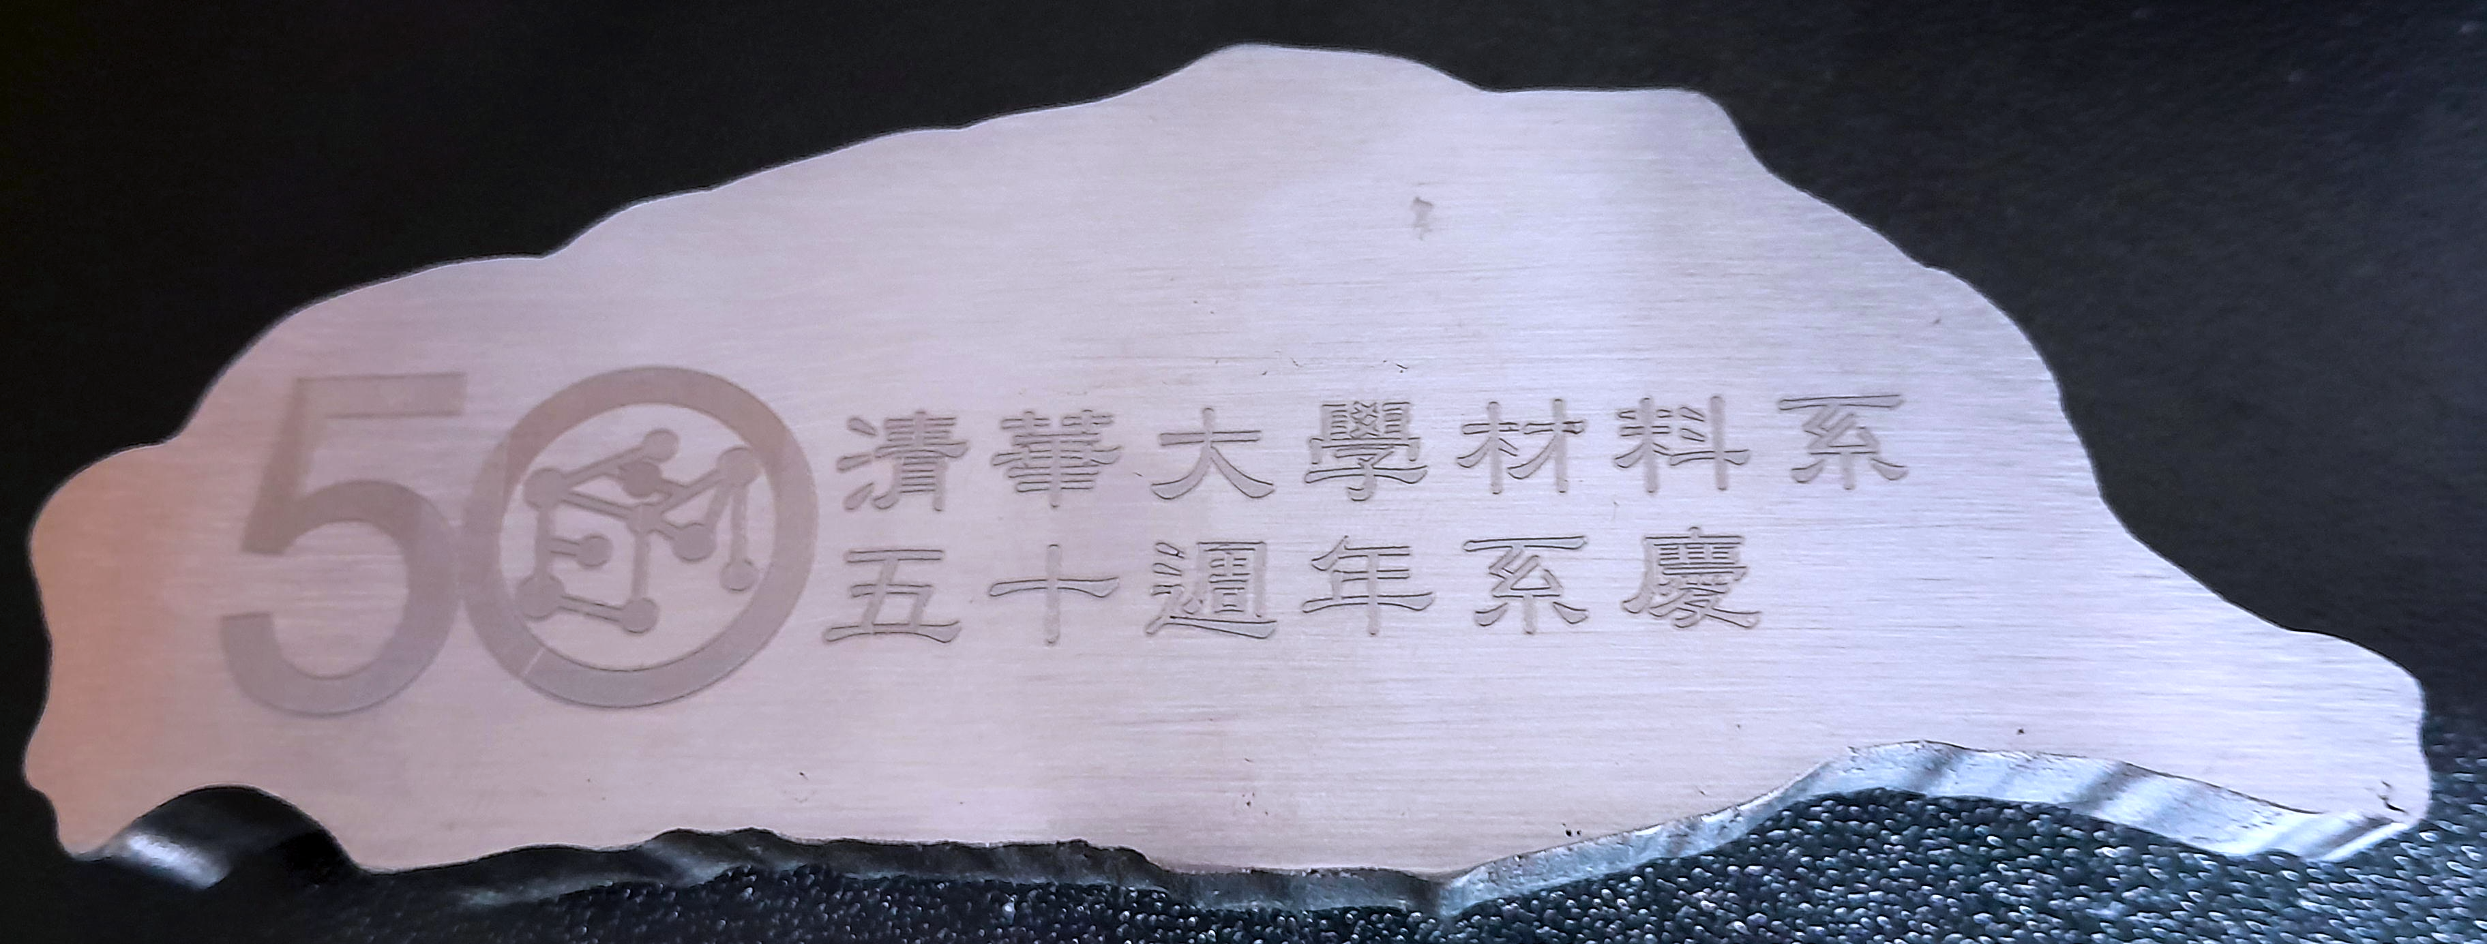


High-entropy alloys
– science & exploitation
www.phase-trans.msm.cam.ac.uk

Slide 2
Successful approach in alloy design
One element as solvent
+ small concentrations of solutes
Steels
Ni alloys
Mg alloys
2 billion tonnes
used annually
Al alloys
Ti alloys

Slide 3


Why small quantities of solute?
effective combined with processing
cost
ability to recycle
can be joined
large-scale construction possible
Notes:
recycling – easier to recycle lean steels, expensive alloying elements often are oxidised during steelmaking

Slide 4


K. H. Huang and Jien-Wei Yeh (advisor)
Study of multicomponent alloy systems
containing equal-mole elements
Master’s Thesis,
National Tsing Hua University, Taiwan
A. J. Vincent and Brian Cantor (advisor)
Study of three multicomponent alloys
Part II Thesis, University of Sussex

Slide 5
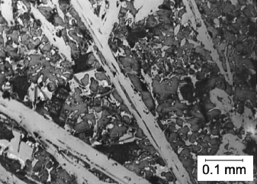
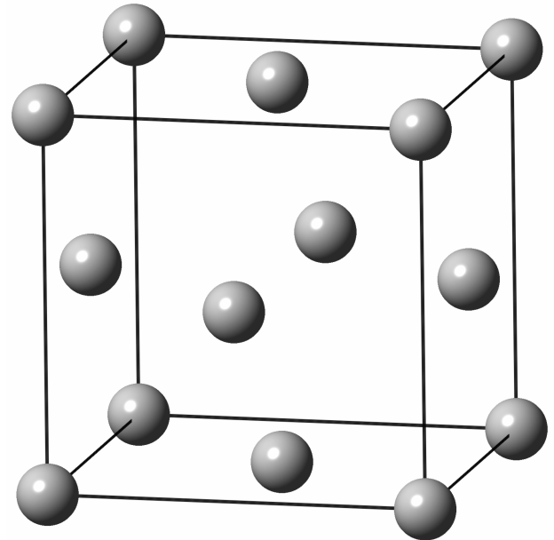
One of the phases has mostly Cr-Co-Ni-Fe-Mn with face-centred cubic crystal structure
The original twenty-component alloy (Mn, Cr, Fe, Co, Ni, Cu, Ag, W, Mo, Nb, Al, Cd, Sn, Pb, Bi, Zn, Ge, Si, Sb, Mg), melted in a crucible using pure components in equiatomic proportions, and air cooled. Image courtesy of Brian Cantor (Vincent:1981).

Slide 6
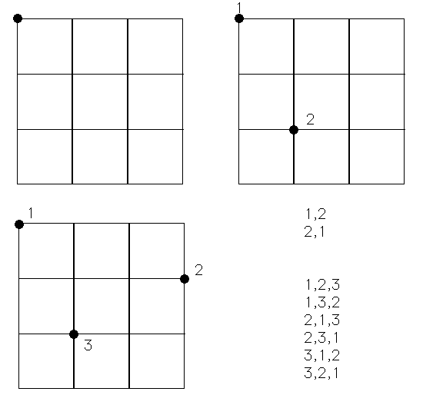

Slide 7
This is the number of configurations (w).
So what is the configurational entropy?

Slide 8
+
=
configurational entropy?

Slide 9
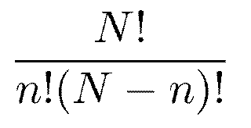
For a random mixture, number of configurations given by:

Slide 10
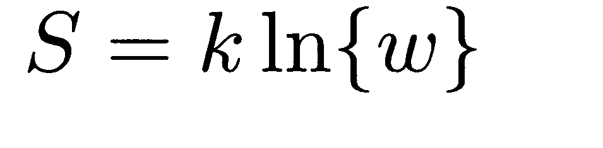
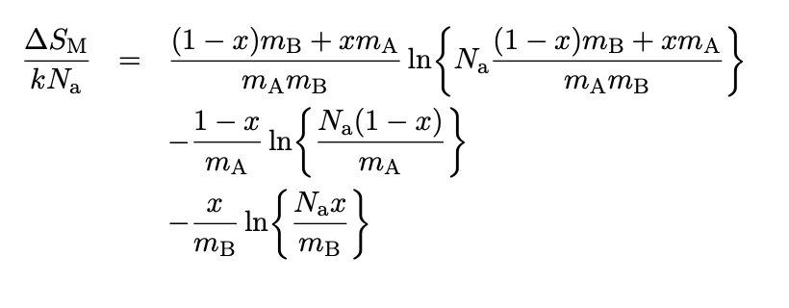

Slide 11
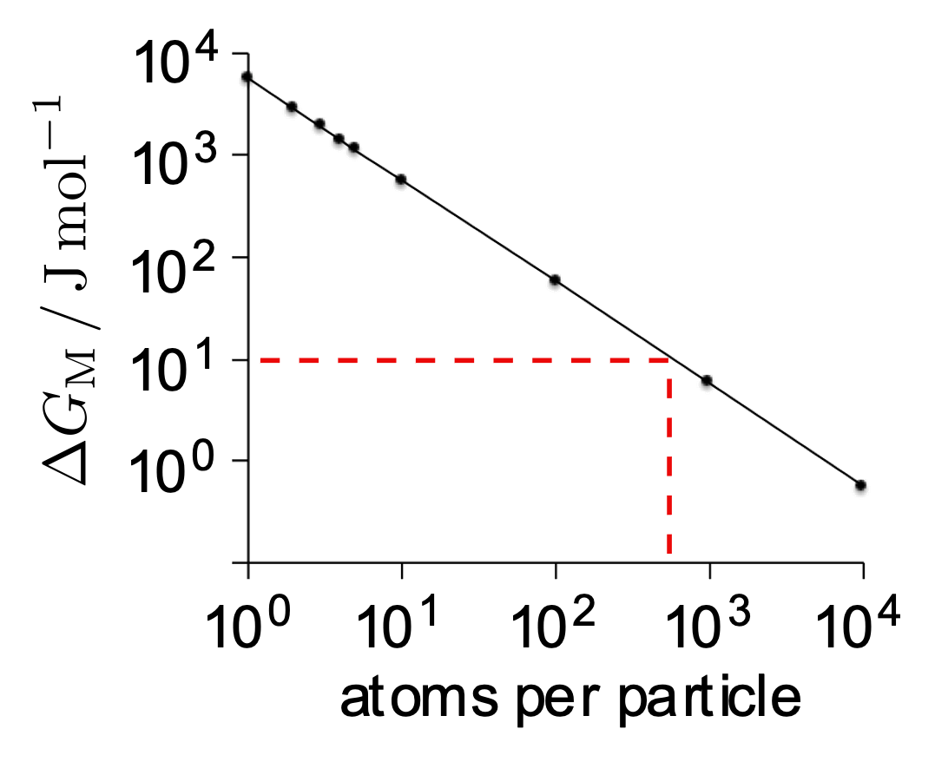
Solution-like behaviour when particles about 1000 atoms in size
Free energy of mixing due to configurational entropy alone

Slide 12
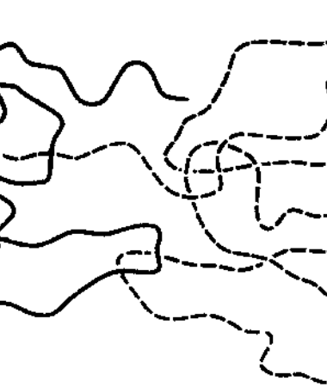
for this reason:
no high-entropy polymer alloys
no equilibrium concentration of dislocations

Slide 13

configurational entropy maximum at equiatomic concentration
free energy minimum at equiatomic concentration, assuming only the entropy contributes to free energy
1000 K

Slide 14
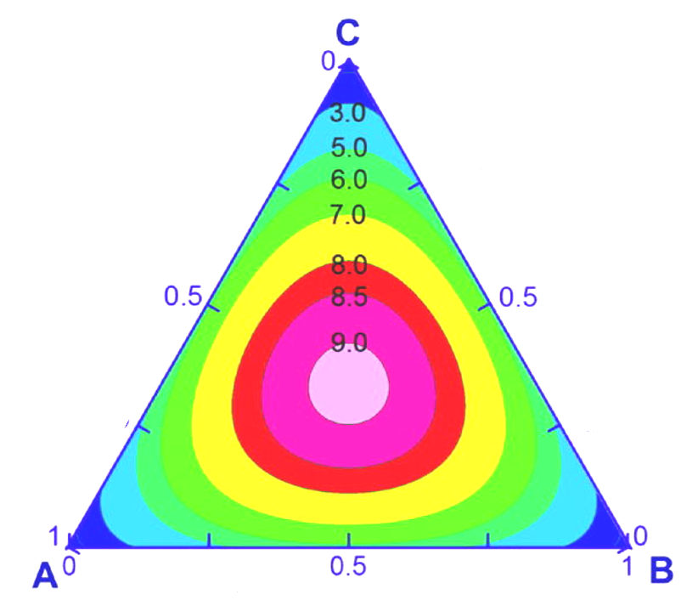

Slide 15
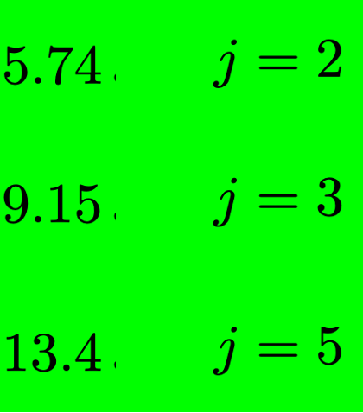

Ni-20Cr, nichrome
Fe-25Mn-3Al-3Si, TWIP
55Cu-18Ni-27Zn, “Ni-silver”
21Cr-24Ni-6.5Mo-0.2N-48.3Fe
AL-6XN austenitic stainless steel
mass produced
single-phase alloys
equiatomic

Slide 16
configurational entropy has huge consequences.
if entropy is dominant contribution to free energy, it becomes feasible to “stabilise” a muliticomponent solution

Slide 17
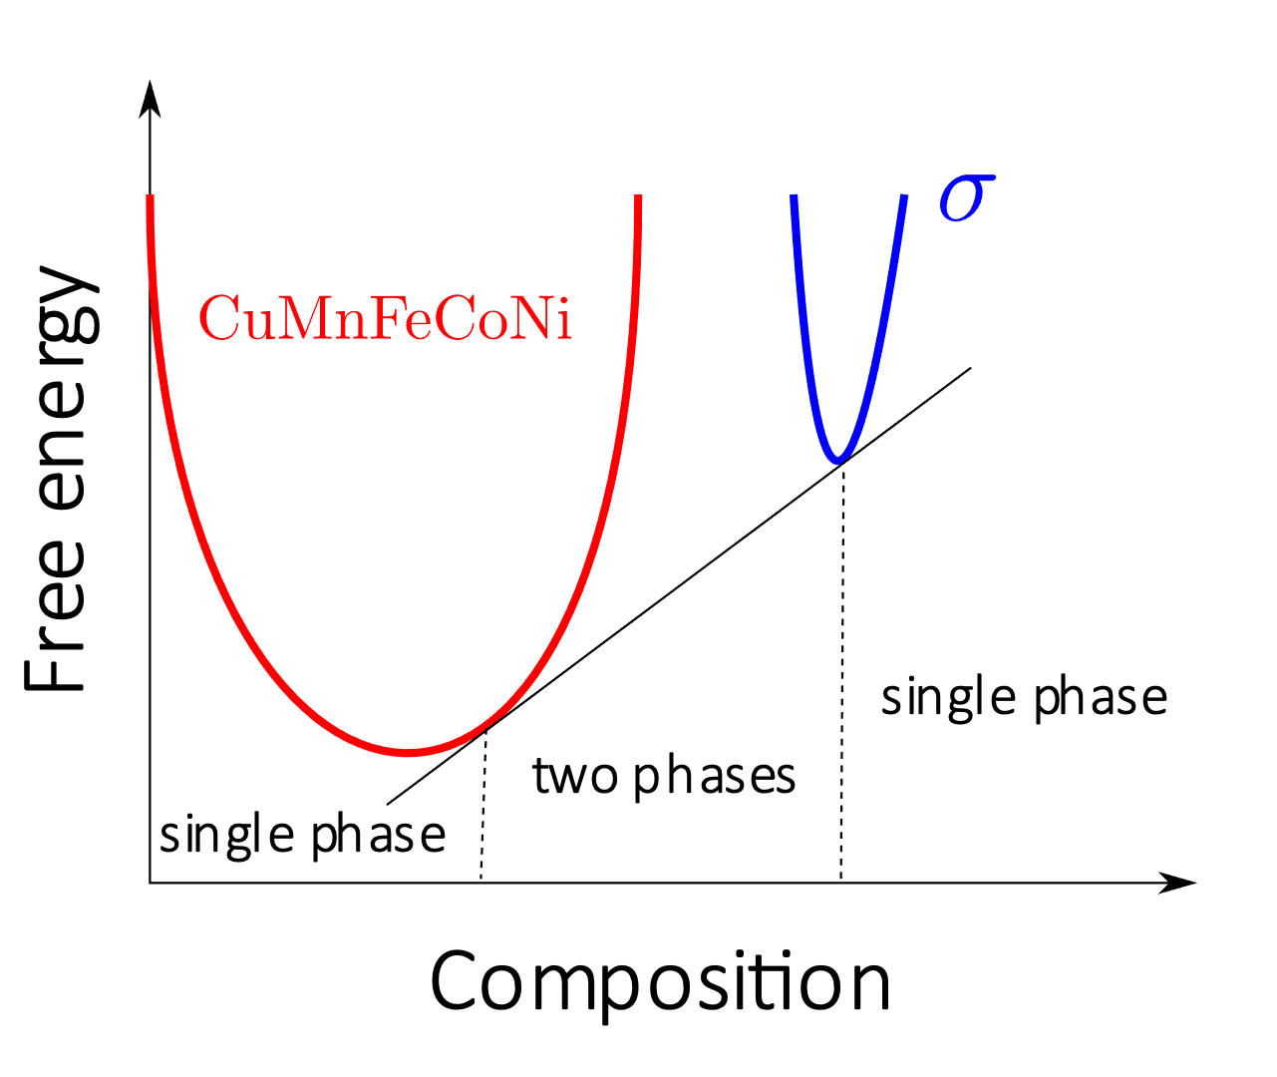
Meaning of stability
stable with respect to ....?

Slide 18
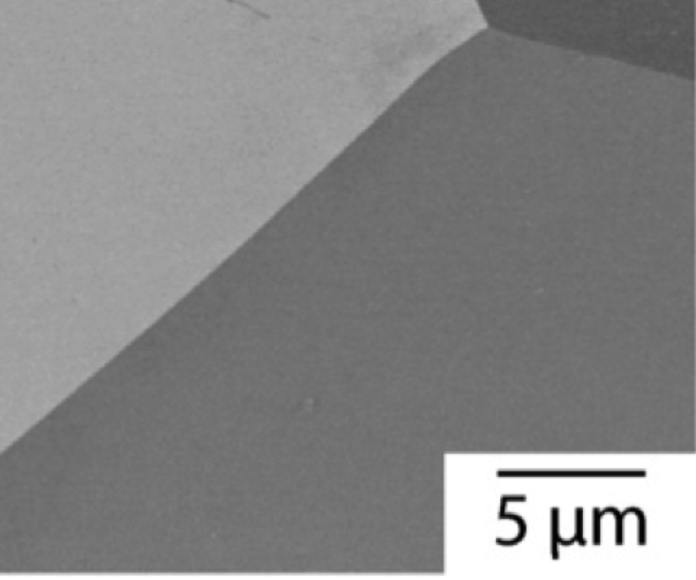
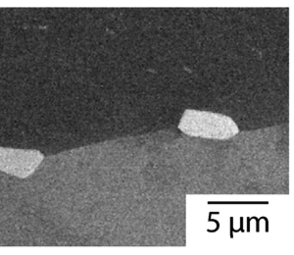
homogenised
1000 h, 700°C
equiatomic Cr Mn Fe Co Ni
Reproduced under CC BY 4.0 license
https://creativecommons.org/licenses/by/4.0/
EJ Pickering, R Muñoz-Moreno, HJ Stone, NG Jones
Scripta Materialia 113 (2016) 106

Slide 19
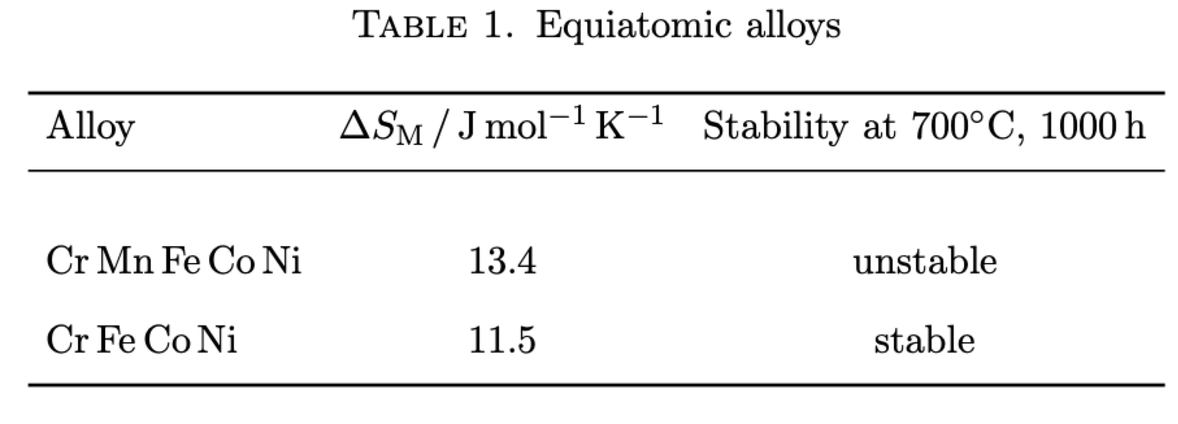
Cr Mn Fe Co Ni
Cr Fe Co Ni
EJ Pickering, R Muñoz-Moreno, HJ Stone, NG Jones
Scripta Materialia 113 (2016) 106
Christofidou KA, Pickering EJ, Orsatti P, Mignanelli PM, Slater TJ, Stone HJ, Jones NG.
Intermetallics. 2018 Jan 1;92:84-92.

Slide 20
Atomic structure of solution
Chou, Bhadeshia, Structural Applications of Mechanical Alloying,
ASM International,
September 1993, 77-82

Slide 21
MA956
Chou & Bhadeshia, 1994

Slide 22
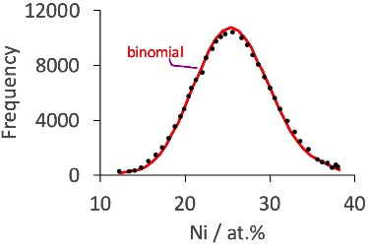
CoCrFeNi
atom probe analysis
100 ion clusters
Selected data from Vaidya M, Pradeep KG, Murty BS, Wilde G, Divinski SV.
Acta Materialia 146 (2018) 211

Slide 23
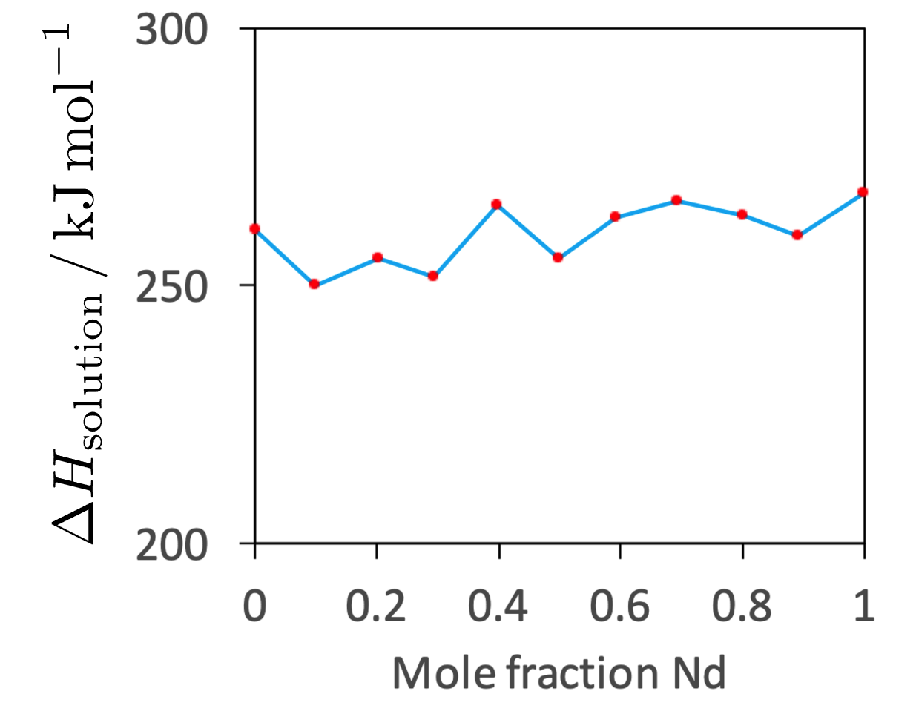
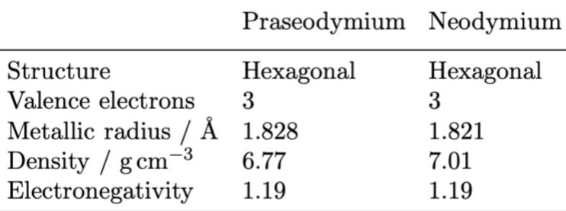
Praseodymium-neodymium solid solutions
Lundin, Pool: J. Less Common Metals 9 (1965) 48-53

Slide 24
almost no alloys with
assumes ∆S_{M} from random mixture of atoms – may not be justified if ∆H_{M} non-zero, except at high T

Slide 25
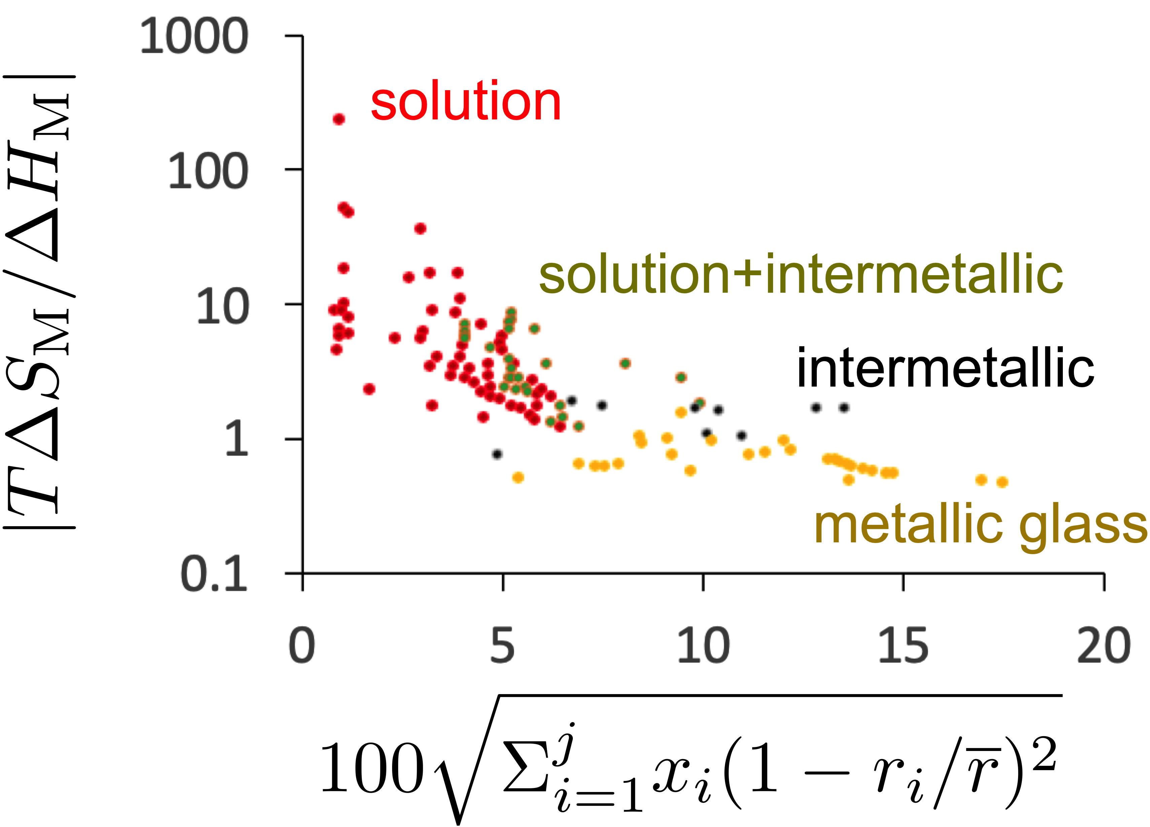
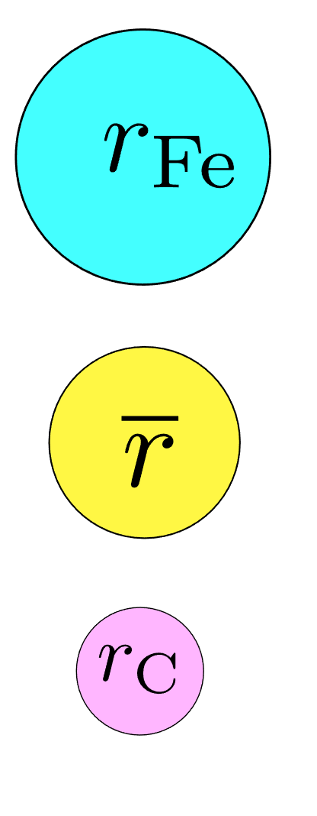
Data from Zhang et al. Prog. Mater. Sci. 61 (2014) 1-93

Slide 26
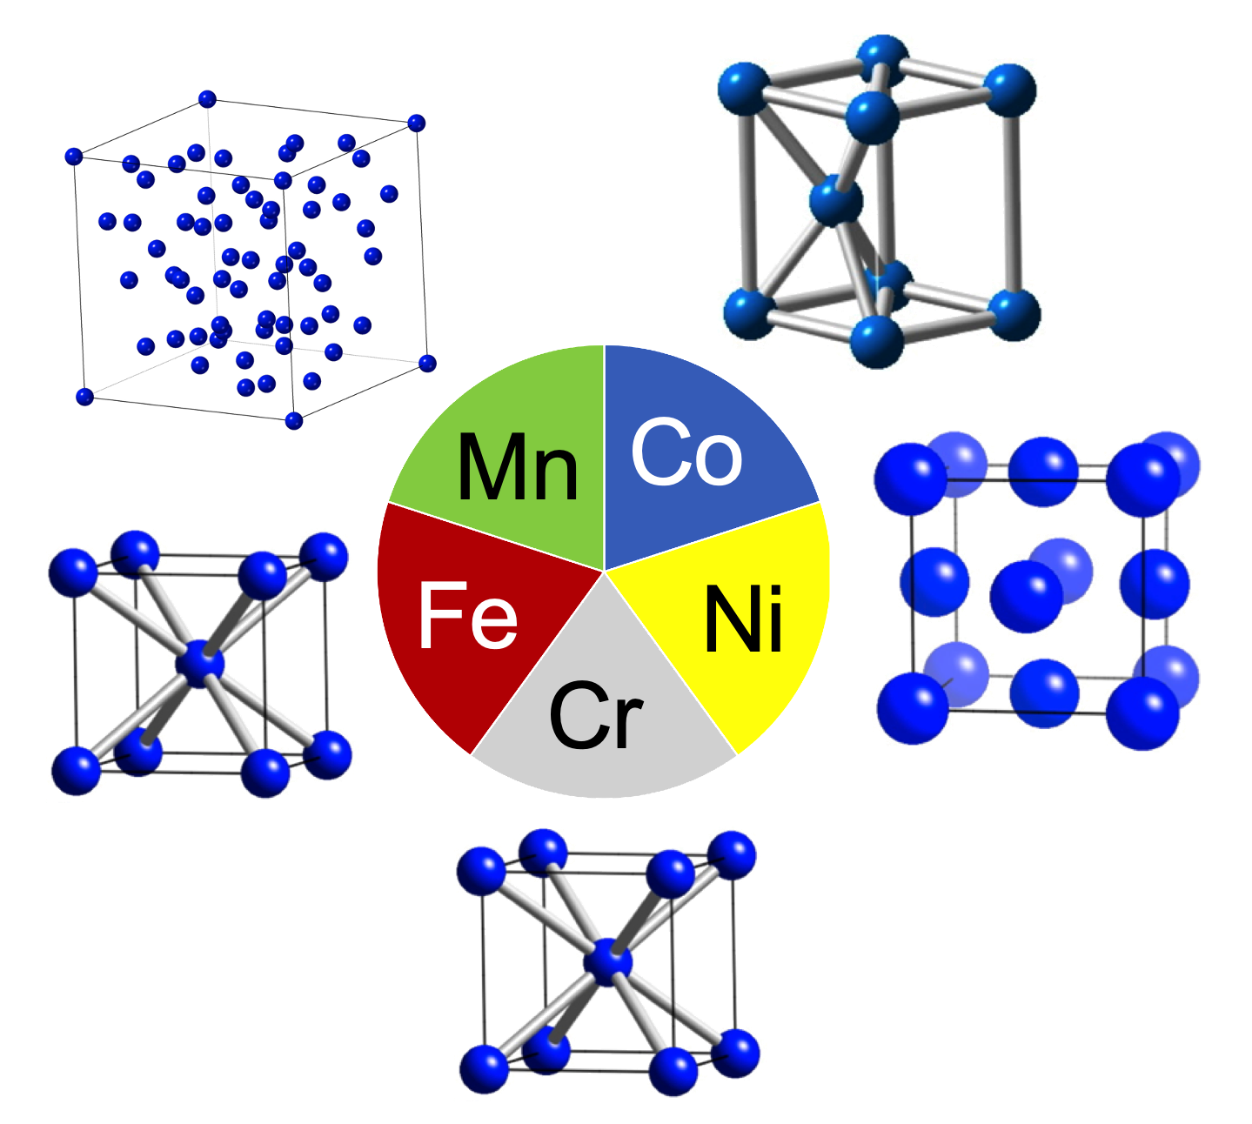
Crystal structure?
equiatomic Cr Mn Fe Co Ni

Slide 27
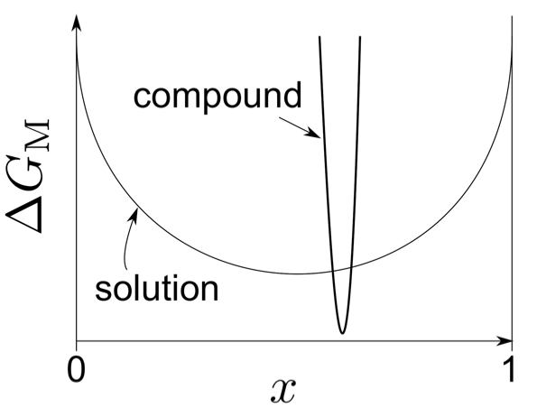
Alloy design: Hume-Rothery
mixing metals with different valencies
compounds initiate when valence-electron to atom ratio in alloy exceeds a critical value
W. Hume-Rothery, J. Inst. Metals 35 (1926) 295
Notes:
atomic size difference <15%, small difference in electronegativity, lower valency atoms dissolve in solution formed by higher valency atoms

Slide 28
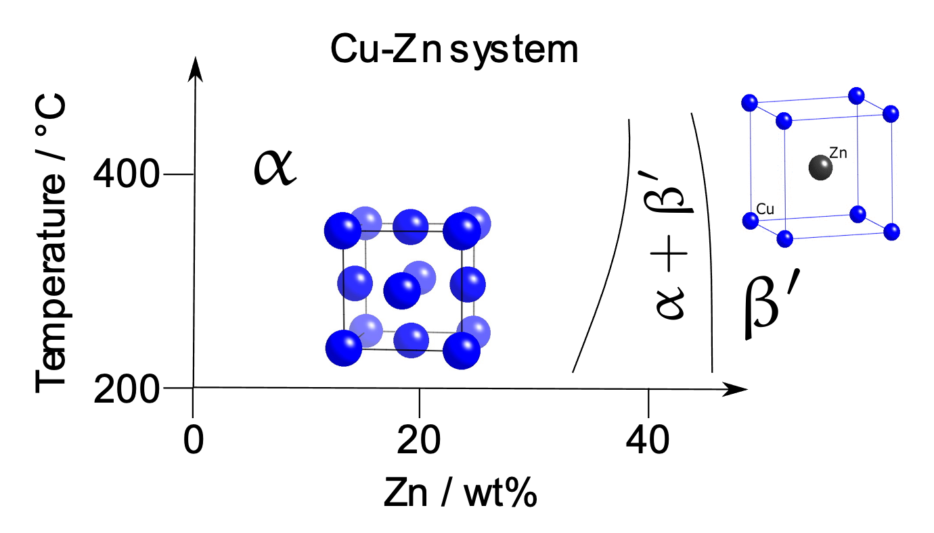
Alloy design: Hume-Rothery
fcc phase boundary
at 1.38 e/a
Notes:
atomic size difference <15%, small difference in electronegativity, lower valency atoms dissolve in solution formed by higher valency atoms

Slide 29
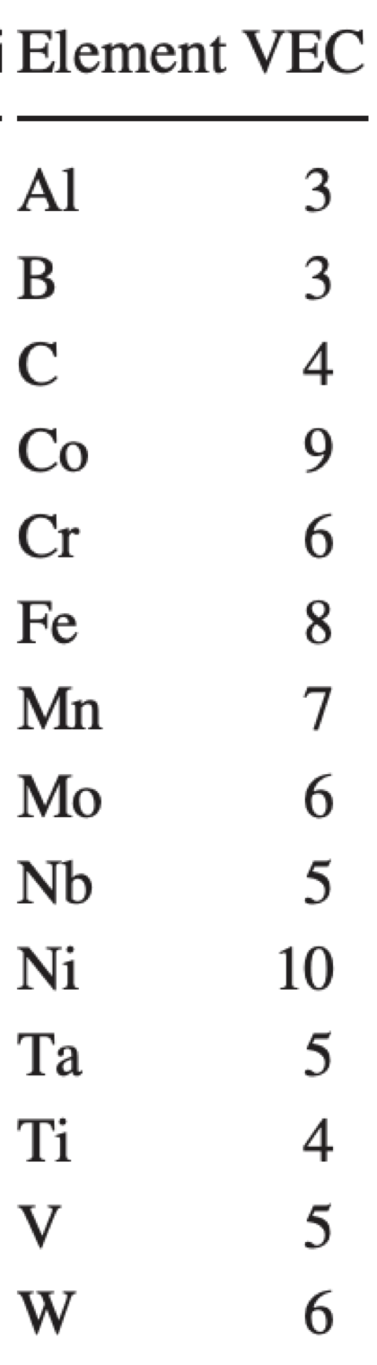
alloy design
crystal structure
Tian, Varga, Vitos, Intermetallics 83 (2017) 9
Guo, Ng, Lu, Liu, J. Appl. Phys. 109 (2011) 103505

Slide 30
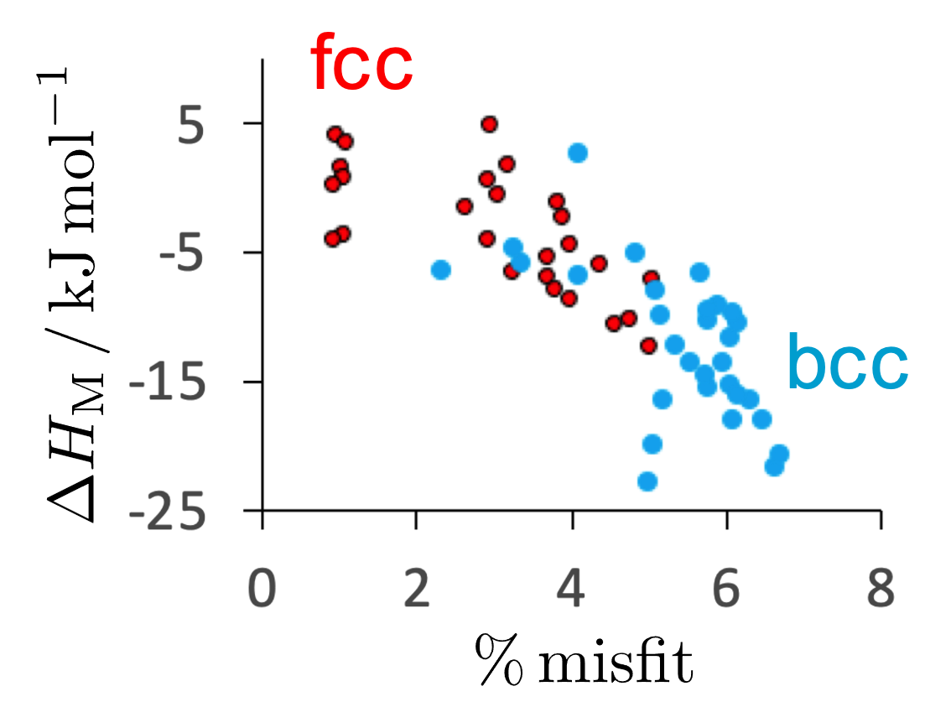
Crystal structure? single-phase, 5,6 component alloys
Fe-Ni-Al, Cr, Co, Cu, Ti, Mn, Mo, V, Si
Selected data from:
Zhang Y, Lu ZP, Ma SG, Liaw PK, Tang Z, Cheng YQ, Gao MC. MRS Communications. 2014 Jun;4(2):57-62.

Slide 31
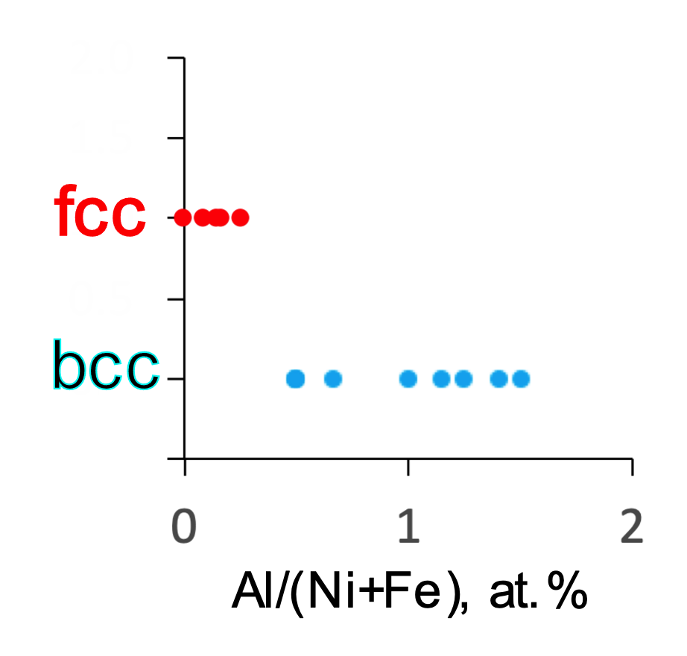
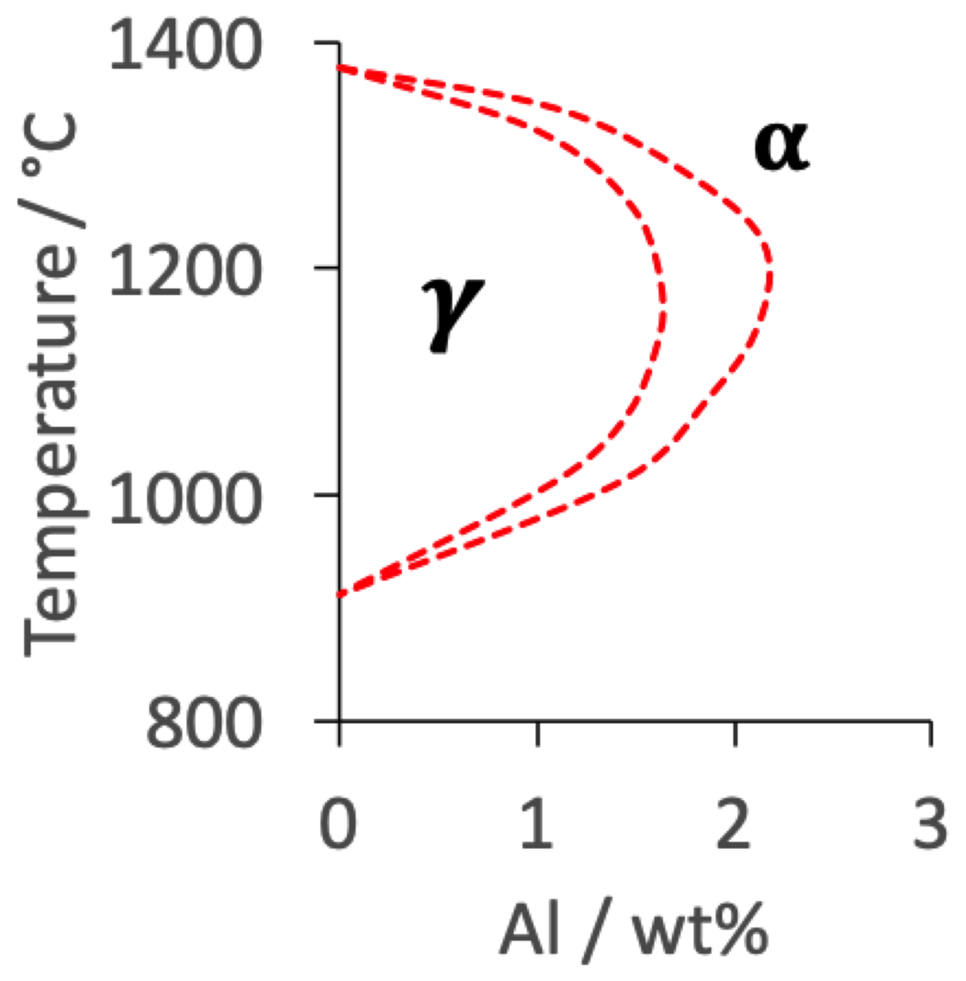
Crystal structure?
single-phase, 5,6 component alloys
Fe-Ni-Al, Cr, Co, Cu, Ti, Mn, Mo, V, Si
Bhadeshia:2021, using selected data from Zhang et al. (2014)

Slide 32
Refractory high-entropy materials
Cr, Hf, Mo, Nb, Re, Ta, V, W, and Zr
Al, Ti, Si, Co, and Ni and C, N
body-centred cubic
Melting temperature of W-Nb-Mo-Ta-V alloy
calculated: 2946 K
density 13.75 g cm⁻³
[Intermetallics 18 (2010) 1758]

Slide 33
First principles calculations
condition for compound formation
Troparevsky MC, Morris JR, Kent PR, Lupini AR, Stocks GM. Physical Review X. 2015 Mar 31;5(1):011041.

Slide 34
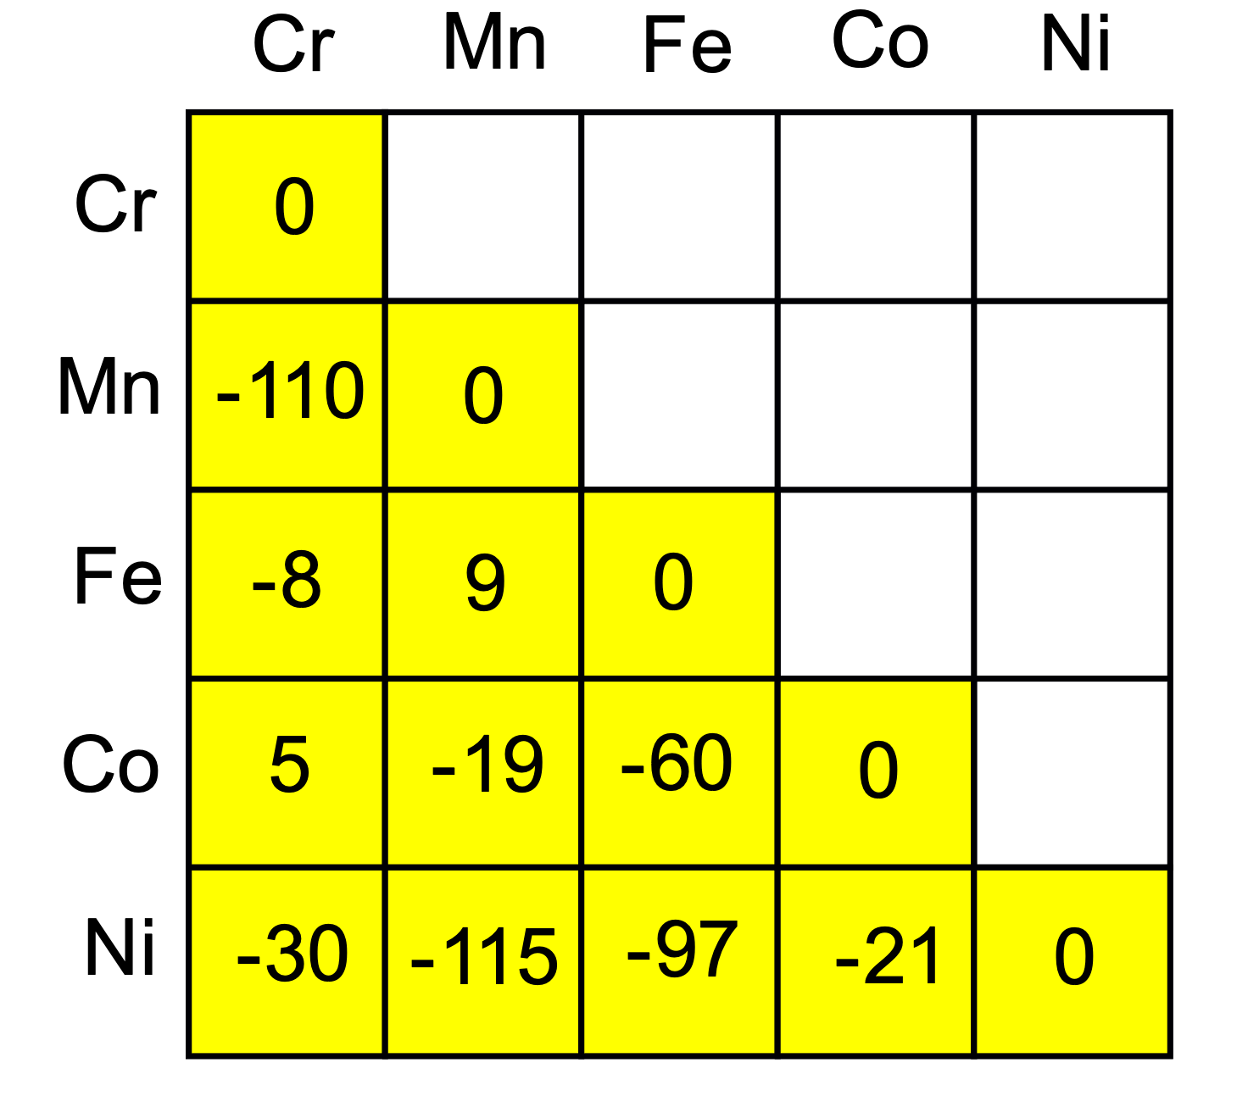
First principles calculations
Does not represent equilibrium,
compounds often
multicomponent (n>2)
therefore, equiatomic CrMnFeCoNi
solid solution predicted to be stable
on the basis of lowest energy, ordered
binary compound calculations
and annealing at 1000 K.
selected data from Troparevsky et al.

Slide 35
First principles enthalpy calculations
... approximations
calculations for binary compounds
stoichiometry assumed
zero Kelvin, zero pressure
range of acceptance to avoid compound is empirical
selected heat capacity data from
Bhandari, Zhang, Zeng, Guo, Yang, J. of Mat. Res. Techn. 9 (2020) 8929

Slide 36
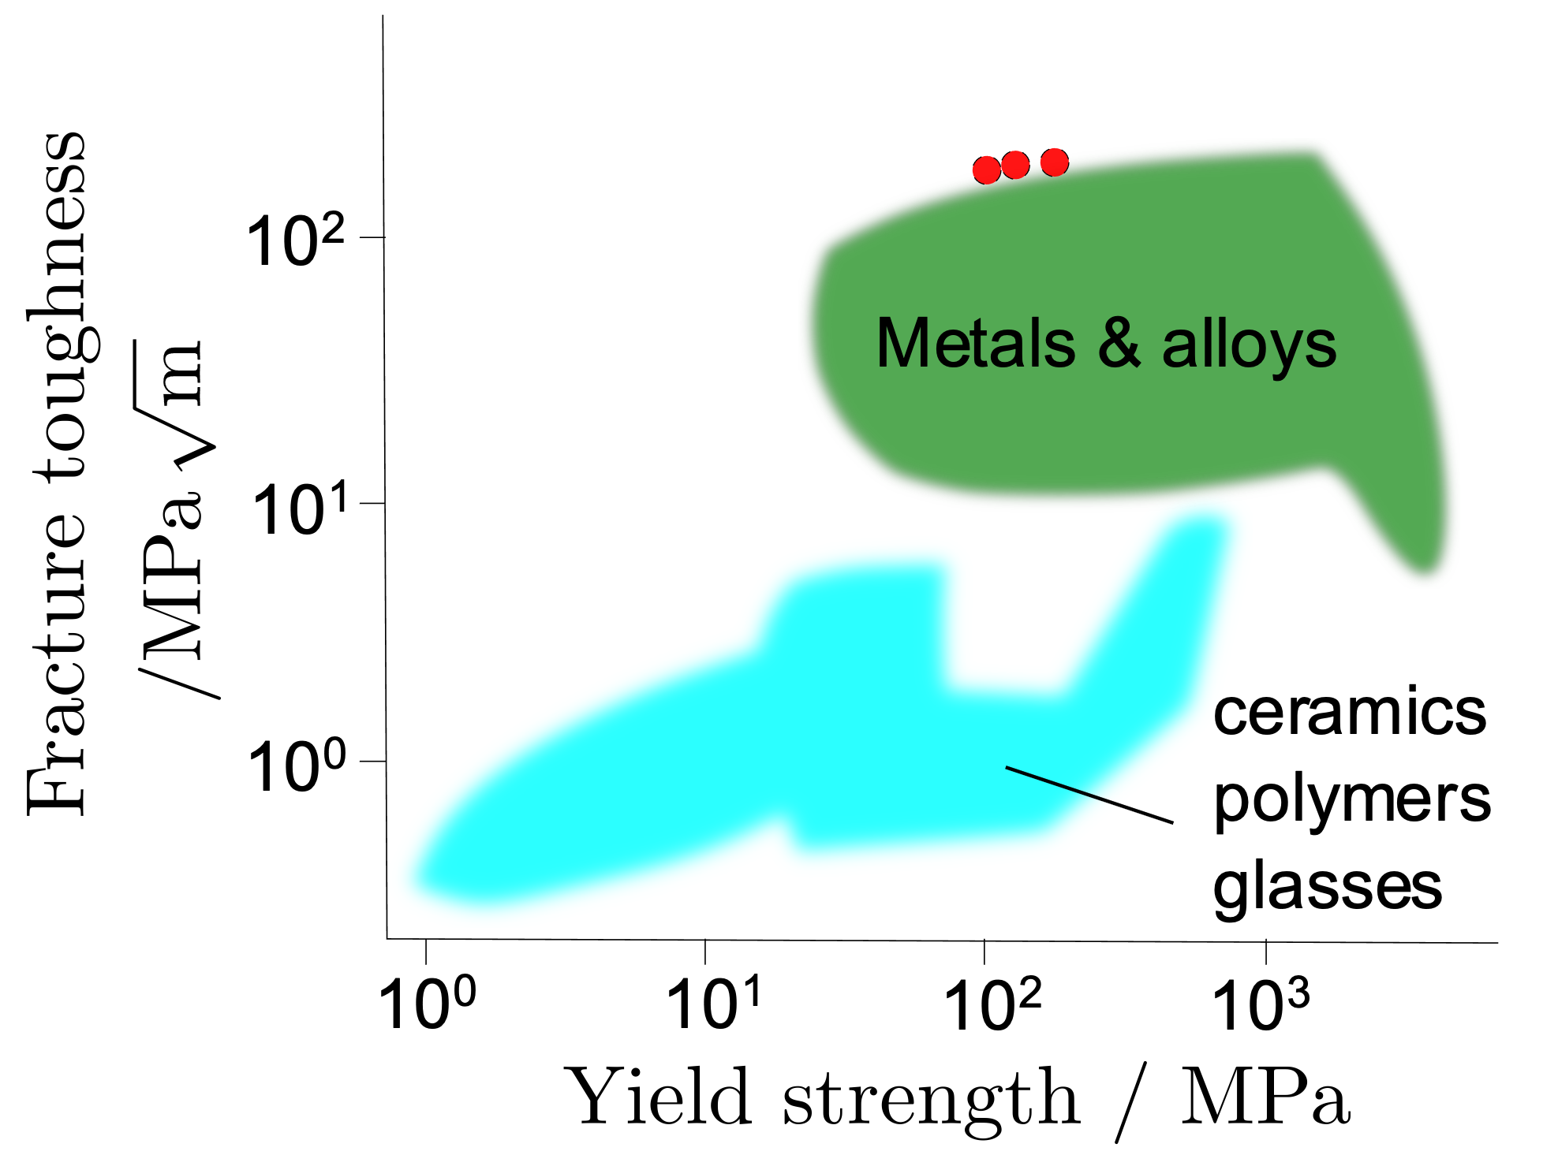
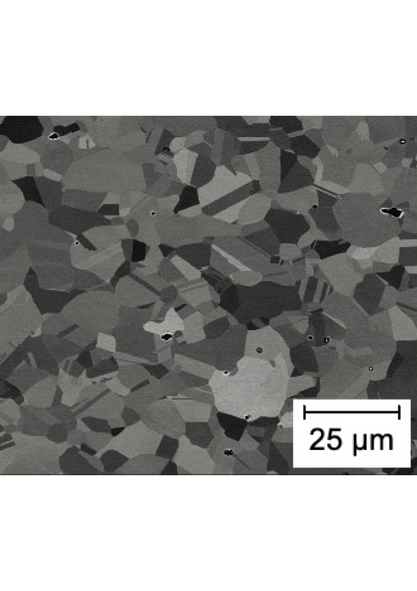
CrFeMnCoNi

Slide 37
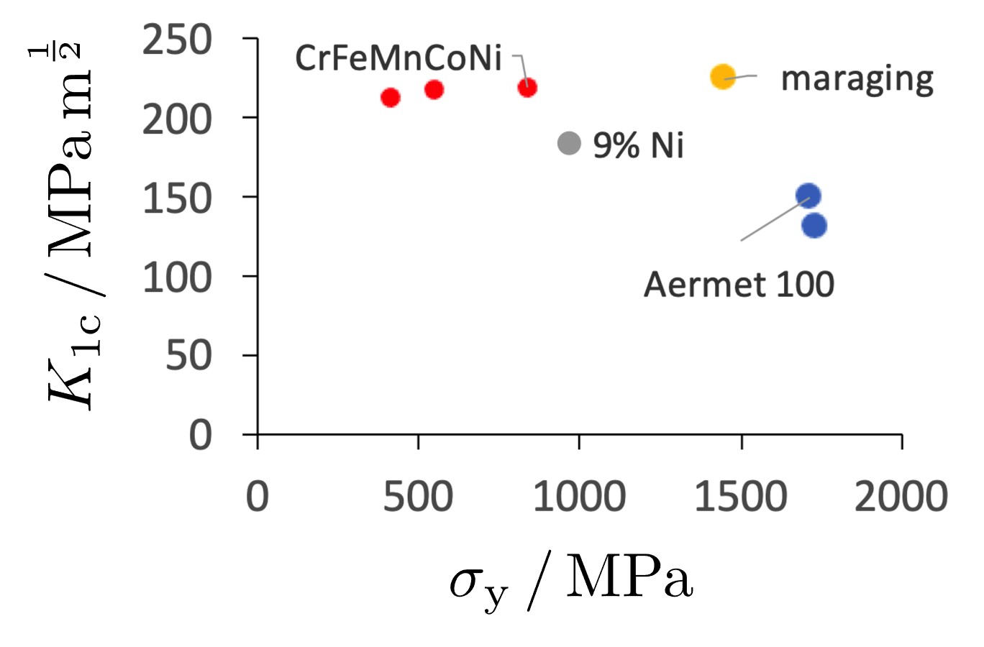
CrFeMnCoNi
Data from: Gludovatz B, Hohenwarter A, Catoor D, Chang EH, George EP, Ritchie RO. Science. 2014 Sep 5;345(6201):1153-8.
Blauel JG, Smith HR, Schulze G. Weld J Res Suppl. 1974 May 1;53:211
Strife JR, Passoja DE. Metallurgical Transactions A. 1980 Aug 1;11(8):1341.
Wang LD, Jiang LZ, Zhu M, Liu X, Zhou WM, Li Y. Journal of Physics D: Applied Physics. 2004 Jul 14;37(15):2151.

Slide 38
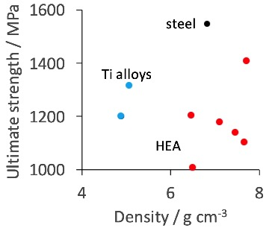
AlCoCrFeNi
Tang Z, Senkov ON, Parish CM, Zhang C, Zhang F, Santodonato LJ, Wang G, Zhao G, Yang F, Liaw PK. Materials Science and Engineering: A. (2015) 28
Kim SH, Kim H, Kim NJ.
Nature. (2015) 518
Polmear, Light Alloys, Edward Arnold

Slide 39
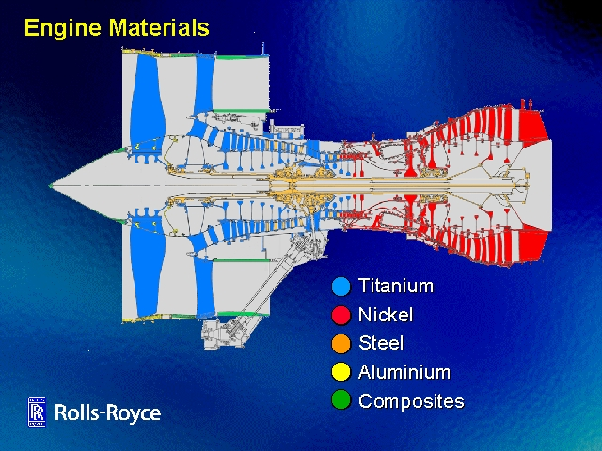
There is no possibility of using high-density alloys in rotating components.
∴ CrNbTiVZr 6.57 g cm⁻³

Slide 40
Al Mo_{0.5} Nb Ta_{0.5} Ti Zr
2-phase bcc+
properties measured in compression
show good elevated temperature strength

Slide 41
Making concentrated alloys
Thus far, only kg quantities of high-entropy alloys made, for research.
Chemical segregation on microscopic scale.
Can influence stability.
Microsegregation treated by homogenisation.
Macrosegregation in large melts impossible to homogenise in realistic time scales.

Slide 42
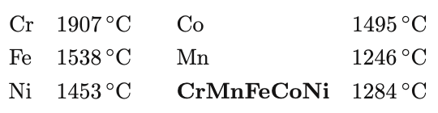
Making concentrated alloys
Melting temperatures
by melting and casting if the melting temperatures of constituents
not too different
laboratory electric arc furnace, vacuum, homogenise

Slide 43
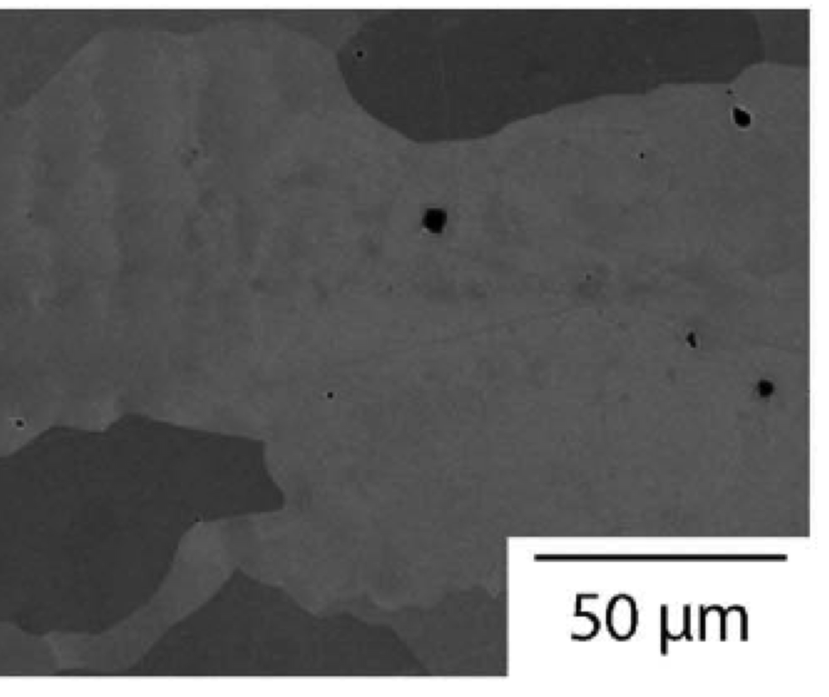
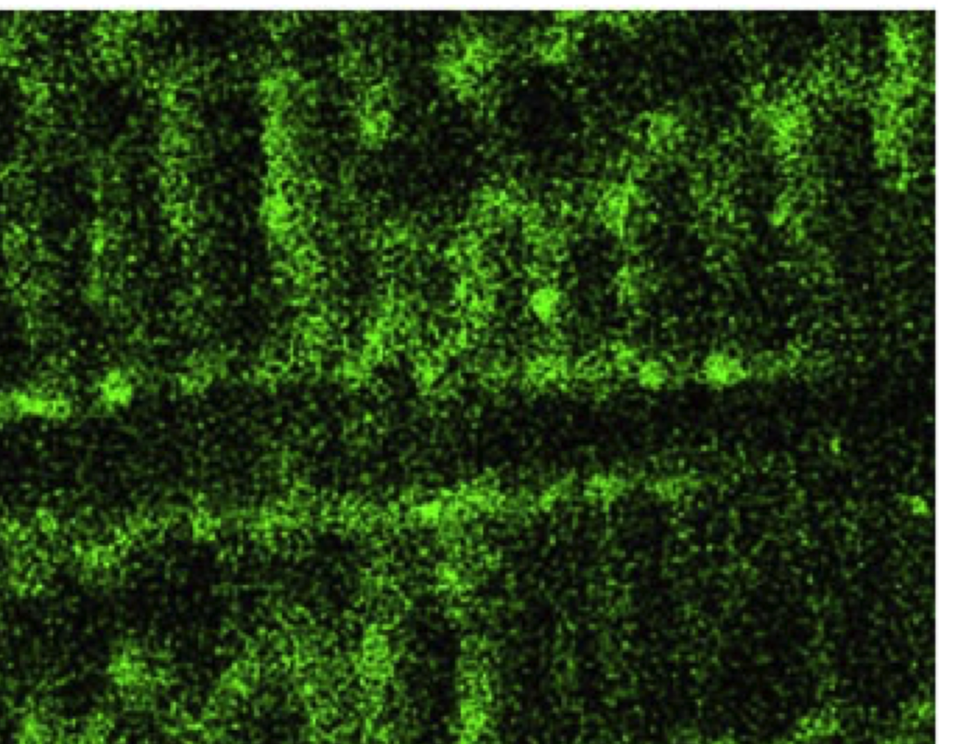
Problems in making concentrated alloys
Cr Mn_{0.5} Fe Co Ni, as-cast
Reproduced under CC BY 4.0 license
https://creativecommons.org/licenses/by/4.0/
Christofidou KA, Pickering EJ, Orsatti P, Mignanelli PM, Slater TJ, Stone HJ, Jones NG.
Intermetallics. 2018 Jan 1;92:84-92.

Slide 44
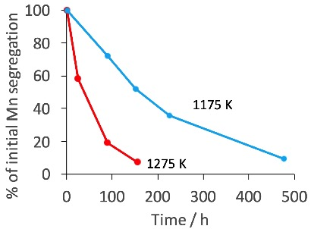
Homogenisation: microsegregation
adapted using data from R. G. Ward, J. Iron & Steel Institute 203 (1965) 930

Slide 45
Homogenisation: microsegregation
AlCoCrFeNi
Repeated melting & solidification
Hot isostatic pressing
Homogenisation

Slide 46
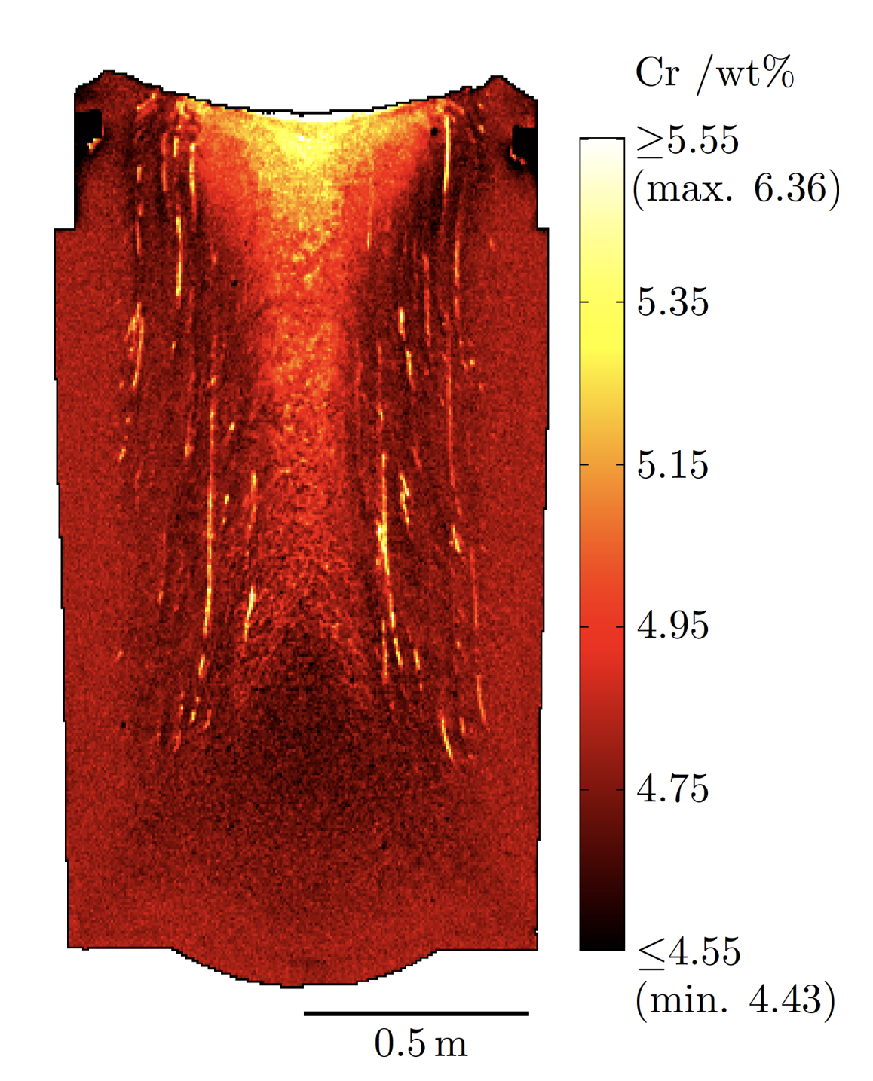
Homogenisation: macrosegregation
segregation on this scale cannot be eliminated
therefore, design the alloy to be stable in spite of composition variations
Ed Pickering

Slide 47
Homogenisation: macrosegregation
Cut off, discard worst segregated region
Hot deformation – helps but does not resolve long-range segregation, spreads it out

Slide 48

cast-iron
balls
powder
Al Li Mg Sc Ti
reactive elements
T_{M} varies by 1000 K
mechanical alloying

Slide 49
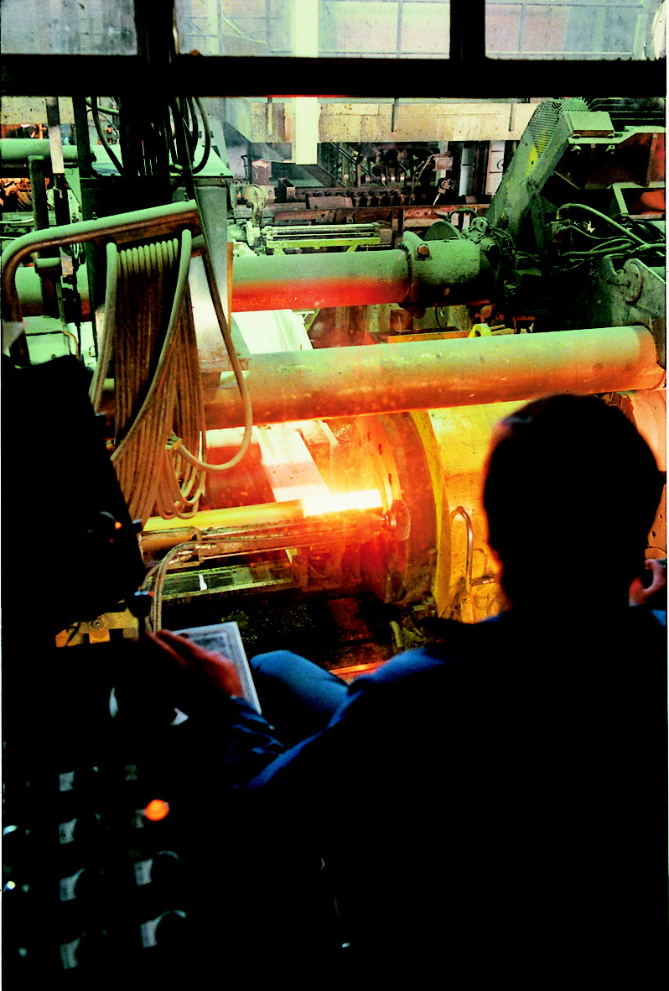
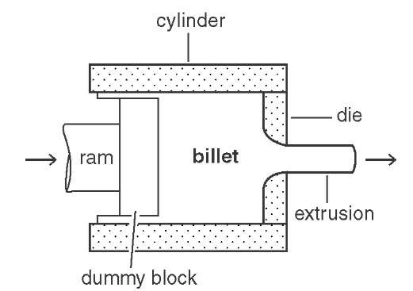
extrusion of canned powder
image courtesy of Jan-Olof Nilsson
Sandvik Materials Technology.
Extrusion of stainless steel.

Slide 50
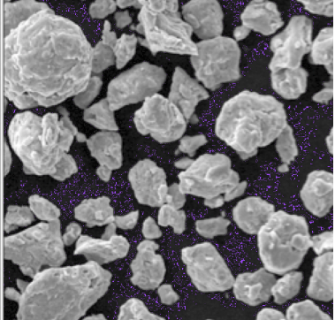
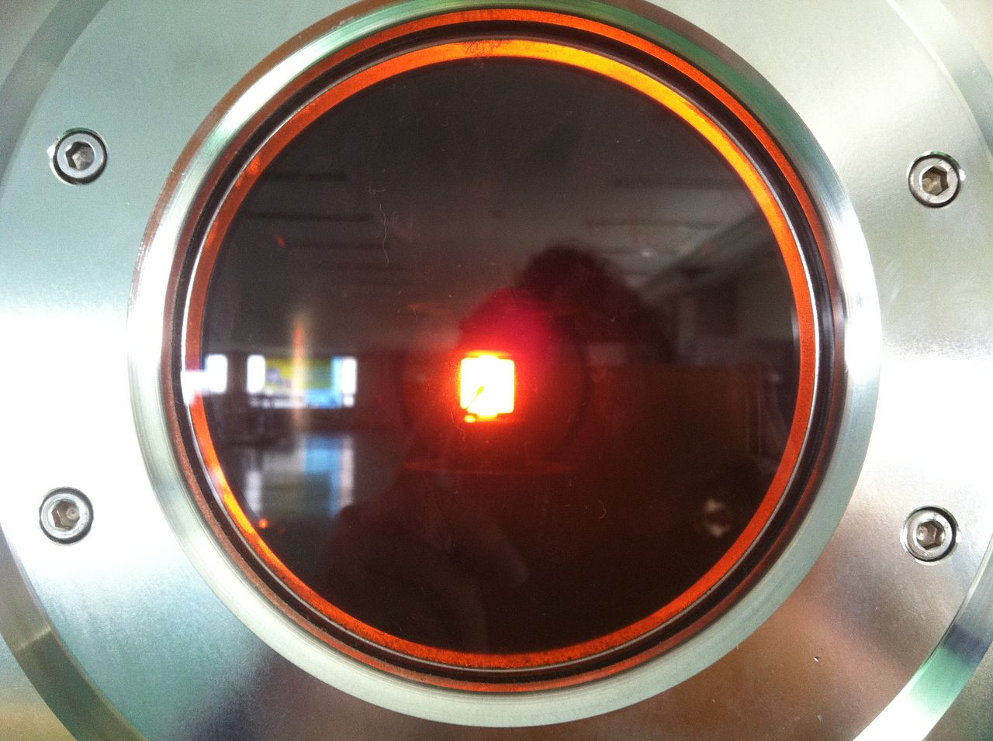
Spark plasma sintering
ZrC, HfC, TaC, NbC, and TiC powders (raw material)
equiatomic proportions
ball-milled for 10 h.
Spark plasma sintering at 2100 °C, 5 min, 60 MPa.
CC BY-SA 4.0, Raihan Rumman (https://en.wikipedia.org/wiki/Spark_plasma_sintering)
https://creativecommons.org/licenses/by-sa/4.0/deed.en

Slide 51
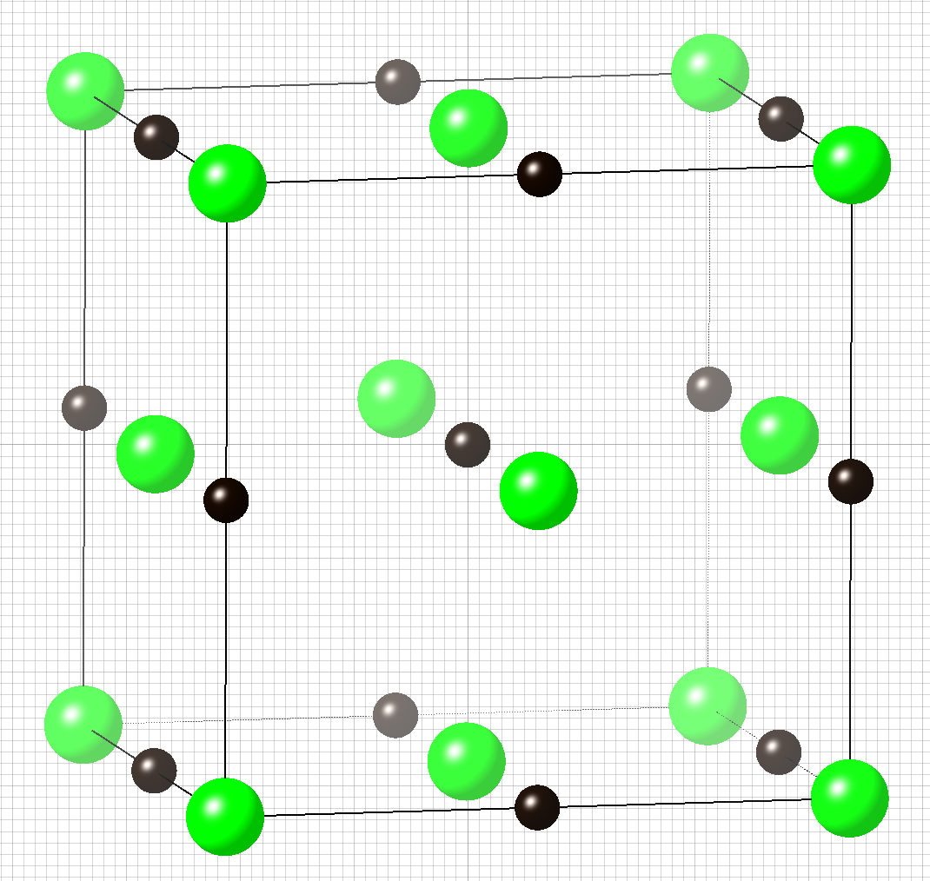
High-entropy carbide
(Zr,Ti,Hf,Nb,Ta)C
Much better oxidation resistance in water vapour at 1200°C relative to ZrC
Speculation that this is because of reduced diffusion of both metal atoms and water molecules.
Tan, Y., Chen, C., Li, S., Han, X., Xue, J., Liu, T., Zhou, X. and Zhang, H.,
J. Alloys Compounds 816 (2020) 152523.

Slide 52
stoichiometric phase
Hillert, Staffonson; Temkin: Acta Chim. Scand. 24 (1970) 3616; Acta Phsicochimica URSS 20 (1945) 411

Slide 53
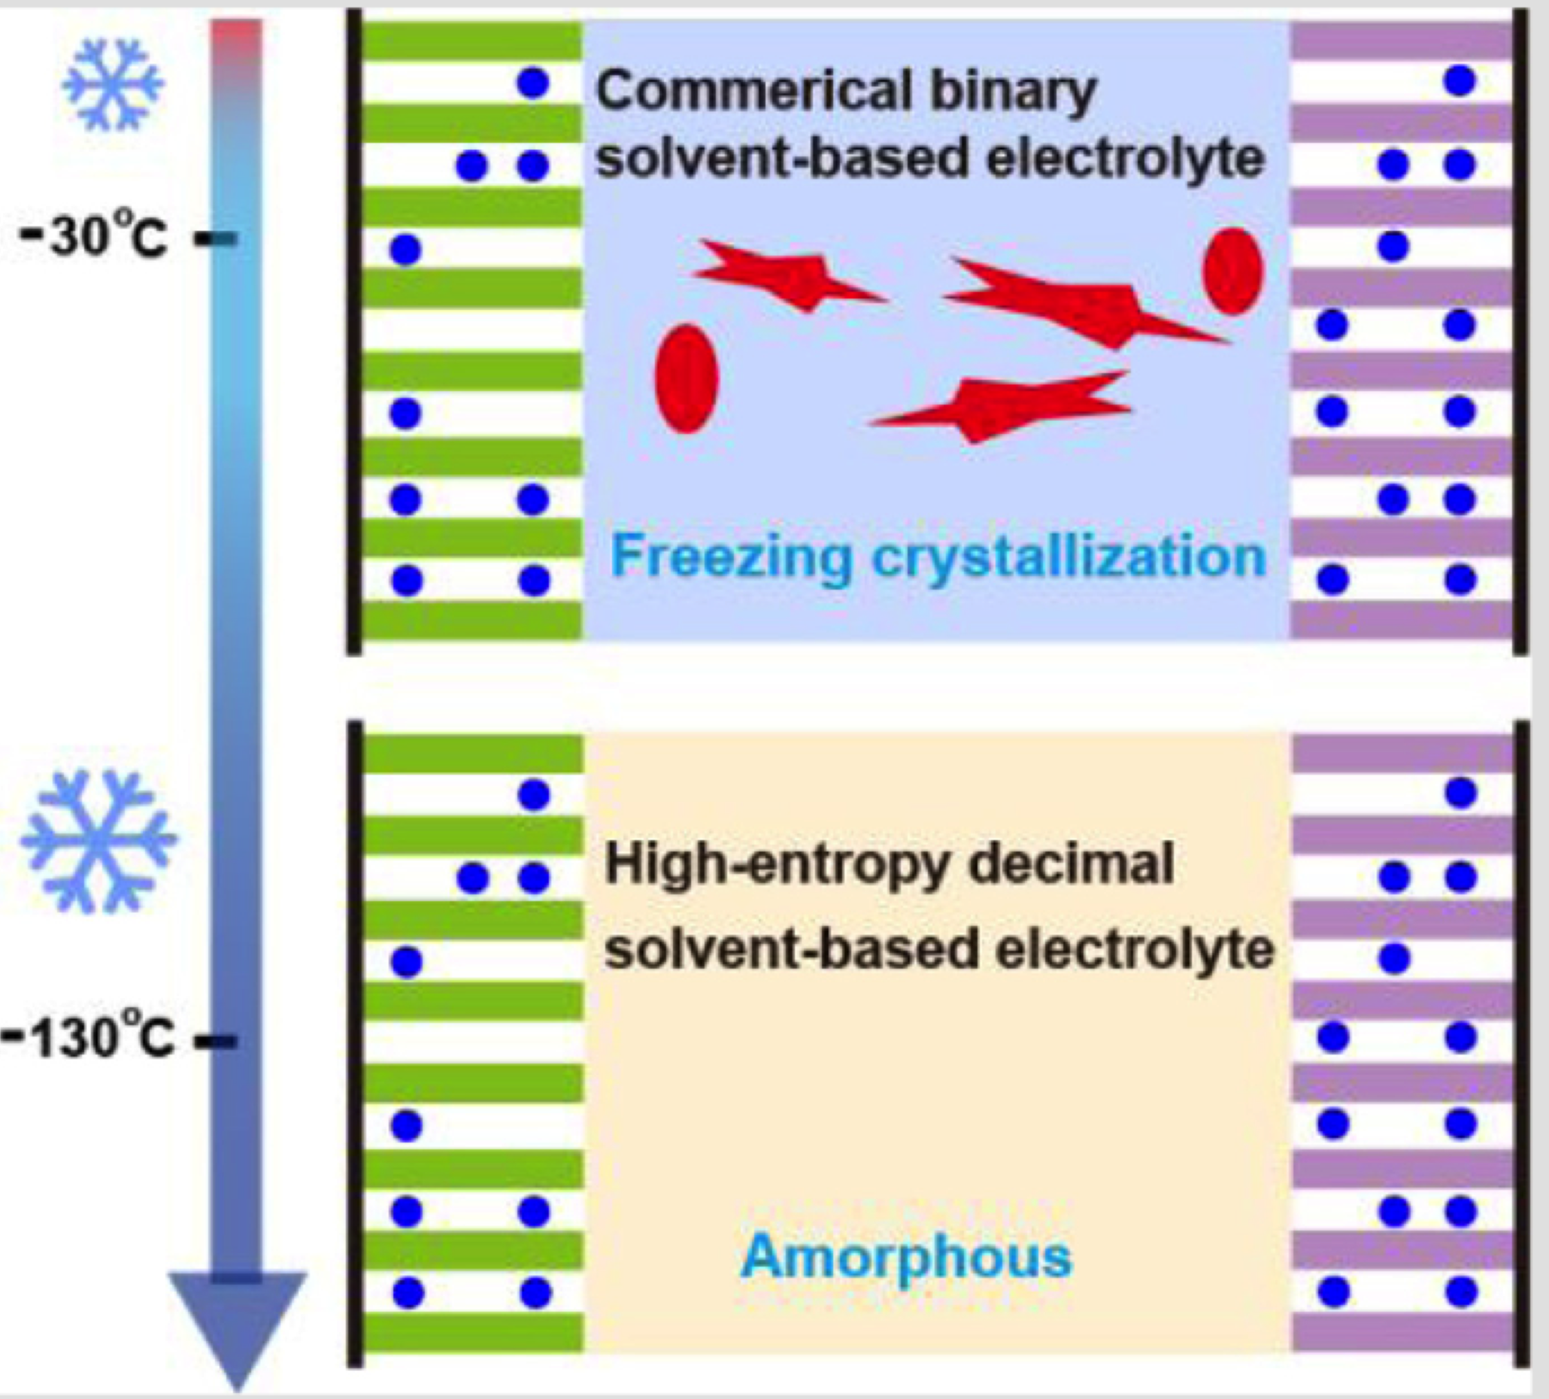
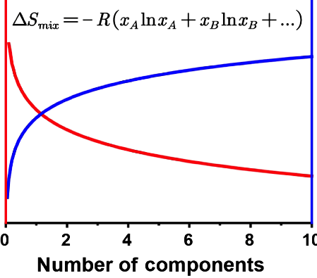
Lithium-ion batteries: high-entropy electrolyte
temperature
entropy of mixing
Zhang W, Xia H, Zhu Z, Lv Z, Cao S, Wei J, Luo Y, Xiao Y, Liu L, Chen X. CCS Chemistry. 3 (2021) 1245
open access article

Slide 54
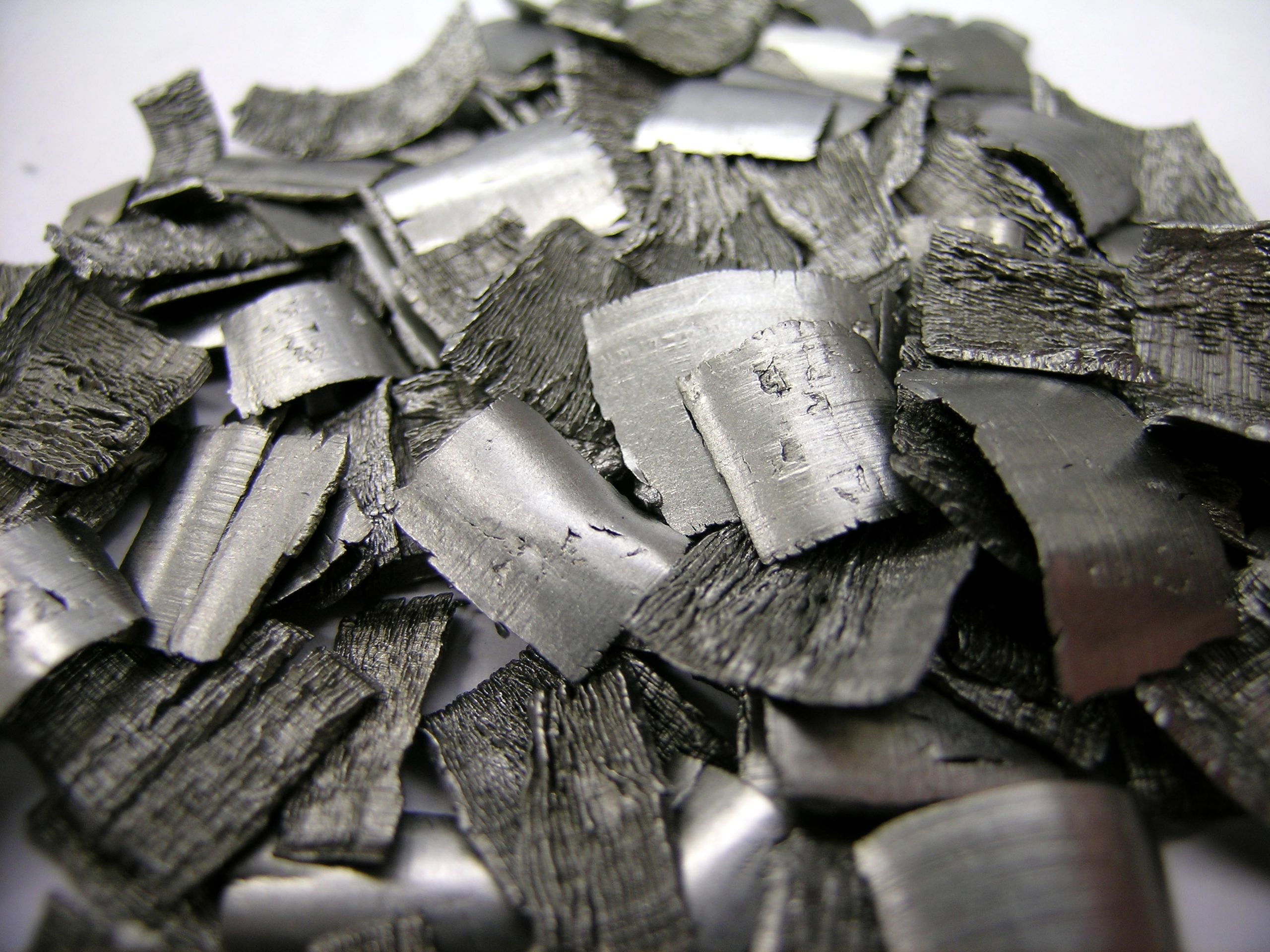
Nb-Ta-Hf-Ti-Zr single-phase bcc
cold-rolled, tensile test:
σ_{0.2} 1438 MPa, σ_{peak} 1495 MPa
ductility 5%
after recrystallisation at 1000°C
σ_{0.2} 1112 MPa, σ_{peak} 1170 MPa
ductility 12-19%
density of hafmium
13.07 g cm⁻³
O. N. Senkov, A. L. Pilchak and S. I. Semiatin: Metall. Mater. Trans. A 49 (2018) 2876
Image reproduced under CC BY-SA 3.0 license, Deglr6328 Wikipedia
https://creativecommons.org/licenses/by-sa/3.0/

Slide 55


Slide 56
