Slide 1



Machine learning - steels
“artificial intelligence”?
Episodic memory
Planning the future
is everything calculable?
ISIJ International 39 (1999) 966

Slide 2
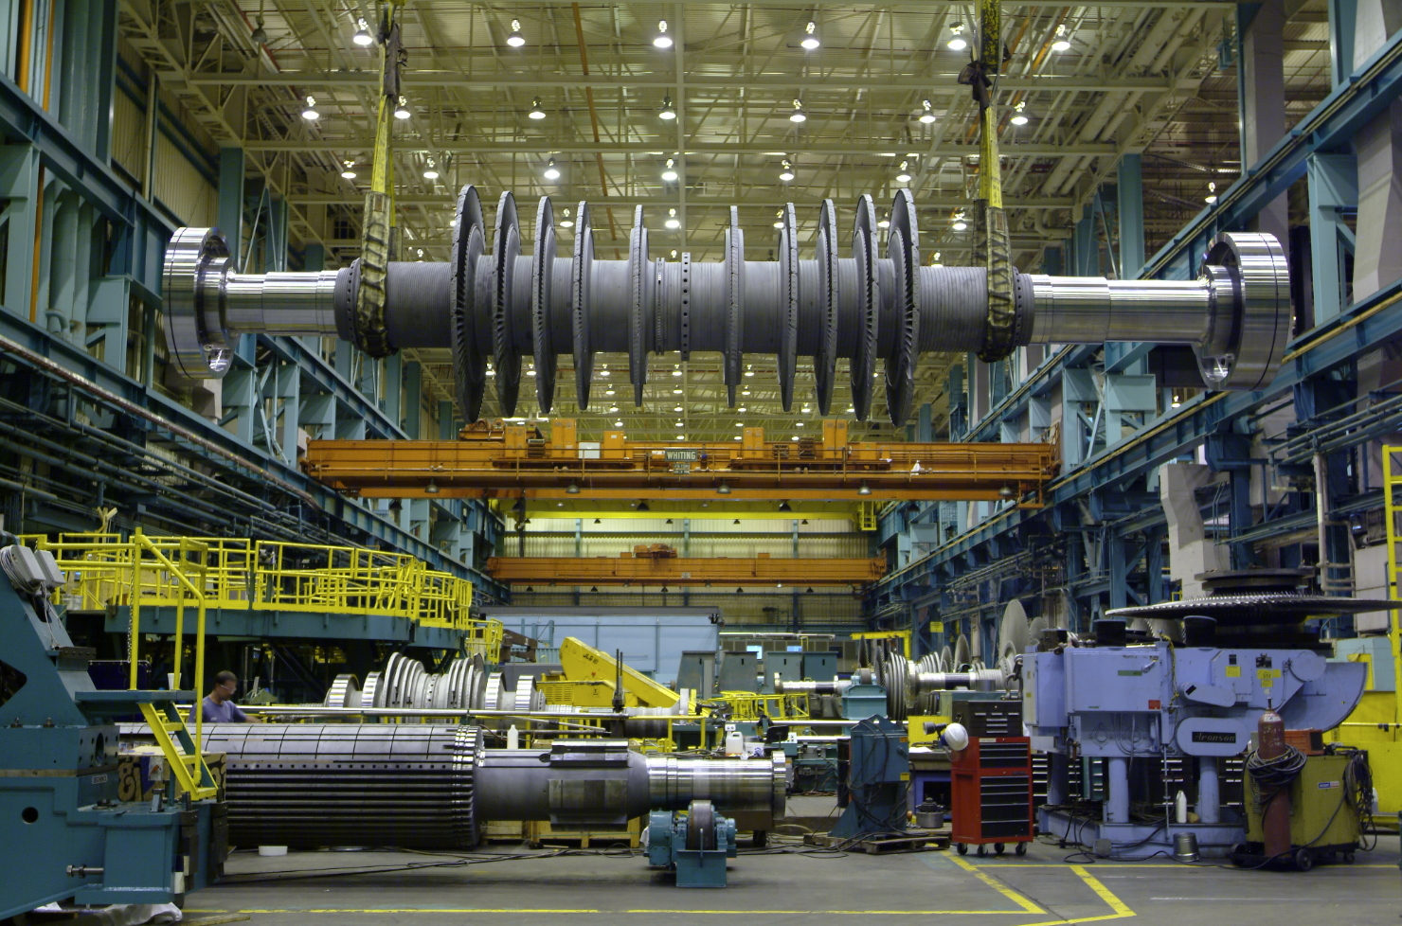
The need for empirical learning
600°C steam
40 year service
100 MPa stress
oxidation resistance
consistency
mass production
weldability
sequence of heat treatments
C, Mn, Si, Ni, Cr, Mo, V, W, ....

Slide 3
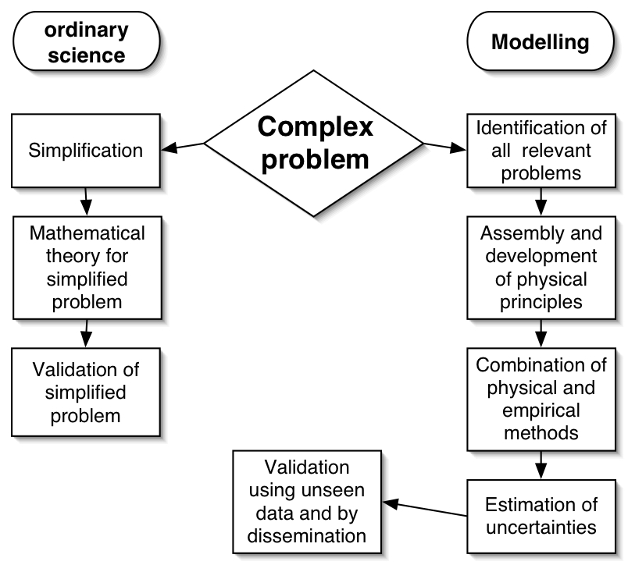

Slide 4
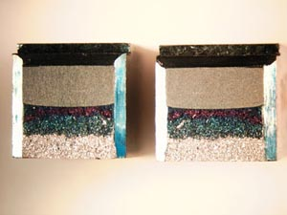
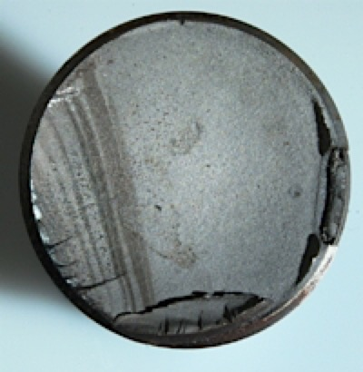
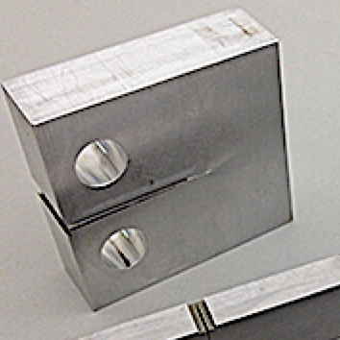
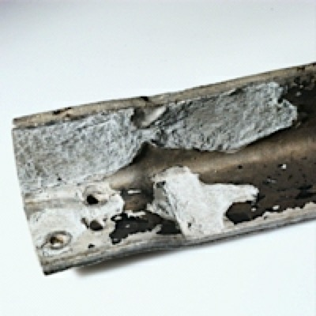
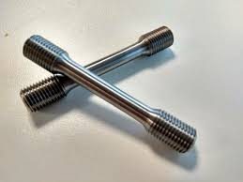
Charpy
fatigue
critical stress intensity
corrosion
tensile

Slide 5

electron theory
molecular dynamics
thermodynamics
irreversible thermodynamics
kinetics
finite elements
structure-properties
uncertainties

Slide 6

y
x
Michael McIntyre

Slide 7
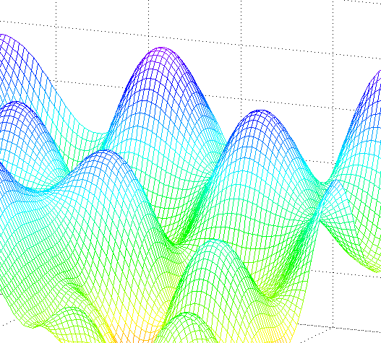
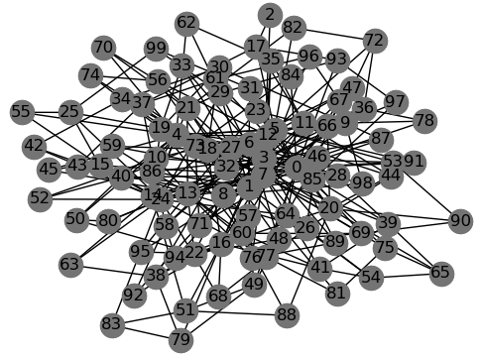


Solution
non-linear functions
Many, many variables
uncertainties
large knowledge base
Notes:
Dogma - statement of belief

Slide 8
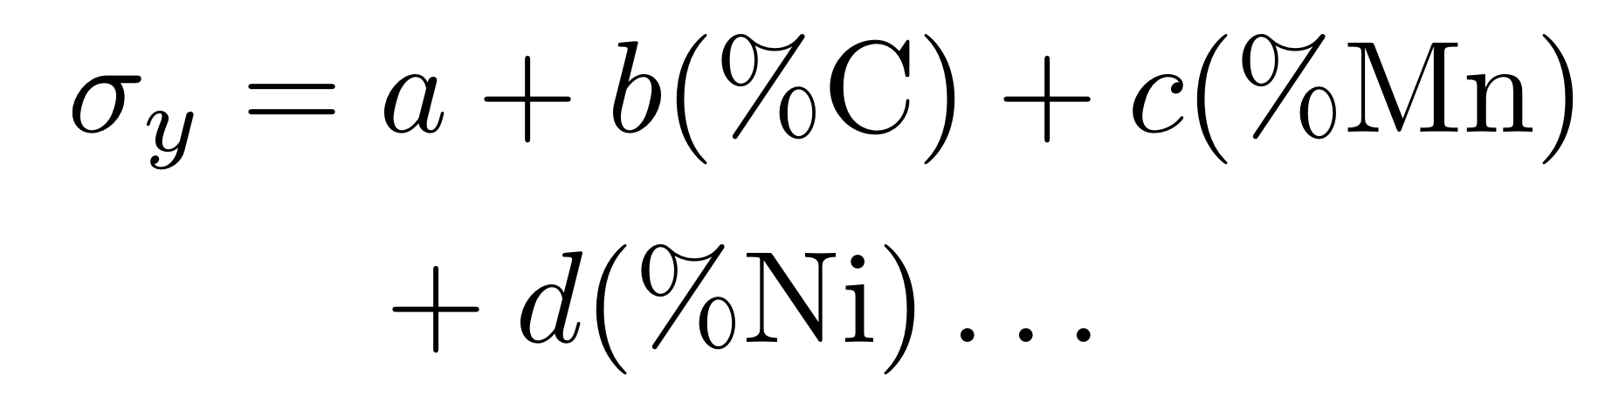
Empirical Equations

Slide 9
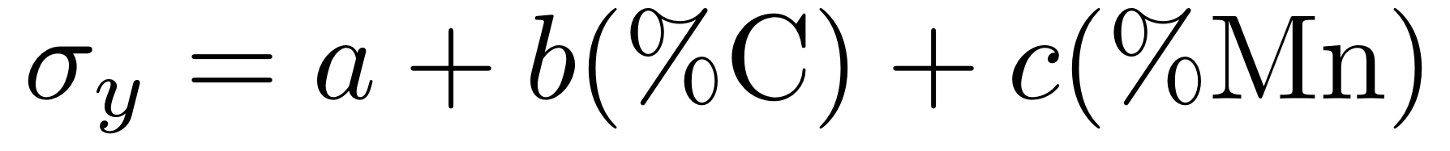
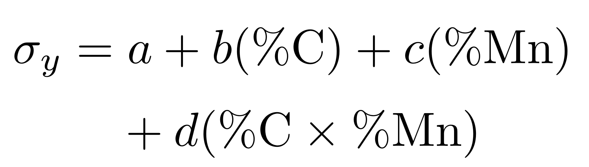

Slide 10
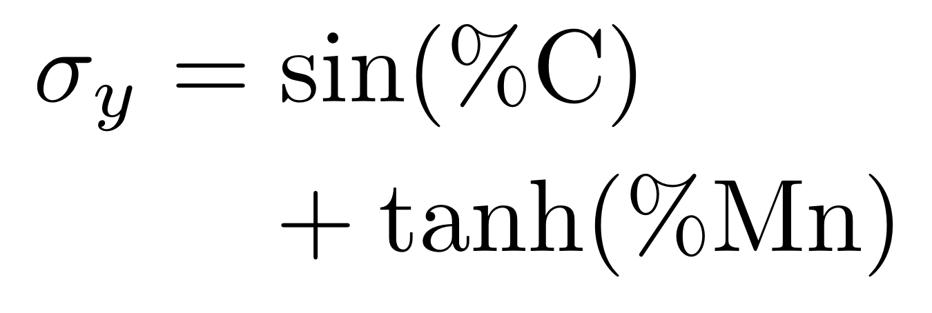

Slide 11
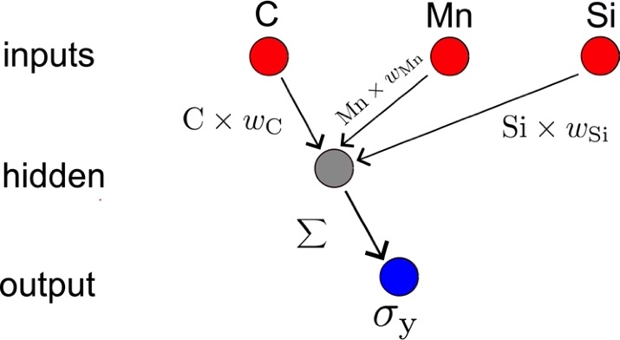

Slide 12
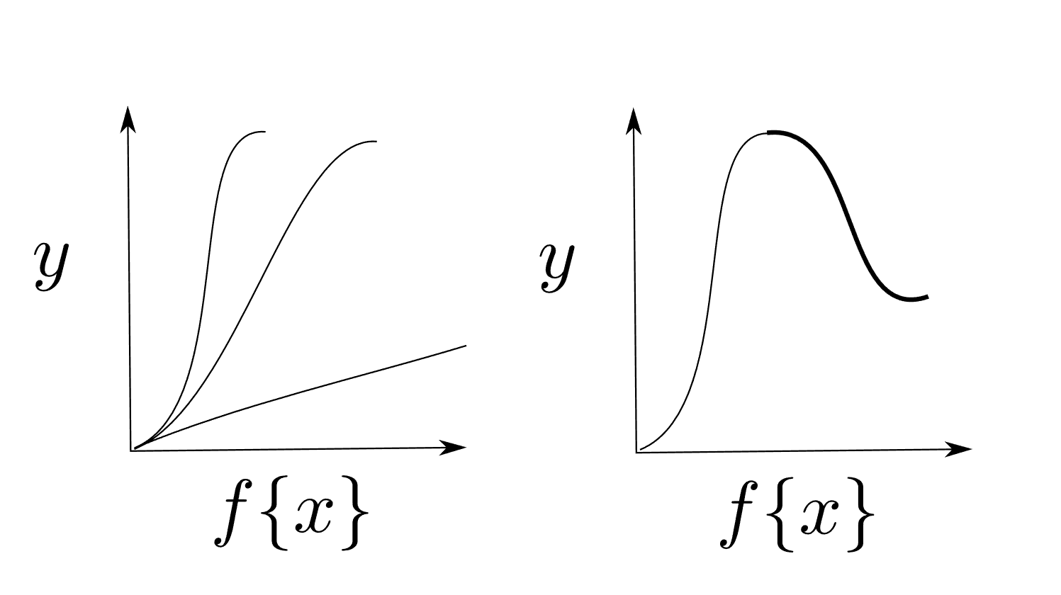
Hyperbolic Tangents

Slide 13
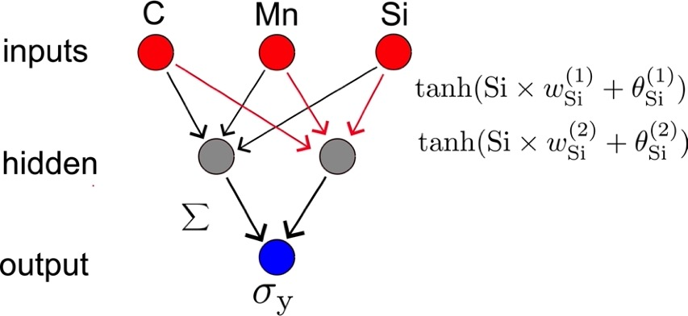

Slide 14
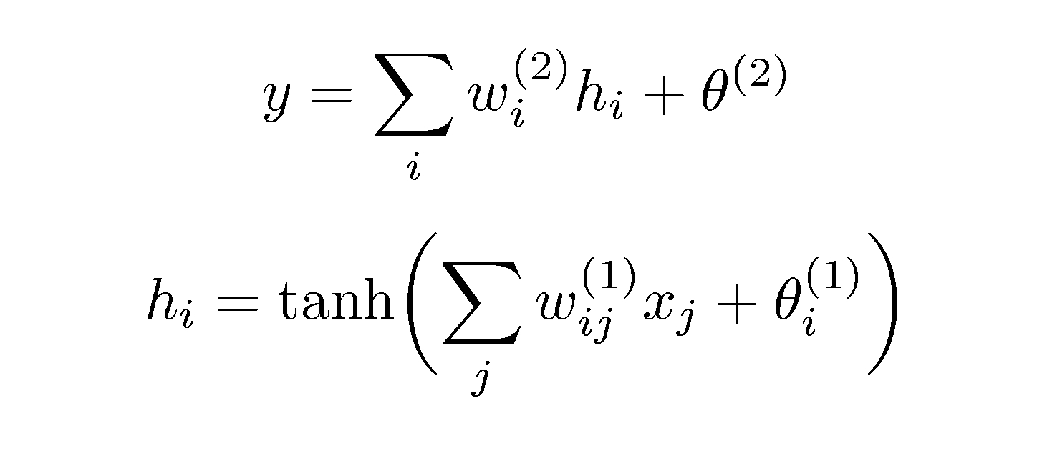
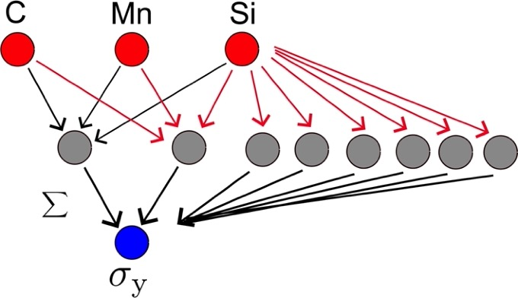

Slide 15
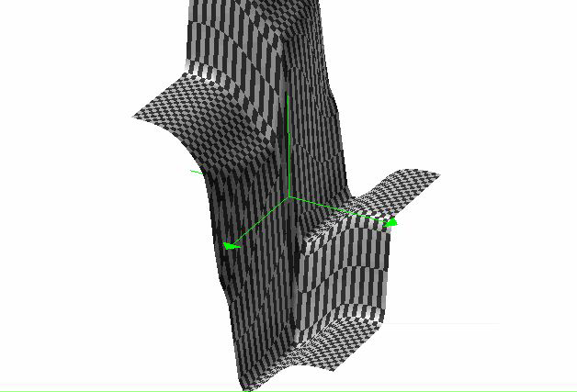
non-linear
functions

Slide 16
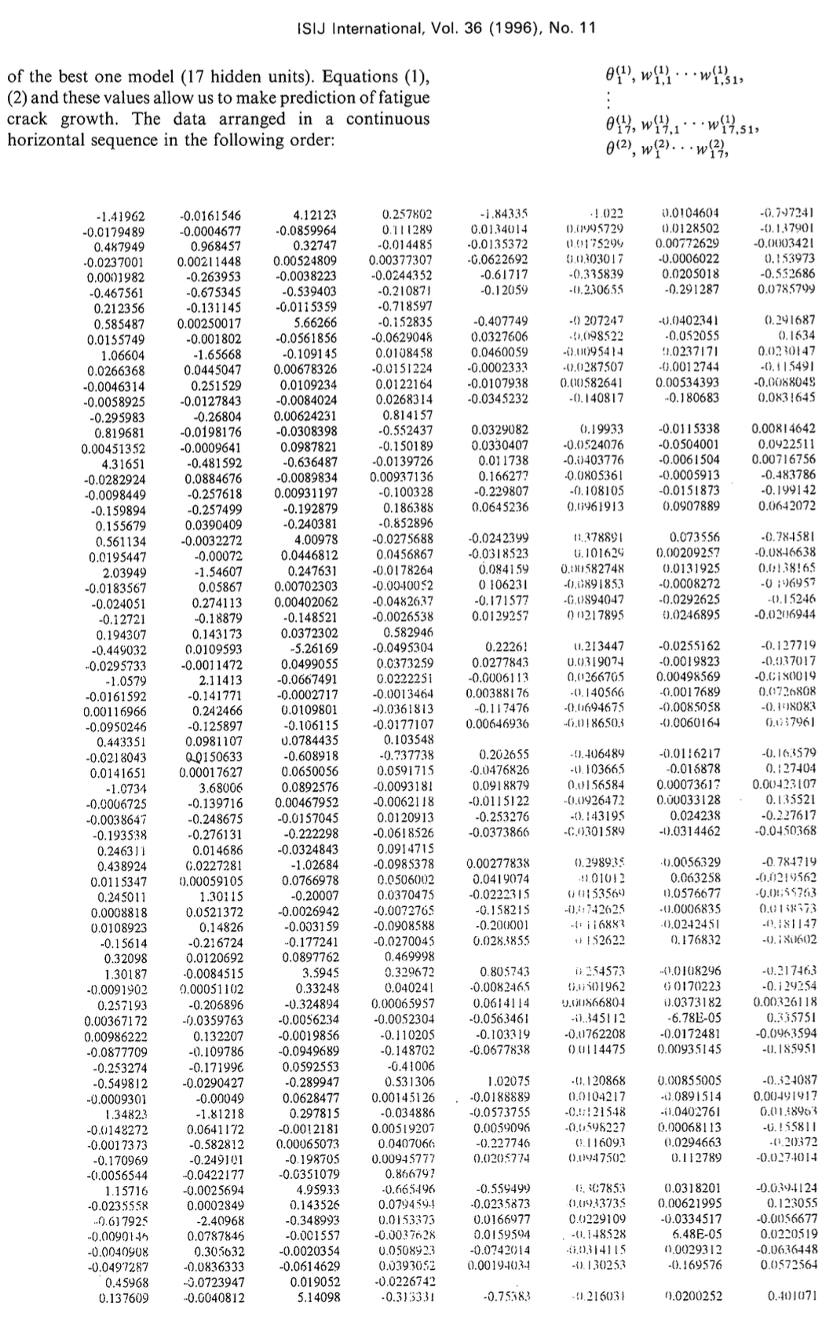
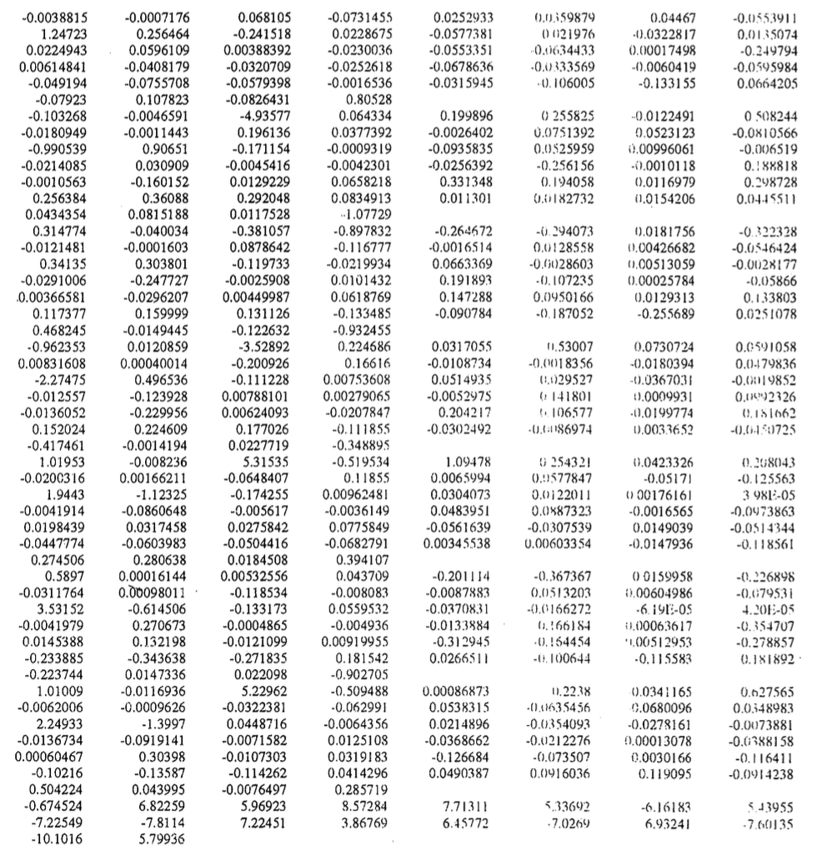
51 inputs
17 hidden units
Fujii, Mackay, Bhadeshia. Fatigue crack growth. ISIJ International. 36 (1996) 1373

Slide 19
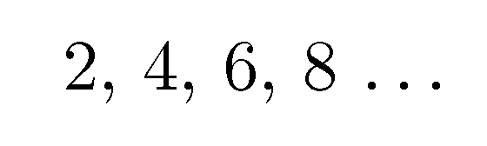
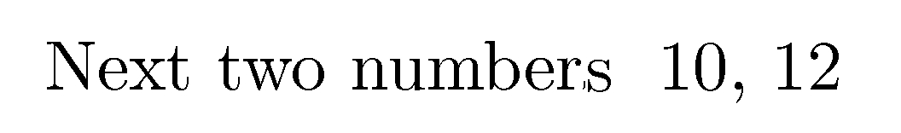

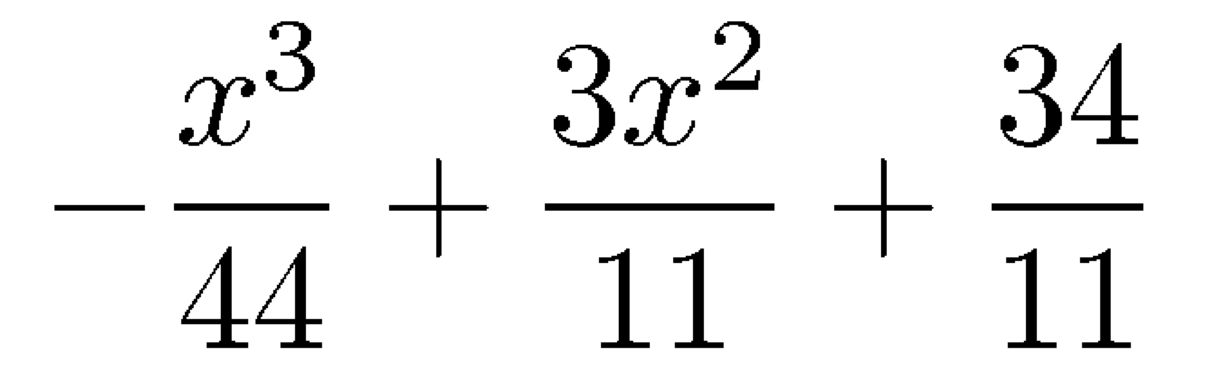

Slide 20
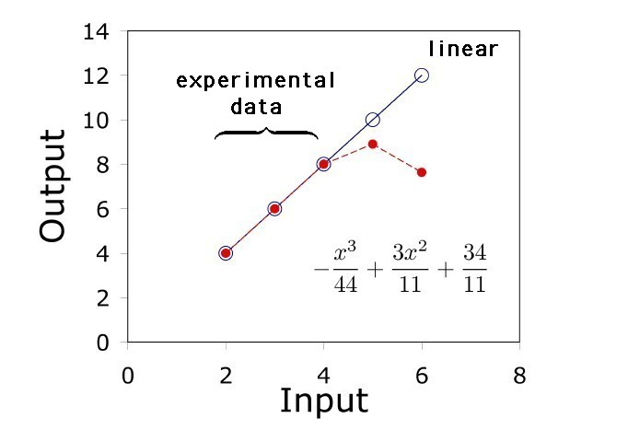

Slide 21
y
A
B
x

Slide 22
ultrasupercritical
>700°C

Slide 23
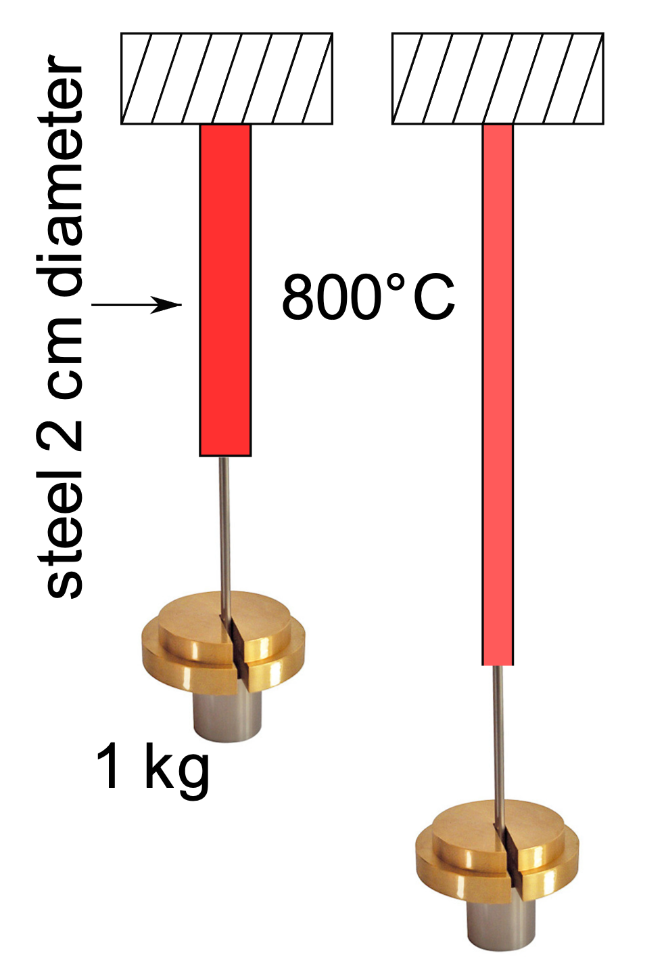
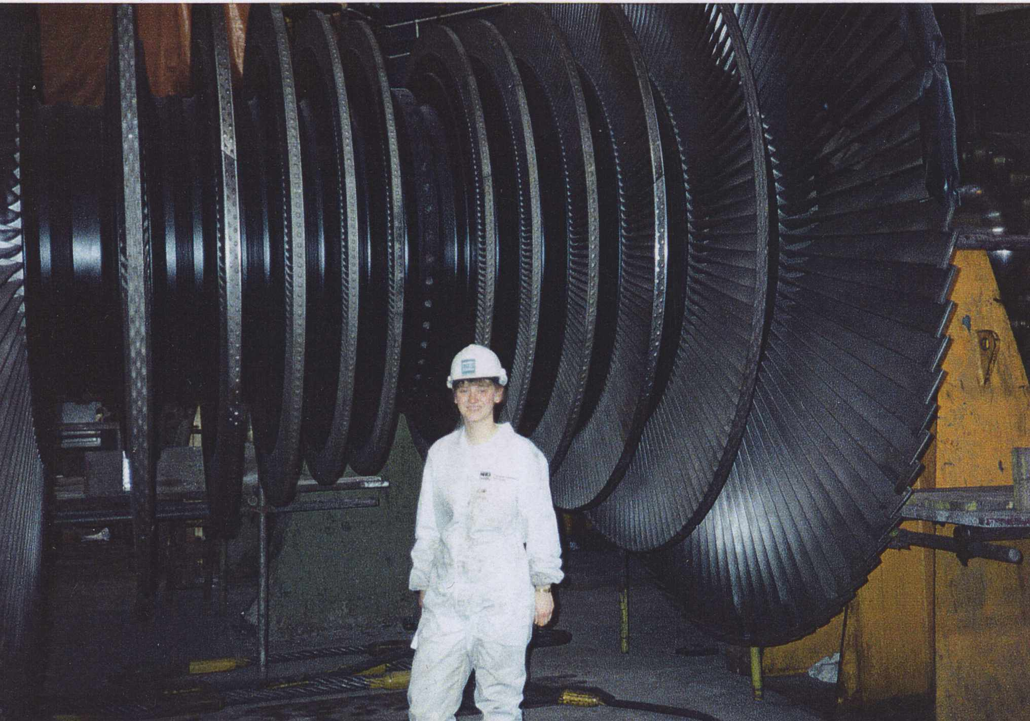
Creep

Slide 24
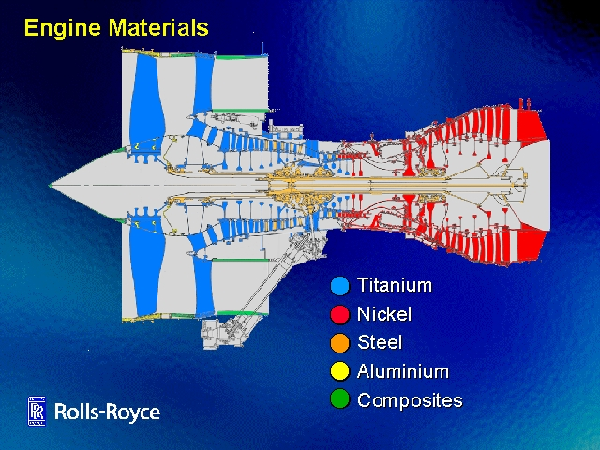
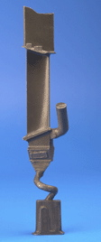
Suppose we fail to achieve 650°C ferritic creep-resistant steel

Slide 25
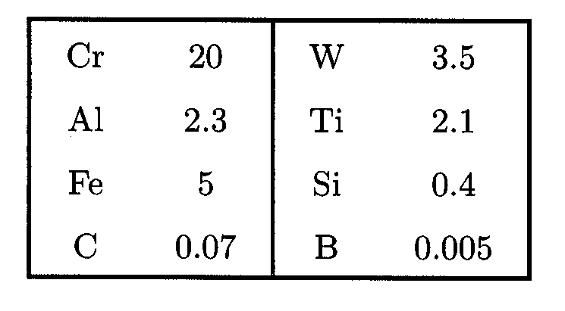
Nickel base alloy FT750dc
wt%

Slide 26
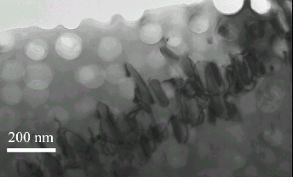

Slide 27
Tancret & Bhadeshia, 2002
1000
800
600
Yield stress / MPa
400
200
0
0
200
400
600
800
1000
1200
Temperature / °C

Slide 28
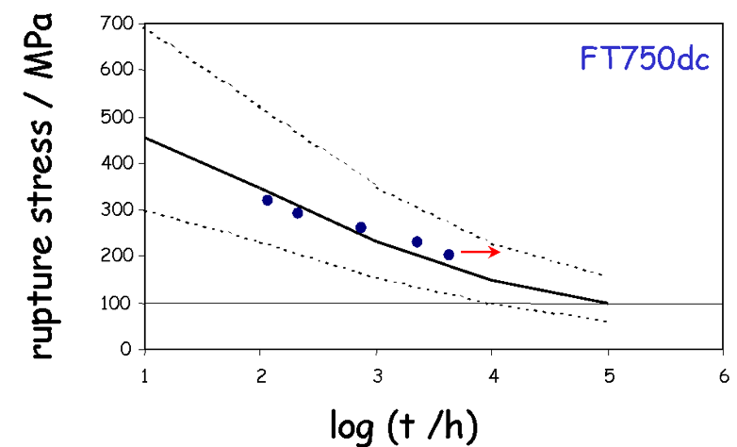

Slide 29
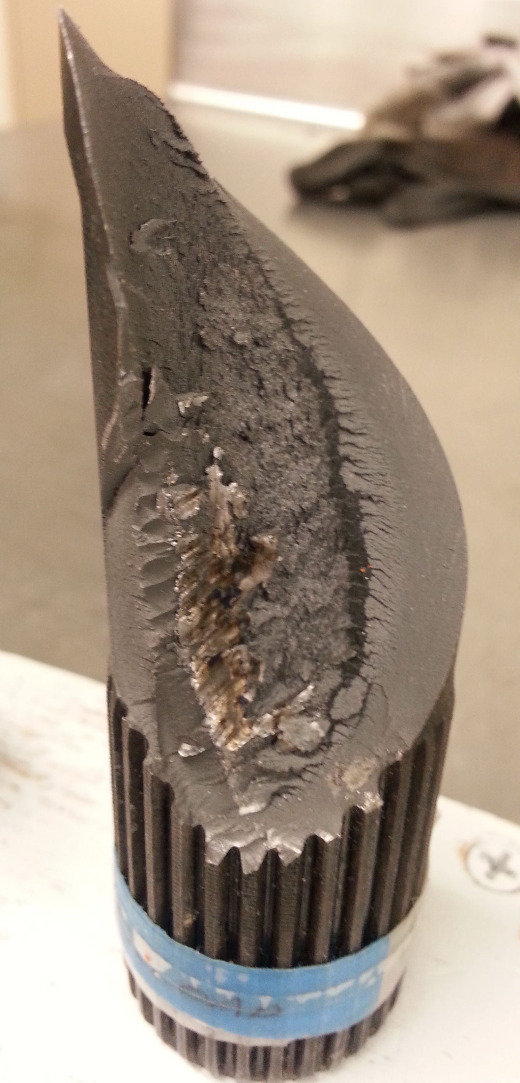
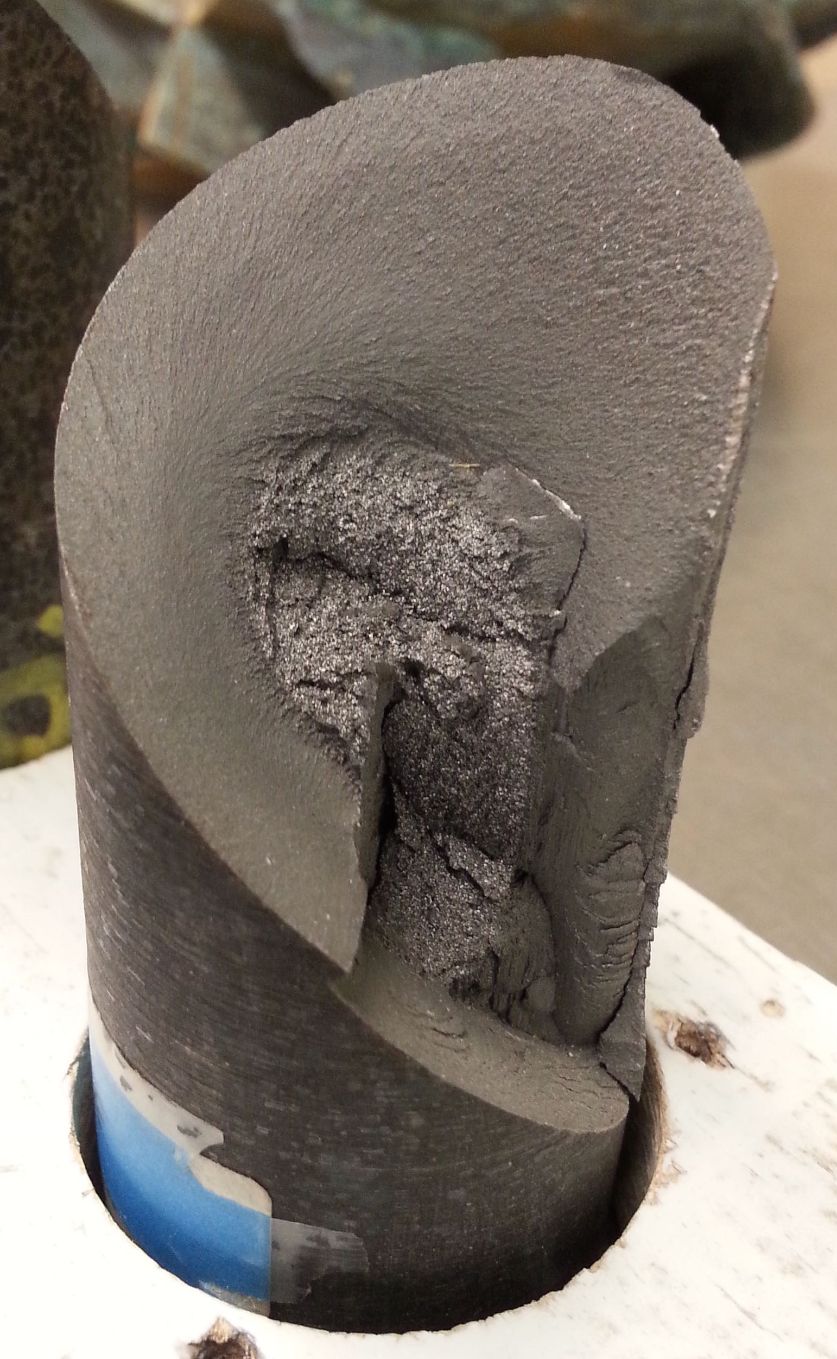
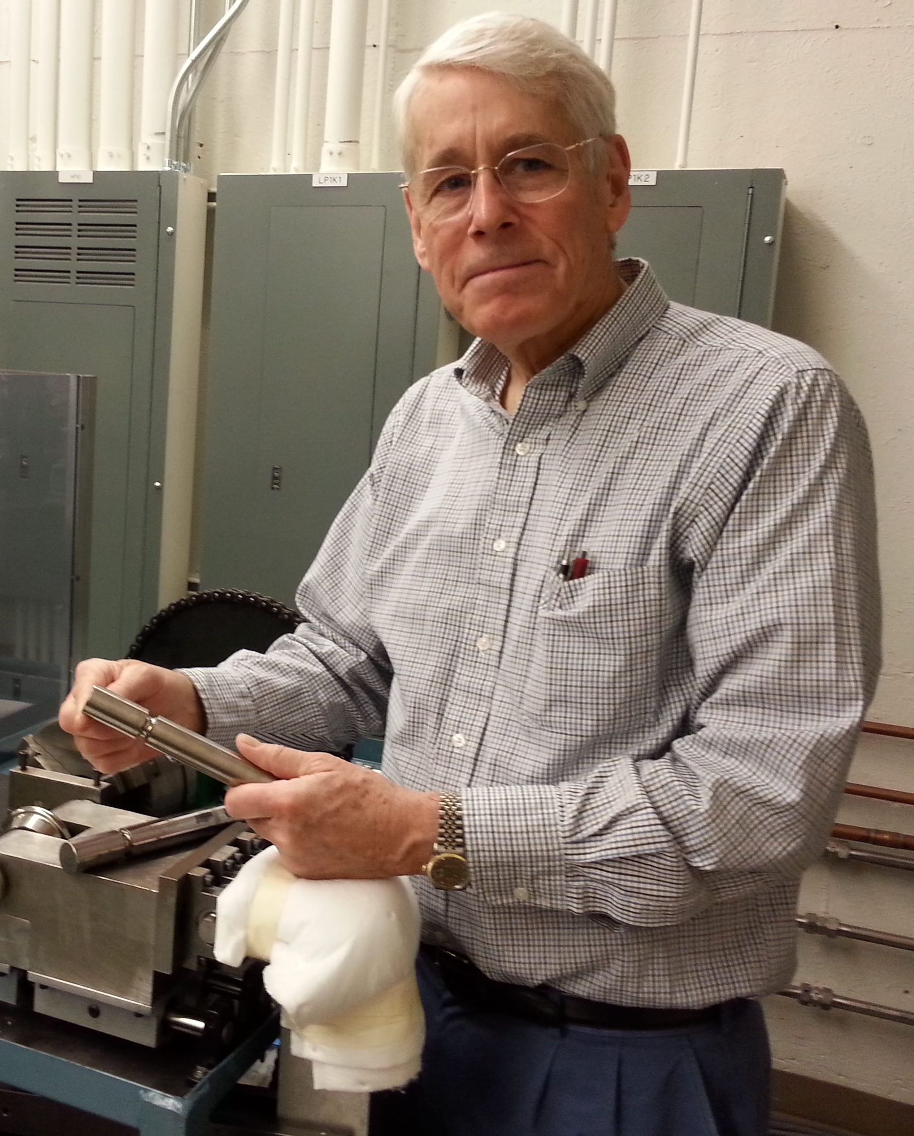
Fatigue

Slide 30
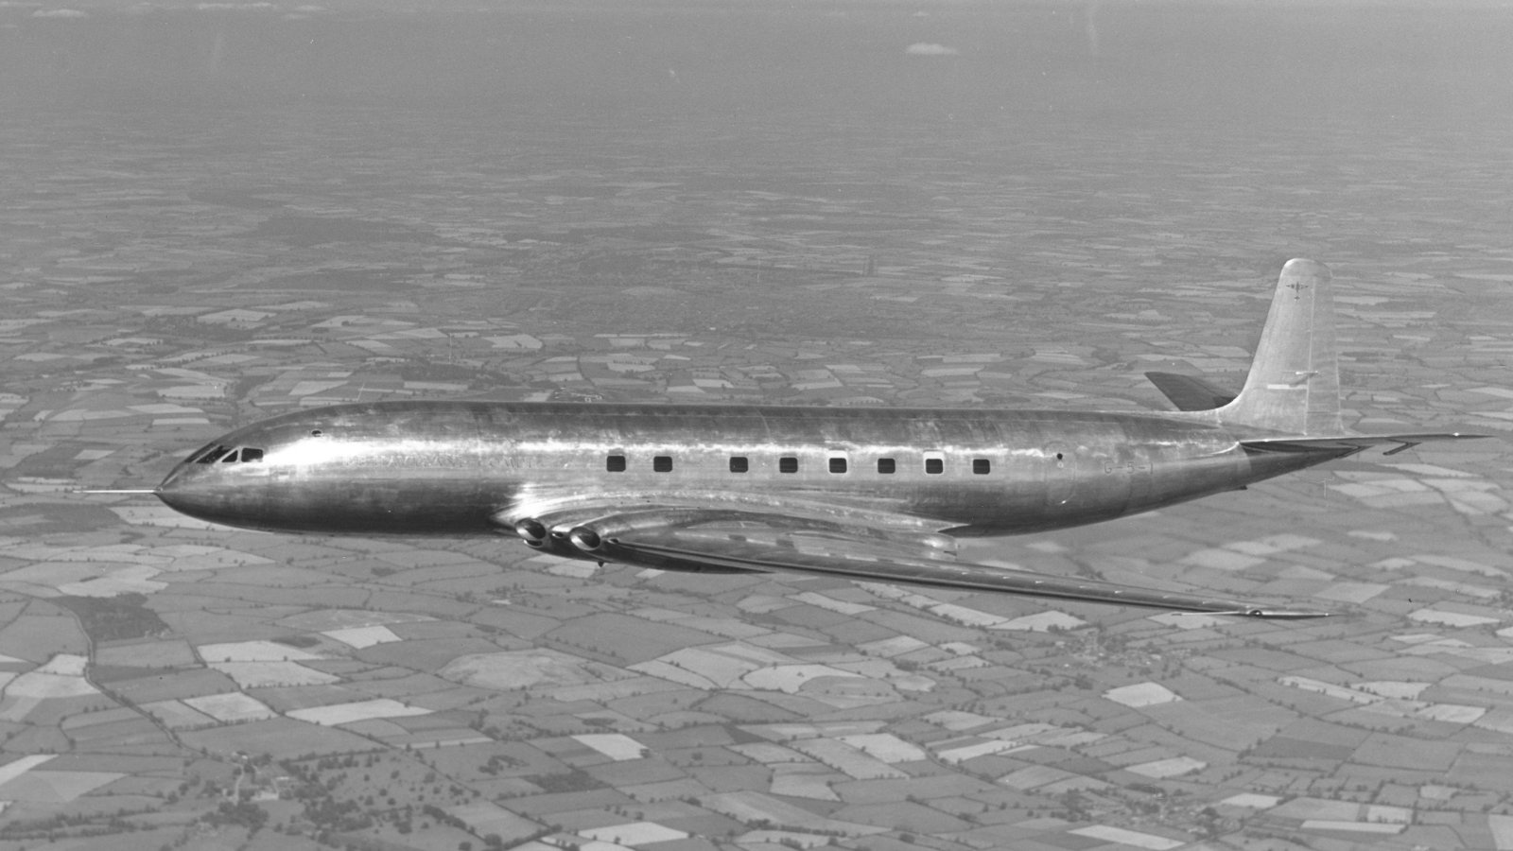
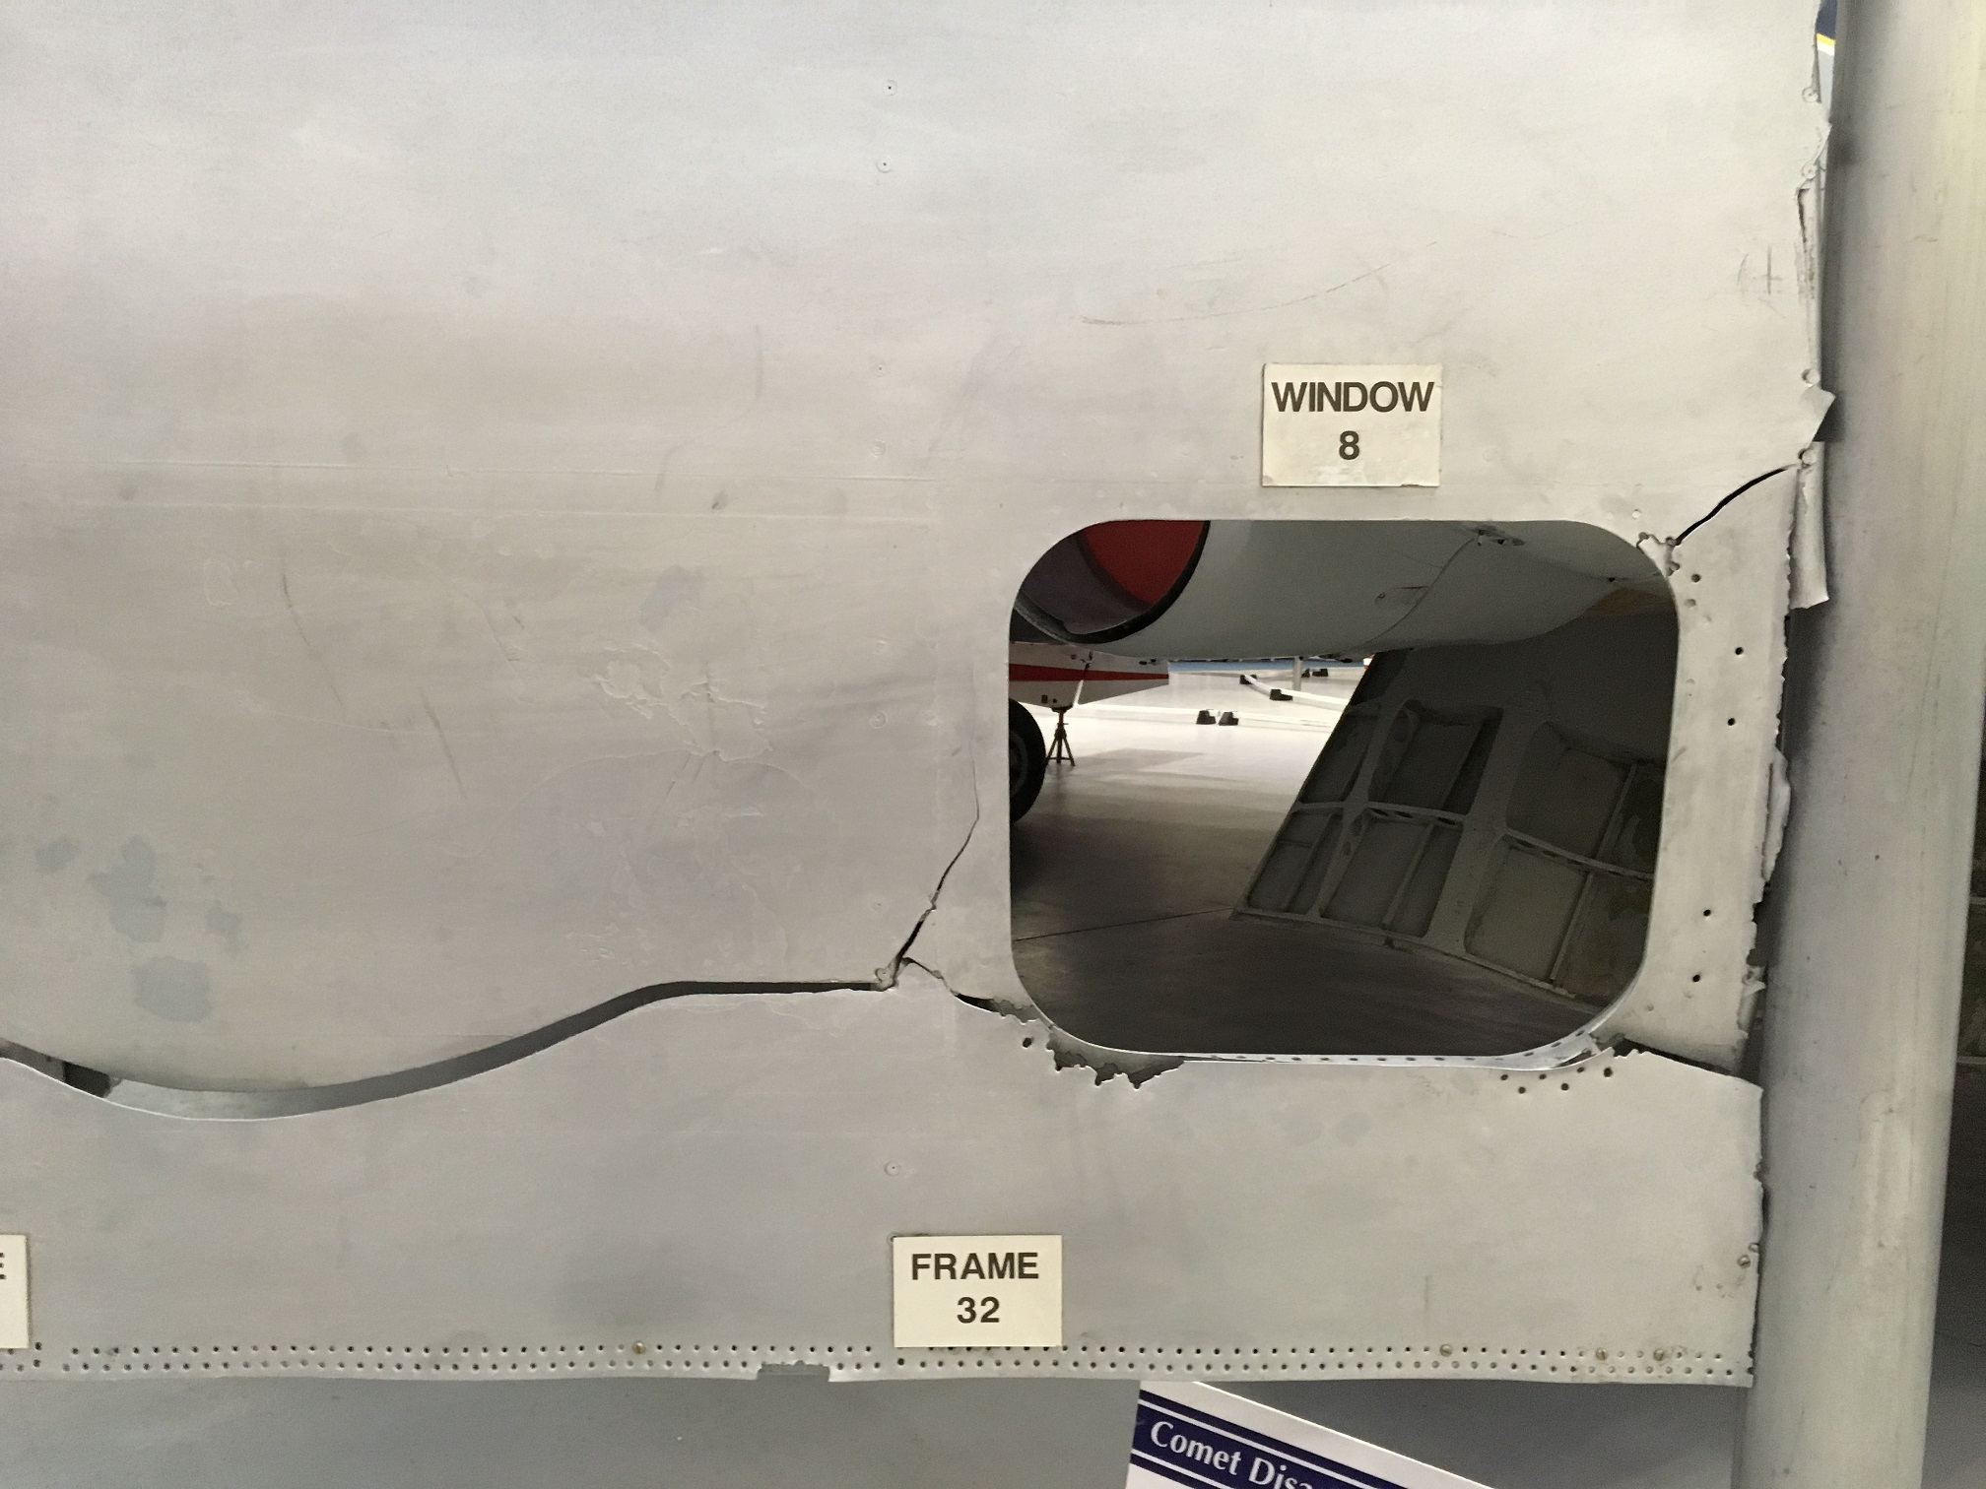

Slide 31
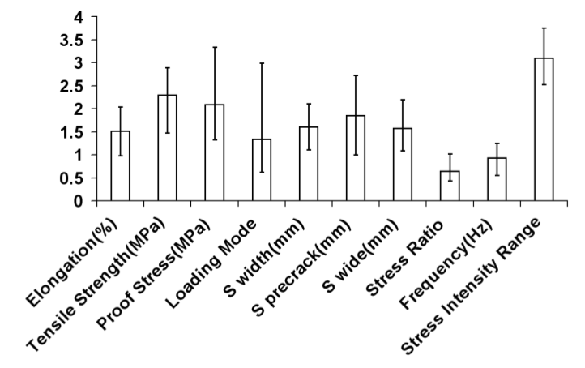
Generic fatigue model

Slide 32
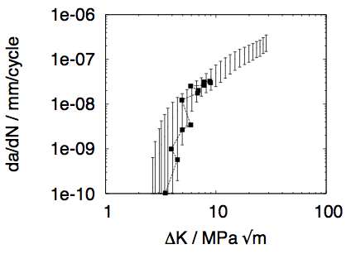
Steel

Slide 33
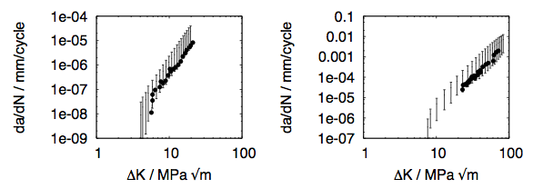
Nickel Alloys

Slide 34
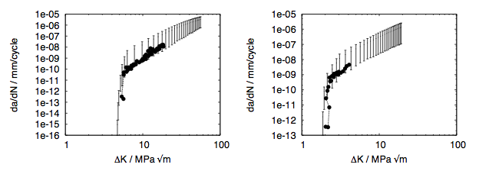
Titanium and Aluminium alloys

Slide 35
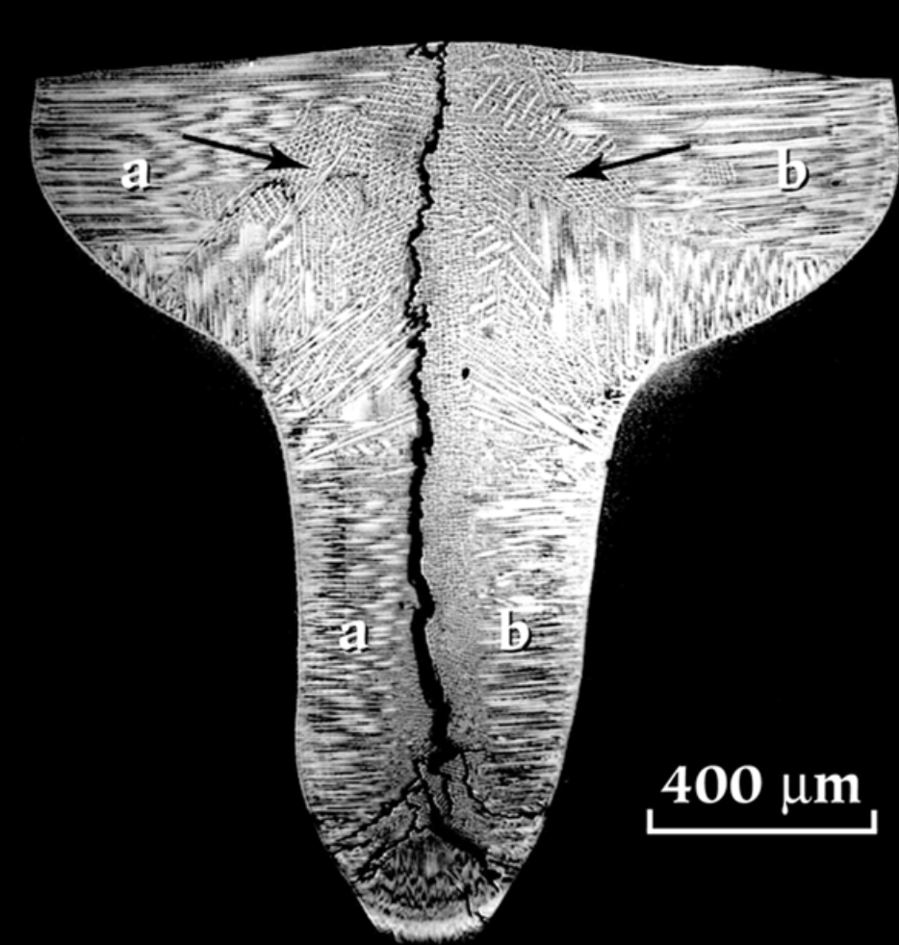
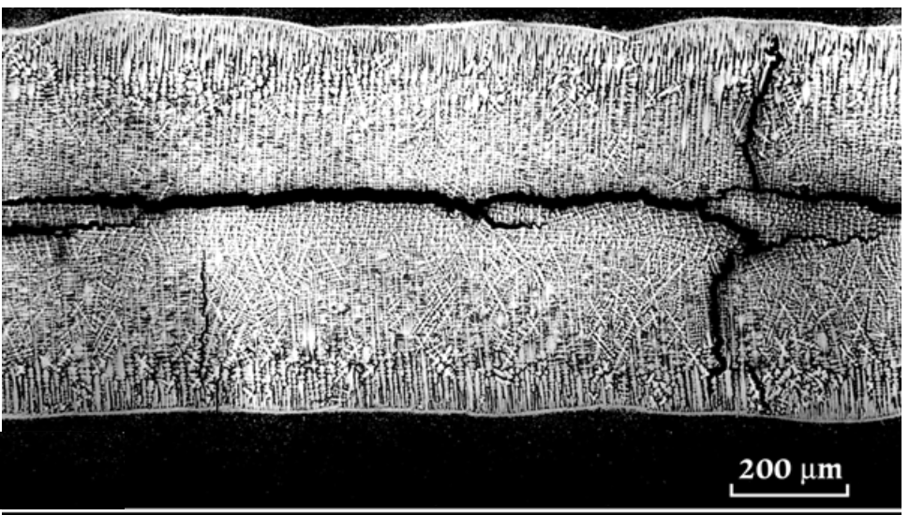
Solidification cracking
Babu, David, Park, Vitek

Slide 36
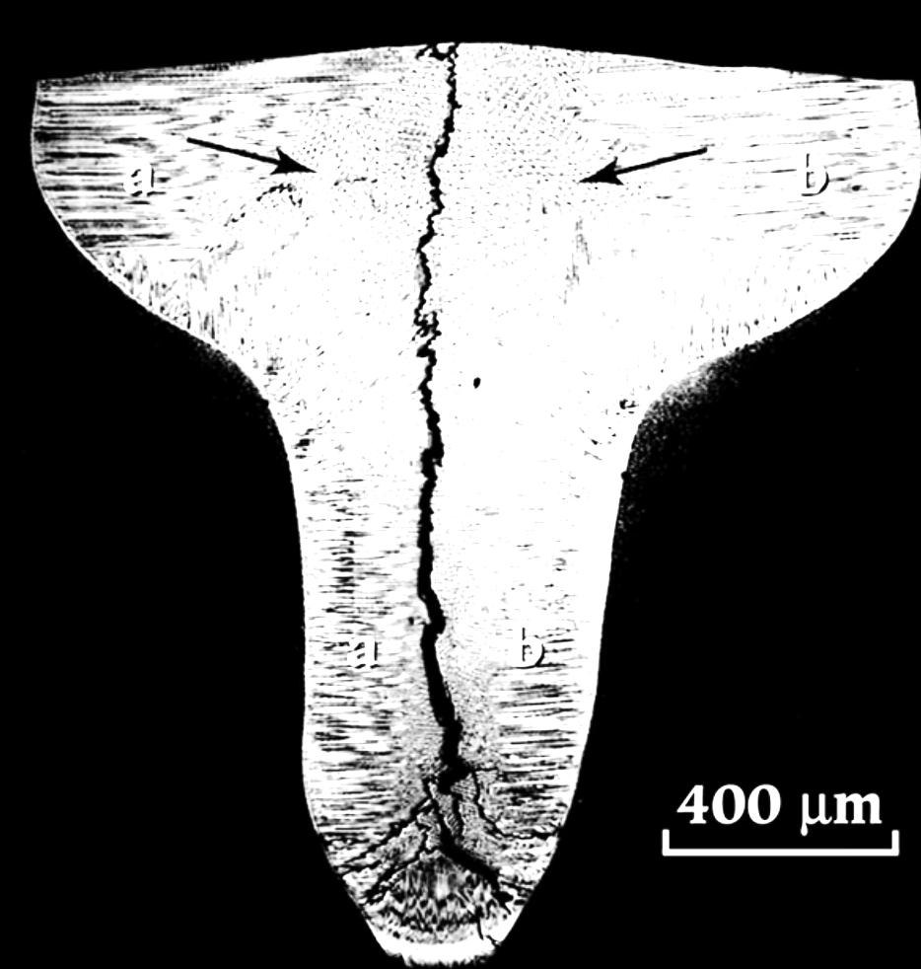
Cracked = 1
Not cracked = 0
uncertainty?
value of 0.5 is the greatest
uncertainty in the output
Ichikawa, Bhadeshia, MacKay
Model for solidification cracking in low alloy steel weld metals
Science and Technology of Welding and Joining 1 (1996) 43-50.

Slide 37
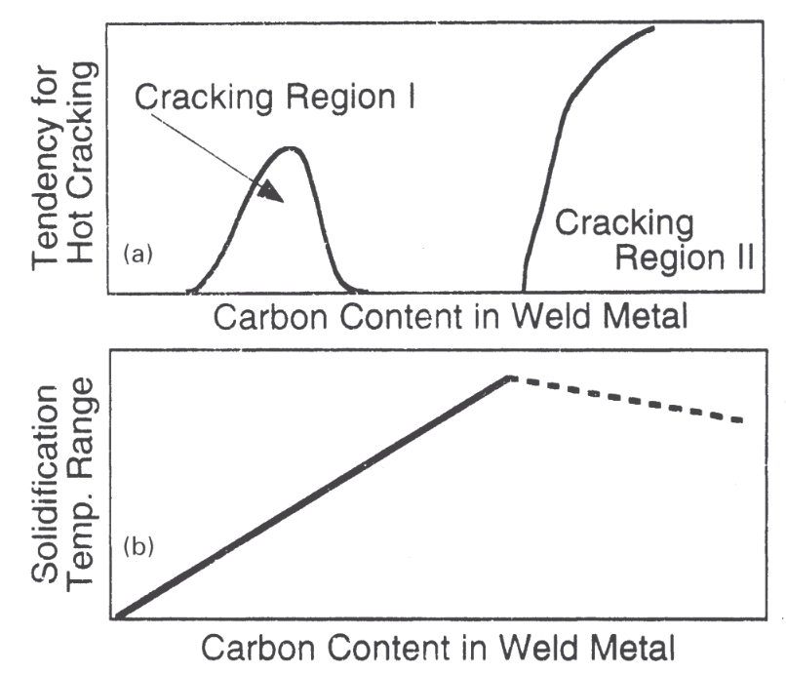
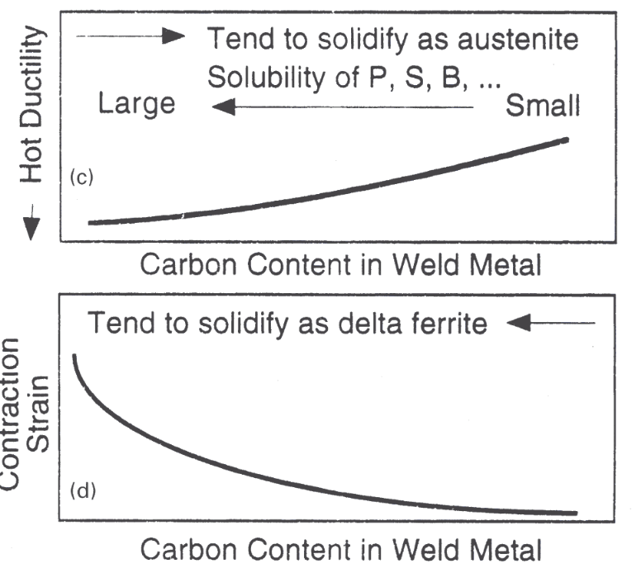

Slide 38
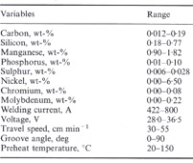

Slide 39
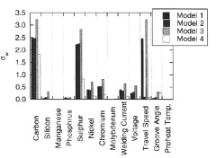

Slide 40
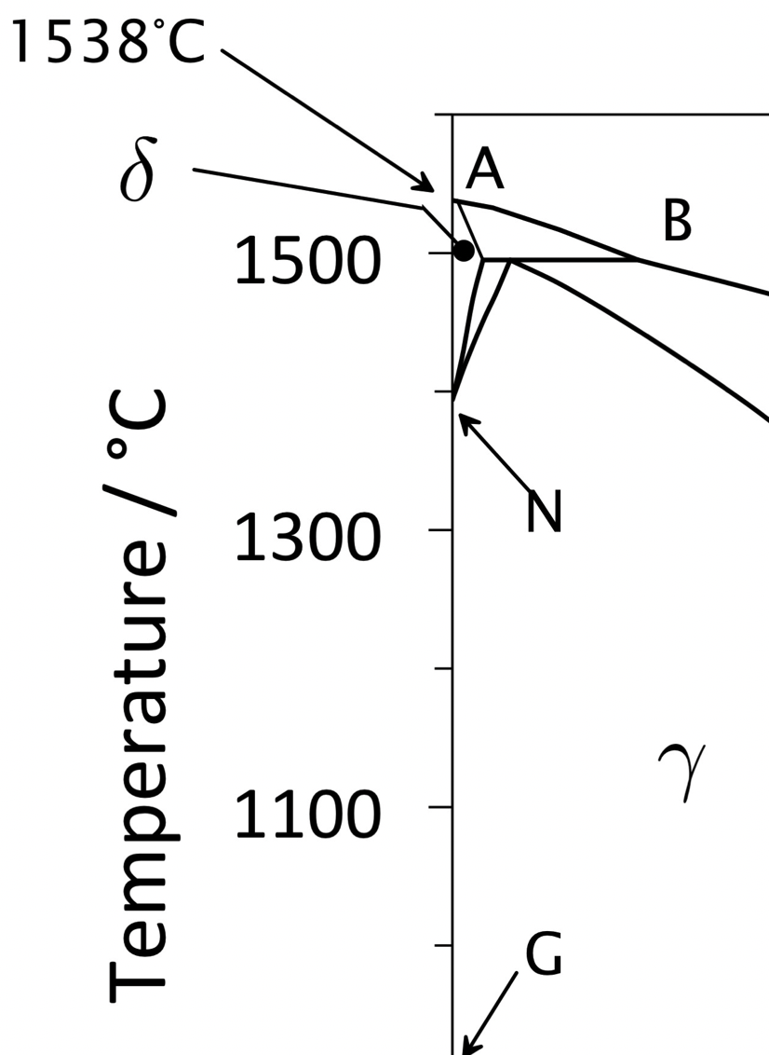
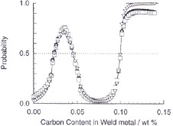
decreasing
density change
increasing
solidification range
solidification as
as austenite

Slide 41


Slide 42


Slide 43


Slide 44
Large number of variables
C, Mn, Si, Ni, Cr, Mo, V, Co, B, N, O…..
Thermomechanical processing of steel
Welding consumable
Welding parameters
Subsequent heat treatment
temperature
duration
number of cycles
deformation
strain
anisotropy
protection
structural changes

Slide 45





Slide 46



Cool & Bhadeshia, 1996

Slide 47


Slide 48




welded
600°C
650°C
700°C

Slide 49

new welding
consumables

Slide 50
Cole & Bhadeshia, 1999

Slide 51
GTA weld at 823 K (data from Nippon Steel)
600
500
400
300
200
100
0
20000
30000
40000
Life / hours
Cole & Bhadeshia, 1999

Slide 52

Cole & Bhadeshia, 1999

Slide 53


Slide 54




Slide 55


Pous, Lonardeli, Cogswell, Bhadeshia
Mat. Sci. Eng. A 567 (2013) 72

Slide 56


Slide 57

International Fusion Reactor
Reduced activation steels:
design of experiments

Slide 58
Modelling irradiation hardening
No strongly predictive model
Data by Yamamoto et al. and European RAFM database
~1800 data up to 90 dpa
  36 input variables
  No heat treatment information included

Slide 59

Fusion reactor steels
Kemp, Cottrell & Bhadeshia, 2006

Slide 60


Slide 61
Breast cancer: probability of relapse
tumor size
number of axillary lymph nodes
age
receptors (proteins activated by pro/estrogen)
DNA ploidy
S phase fraction
Ravdin, Clark
Breast Cancer Research & Treatment 22 (1992) 285
Notes:
lymph nodes in underarm, responsible for draining lymph from breasts; DNA ploidy – DNA content per nucleus

Slide 62

Breast cancer: probability of relapse
tumor size
age
estrogen receptor
Ravdin, Clark
Breast Cancer Research & Treatment 22 (1992) 285
Notes:
lymph nodes in underarm, responsible for draining lymph from breasts; DNA ploidy – DNA content per nucleus 1.58 million papers

