Slide 1
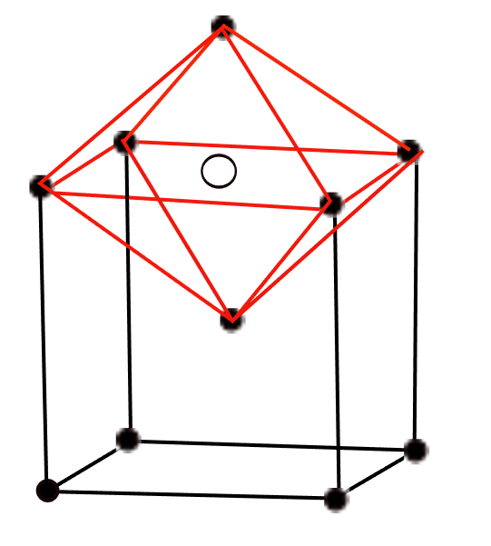
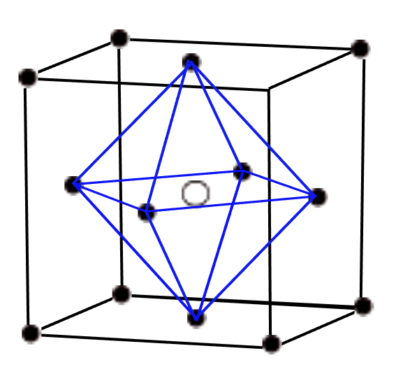



Commercially viable strong steel with γ-grain size < 0.4 µm
www.phase-trans.msm.cam.ac.uk

Slide 2
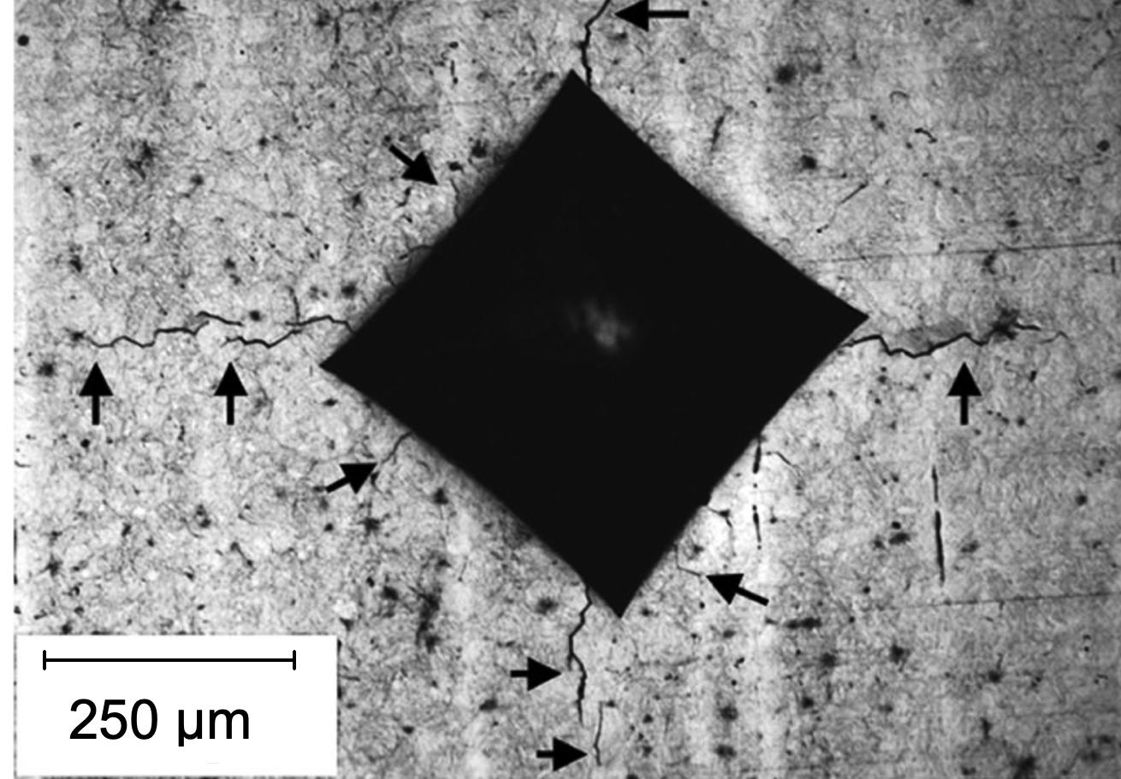
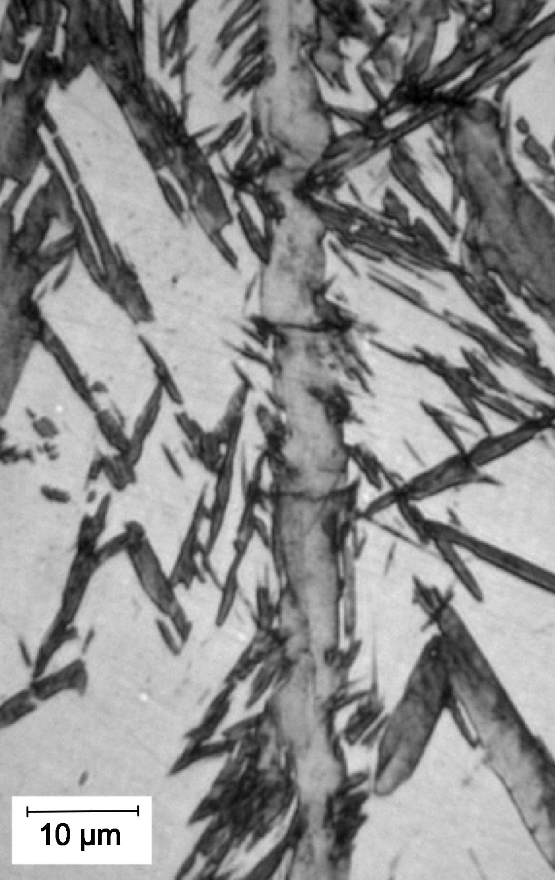
1C 1.5Cr wt%
Solano, Bhadeshia

Slide 3
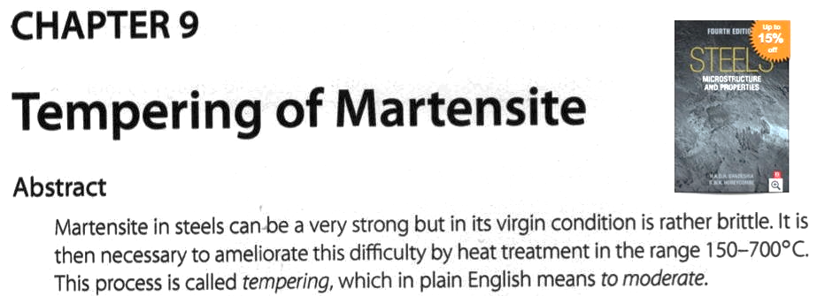

Slide 4
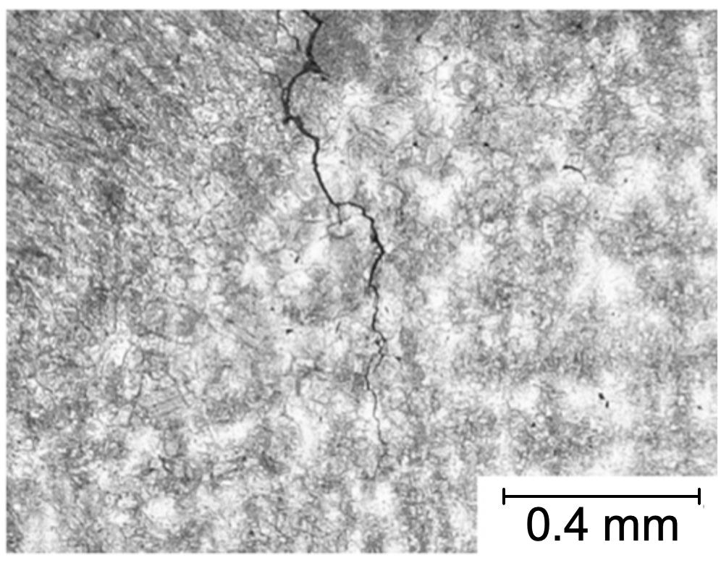
Cannot easily be welded
Fang, Yang, Liu, Song, Fang, Bhadeshia
0.76 C wt% +

Slide 5
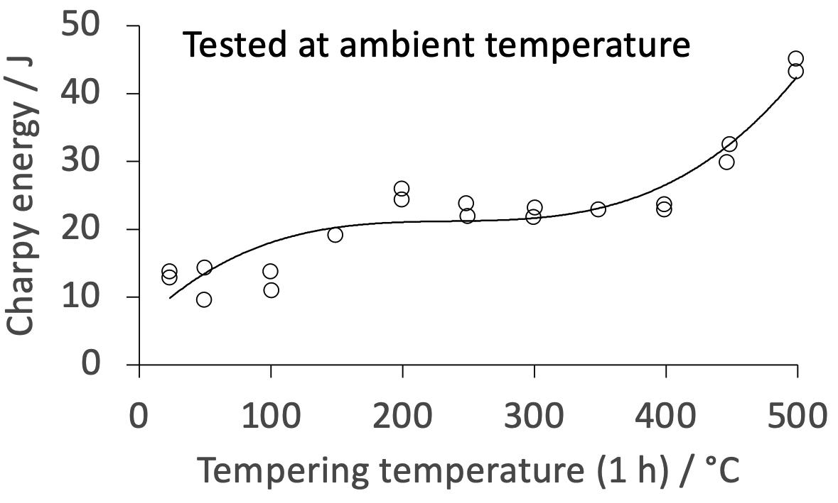
after tempering 200°C, < 3 J at -40°C
adapted from Materkowski, Krauss
Metall. Trans. A 10 (1979) 1643,
Kula, Anctil
Watertown Arsenal report AMRA TR 67-03
Fe-0.4C-0.73Mn-0.27Si-0.75Cr-0.25Mo-1.83Ni wt%

Slide 6
Steel with difficult combination of properties
>2 GPa
30% ductility at conventional strain rates
ductility at very high strain rate
toughness and Charpy impact at -40°C
weldable
cheap, large in all dimensions
mass production
bank of properties

Slide 7
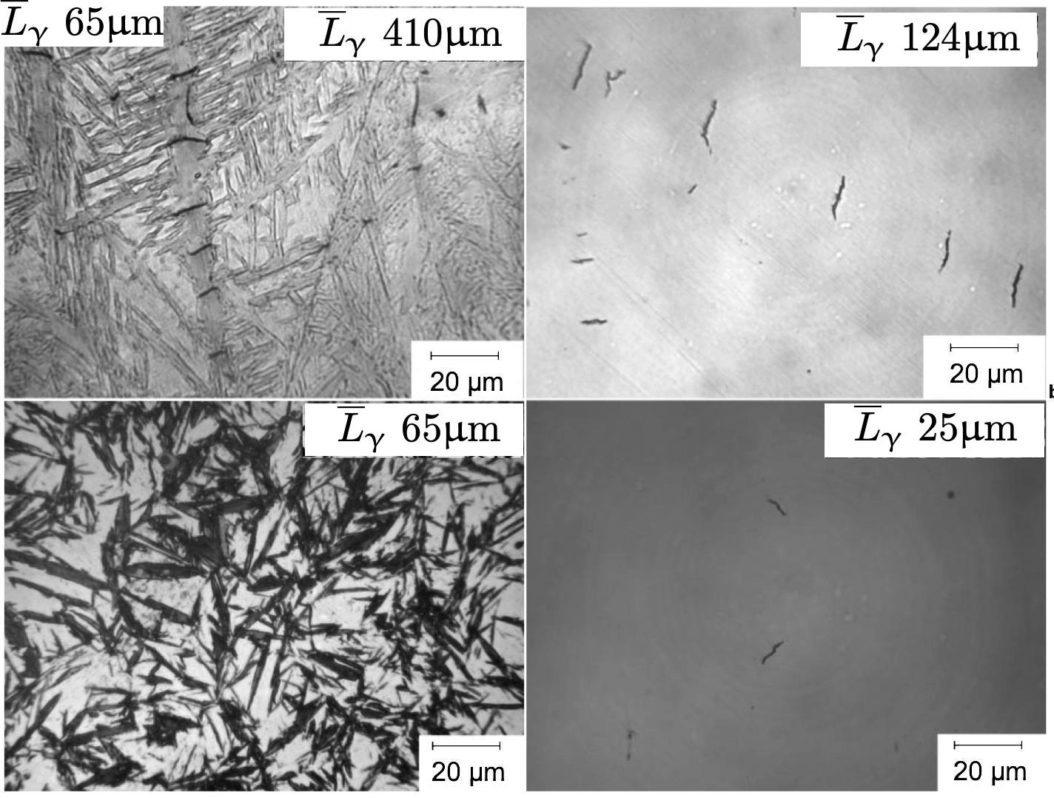
martensite
Chatterjee & Bhadeshia

Slide 8
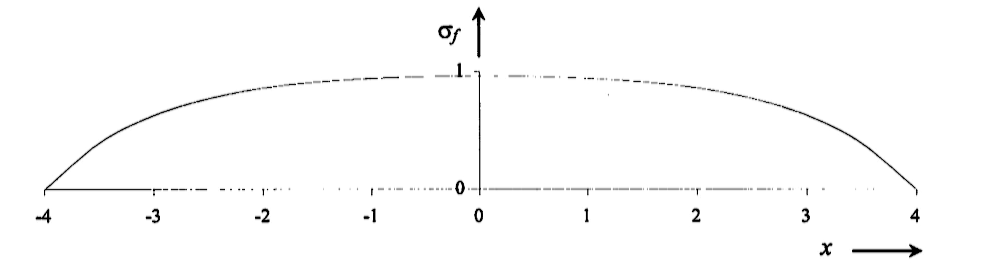
Cracking of high-carbon martensite plates
Fe-1C-1.5Si-2Mn-1.3Cr-0.25Mo wt%
Chatterjee & Bhadeshia
Mat. Sci. Techn. 22 (2006) 645

Slide 9
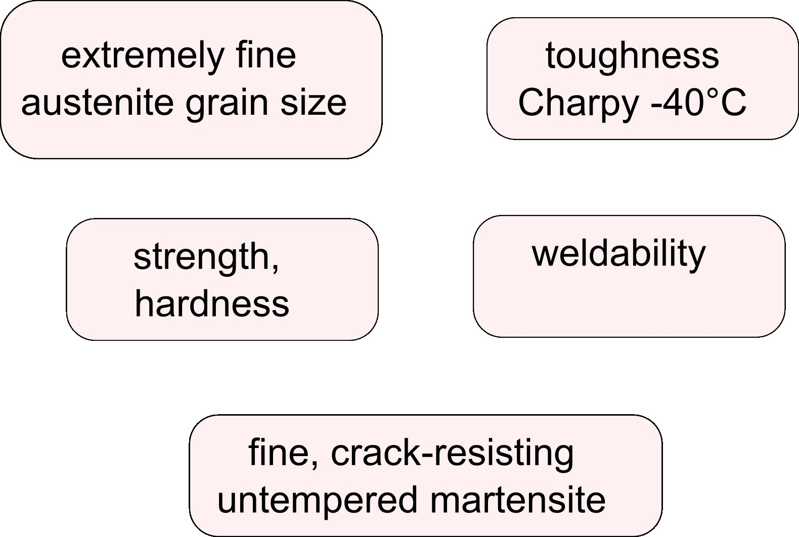

Slide 10
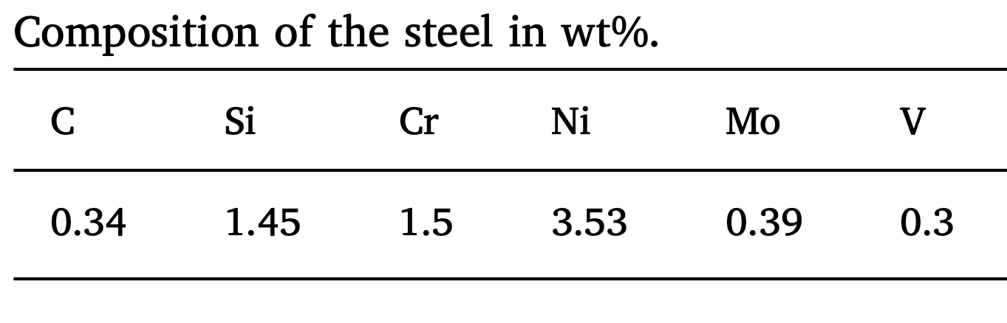
hardenability
grain size control
avoid impurity
embrittlement
normally, in quenched condition
Charpy < 10 J at ambient temperature

Slide 11
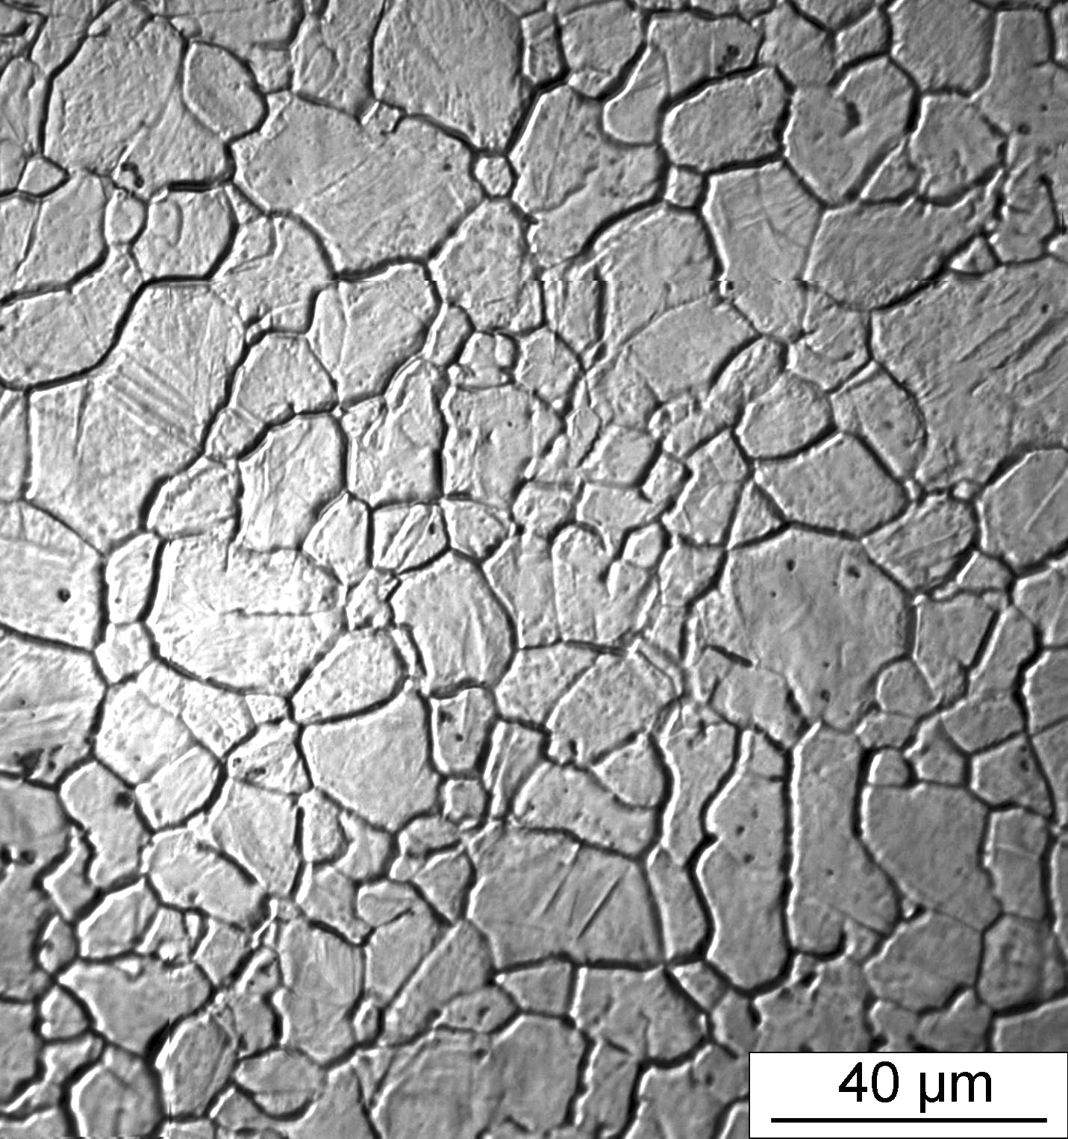
Pous et al. (2014)

Slide 12
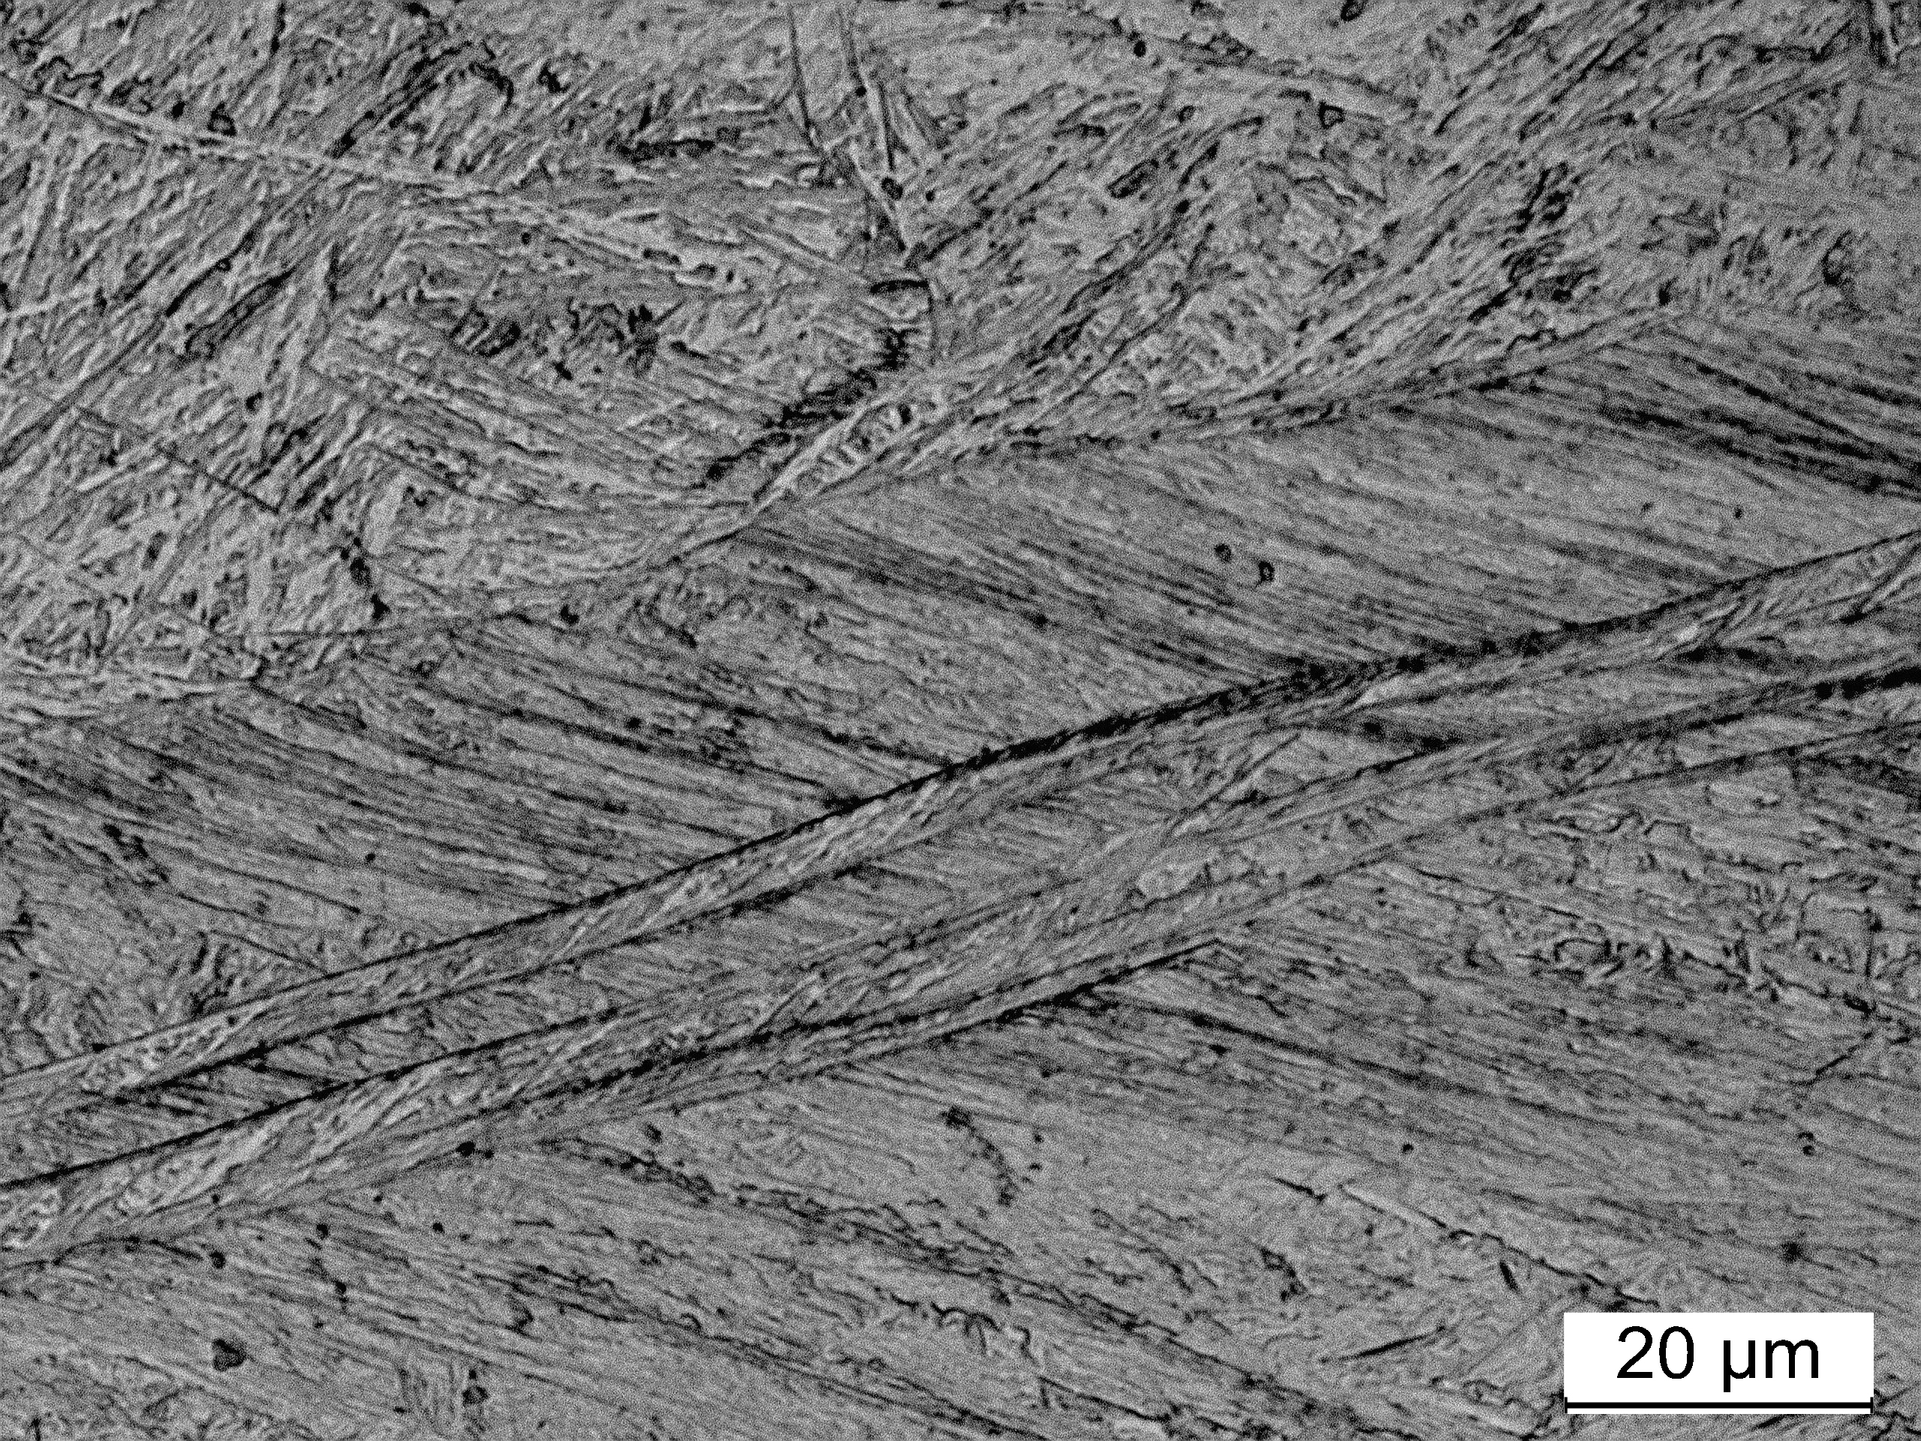
Sourabh Kundu
Chintha et al.
Wear 428-429 (2019) 430-437

Slide 13
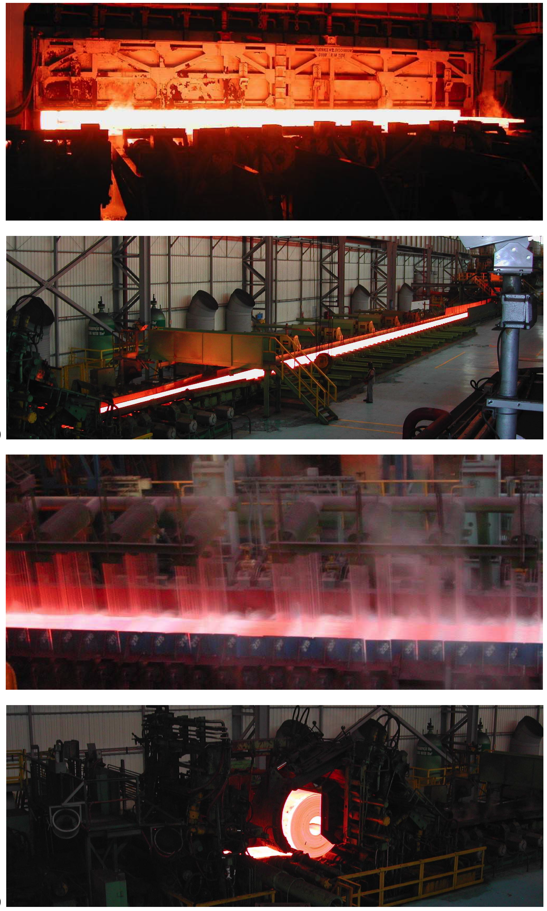
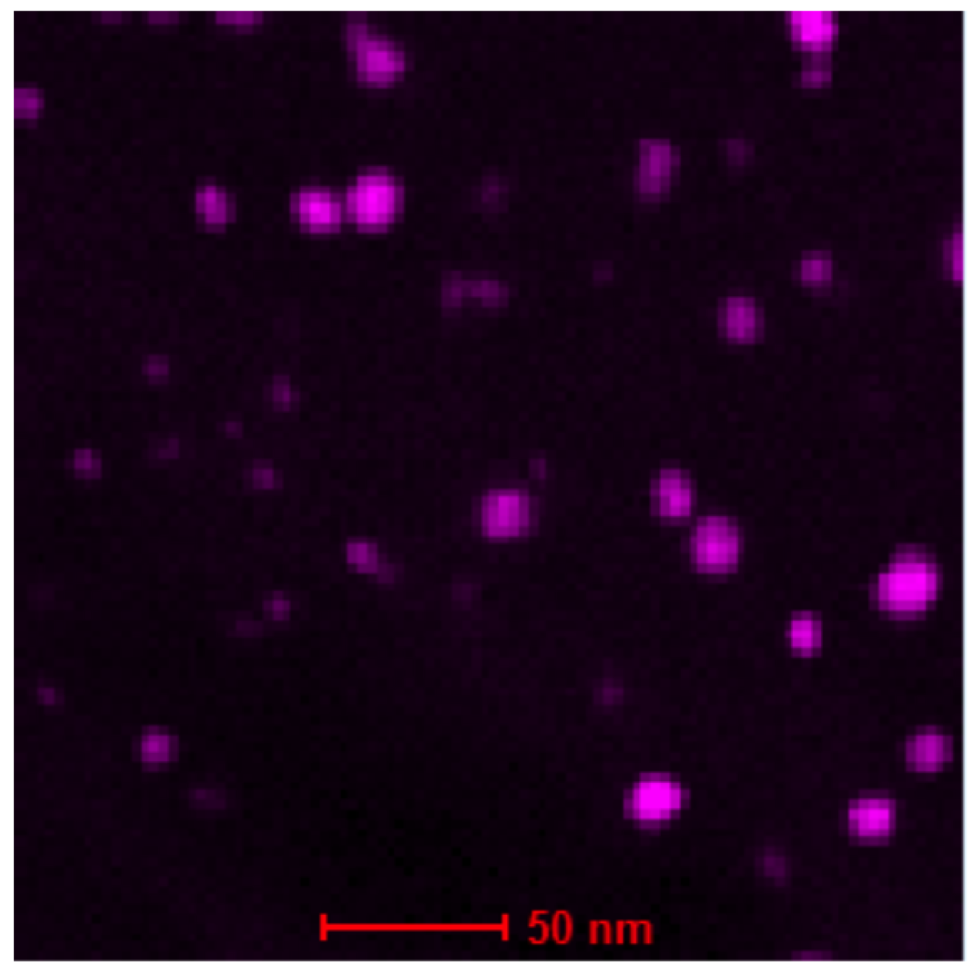
Mathew Peet
finish rolling at low temperature

Slide 14
pancaked austenite, cooled
undeformed austenite quenched

Slide 15
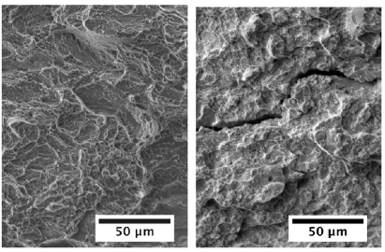
cooled from pancaked austenite
quenched, equiaxed austenite

Slide 16
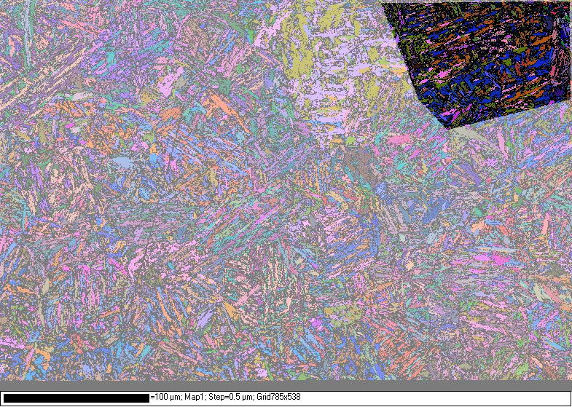
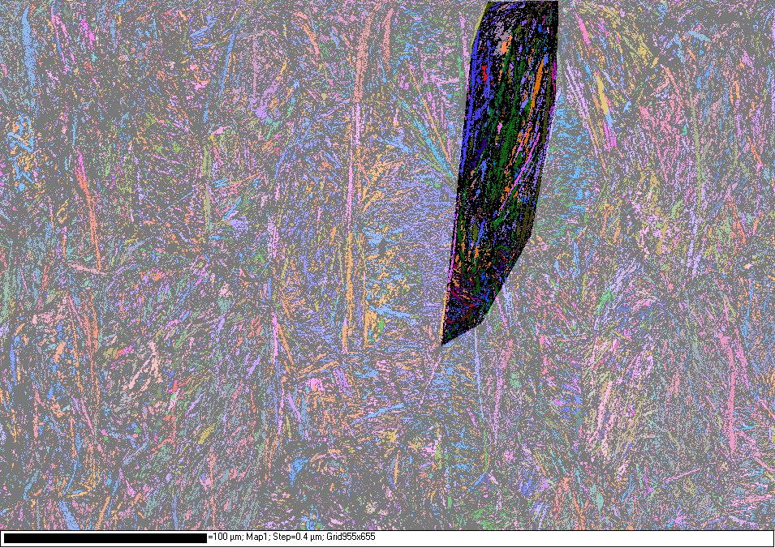
pancaked austenite
quenched from
equiaxed austenite
(magnification markers 100 µm

Slide 17
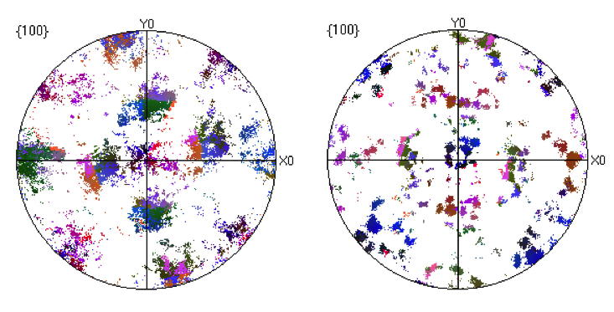
thousands of orientations
in single austenite grain
only 24 orientations
in single austenite grain
Saurabh Kundu

Slide 18
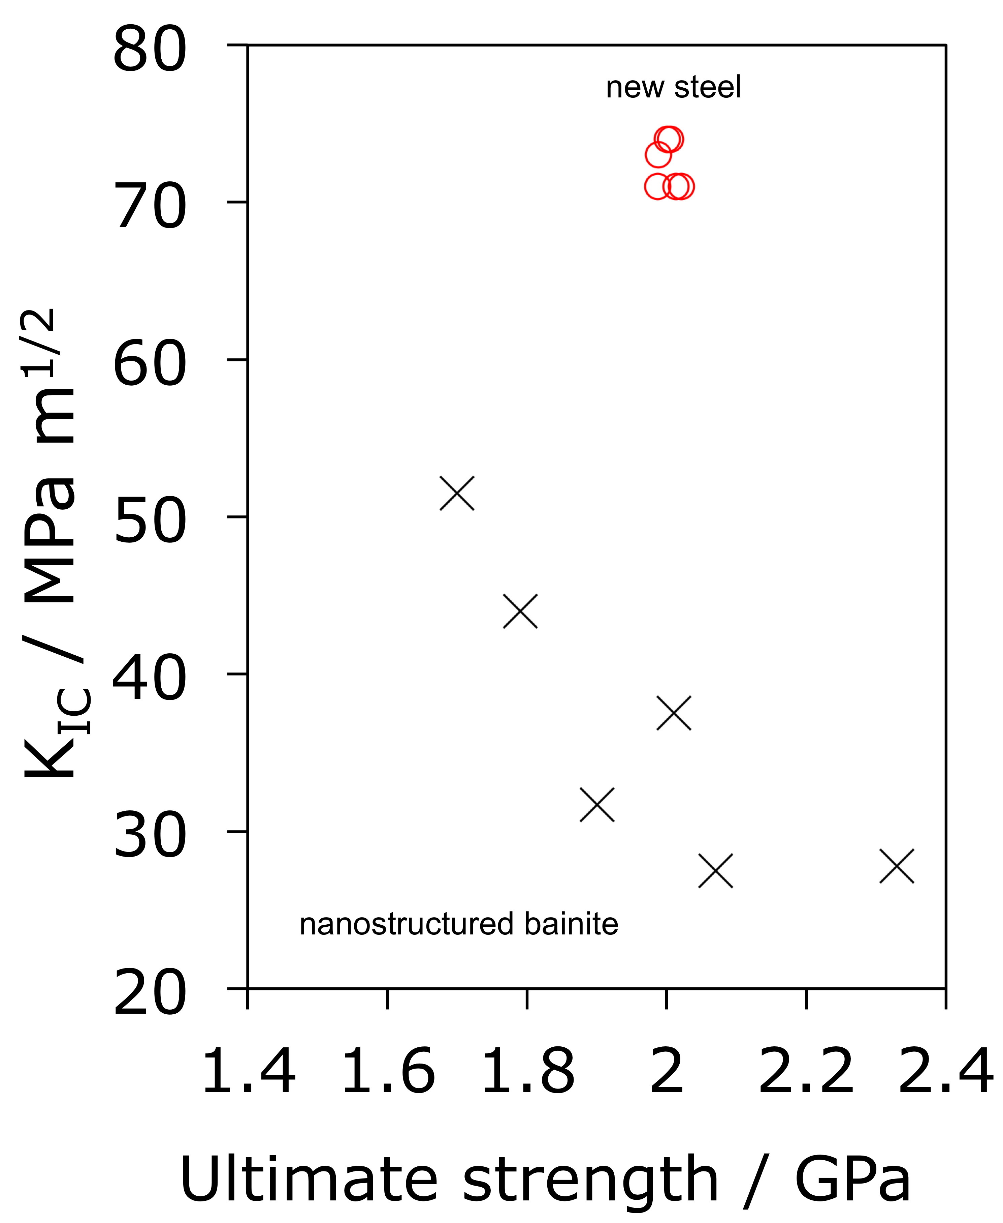
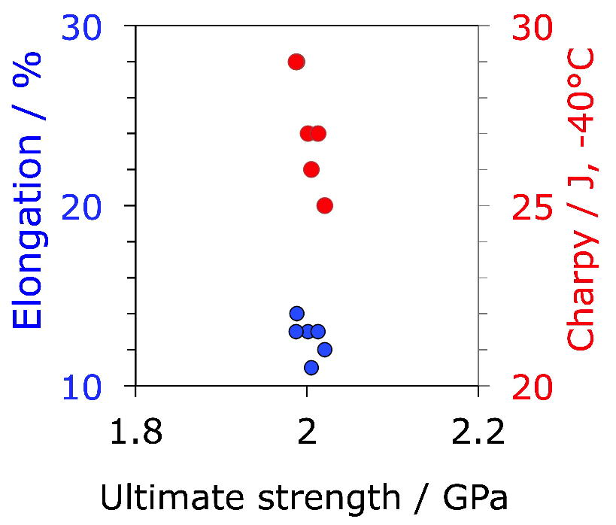
Tata Steel

Slide 19
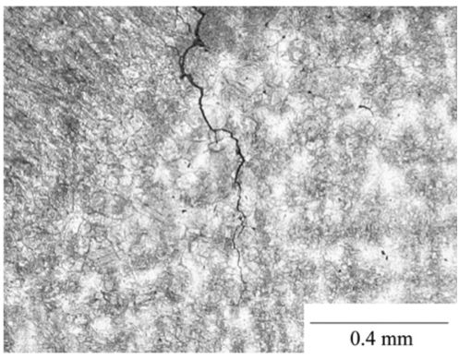
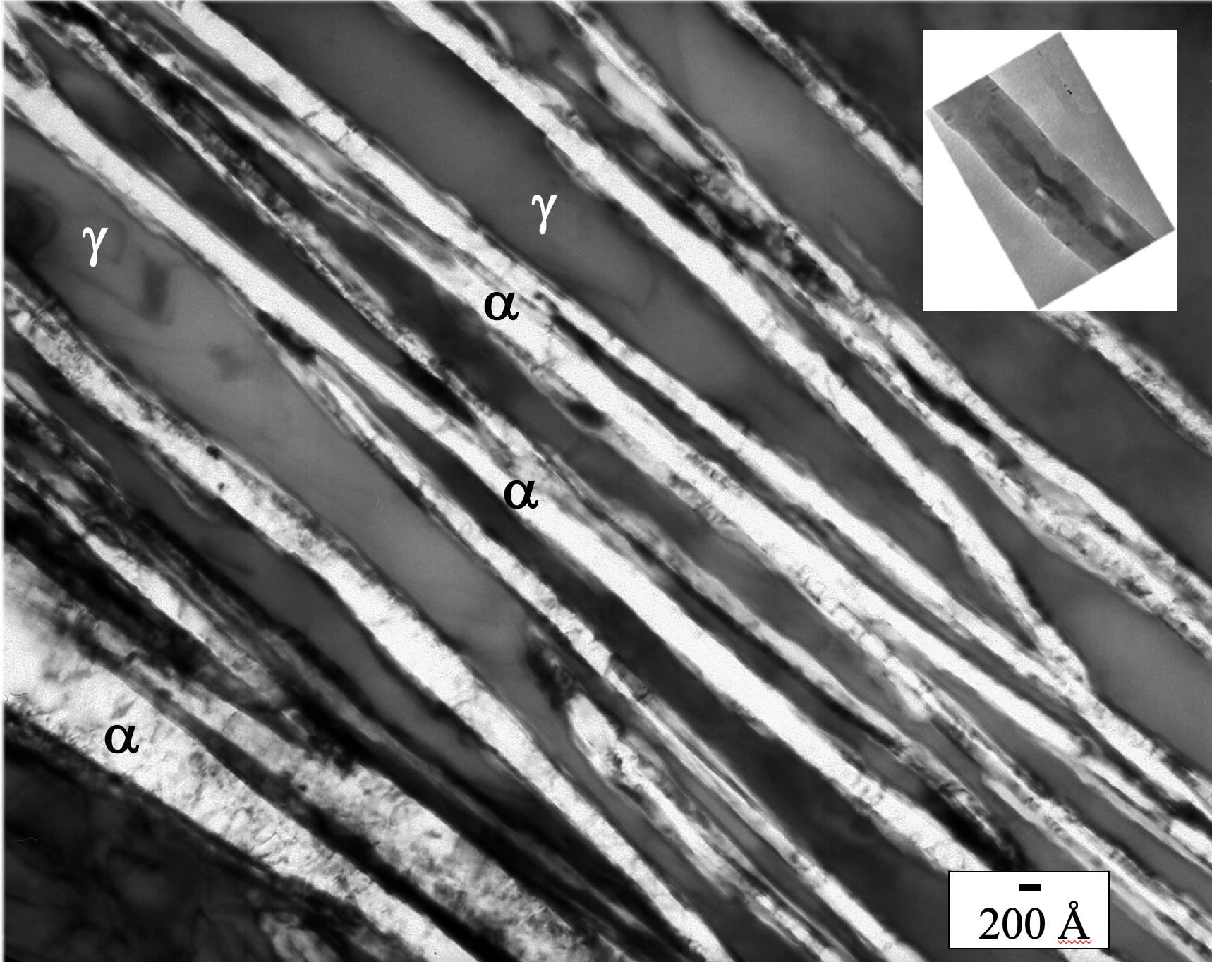
nanostructured bainite
Fe-1C-1.5Si-1.9Mn ... wt%
Cannot easily be welded
Fang, Yang, Liu, Song, Fang, Bhadeshia, Materials and Design, 50 (2013) 38

Slide 20
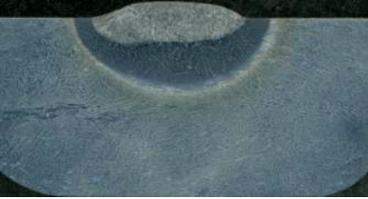
12 mm
Single pass

Slide 21
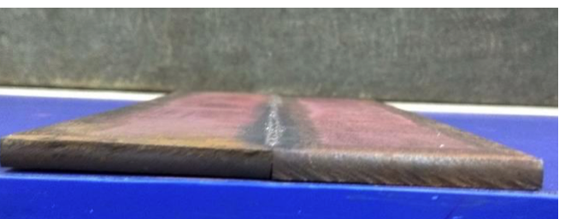
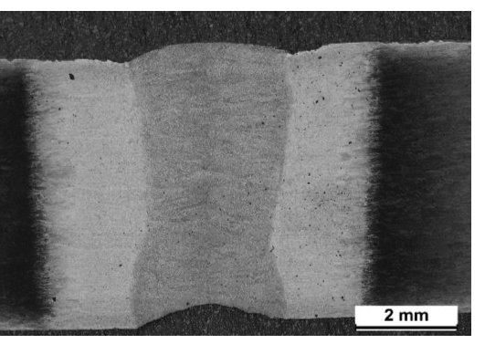
laser weld 1.2-2.7 kJ cm⁻¹
^{no cracking}

Slide 22
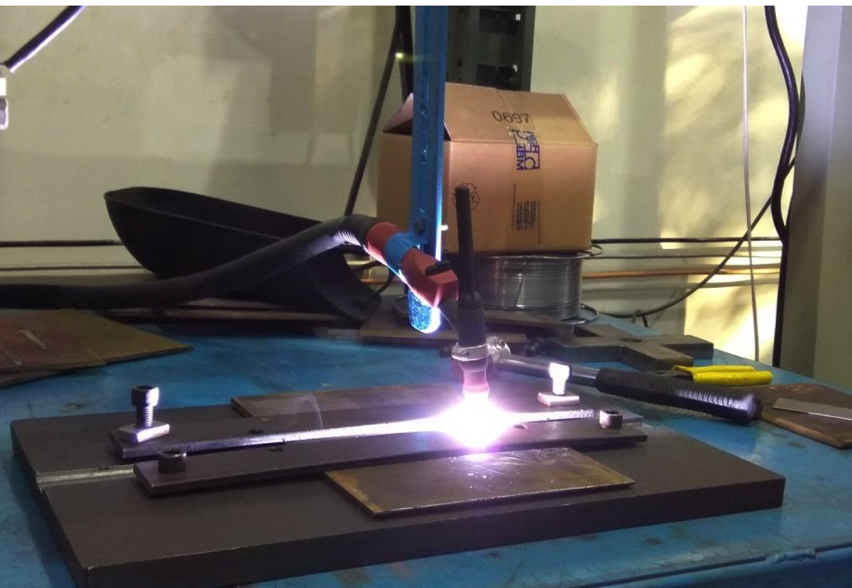
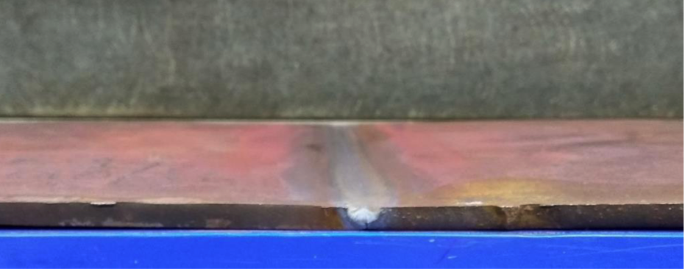
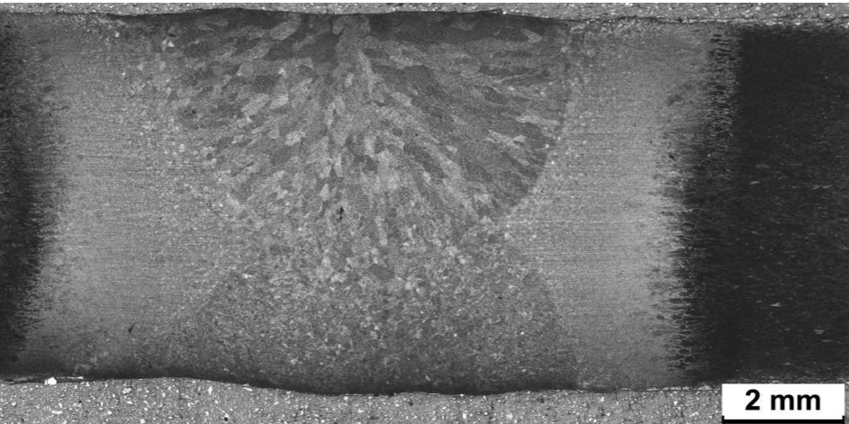
gas tungsten arc & shielded metal arc welding

Slide 23
Fracture toughness (K_{Q} / MPa m^{1/2}) of welded samples
Base metal
Coarse grained HAZ
Fine grained HAZ
Tempered HAZ
60
61
67
56

Slide 24
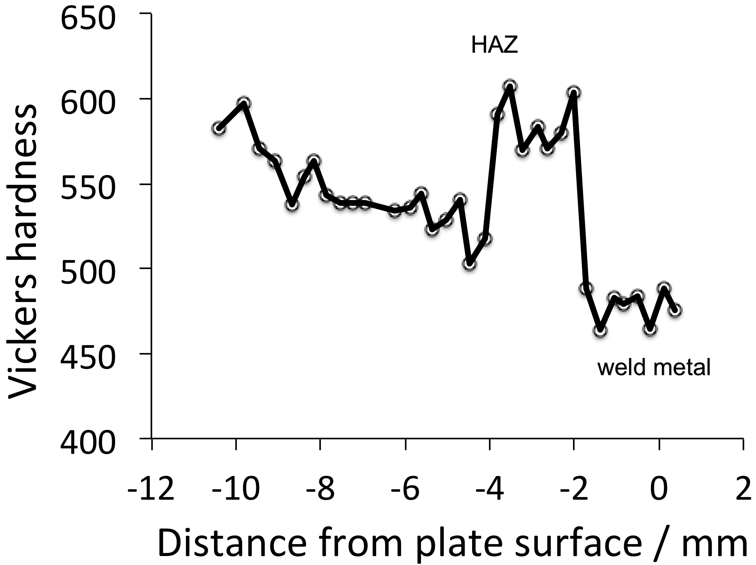
Weld hardness profile
Mathew Peet

Slide 25

High speed video
Survival
V₀ = 445 m s⁻¹
Vikram Deshpande, Mathew Peet

Slide 26
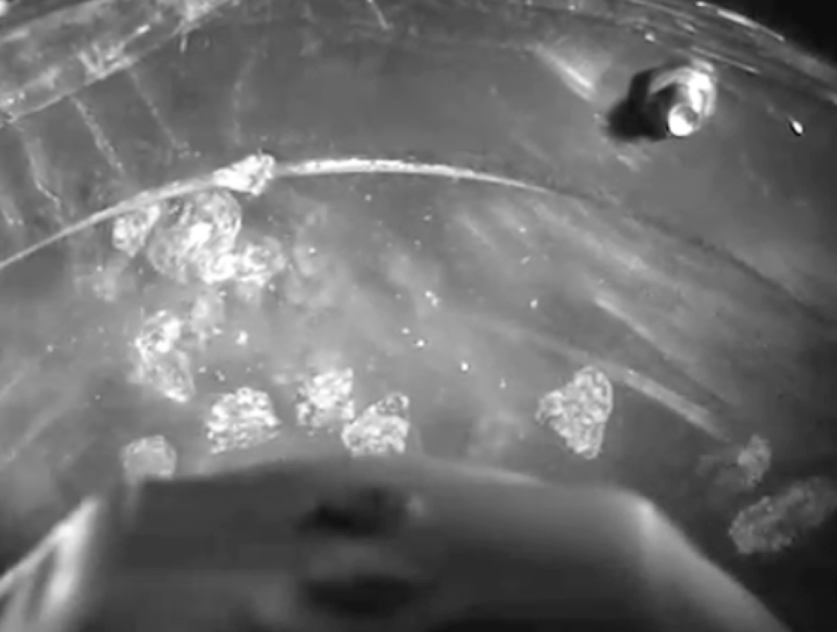
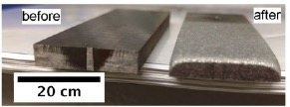
Impact tumbler testing
Movie courtesy of K. Valtonen, V.-T. Kuokkala

Slide 27
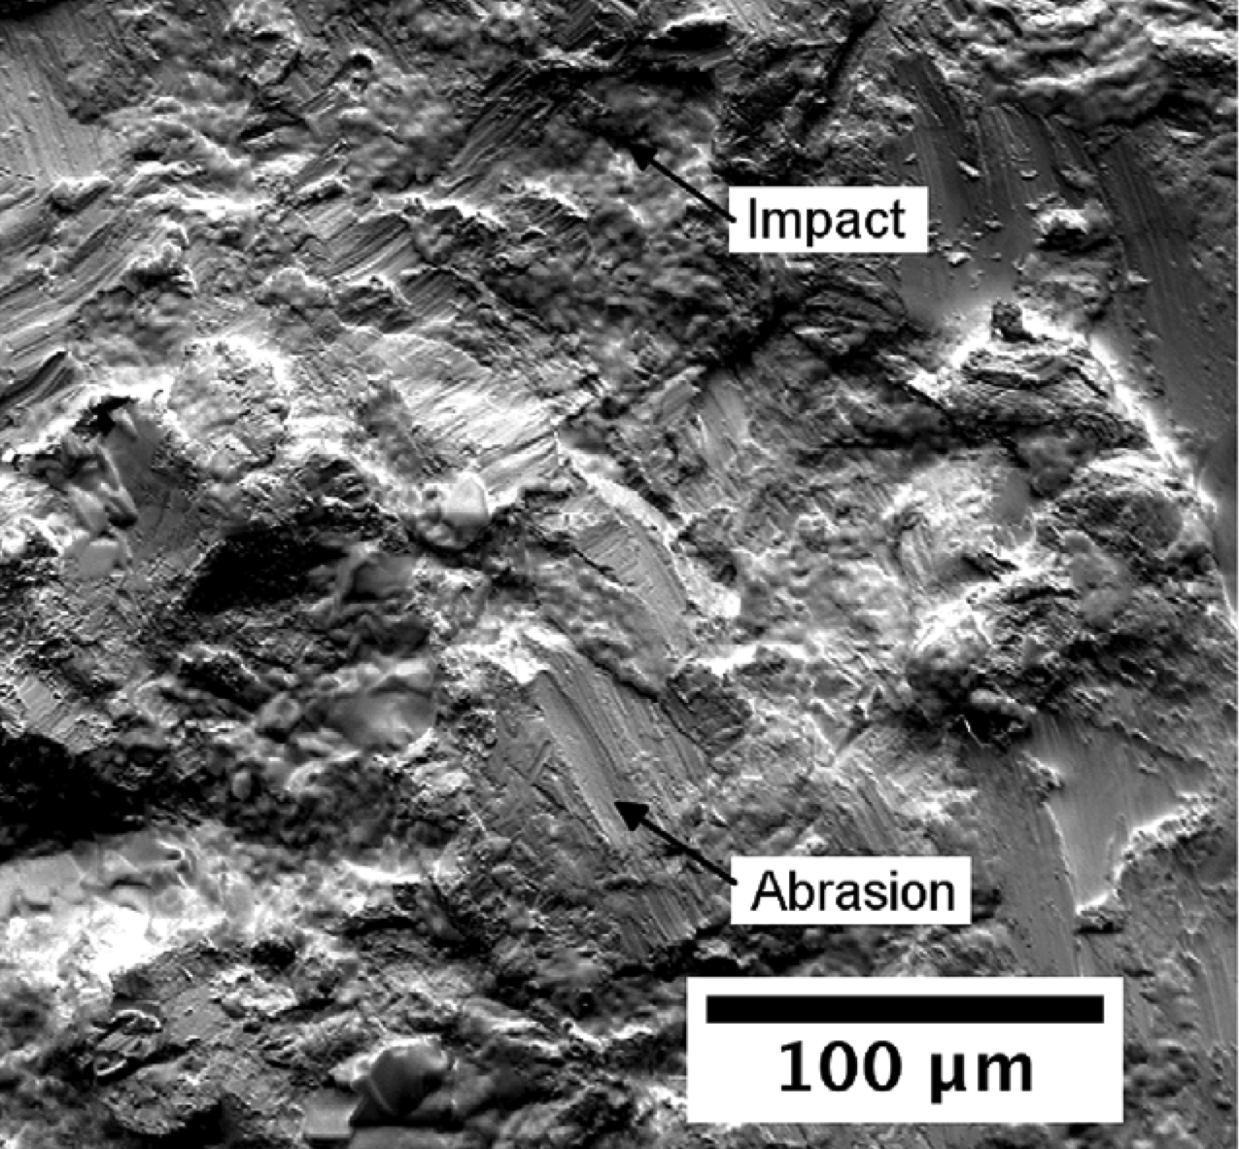

Slide 28
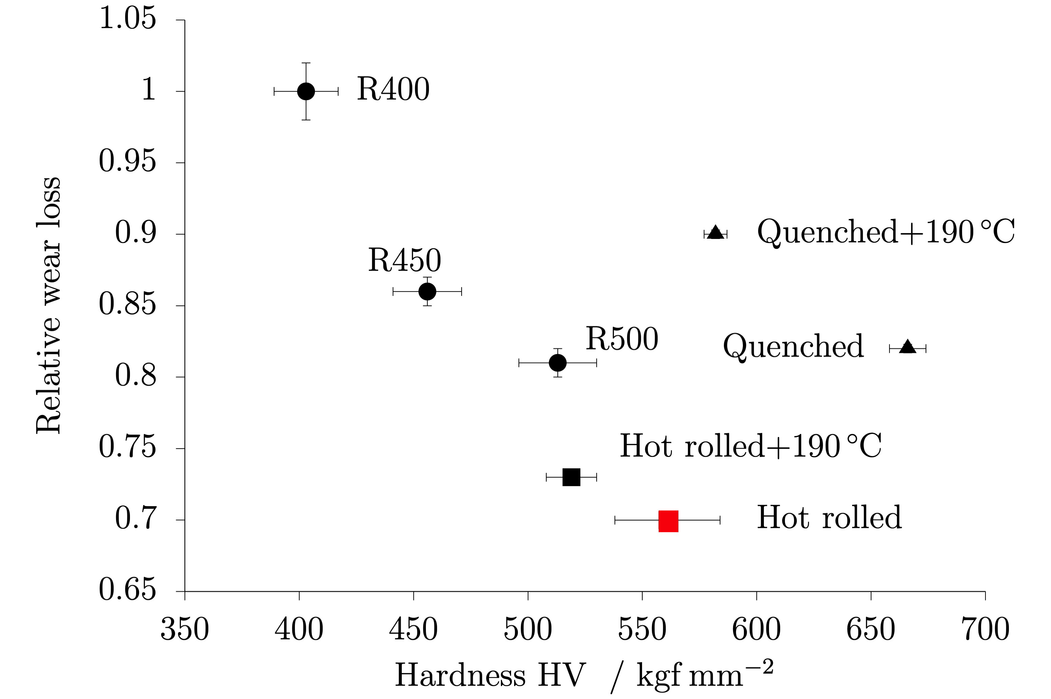

Slide 29
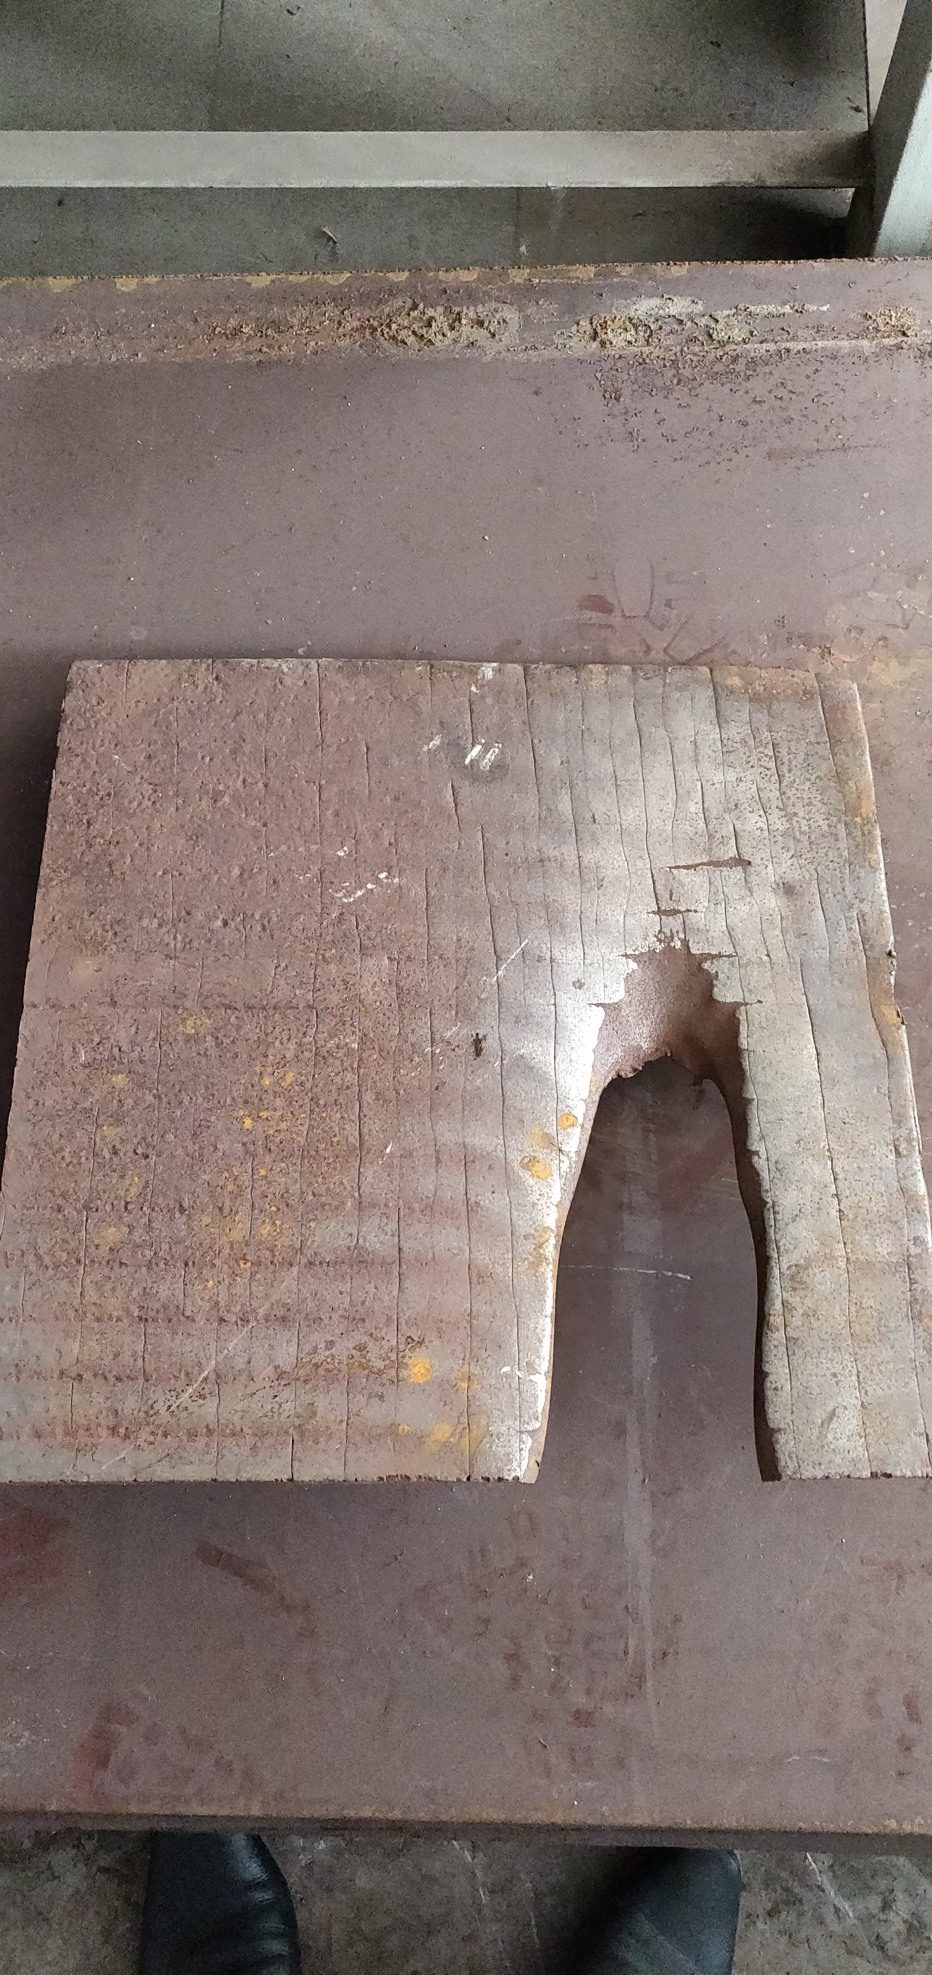
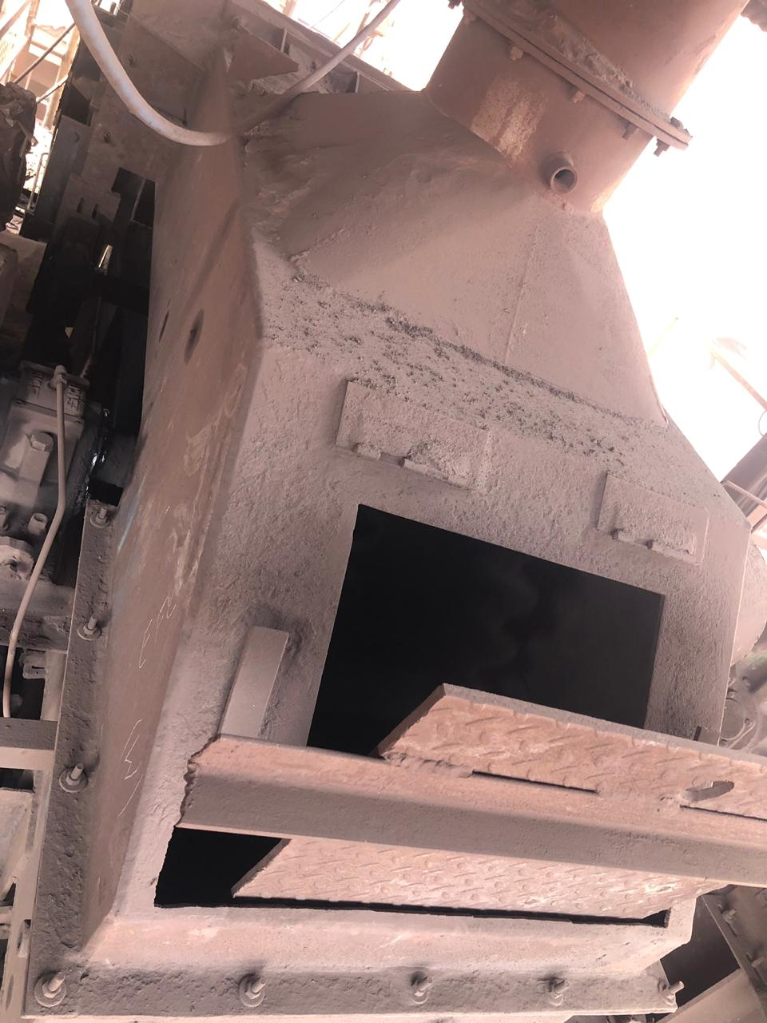
3-4 months of service

Slide 30
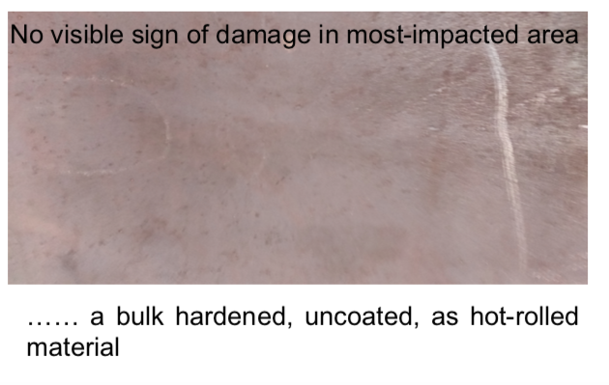
1 year in service
6 mm thick

Slide 31
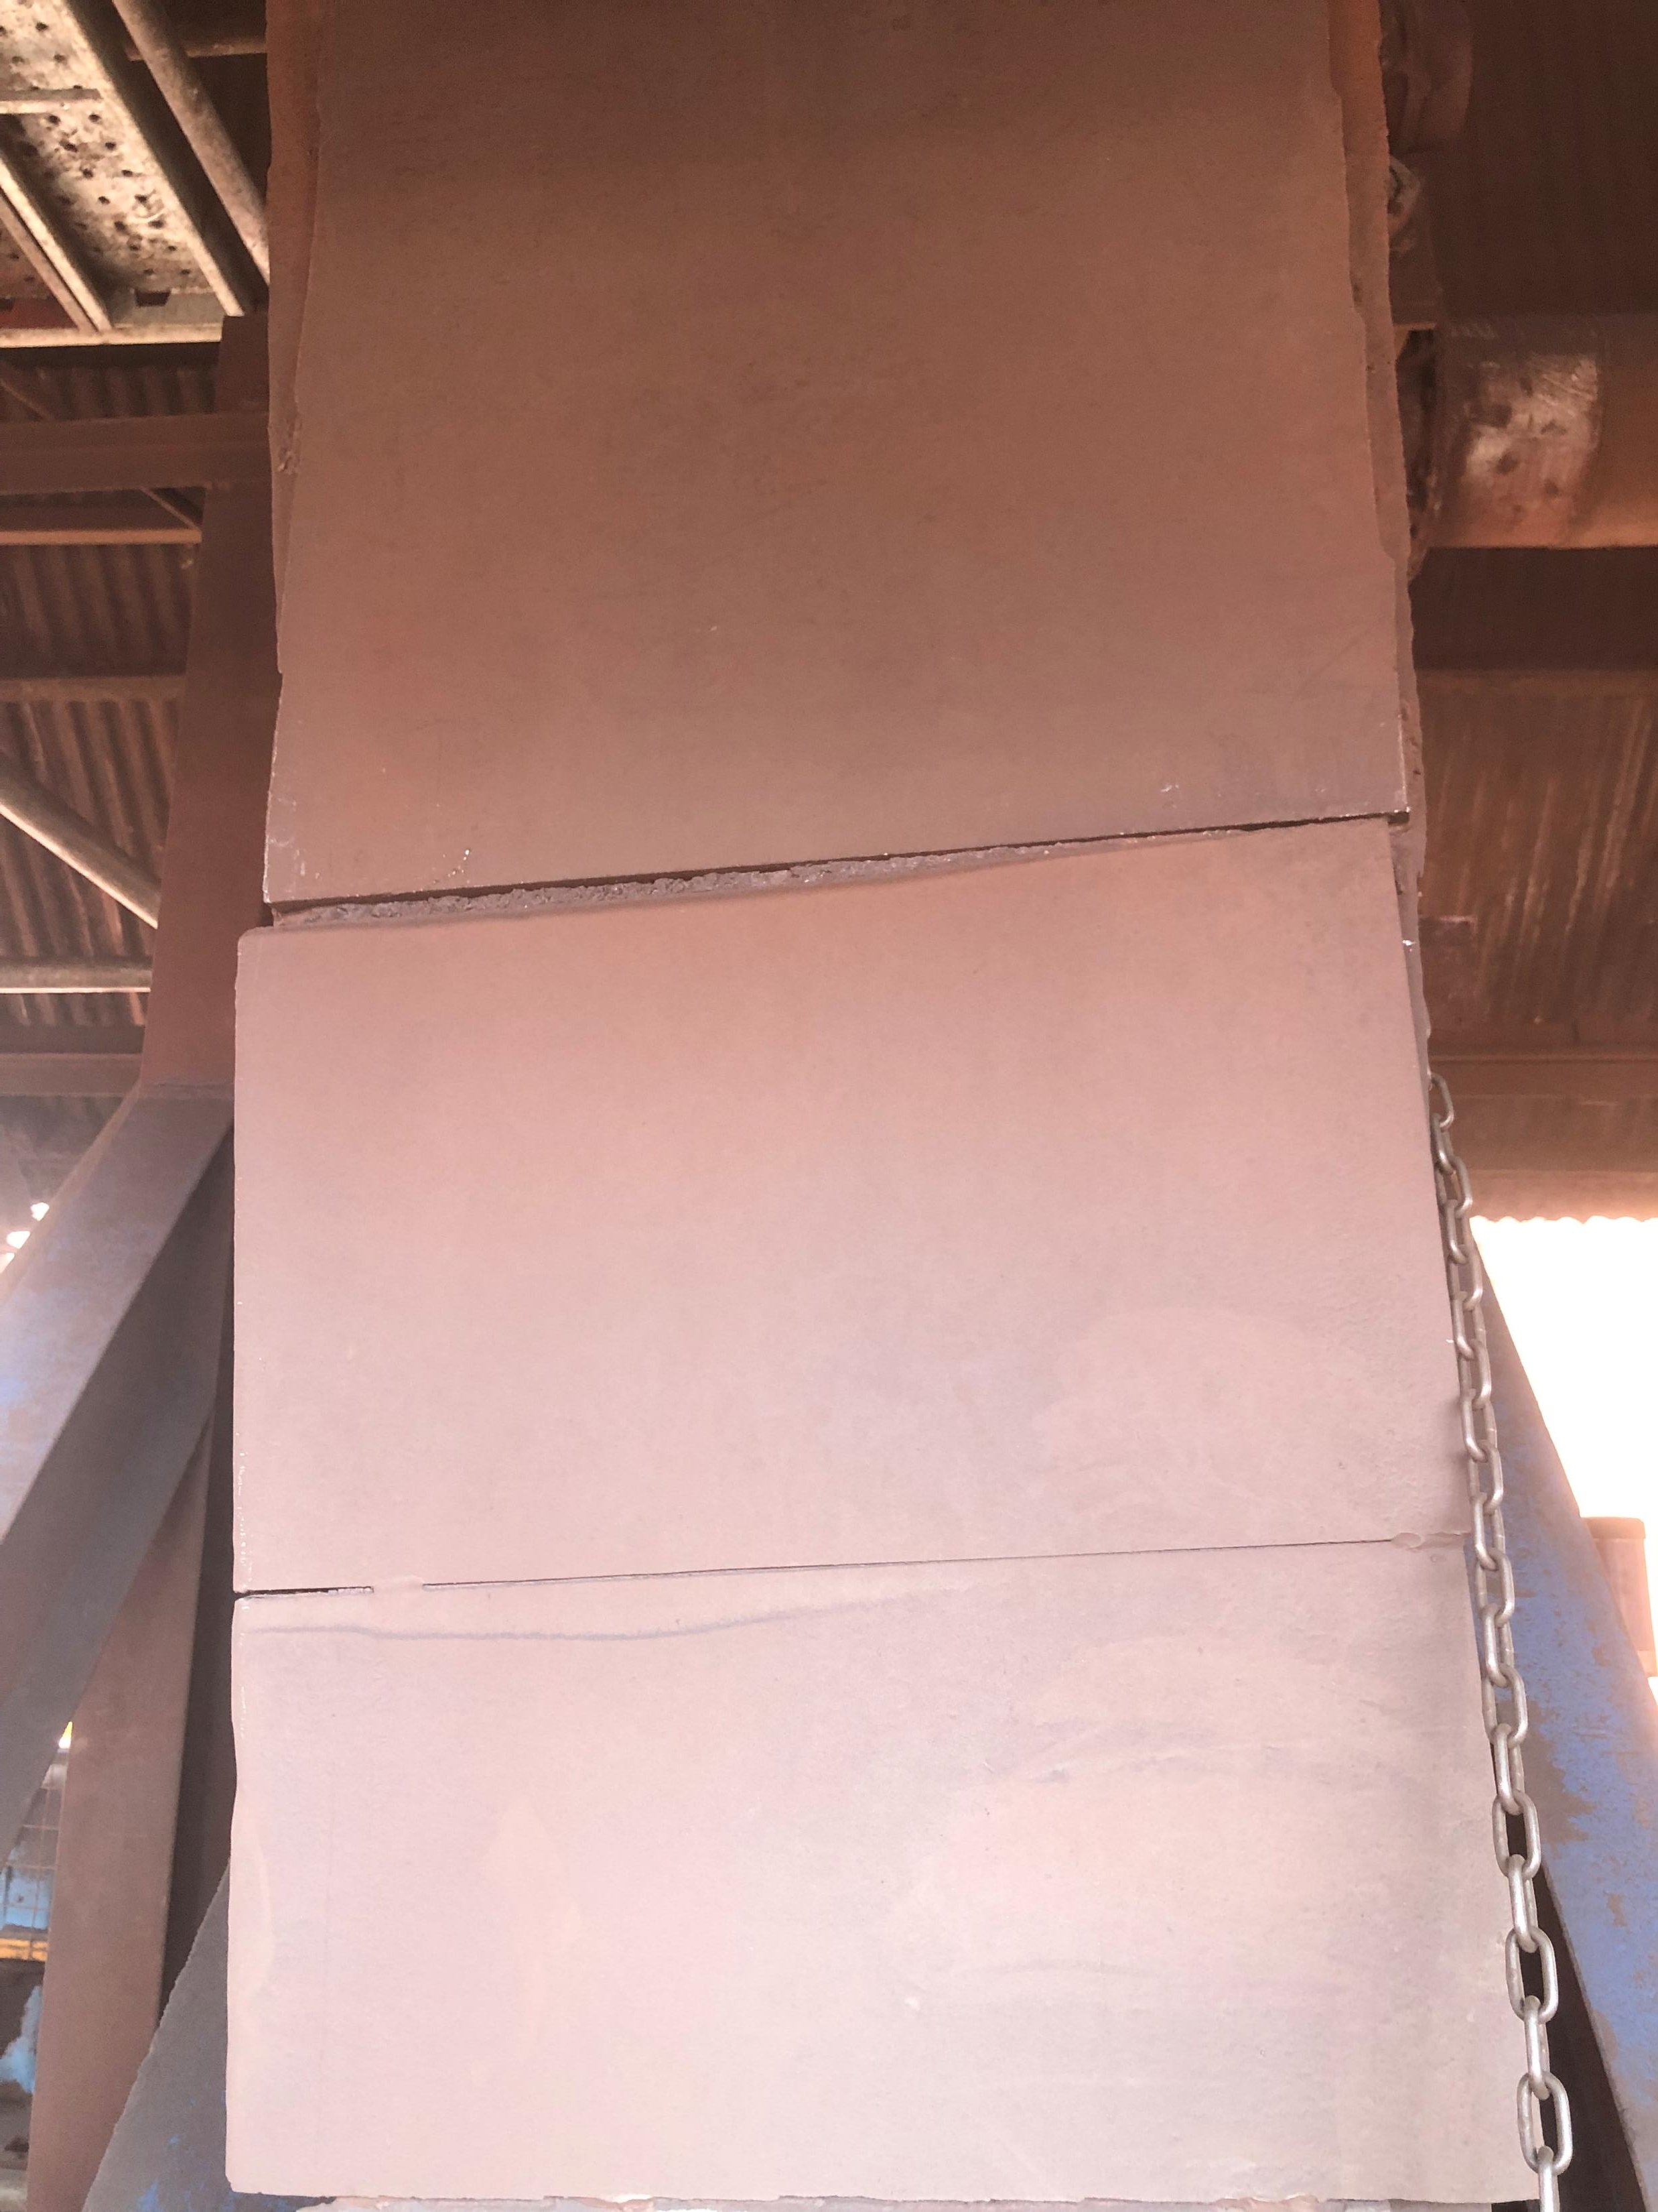
wear plate
Installed May 2019.
Armour grade, sinter-fine return area of blast furnace.
Running successfully for 4 years without visible damage.
Previous, hard-faced steel lasted only 4 months before replacement
Dust deposit
04-05-2023

Slide 32
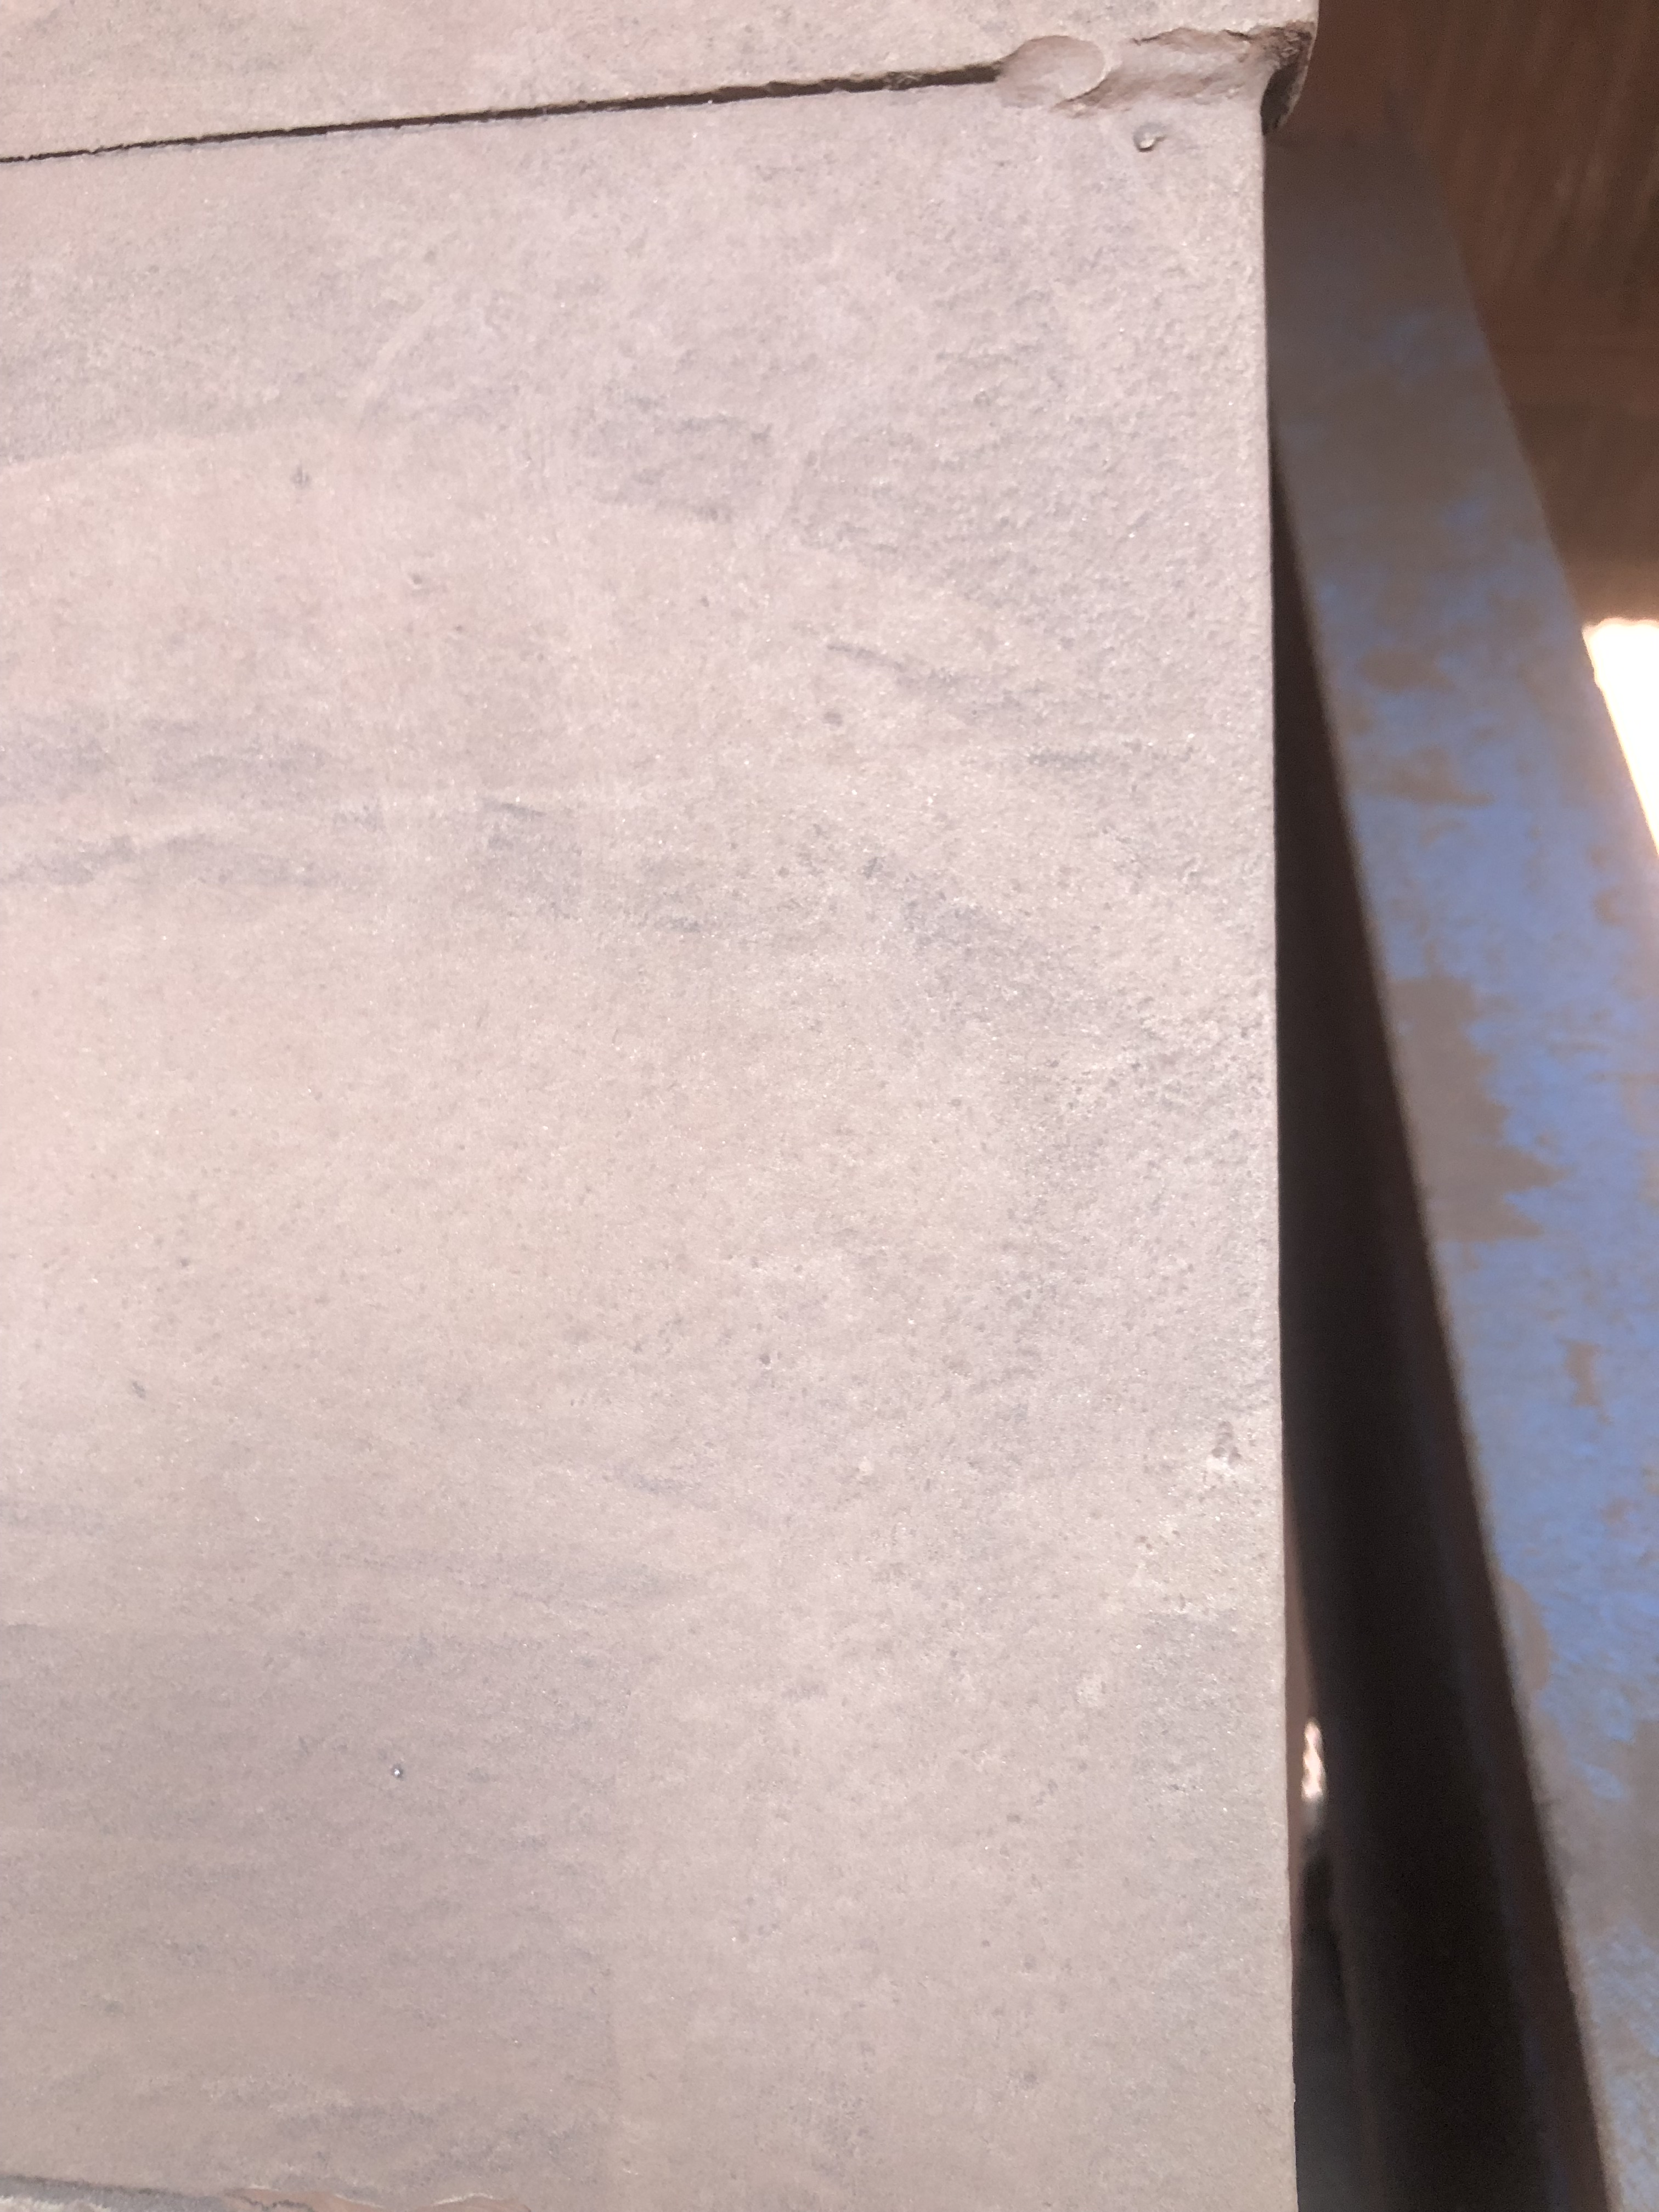

04-05-2023
(4 years in service)
Some microscopic cracks

Slide 33
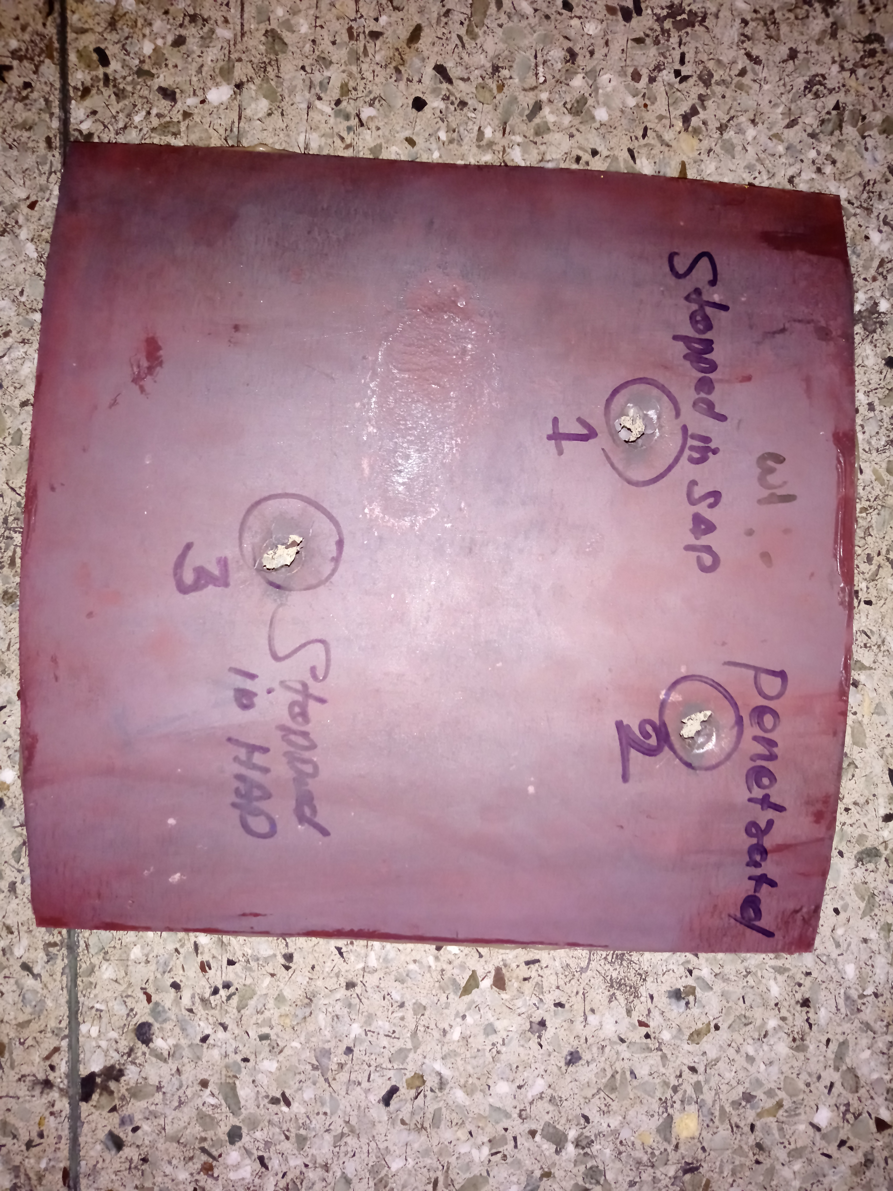
700 m s⁻¹ , 2.5 mm thick, body-armour

Slide 34
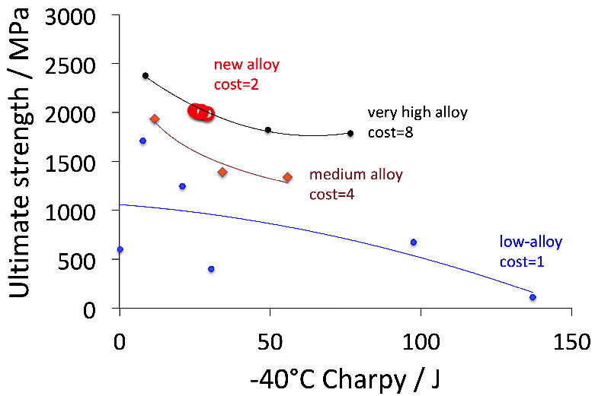

Slide 35
Desire fully martensitic structure following hot-rolling

Slide 36
Mechanical stabilisation
Chatterjee S, Wang HS, Yang JR, Bhadeshia HKDH
Mechanical stabilisation of austenite
Materials Science and Technology 22 (2006) 641-644

Slide 37
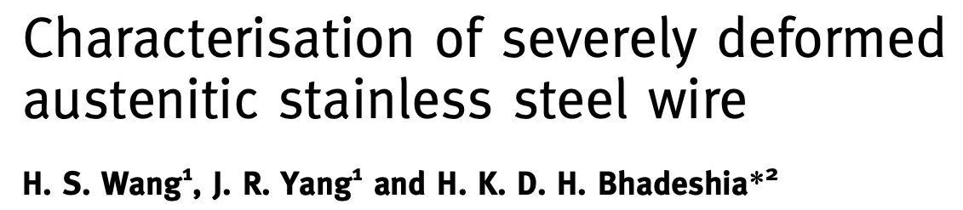
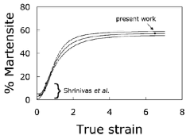
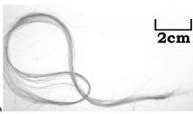

Slide 38
Mechanical stabilisation
Chatterjee S, Wang HS, Yang JR, Bhadeshia HKDH
Mechanical stabilisation of austenite
Materials Science and Technology 22 (2006) 641-644

Slide 39
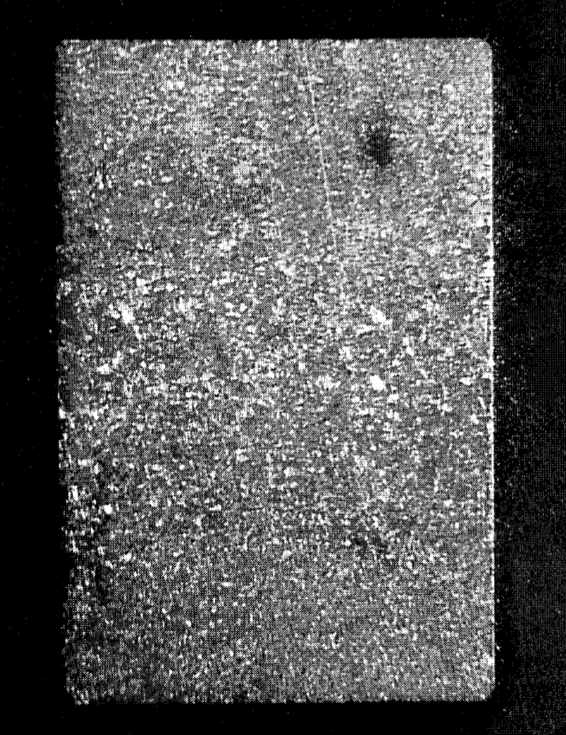
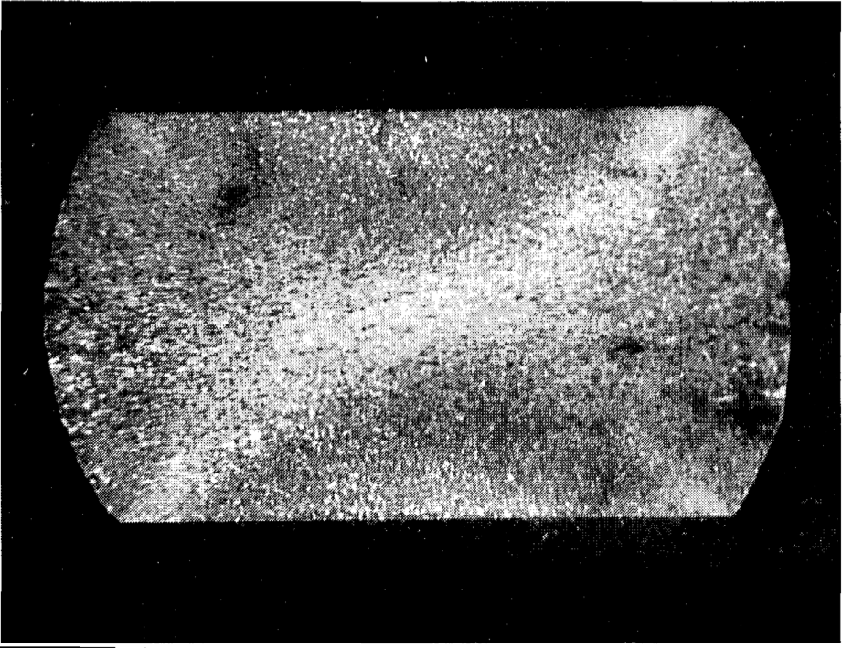
Austenitise, cool to generate bainite in deformed austenite

Slide 40
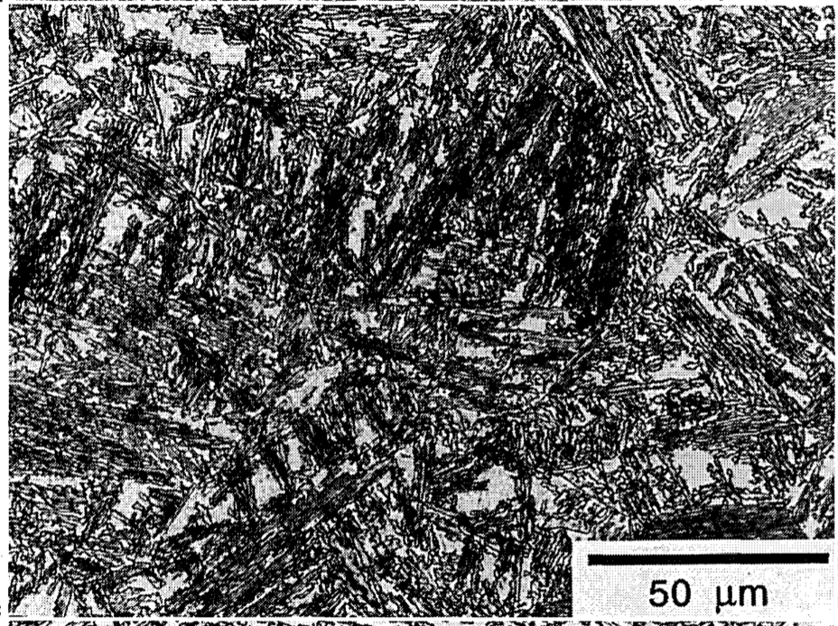
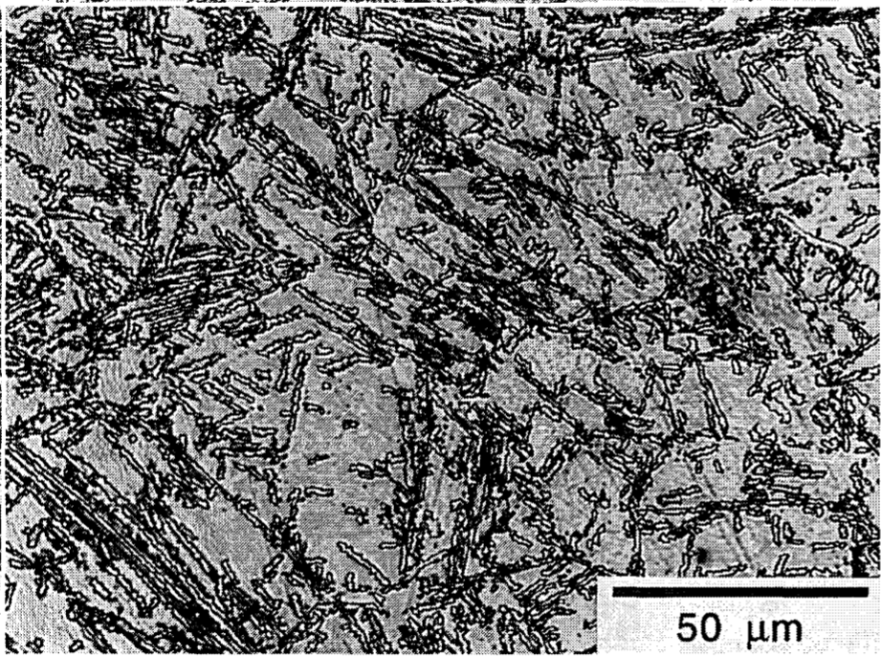
Mechanical stabilisation
Shipway & Bhadeshia

Slide 41
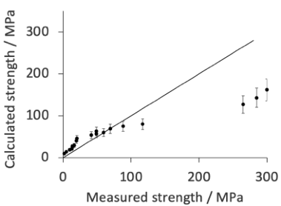
Useful at high-temperatures?
Can 17-7PH steel be treated similarly to improve toughness?
What about rolling load?

Slide 42
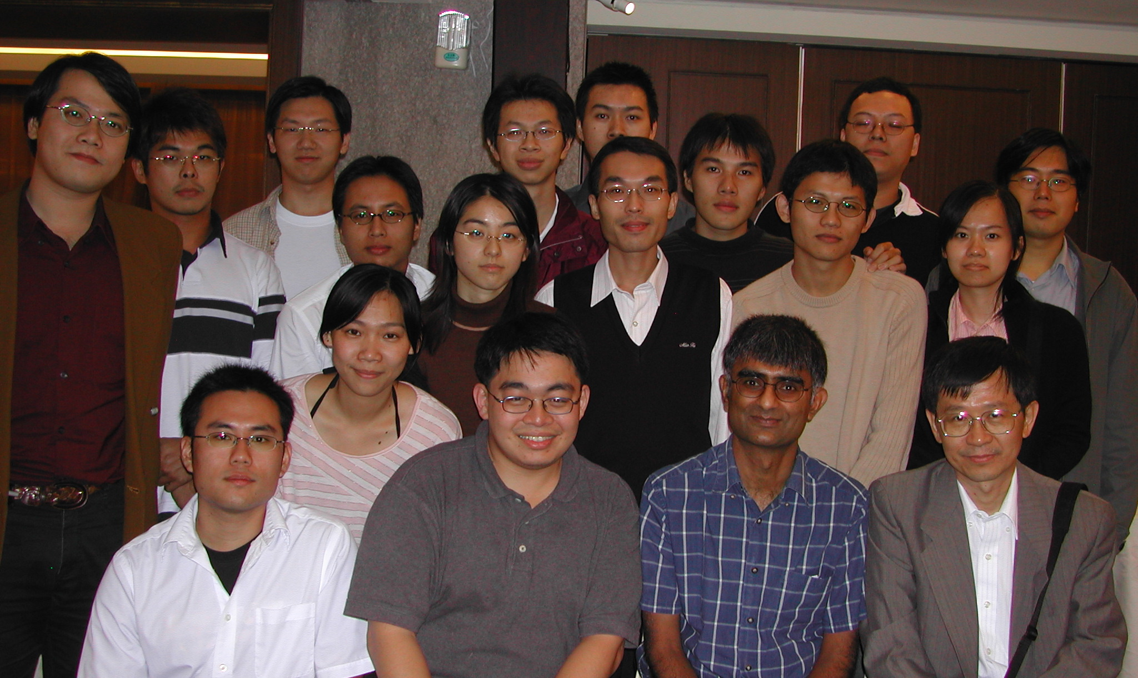





2004

