Slide 1
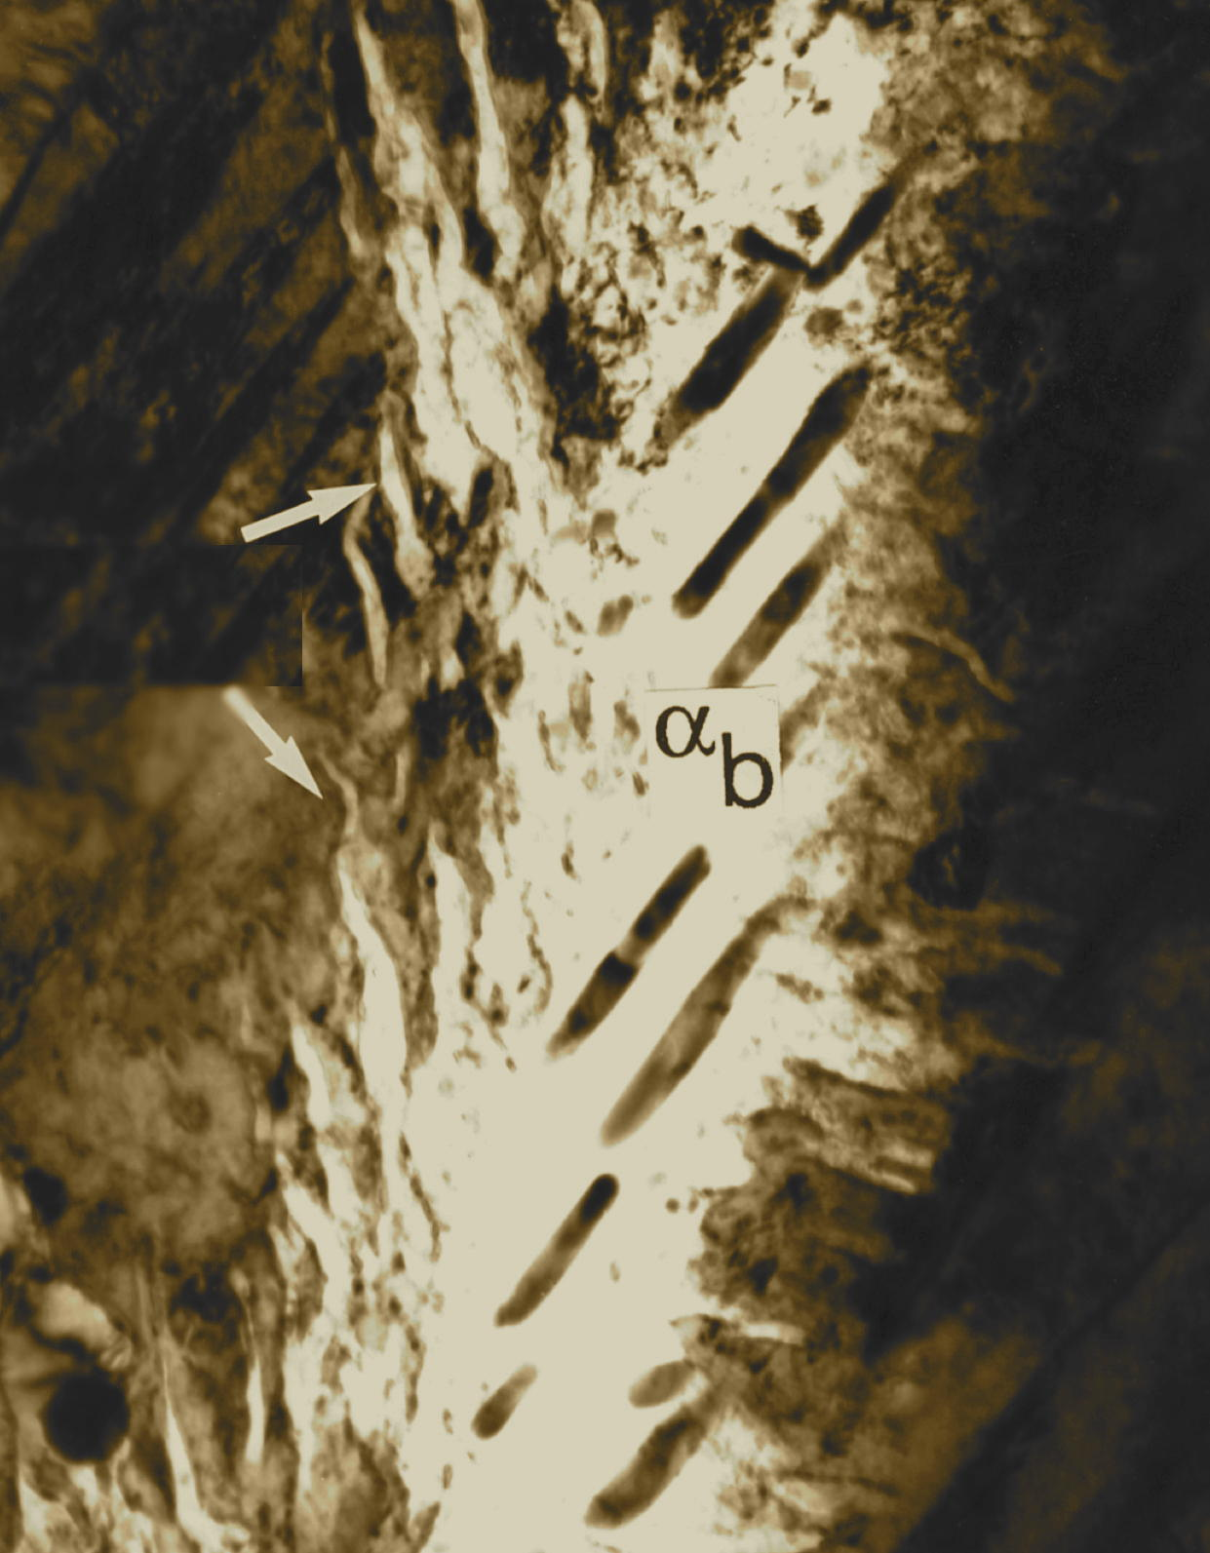

Bainite
unanswered questions,
why they matter.
www.phase-trans.msm.cam.ac.uk

Slide 2
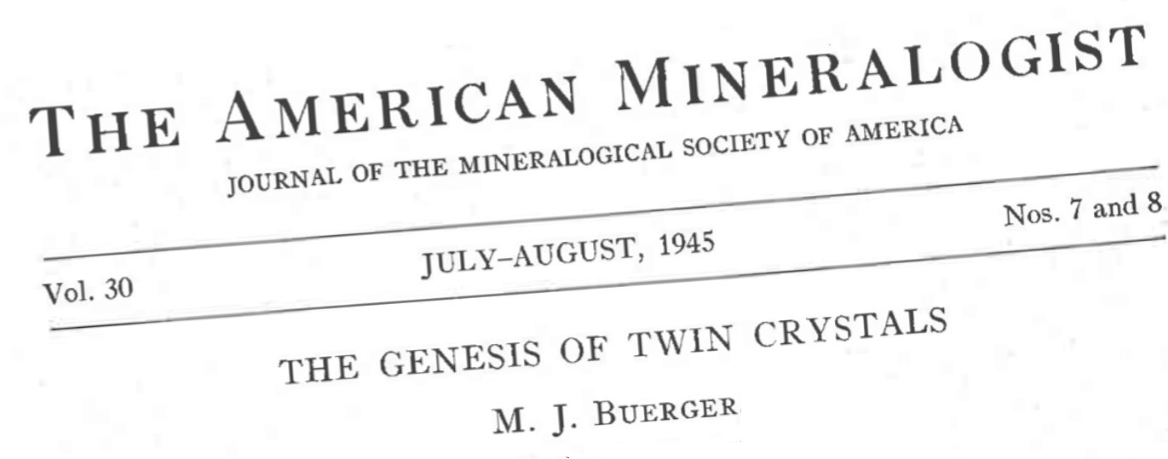
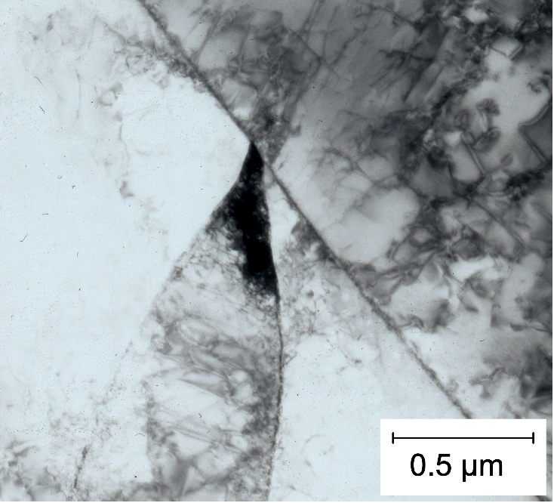
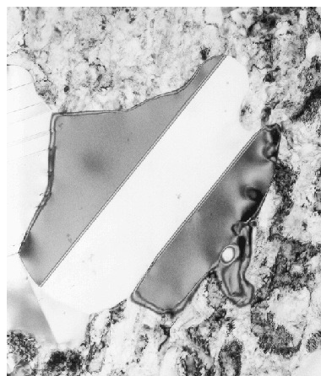
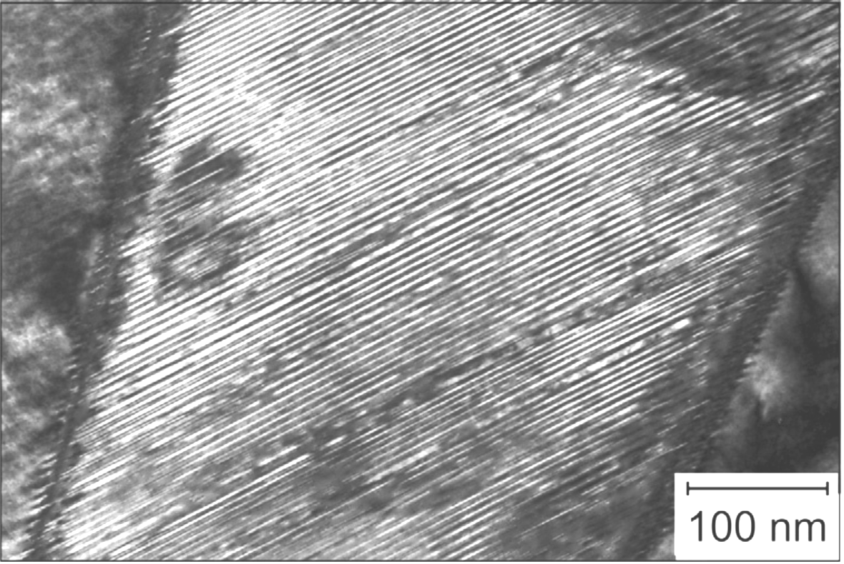


transformation twins
Shibata & Maki

Slide 3

1972, 40 years after Davenport & Bain
Metall. Trans. 3, p.1077
Hehemann: shear transformation,
growth rapid, carbon trapped in α_{b},
strain energy, carbide secondary .....
Kinsman, Aaronson:
non-lamellar eutectoid (carbide essential),
diffusion controlled,
ledge mechanism
“without participation of shear” .....

Slide 4
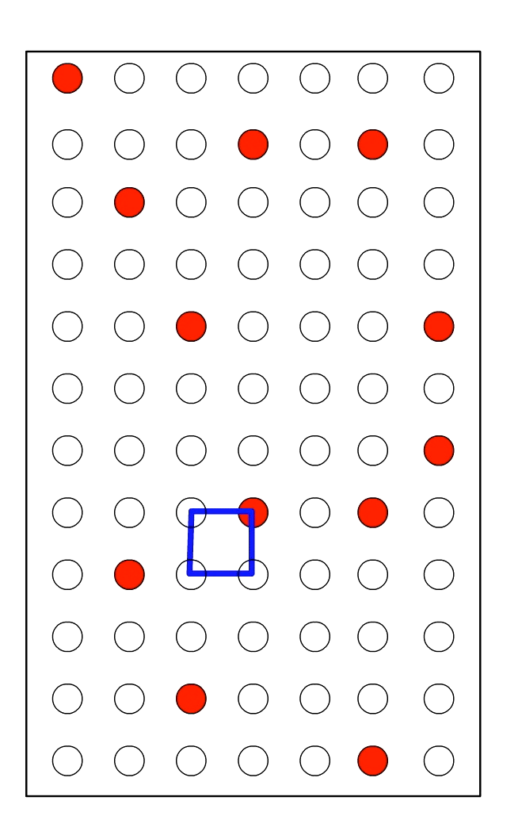
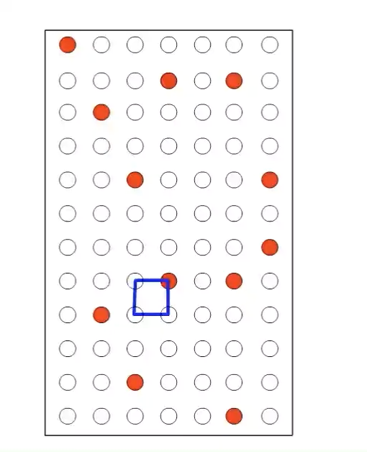
debate on atomic mechanisms
reconstructive
displacive

Slide 5

KTH Sweden
... diffusive mechanism is supported ...
Hillert, ISIJ International 35 (1995) 1134
...... agree that bainite is formed through a displacive mechanism like martensite.
Metallurgical Transactions A 52 (2021) 4546
Controversy resolved?
Was this ever relevant?

Slide 6
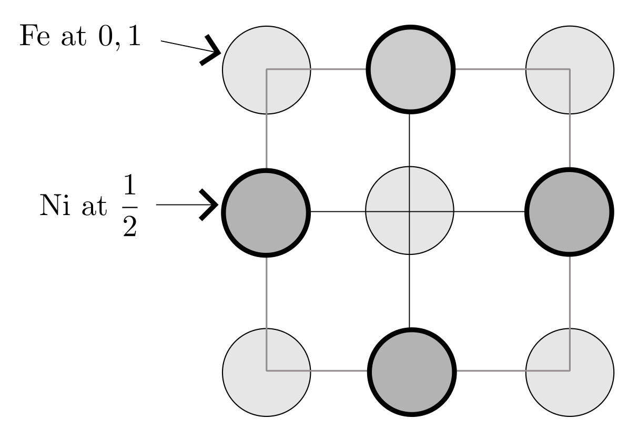
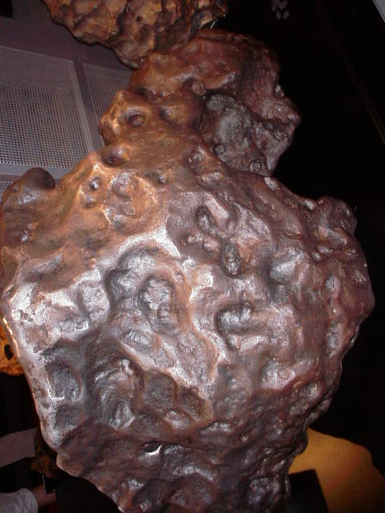
Tetrataenite
cools 1 K in million years
Ferromagnetic
Large magnetic coercivity
Excellent permanent magnet
Ordering temperature 321°C
One atomic jump in 10⁴ years at 300°C

Slide 7
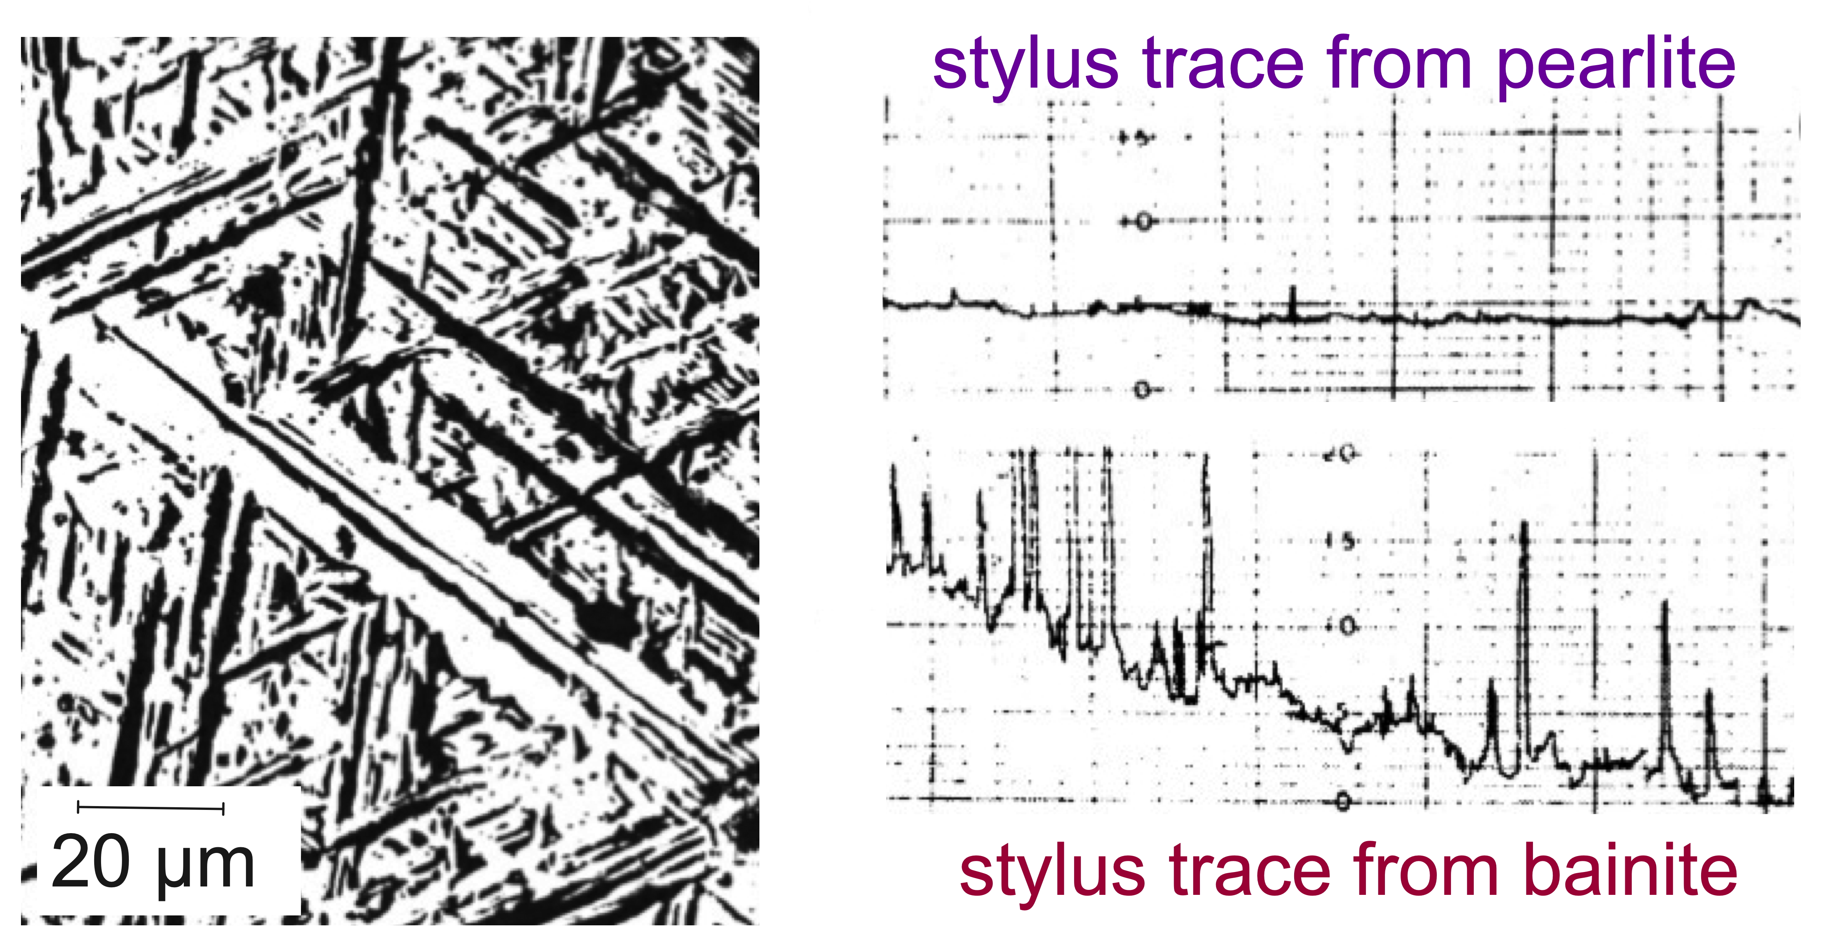
T. Ko, S. A. Cottrell (1952)
J I S I 172 (1952) 307-313

Slide 8
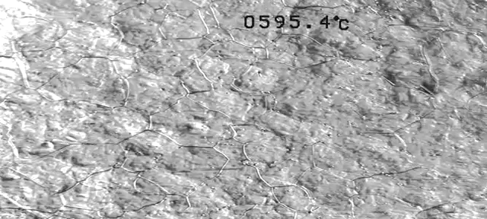
50 µm
Pak, Suh, Bhadeshia
Metall. & Mater. Trans A 43 (2012) 4520

Slide 9
Mistake: acknowledge displacive but not consequences
....strain energy is “extremely small” when fraction of bainite small ....

Slide 10
Nucleation – small sphere, homogeneous

Slide 11
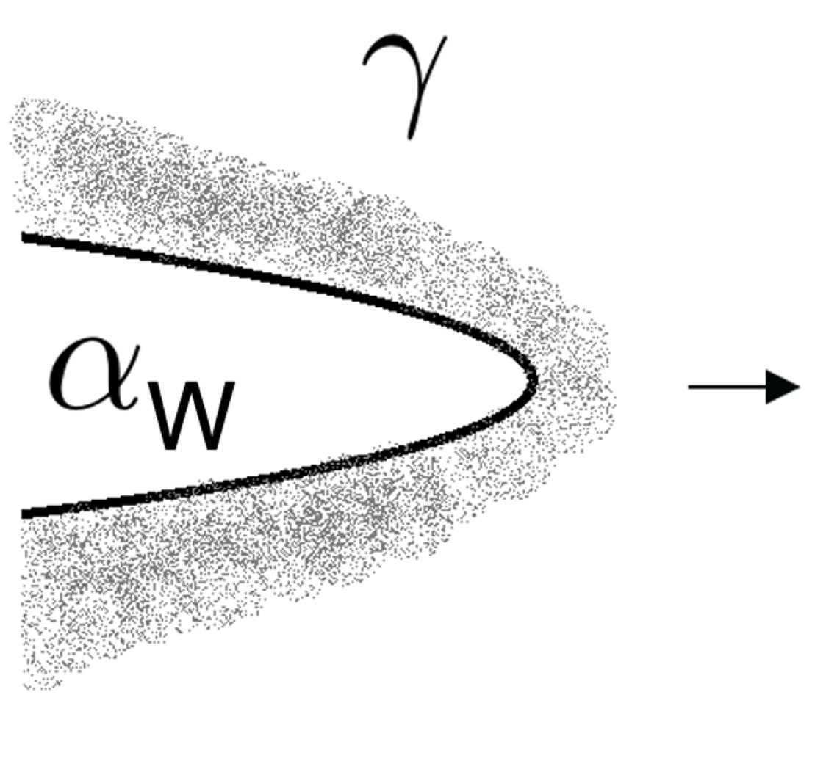
Mistake: acknowledge displacive but not consequences
No accounting for strain energy or why plate shape:
Benrabah, Brechet, Hutchinson, Zurob: Scripta Materialia 250 (2024) 116182
Fe-0.4C-1Si-1Mn wt%, 400°C

Slide 12
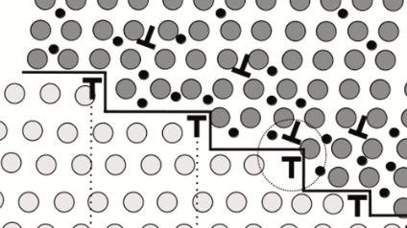
Benrabah, Brechet, Hutchinson, Zurob: Scripta Materialia 250 (2024) 116182
As above + Purdy: Scripta Materialia 223 (2023)115076
``Zener-Hillert model can predict carbon supersaturation’’
... but no strain energy!!

Slide 13
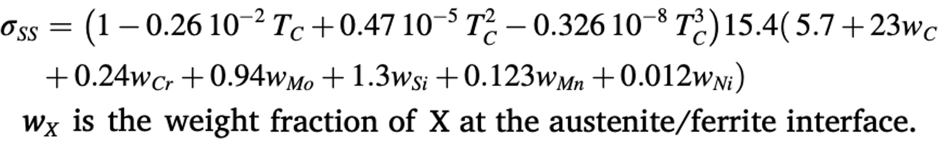
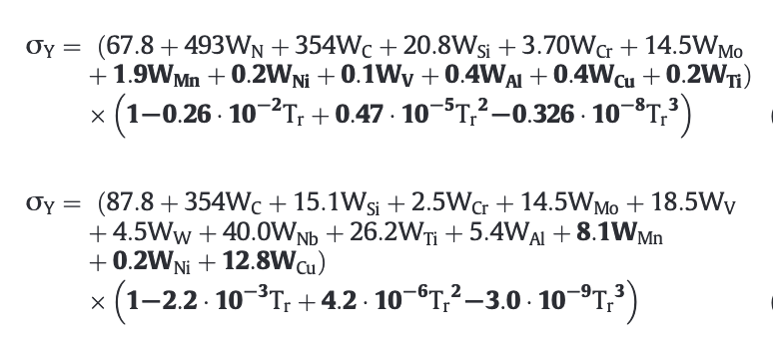
Errors in quoted equation for solid-solution strengthening
Scripta Mat. 250 (2024) 116182
Scripta Mat. 223 (2023)115076
Acta Mat. 268 (2024) 119791
Eres-Castellanos et al.
2020

Slide 14
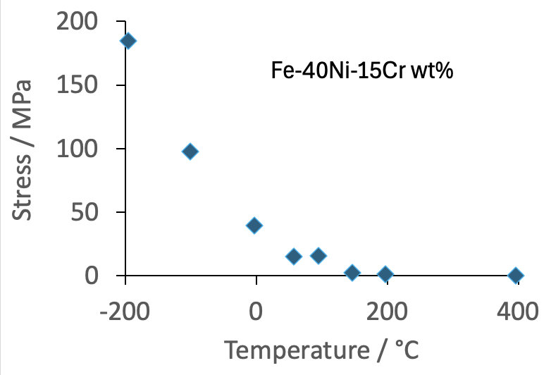
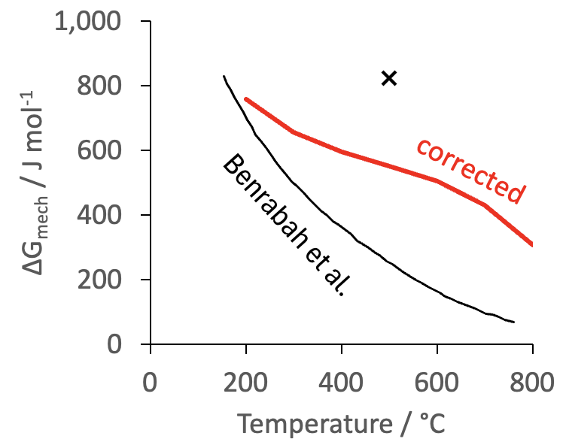
Benrabah, Brechet, Hutchinson, Zurob Purdy
Scripta Materialia 223 (2023)115076
Peierls barrier for austenite
Grujicic, Zhou, Mat. Sci. Engng A 190 (1995) 87
Fe-0.7C wt%

Slide 15
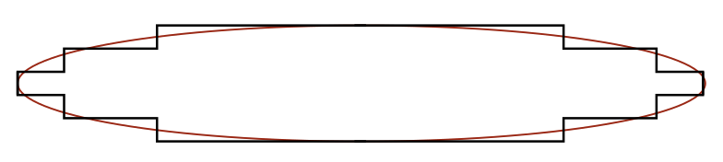
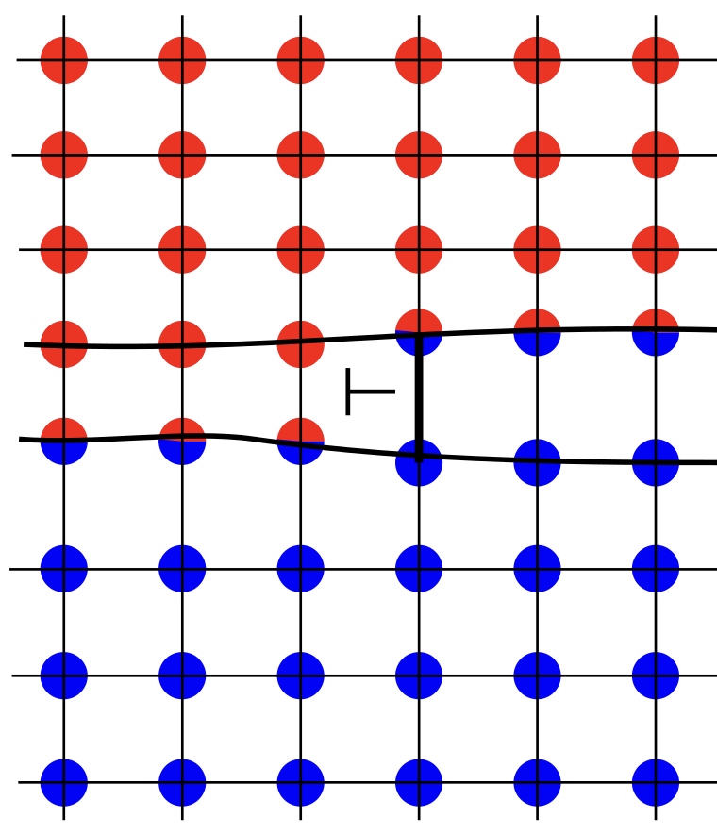
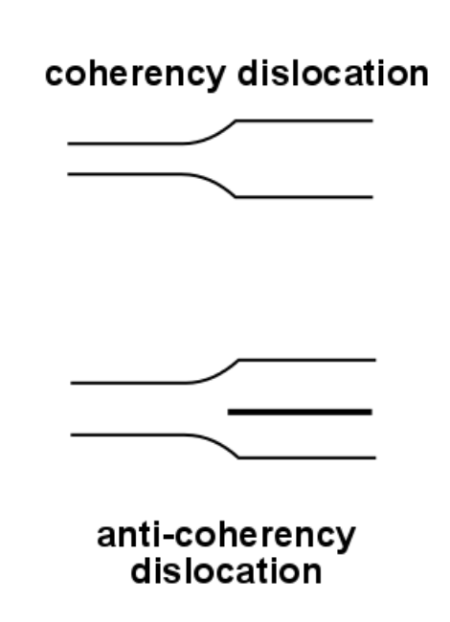
Olson, Cohen
1979

Slide 16
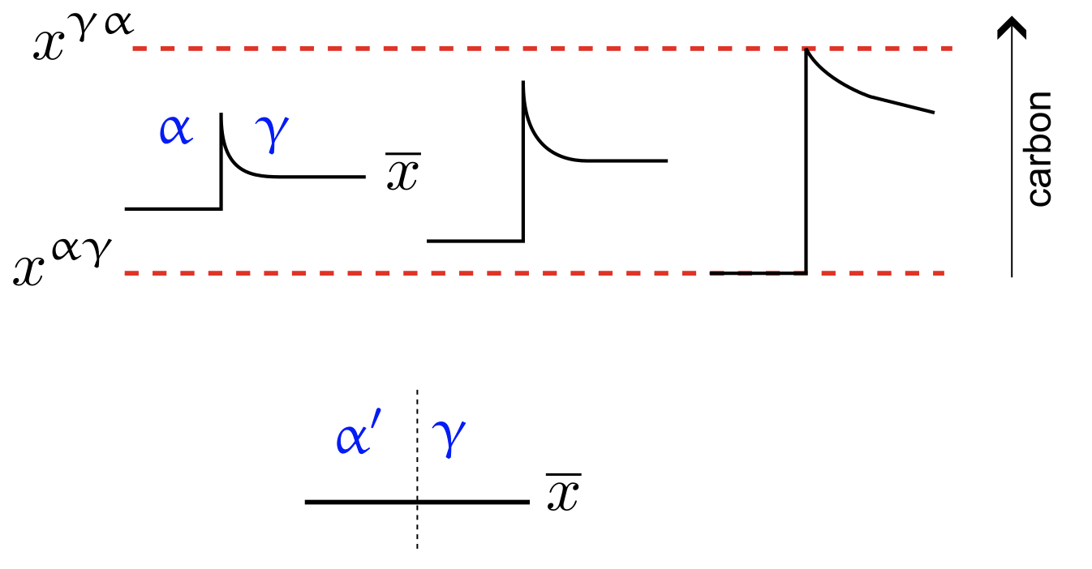
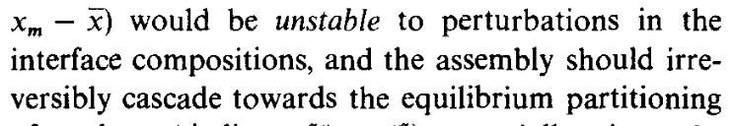
perturbations in diffusion field leading to
Acta Metallurgica 29 (1981) 1117

Slide 17
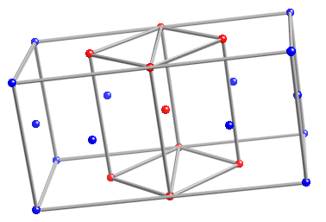
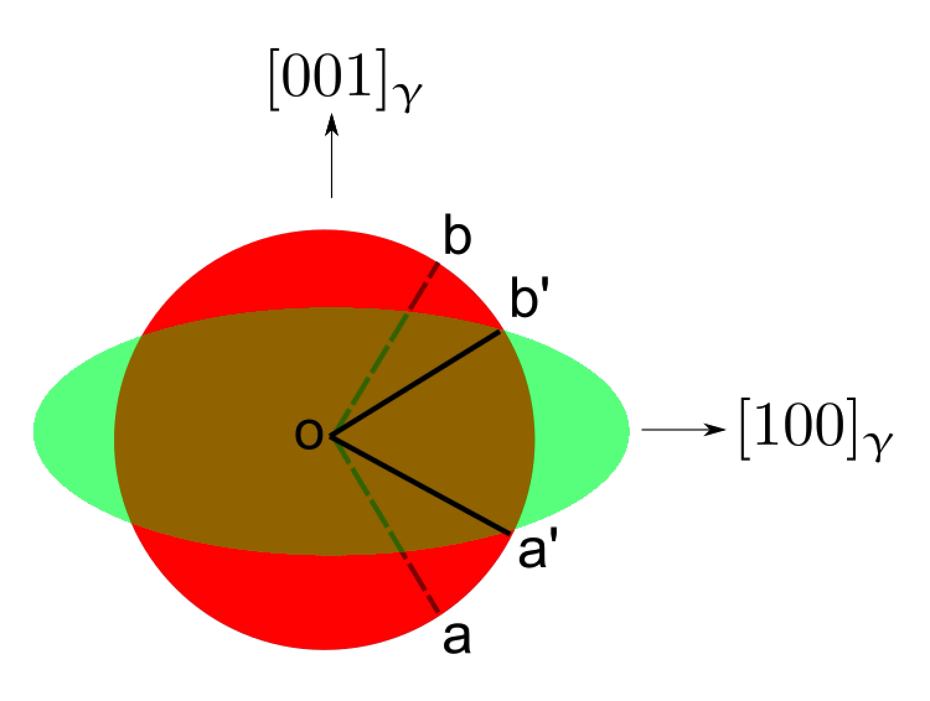
orientation relationships
fundamental condition for displacive transformation

Slide 18
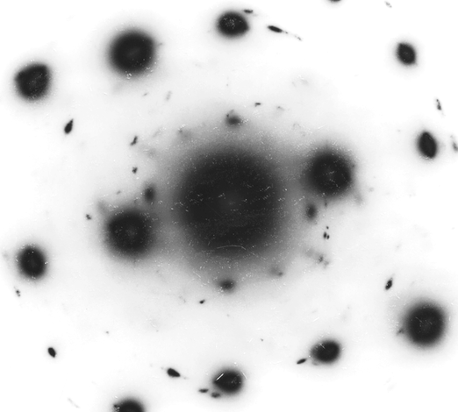
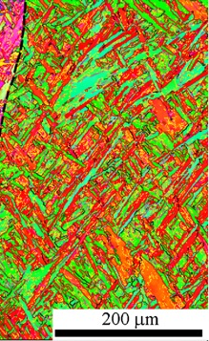
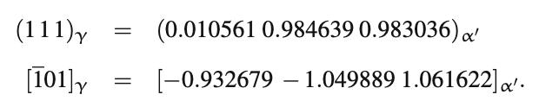
orientation relationships
real orientation relation is irrational

Slide 19
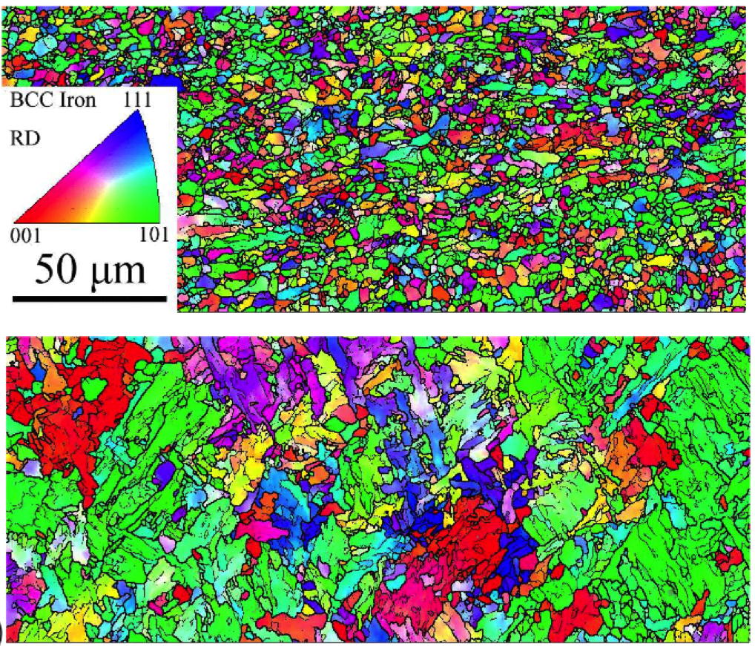
base material
near induction weld
Materials Science and Engineering: A
528, Issues 29-30, 8492

Slide 20
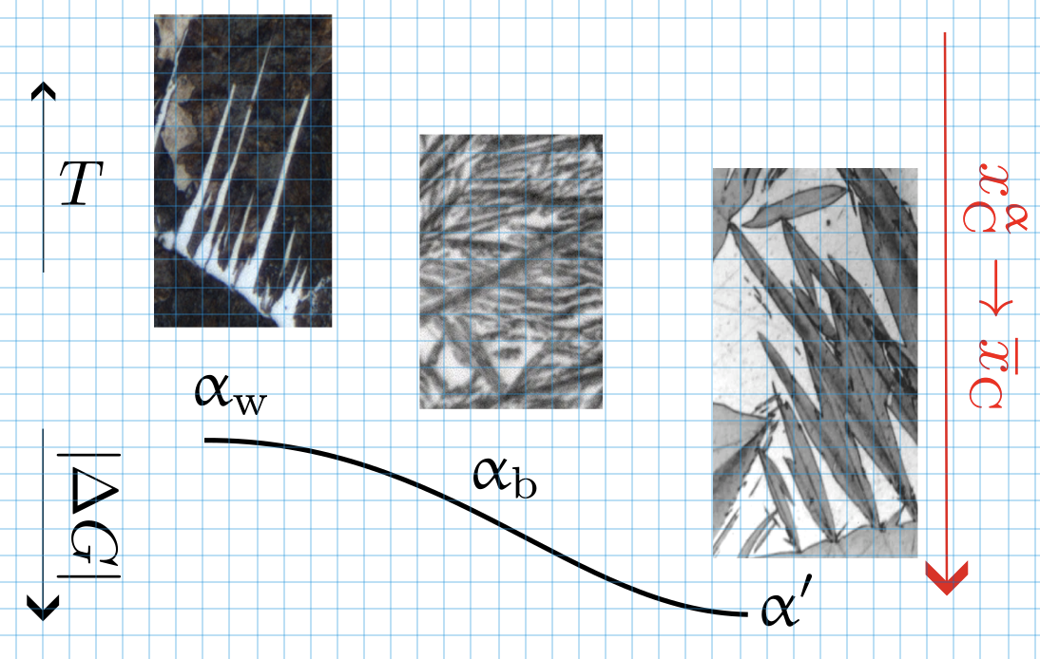
Continuity (of growth) ?
Hillert: Swedish Institute for Metals Research, 1960
e.g., Hillert, Purdy
Acta Metall. 32 (1984) 823
0 strain energy

Slide 21
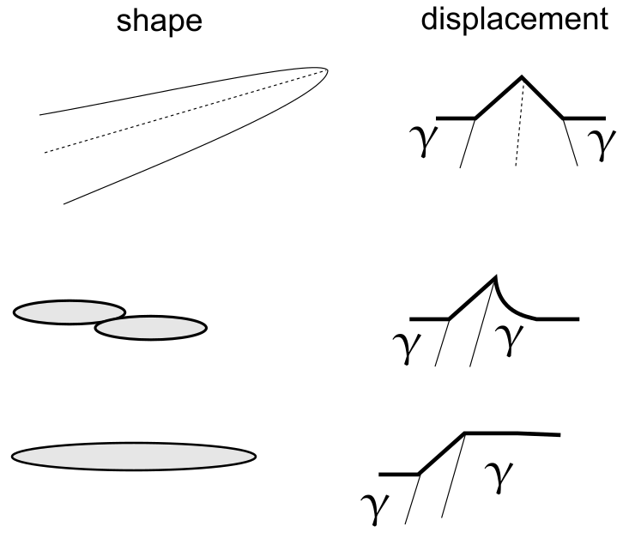
Continuity
strain energy should not be neglected
growth rate measured at
appropriate resolution
X/Fe ratio constant at atomic resolution
no possibility of “solute drag”

Slide 22
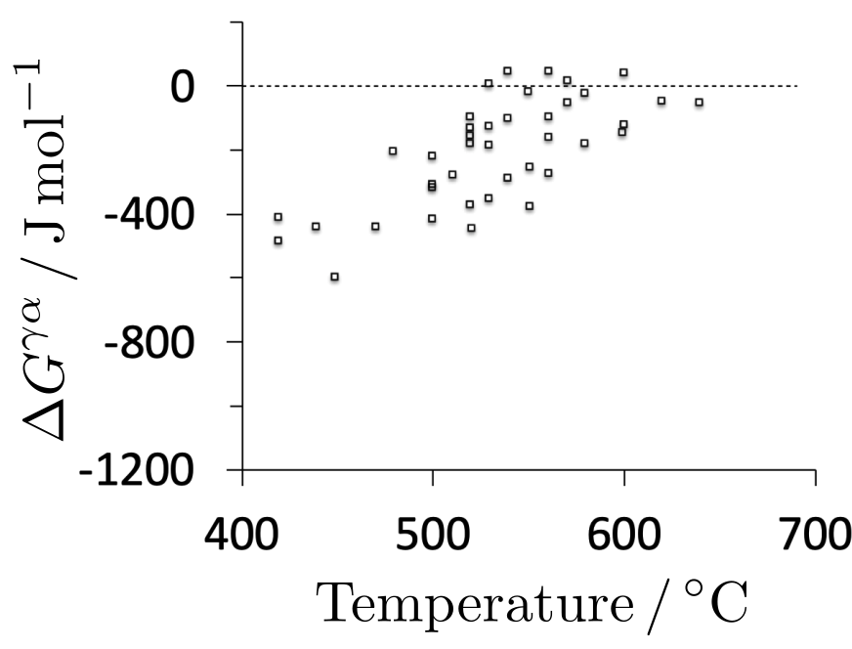
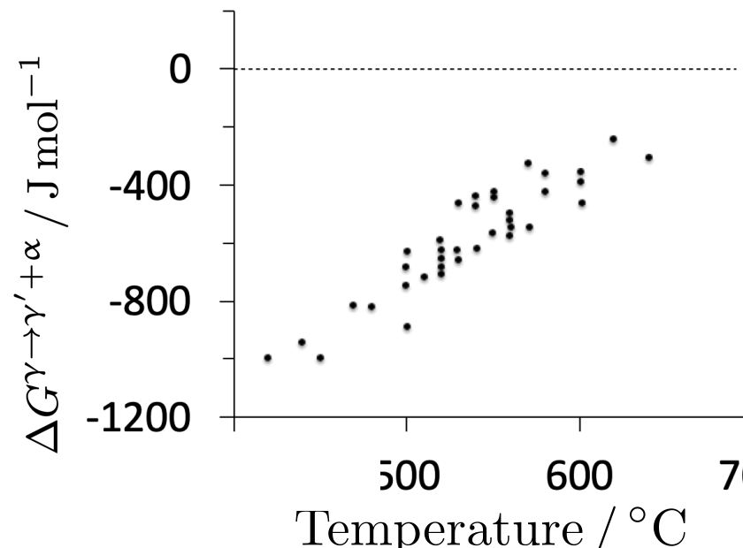
universal nucleation function

Slide 23
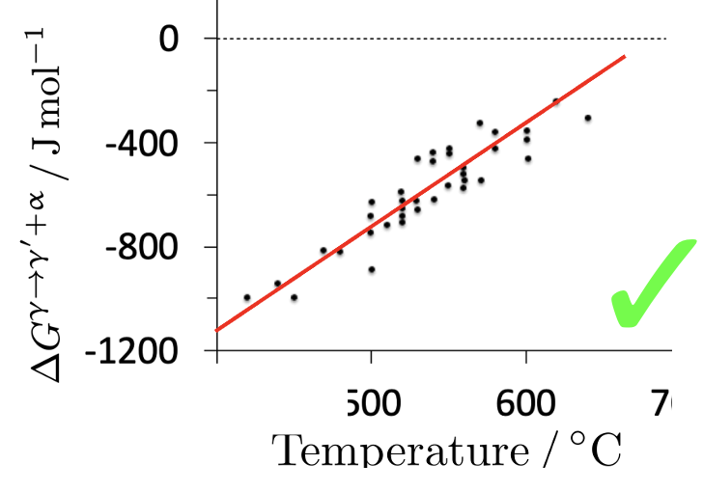
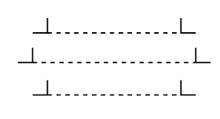

Slide 24
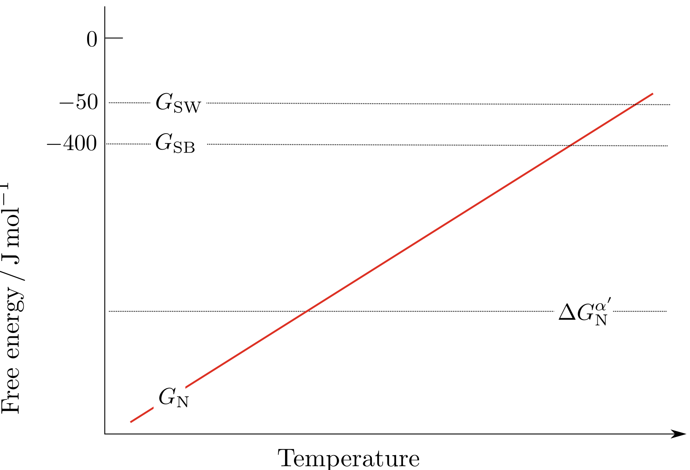
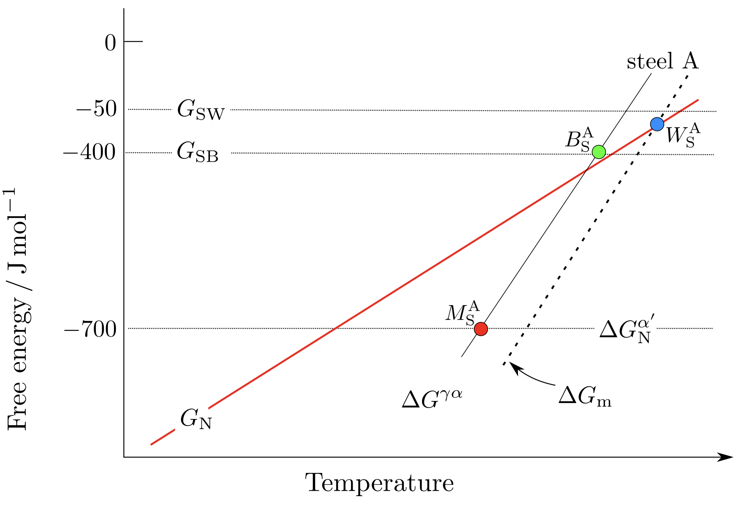
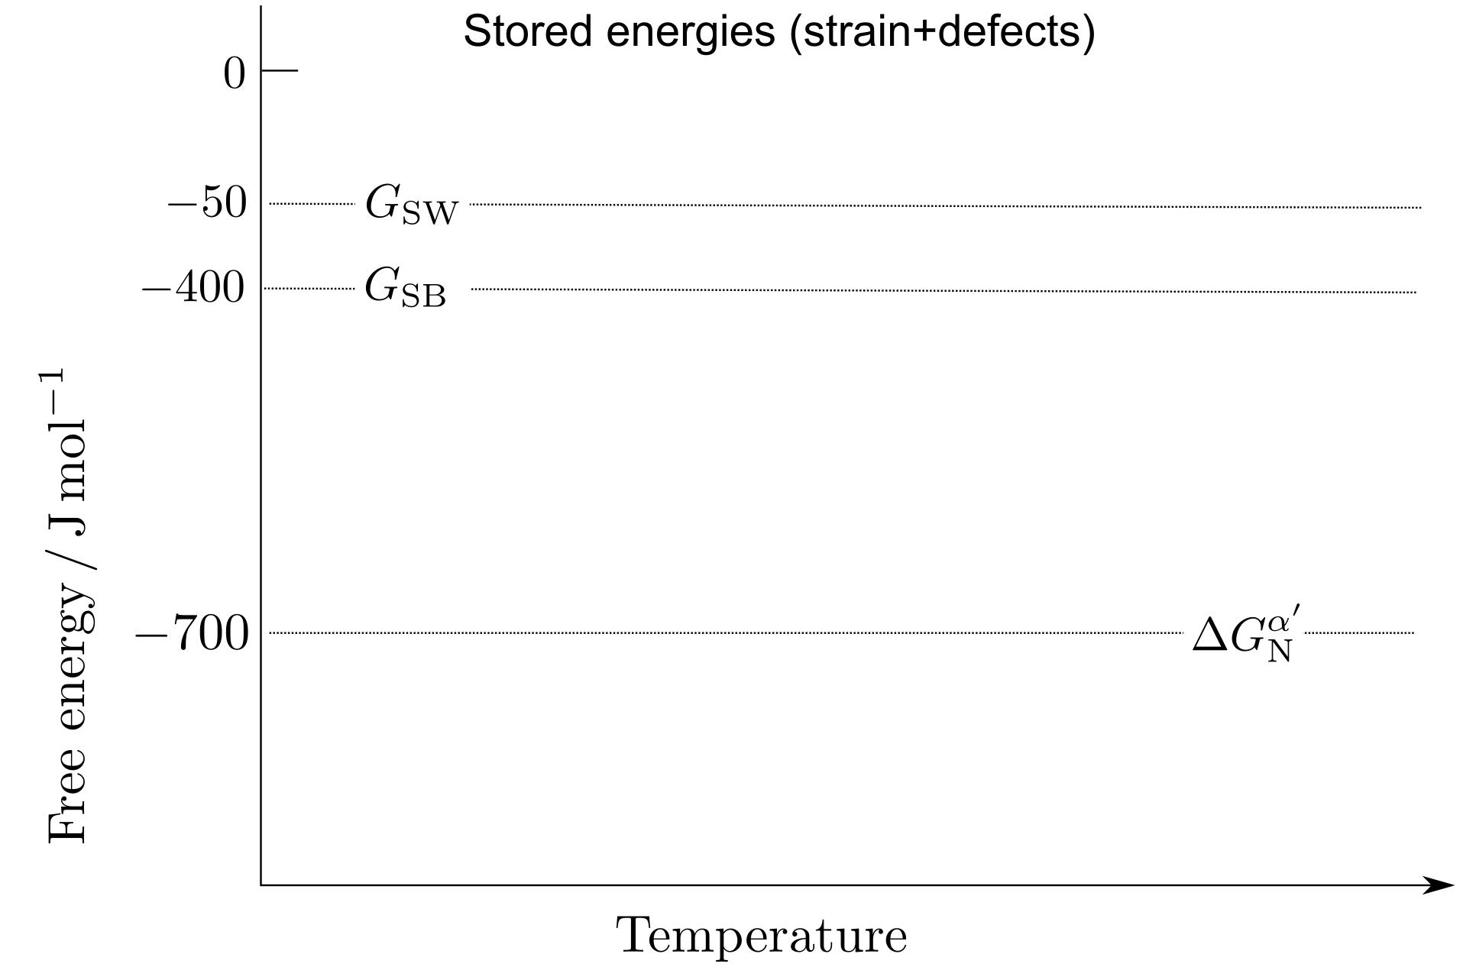

Slide 25
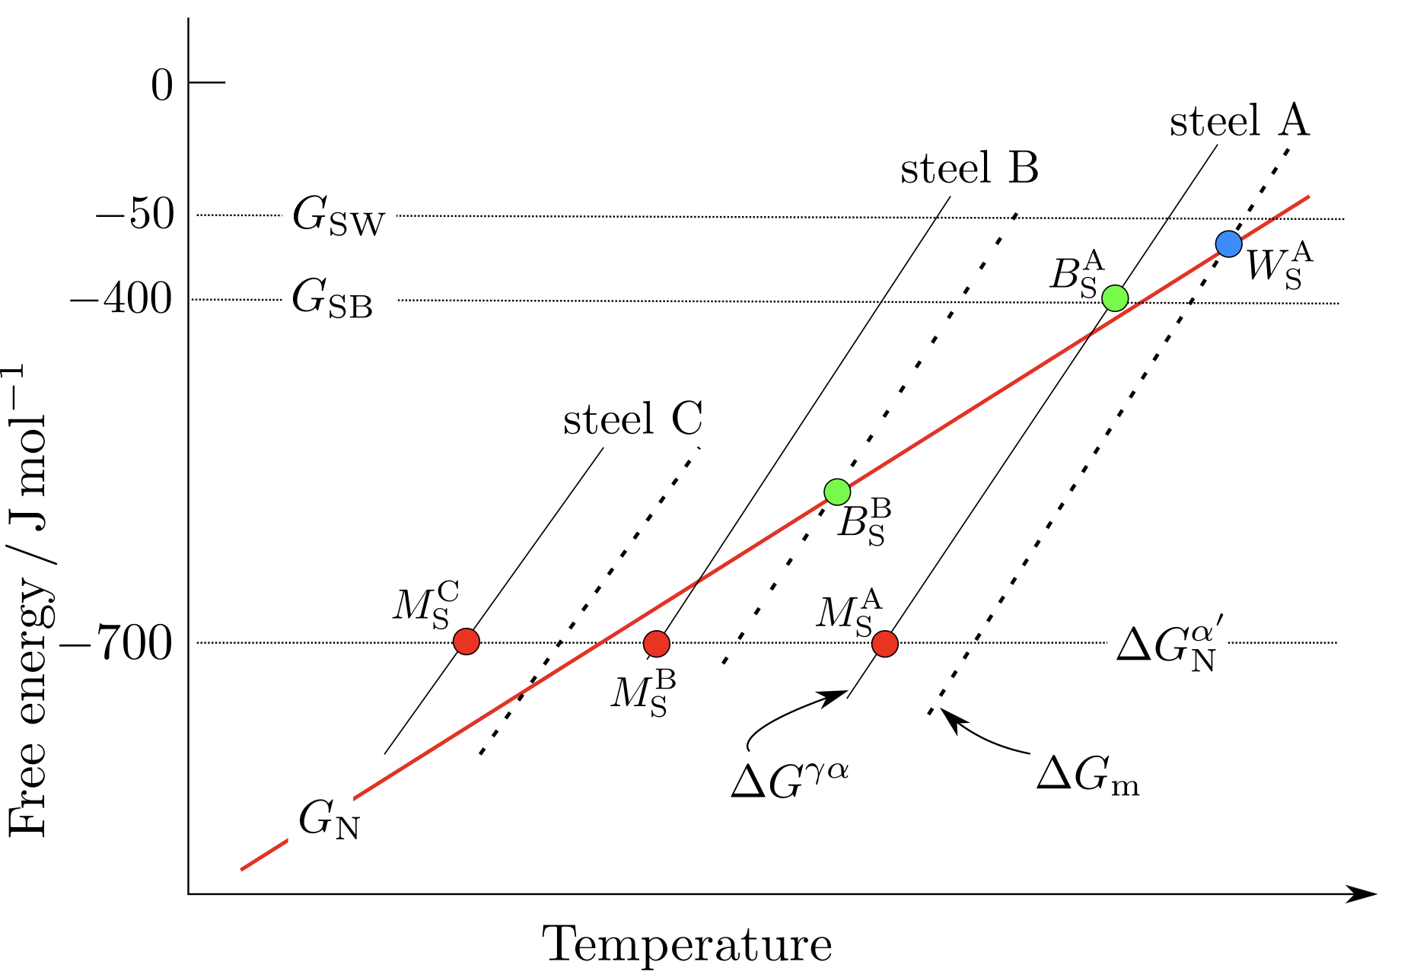
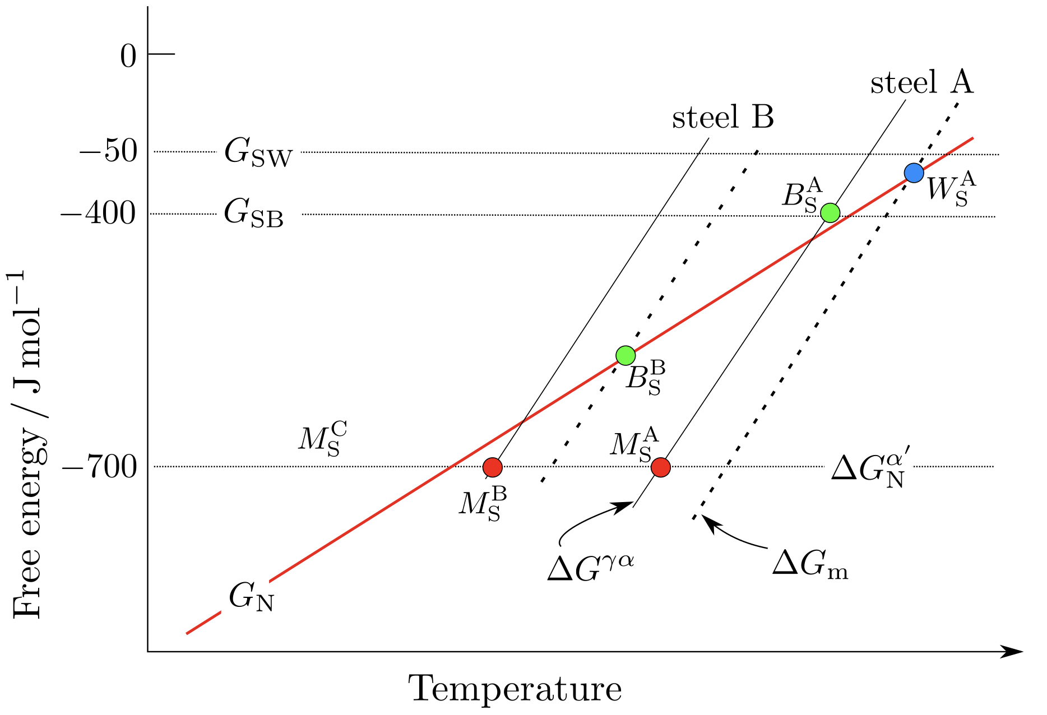
MUCG46

Slide 26
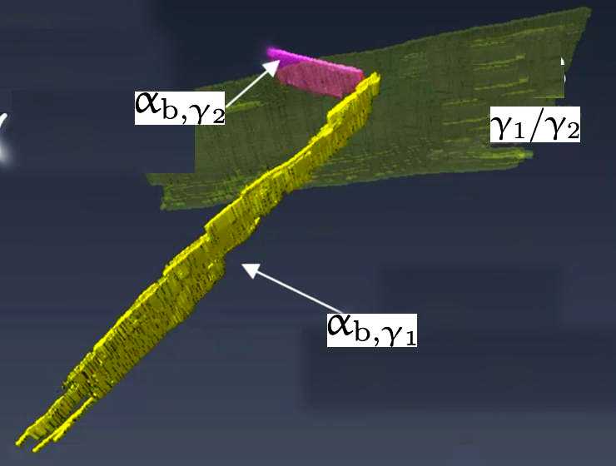
Bainite nucleates predominantly at austenite grain faces
Jimbo & Nambu: Metals 13 (2023) 355

Slide 27
Solute drag
Benrabah, Brechet, Hutchinson, Zurob
Scripta Materialia 250 (2024) 116182
“drag neglected due to high velocities for bainite”
Controversy resolved?

Slide 28
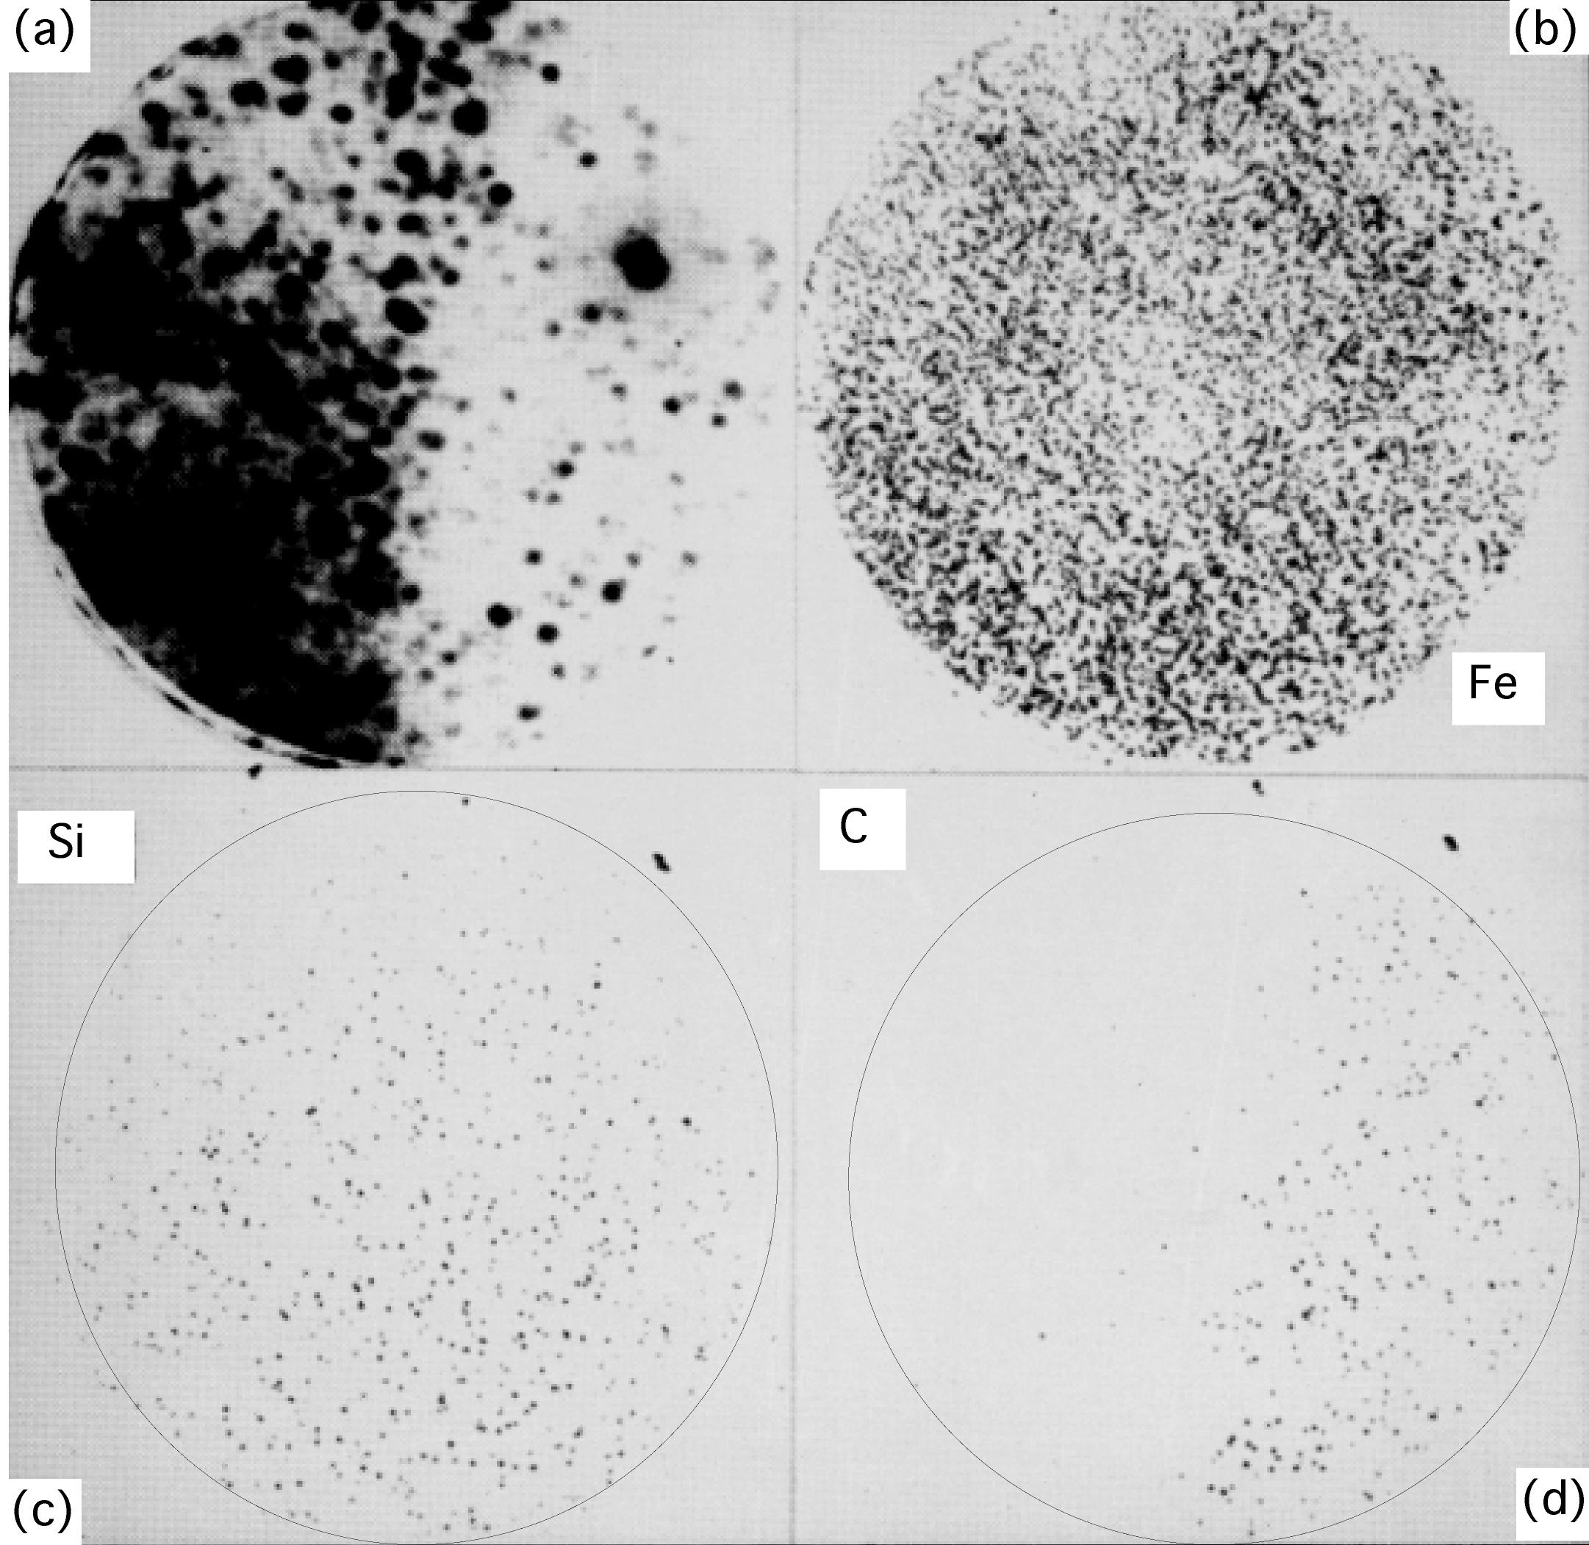
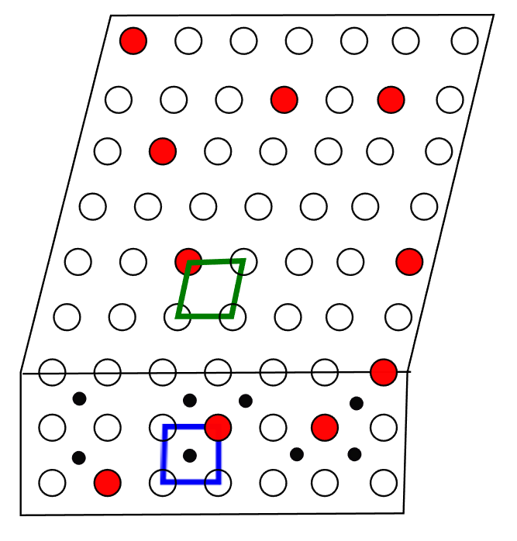
Bhadeshia HKDH, Waugh AR. Bainite: An atom-probe study of the incomplete reaction phenomenon. Acta Metallurgica. 1982;30:775-84.

Slide 29
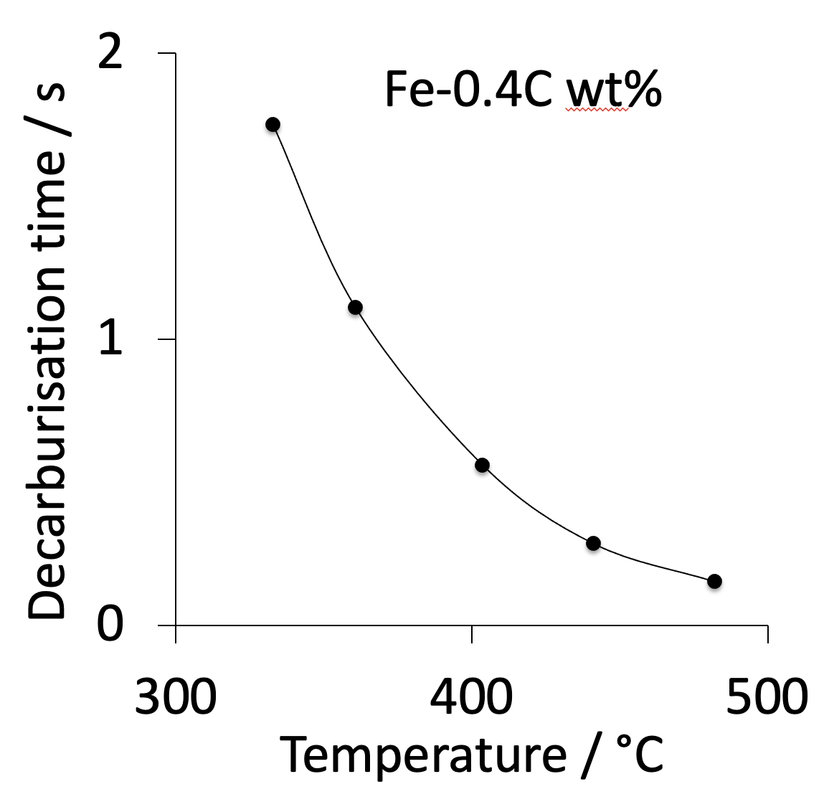
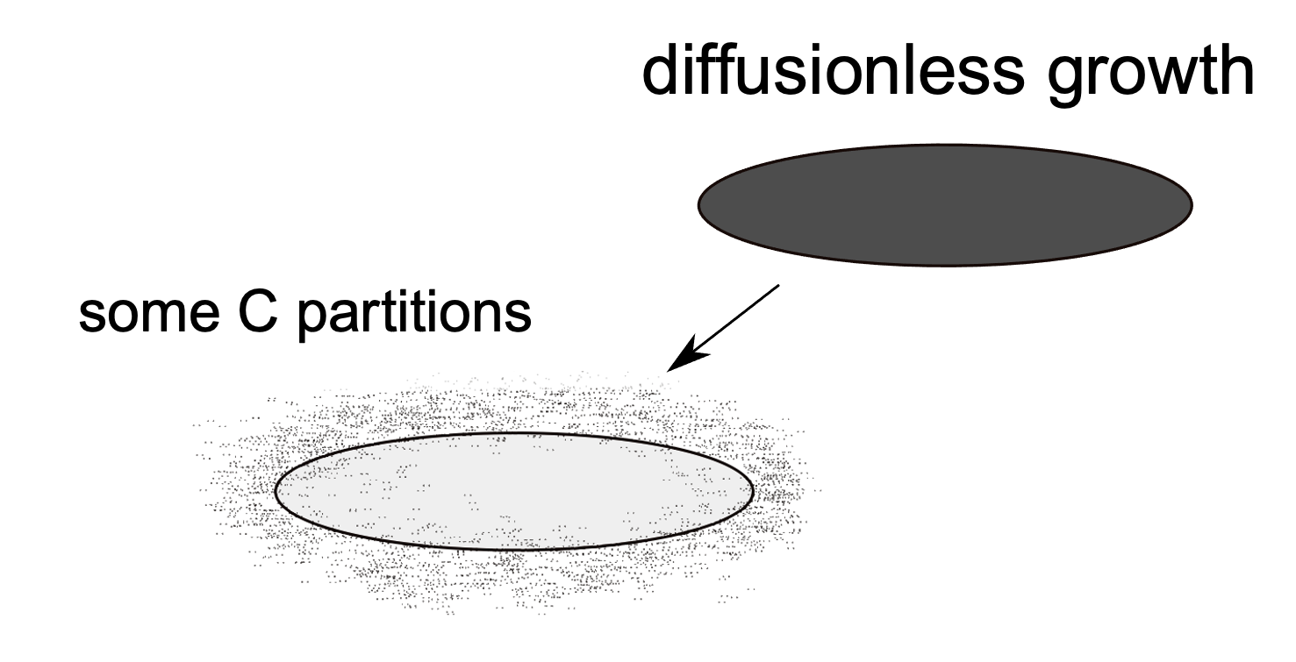

Slide 30
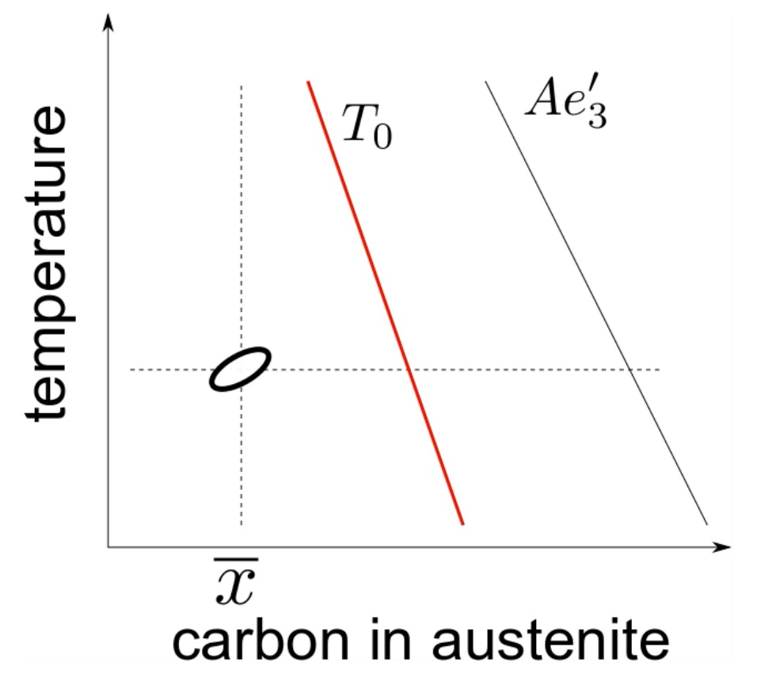

Slide 31
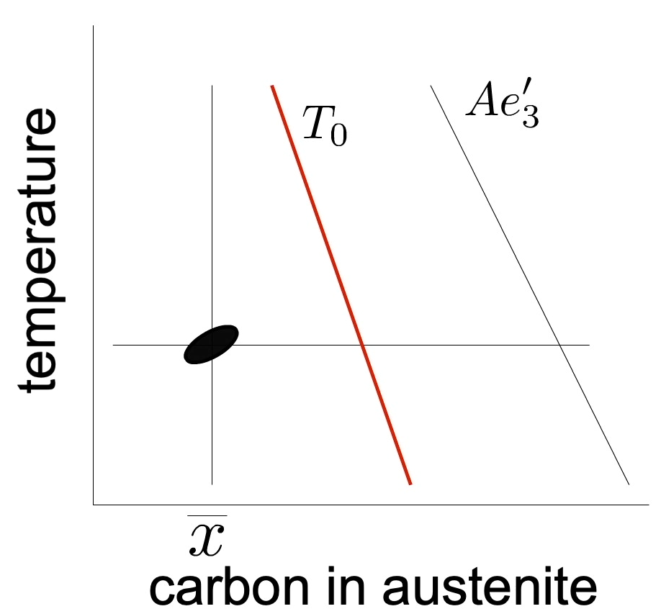
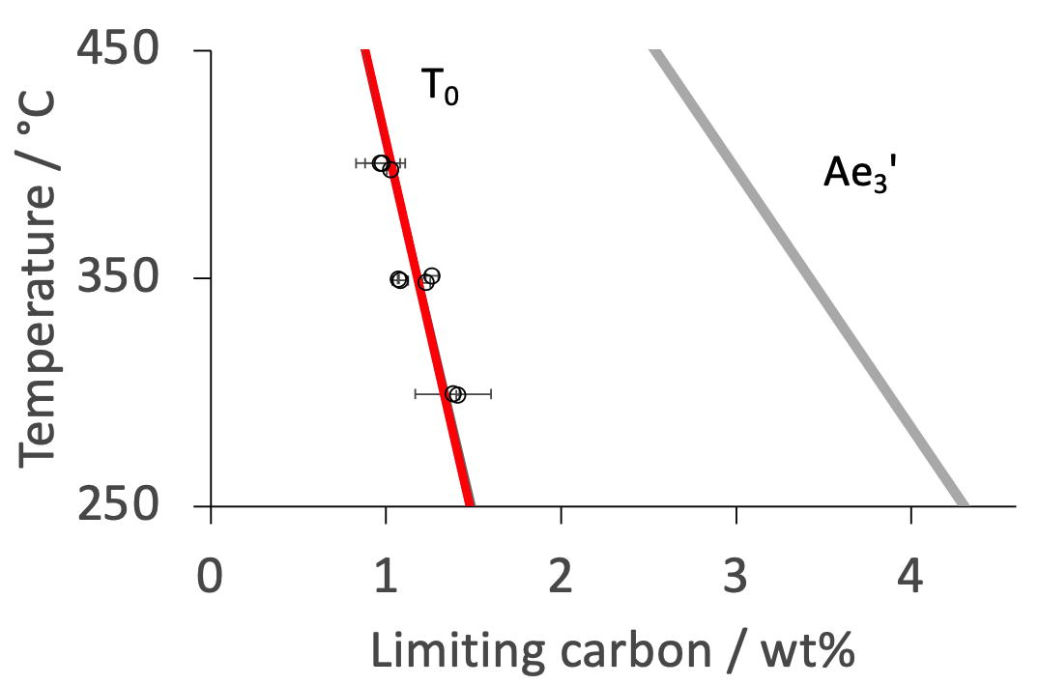
Growth is diffusionless
but plate decarburised shortly afterwards
Lin, Borgenstam, Stark, Hedström.
Materials Characterization 185 (2022) 111774

Slide 32
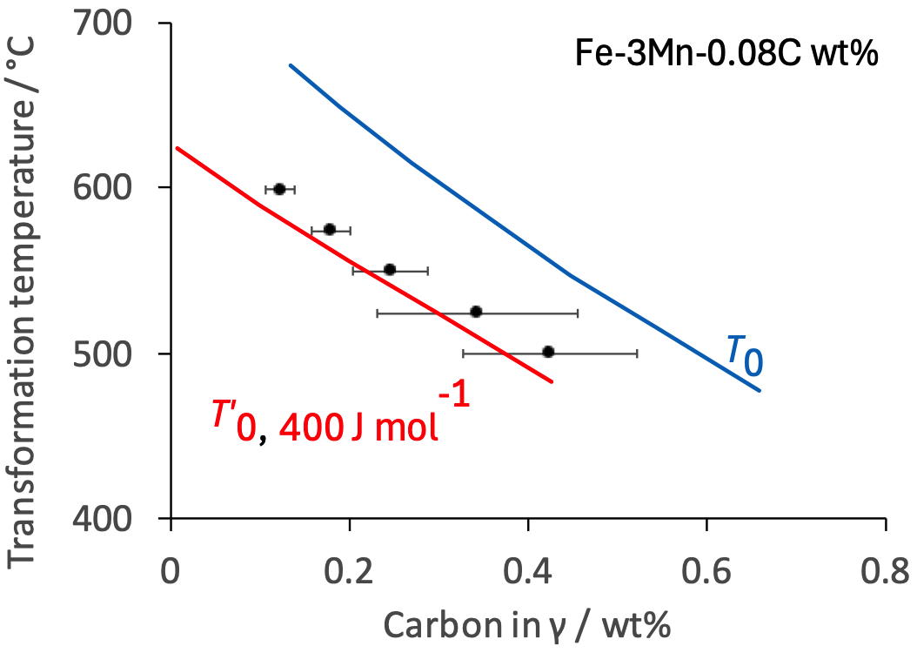
Liu, Miyamoto, Yang, Zhang, Furuhara
Metall. Mat. Trans. A 46 (2015) 1544

Slide 33
γ
High supersaturation
NP-LE mode
Manganese
α
α
γ
α+γ
Carbon
α
γ

Slide 34
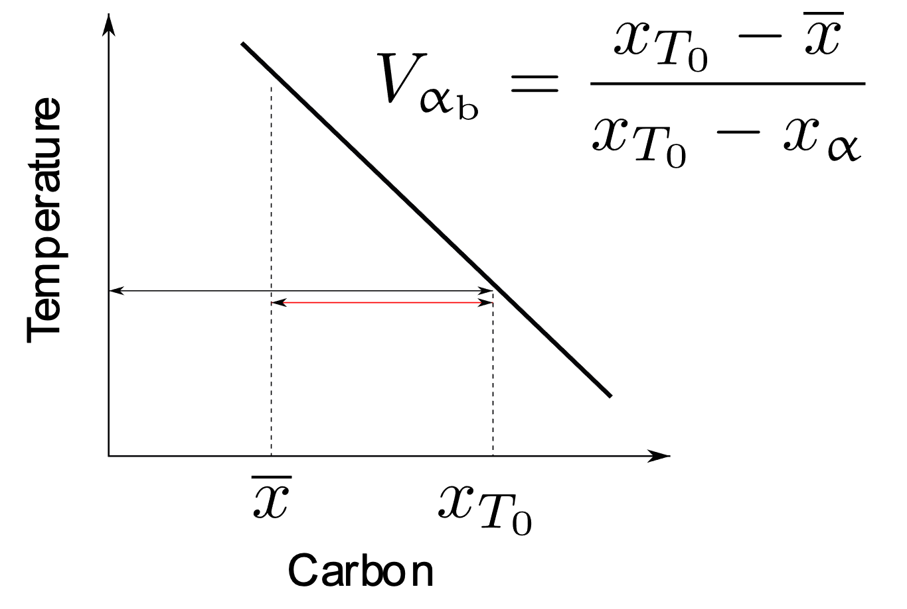
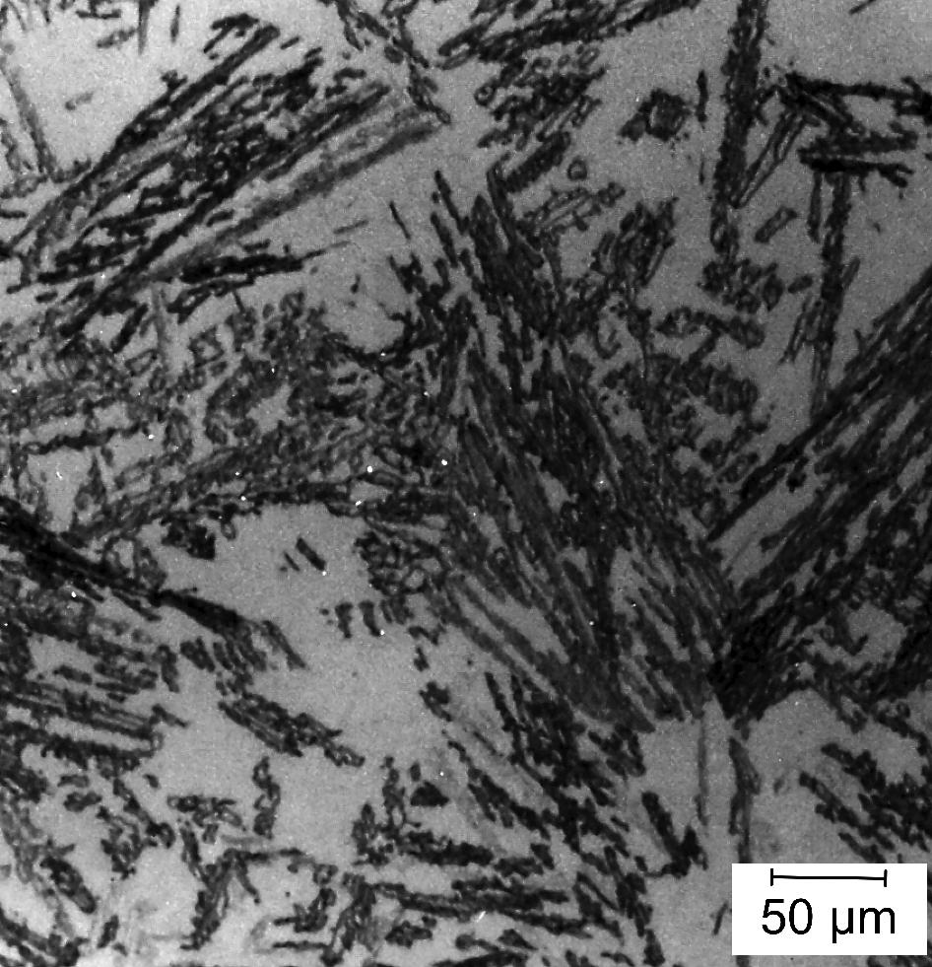

Slide 35


Swallow, Bhadeshia
Materials Science and Technology. 12 (1996) 121

Slide 36



Slide 37





growth rate?
3 orders of magnitude faster than carbon diffusion-control
Photoemission electron microscopy

Slide 38

Acoustic emissions ....
... from bainite
Courtesy of Francisca Garcia Caballero

Slide 39




lot of α_{b}
only displacive transformations
stabilized by plastic deformation
of austenite
mostly α’
Shipway & Bhadeshia 1995

Slide 40


478°C for 43 days – bainite completed in seconds. Bhadeshia (1981)
reconstructive transformation
6000 times slower

Slide 41

Bhadeshia, Met. Sci. (1982)

Slide 42



Bhadeshia, Waugh
Acta Metall. 30 (1982) 775

Slide 43


carbon concentration in solution in ferrite
Fe-1C-1.5Si-1.9Mn-1.3Cr-0.26Mo-0.1V wt%
Acta Mat. 91 (2015) 162
dislocation
Time during transformation at 200°C / hours
Caballero, Miller, Mateo, Cornide. J. Alloys & Compounds, (2012)

Slide 44


Jang, Suh, Bhadeshia, Scr. Mat. 68 (2012) 195

Slide 45


transformed to
bainite at 200°C →25°C
then heated from
25→600°C at 300°C h⁻¹
Hulme-Smith, Lonardelli, Dippel and Bhadeshia, Scr. Mat. 69 (2013) 409.

Slide 46




Slide 47


Slide 48






TRIP-assisted

Slide 49
Challenge
prove me wrong!
reconstructive
displacive
Does your theory explain all observations?
Has it been used independently in design?
.... in manufacture?
.... in critical experiments?

Slide 50


www.phase-trans.msm.cam.ac.uk

Slide 51









Low entropy conference

