Slide 1
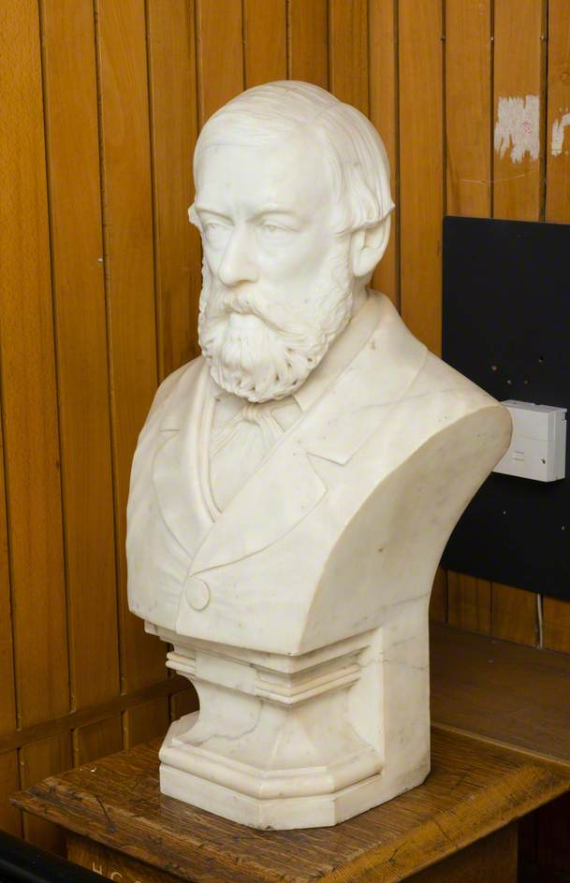
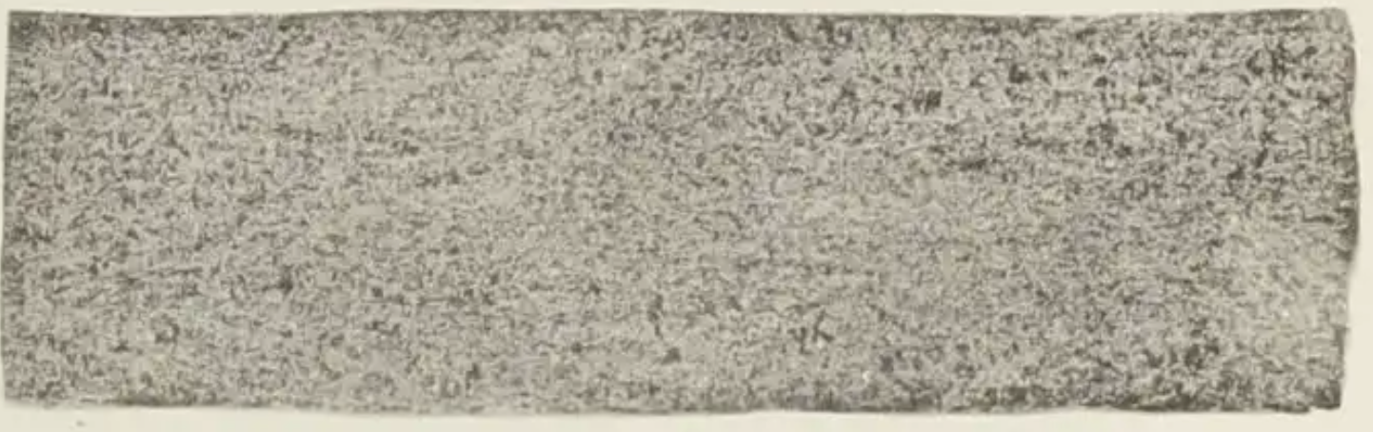
Aspects of pearlite
CC-BY-NC
Sorby (1887)
“I described as pearly. ..... fine straight lines or curved parallel lines alternating thin plates of varying hardness..... iron free from carbon, and the intensely hard substance..”

Slide 2
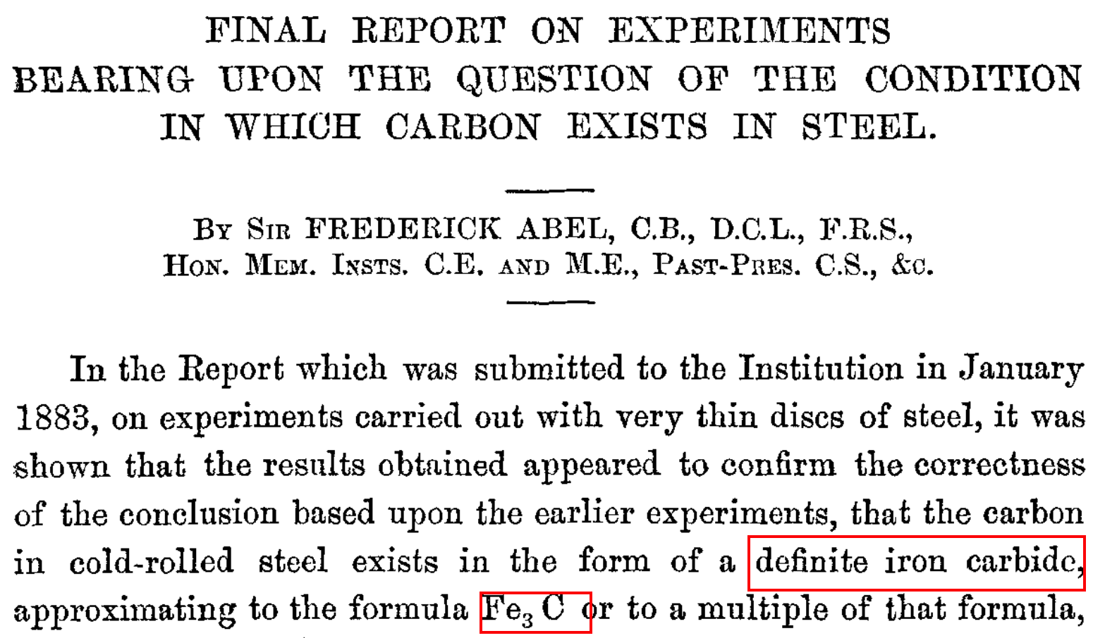
1883 condition of carbon in steel, ≅ Fe₃C
1883 ⇒ Sorby, first metallography
1888 Howe names cementite, ferrite and austenite
1903 Howe in letter to Sauveur, eutectoid

Slide 3
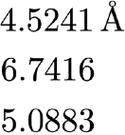
Cementite: primitive crystal structure

Slide 4
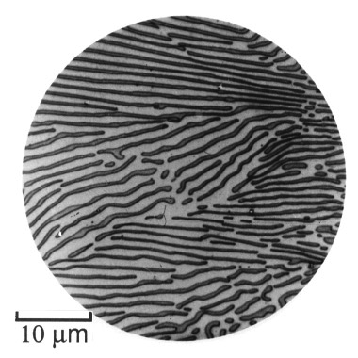
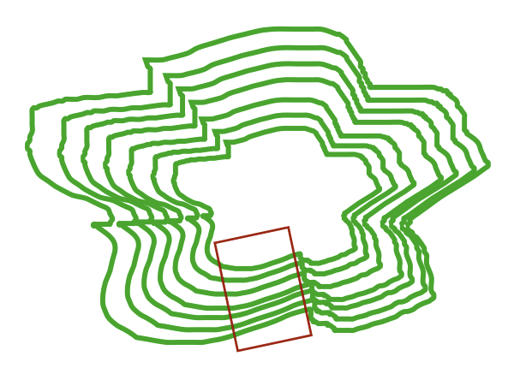
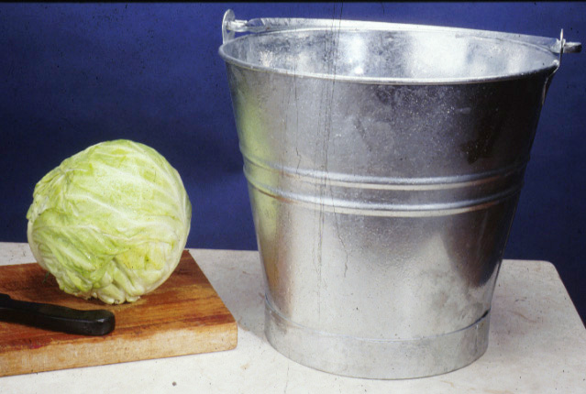
Three-dimensional structure of pearlite
E. C. Bain

Slide 5
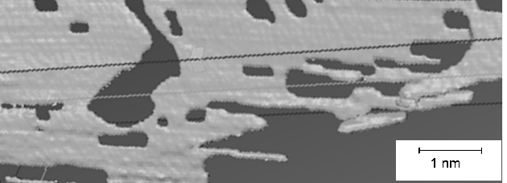
Three-dimensional image of θ-lamella, serial sectioning.
Courtesy of Yoshitaka Adachi.

Slide 6
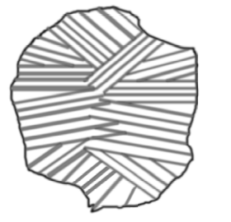
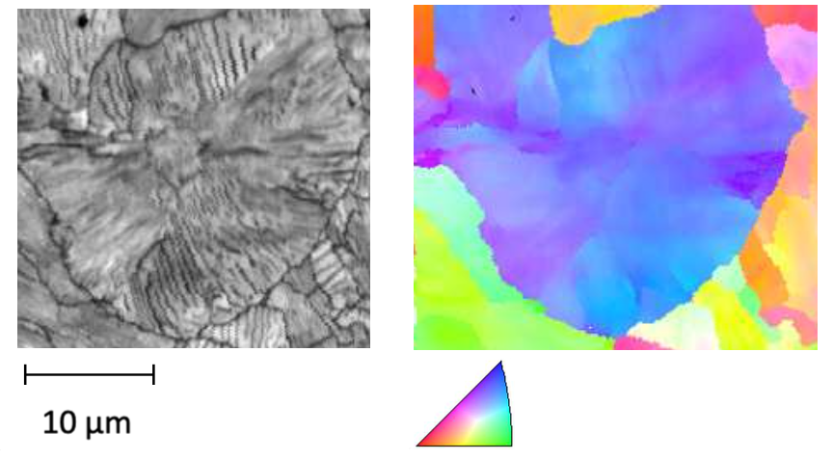
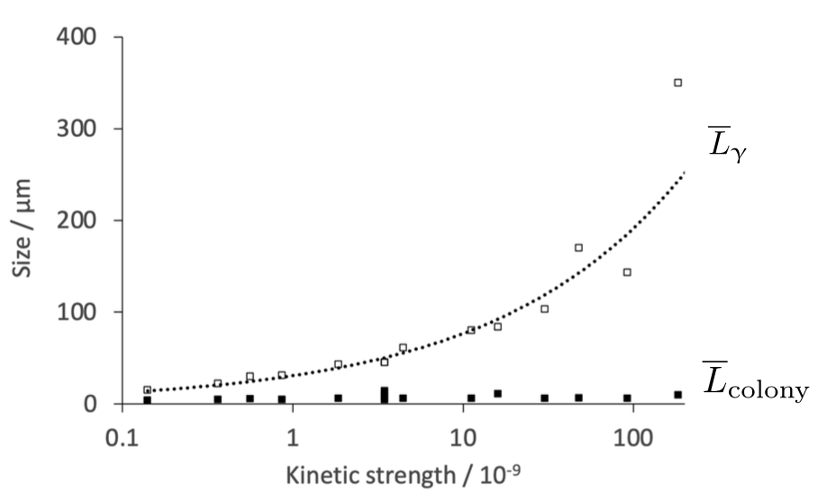
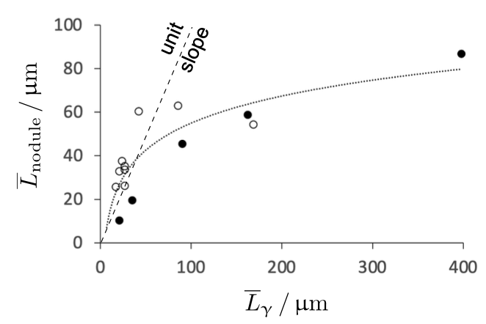
colony
nodule

Slide 7
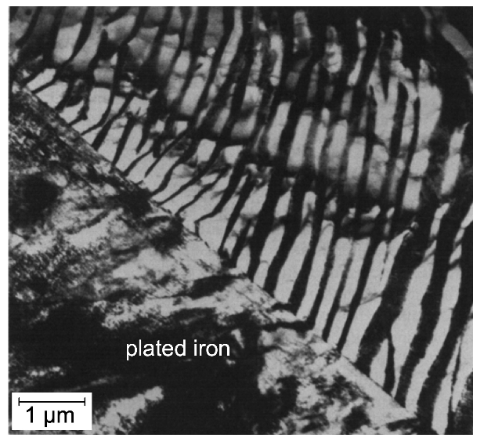
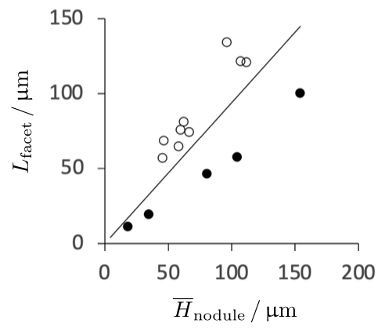
Alexander, Bernstein
Metallurgical Transactions A 13 (1982) 1865
Behera et al. Materials Science & Engineering A 764 (2019) 138256
Zhou et al. Mat. Charc. 119 (2016) 110-113

Slide 8
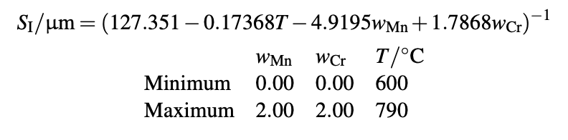
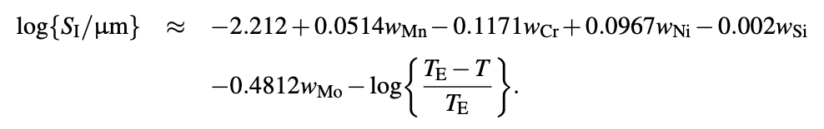
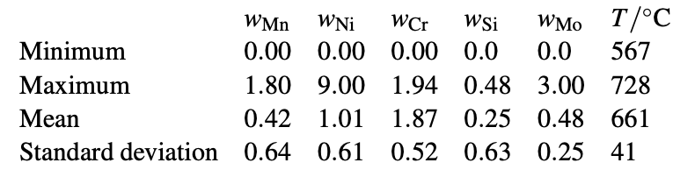
Intelamellar spacing

Slide 9
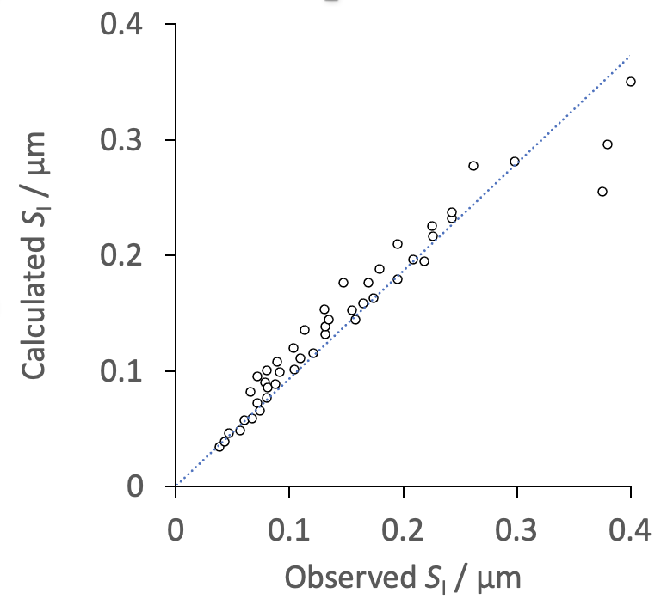
Manabu Takahashi, Ph.D. thesis
Fe-C-1.08Mn
Fe-C-1.98Ni
Fe-C-3.00Ni
Fe-C-1.80Cr
Fe-C-0.90Cr
Fe-C-0.40Cr
Fe-C-9.00Cr wt%

Slide 10
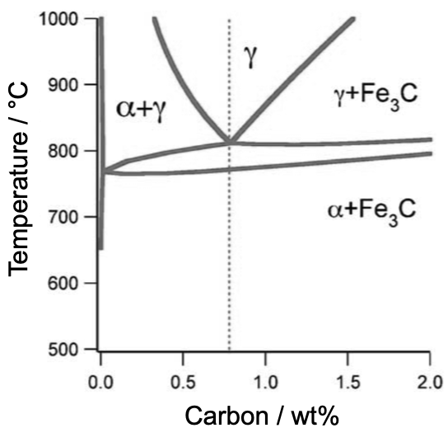
T_{E} of alloy steels?

Slide 11
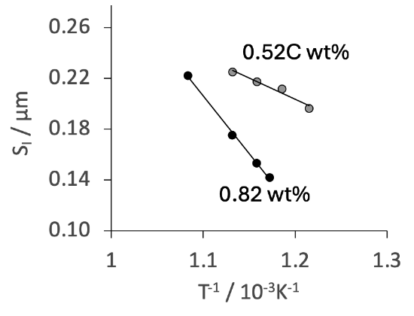
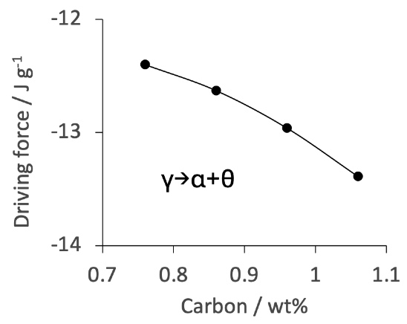
S_{I} independent of carbon concentration?
Fe-C-0.5Mn-0.2Si wt%, Materials Sci. & Techn. 18 (2002) 1317

Slide 12
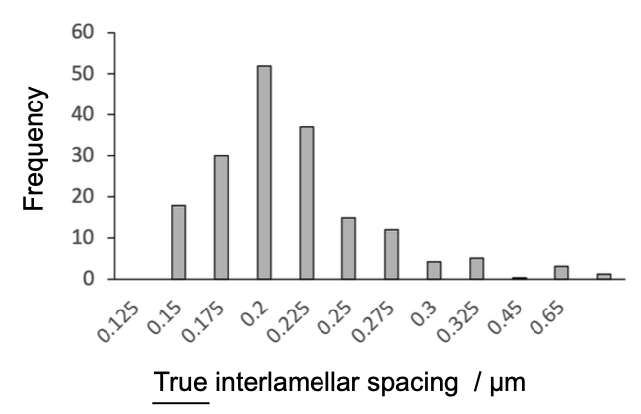
Zhang & Enomoto ISIJ Int. 49 (2009) 921
Fe-0.82C-0.71Mn-0.23Si wt%
700°C

Slide 13
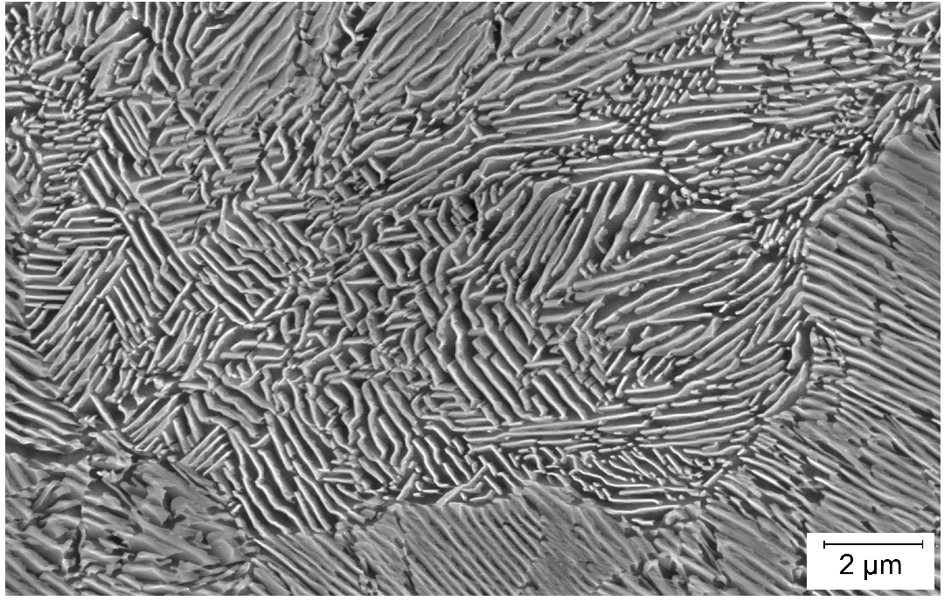
Commercial eutectoid steel, Apparao Chintha

Slide 14
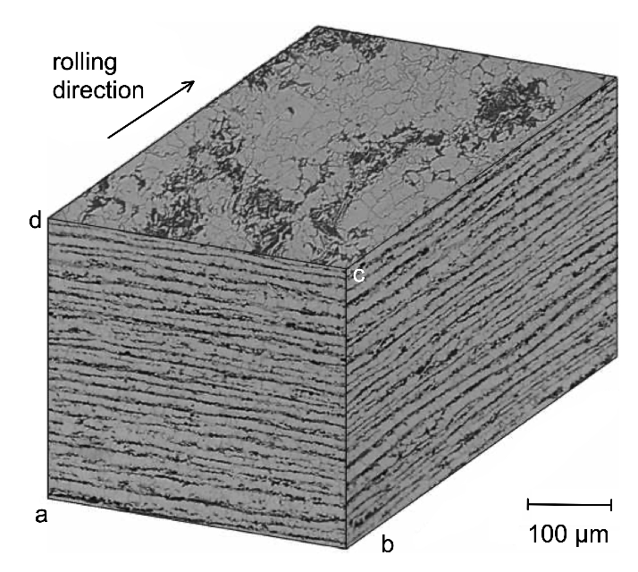
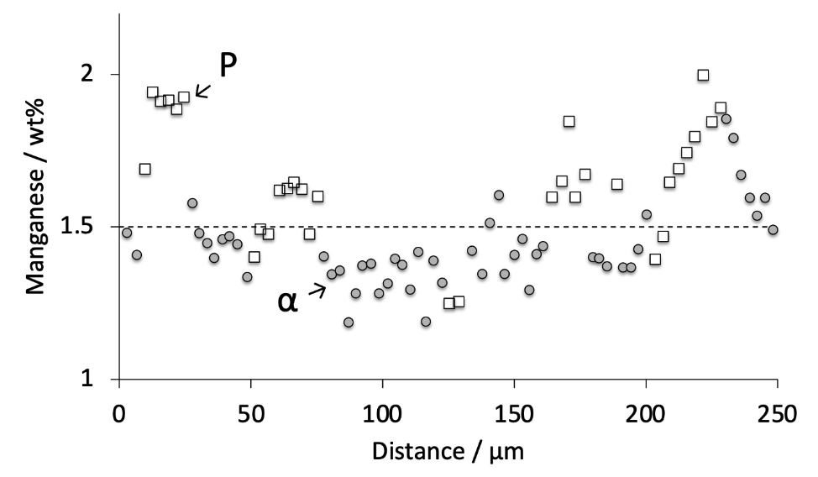
Banded steel (segregation also in fully pearlitic alloys)
Thompson, Howell, Materials Sci. Techn. 8 (1992) 777
Courtesy of Y. Mutoh

Slide 15
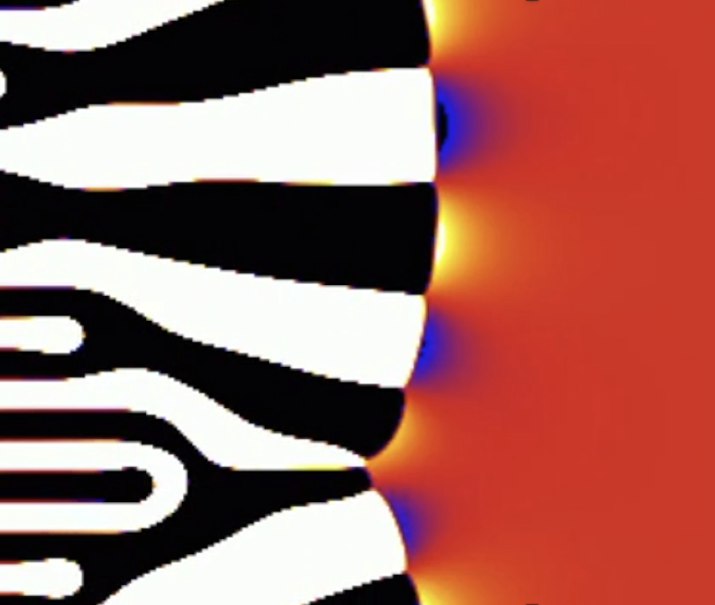
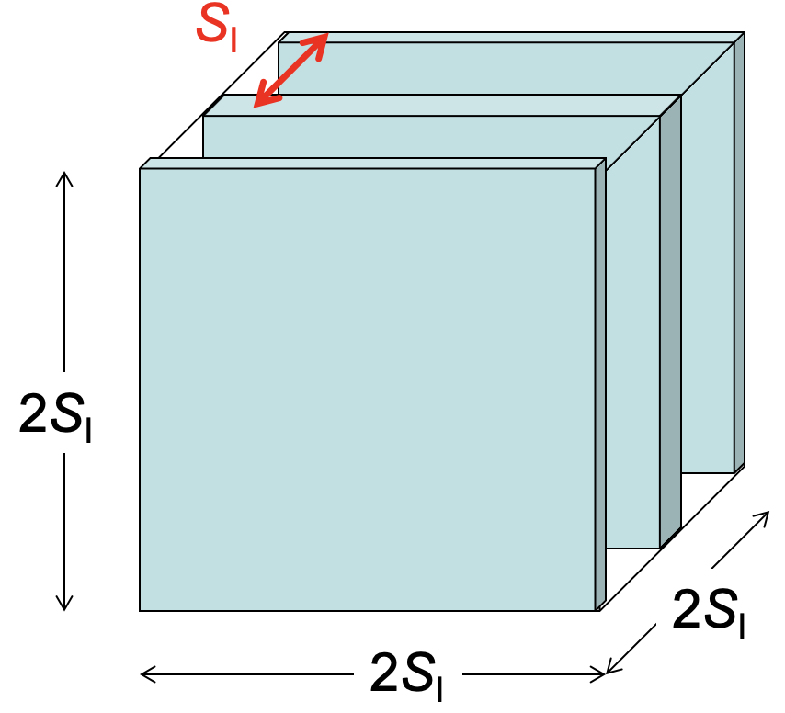

Slide 16
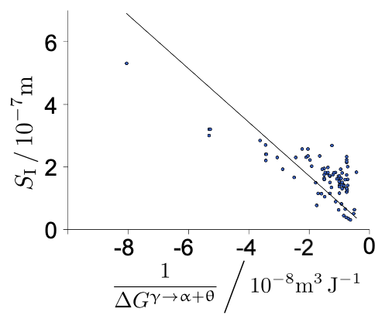

Slide 17
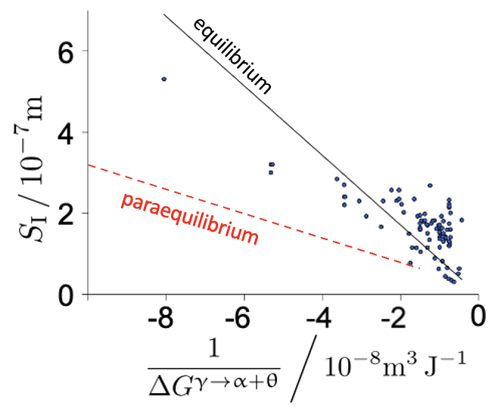
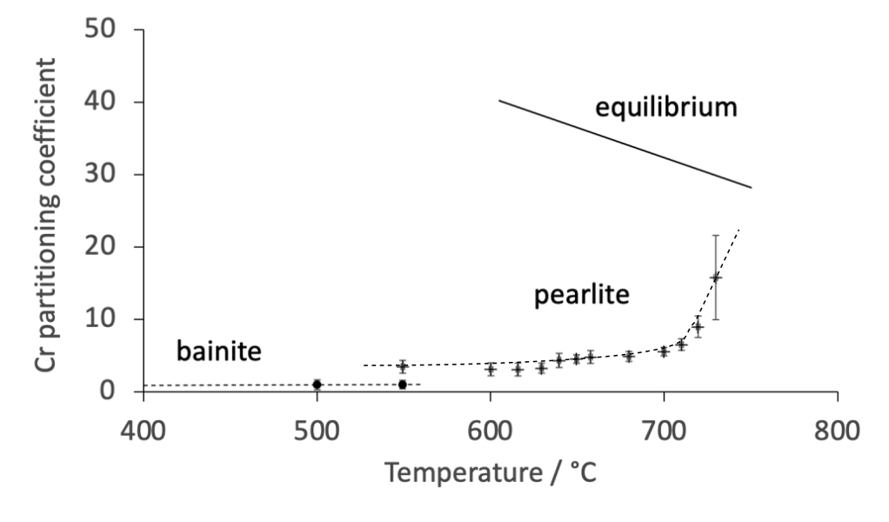

Slide 18
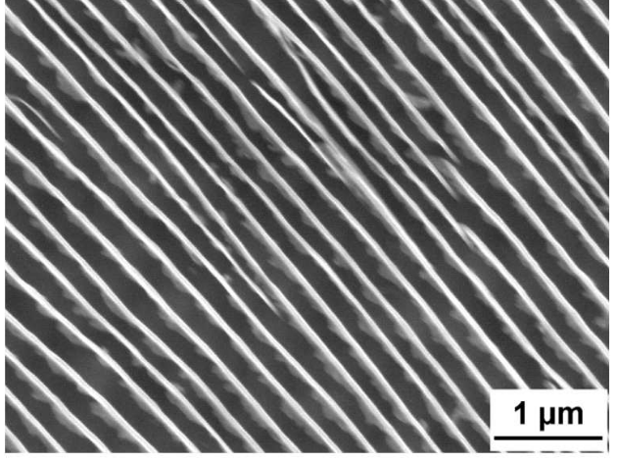
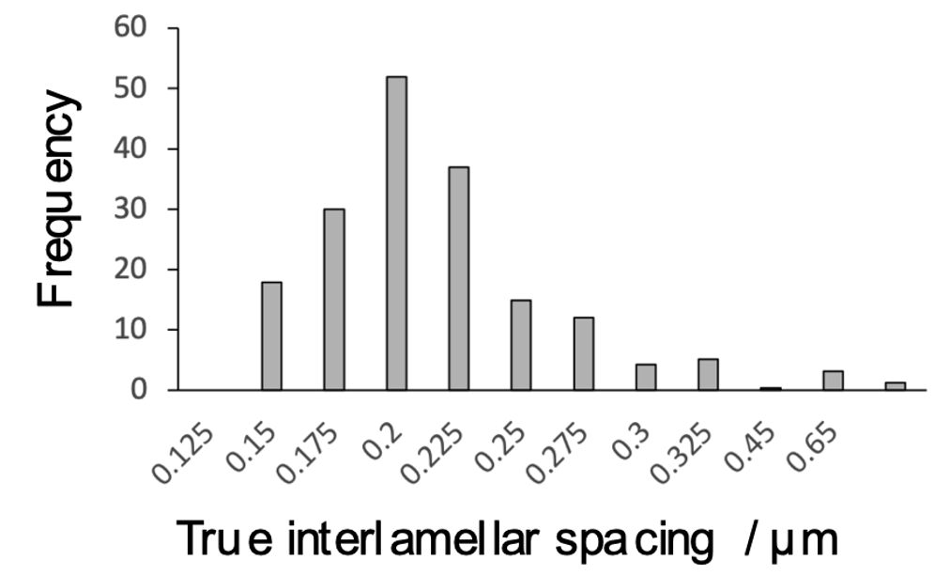
Kaiming Wu
Wuhan University of Science and Technology
Zhang, Enomoto, ISIJ International, 49 (2009) 921

Slide 19
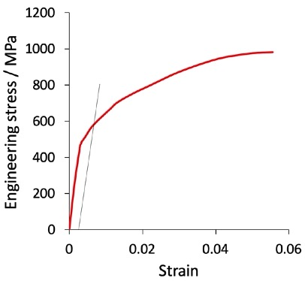
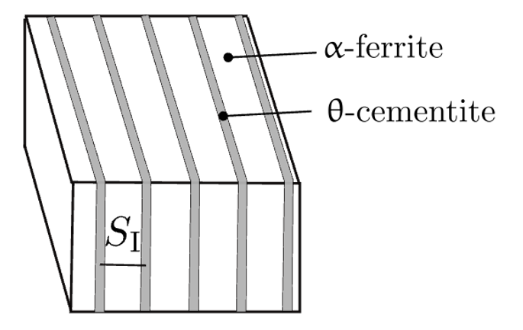
Cementite 1000 HV
Ferrite 250 HV

Slide 20
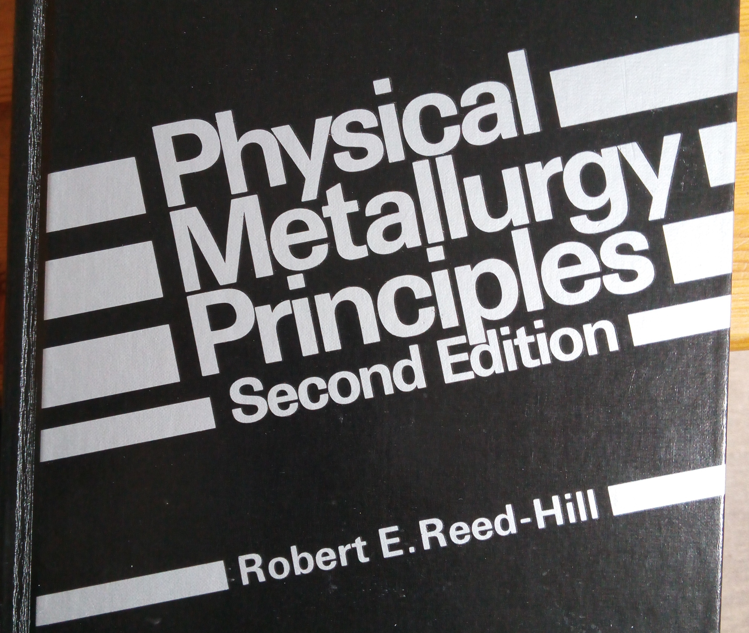
Stress to initiate plasticity sensitive to interlamellar spacing
“Hall-Petch relation …. by no means completely verified”
“equally good”
Page 230

Slide 21
Other problems
Dollar, Bernstein, Thompson
Acta Metallurgica
36 (1988) 311

Slide 22
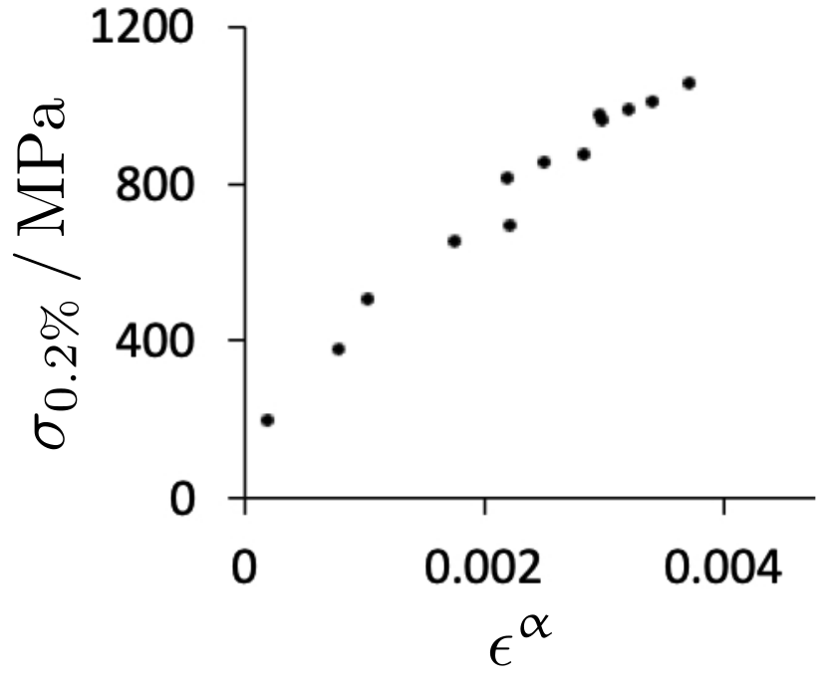
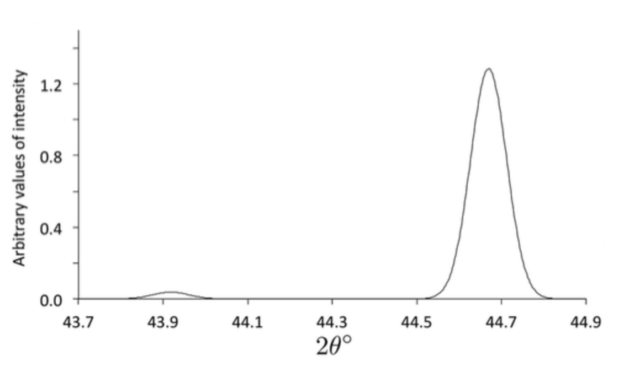
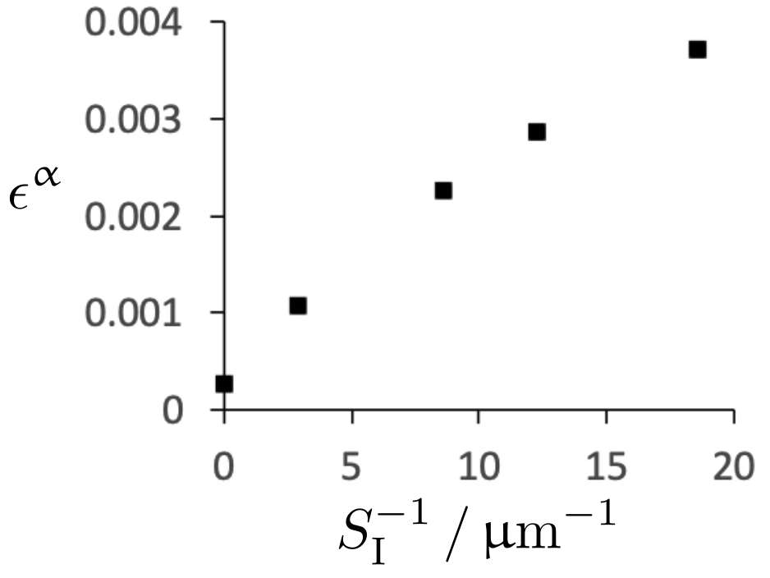
Nakada et al.
strength & S_{I} spurious correlation
α/θ misfit strains α, in proportion to 1/ S_{I}
pearlite yielding begins in α
therefore, strength varies with 1/ S_{I}
misinterpretation
of line broadening

Slide 23
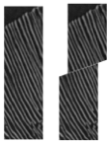
Theories: Langford
Dislocations pass through and shear cementite

Slide 24
Dislocation bowing between rigid cementite

Slide 25
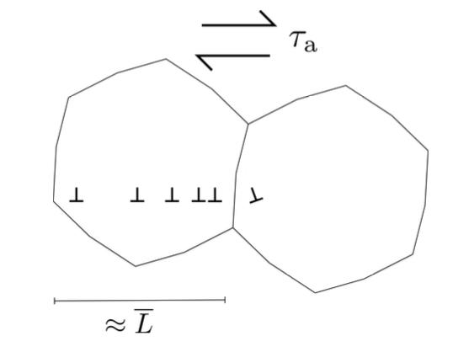

Theories: Hall-Petch

Slide 27
Thin film theory
Order of magnitude smaller than expected from theory

Slide 28
Semiconductors: relaxation of epitaxial layer deposited on a substrate

Slide 29
Hall-Petch

Slide 30
Bayesian analysis

Slide 31
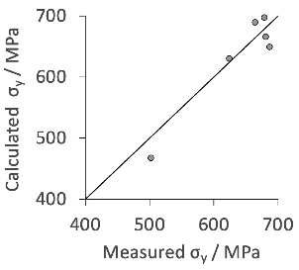
Solid solution effects
Data due to Fu, Furuhara

Slide 32
Why controversy about Hall-Petch?
… friction stress in ferrite negative intercept

Slide 33
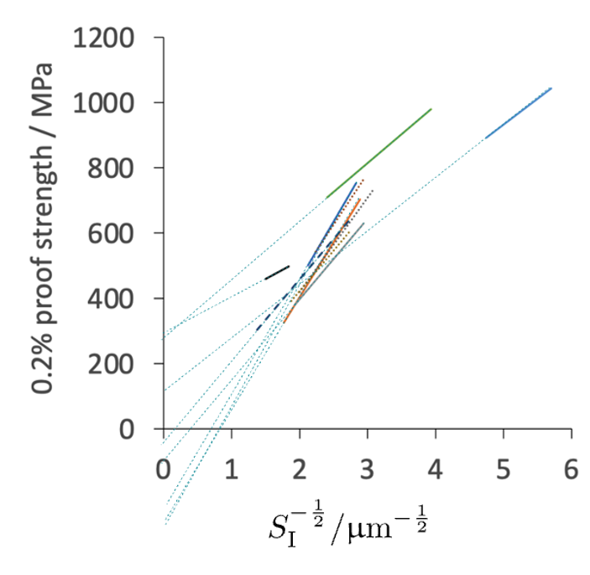
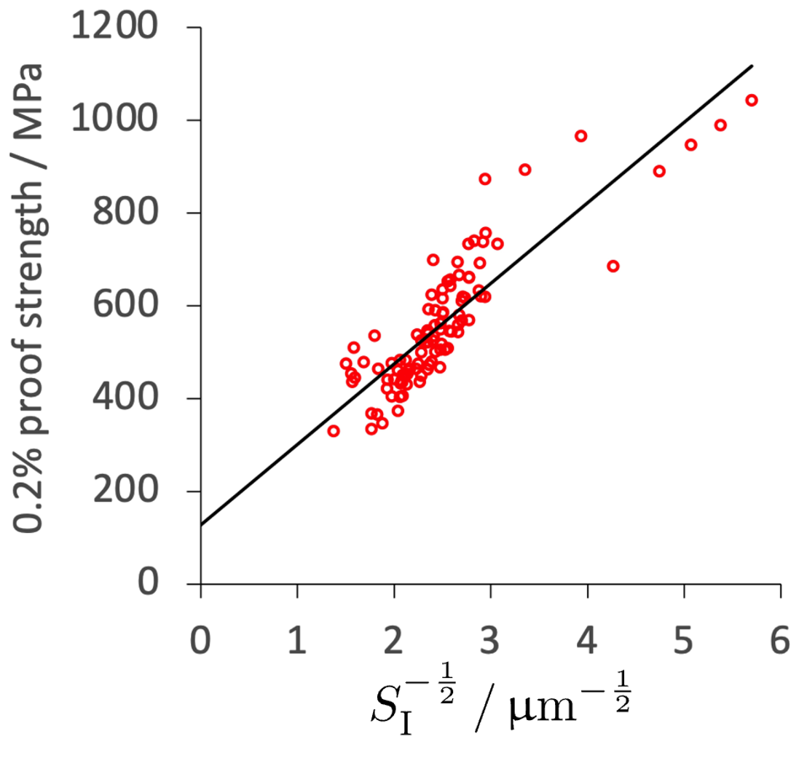
Overfitting of noisy data

Slide 34
Comparison of nanostructure ferrite with pearlite
Data points: Tsuji et al.
Scr Mat 46 (2002) 893

Slide 35
Data can be downloaded from
www.phase-trans.msm.cam.ac.uk/2022/HP.xlsx
Critical assessment: the strength of undeformed pearlite
Materials Science and Technology, 2022
DOI: 10.1080/02670836.2022.2079295

Slide 36
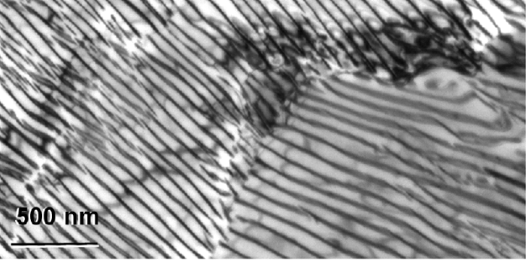
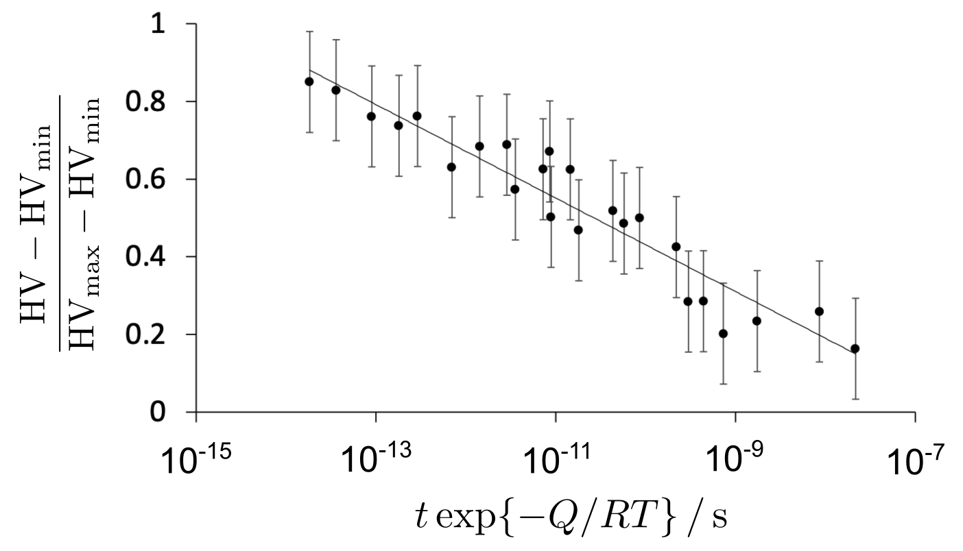
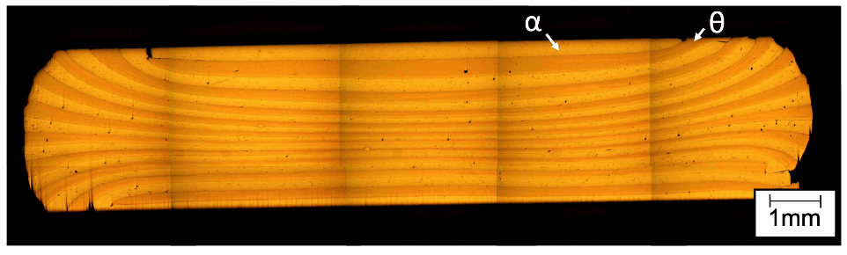
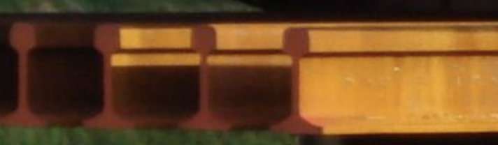
Scripta Materialia 52 (2004) 461
Minoru Umemoto
head-hardened pearlitic rail 420 HV

Slide 37
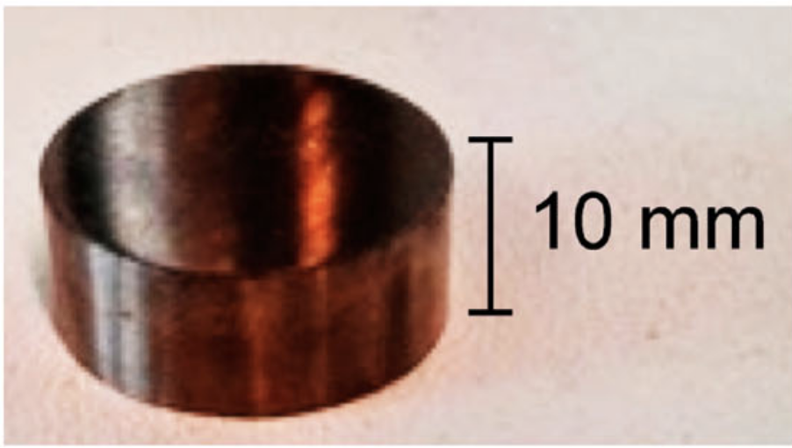
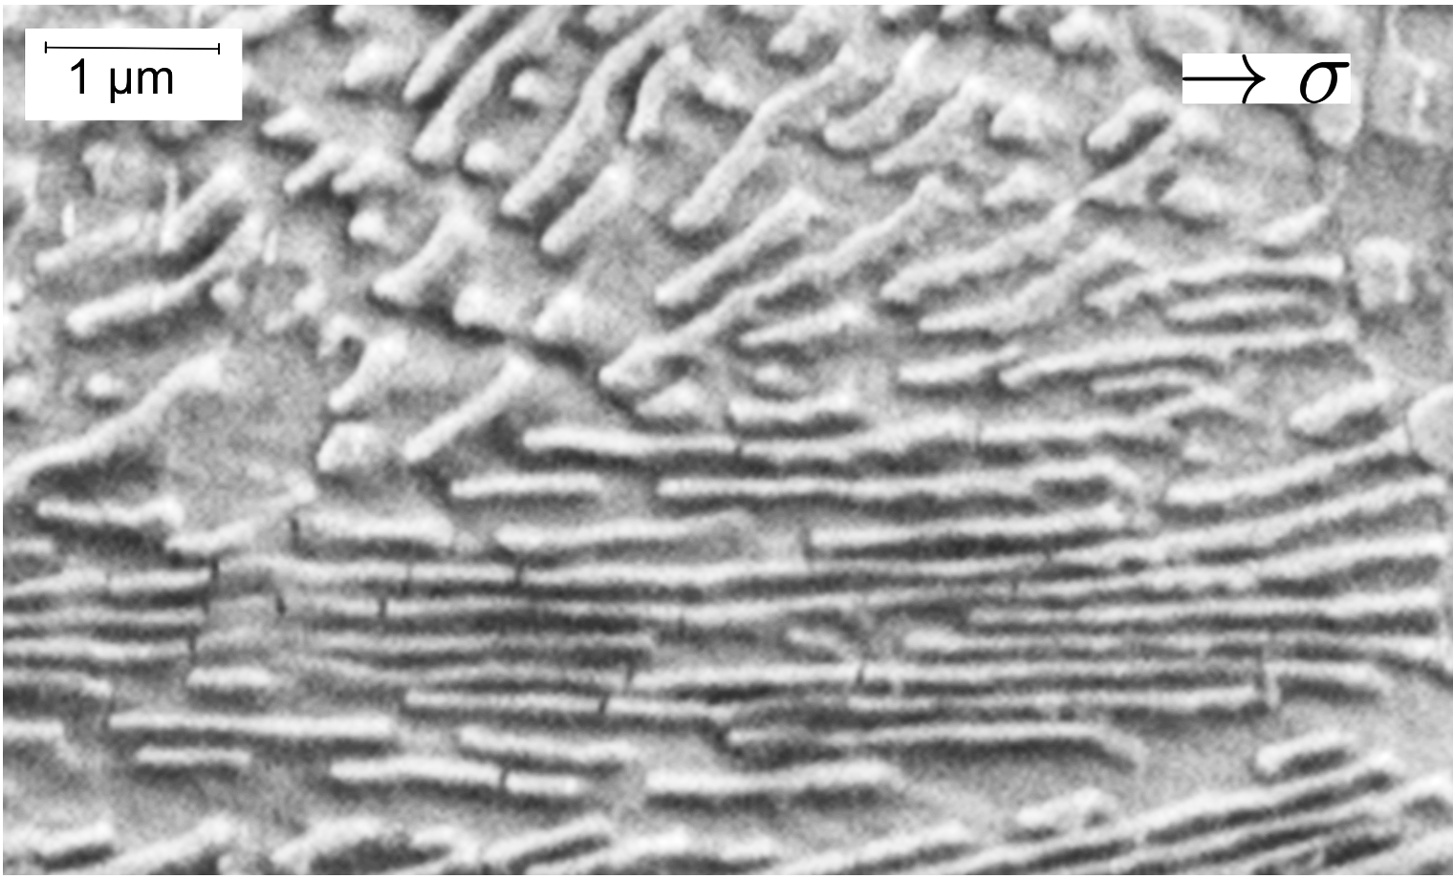
Ductility of cementite (θ)
At 300 K, polycrystalline θ: zero ductility in uniaxial compression
Terashima et al. Scr. Mat. 54 (2006) 1925
Minoru Umemoto
Cracking immediately
after tensile yielding of ferrite
Aparna Singh

Slide 38
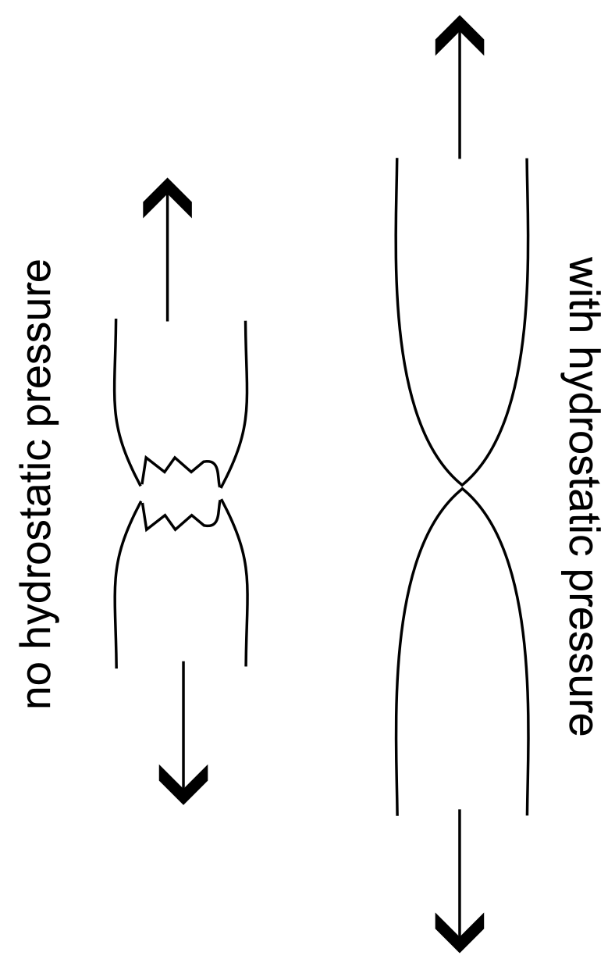

Hydrostatic pressure, ductility
limits cracks, may even seal them,
opposes void formation associate with ΔV ↑
Bridgman, Rev. Modern Phys 17 (1945) 3
“1045 steel”

Slide 39

Wire drawing: also generates hydrostatic stresses
Oh, Trans. Korean Soc. Mech. Engng.
5 (1981) 170

Slide 40



Wire drawing

Slide 41


Wire drawing
cross section

Slide 42


Wire drawing

Slide 43


Hosford: fibre-textured samples would develop elliptical grains; strain compatibility would force grains to curl around each other

Slide 44

Electropulsing
Images courtesy
Rongshan Qin

Slide 45






