Slide 1

Bassey, Guardian Letter, 4th April 2024

Slide 2
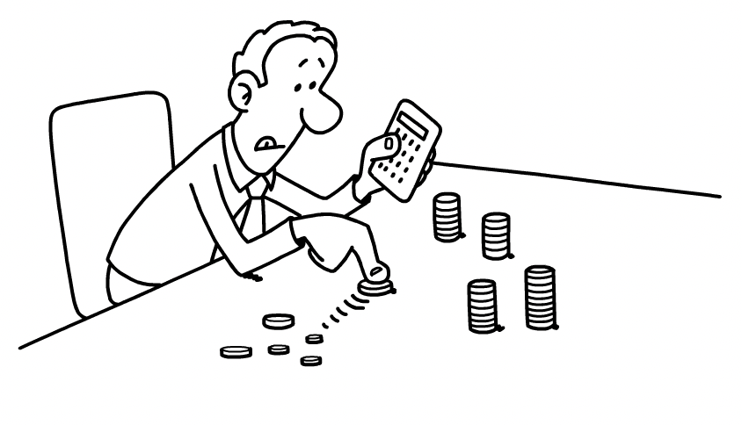


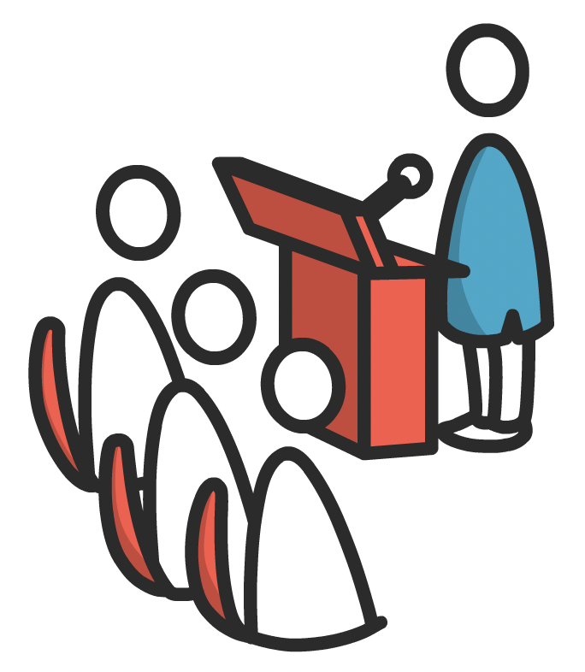

none of the following:
talk talk 2023

Slide 3
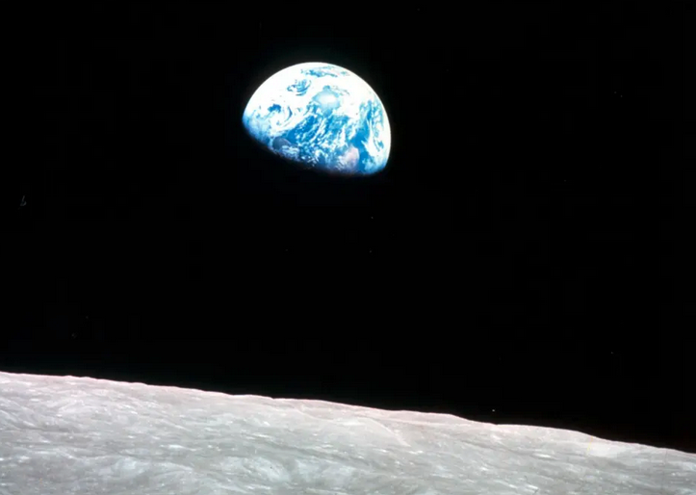
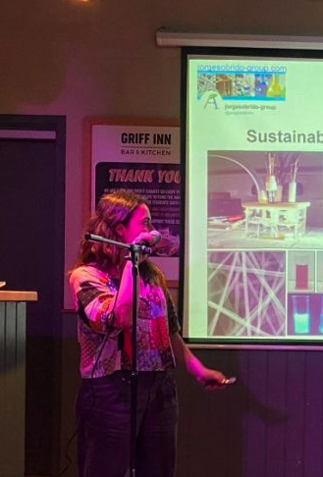
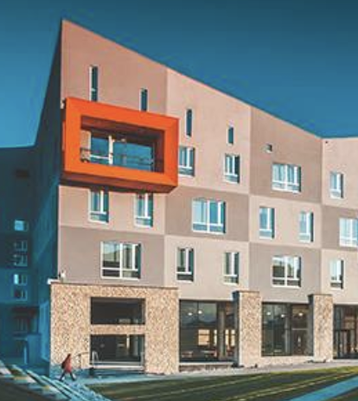

…. transparent knowledge ….
…. engage with all ….
building networks
long term but little effort

Slide 4
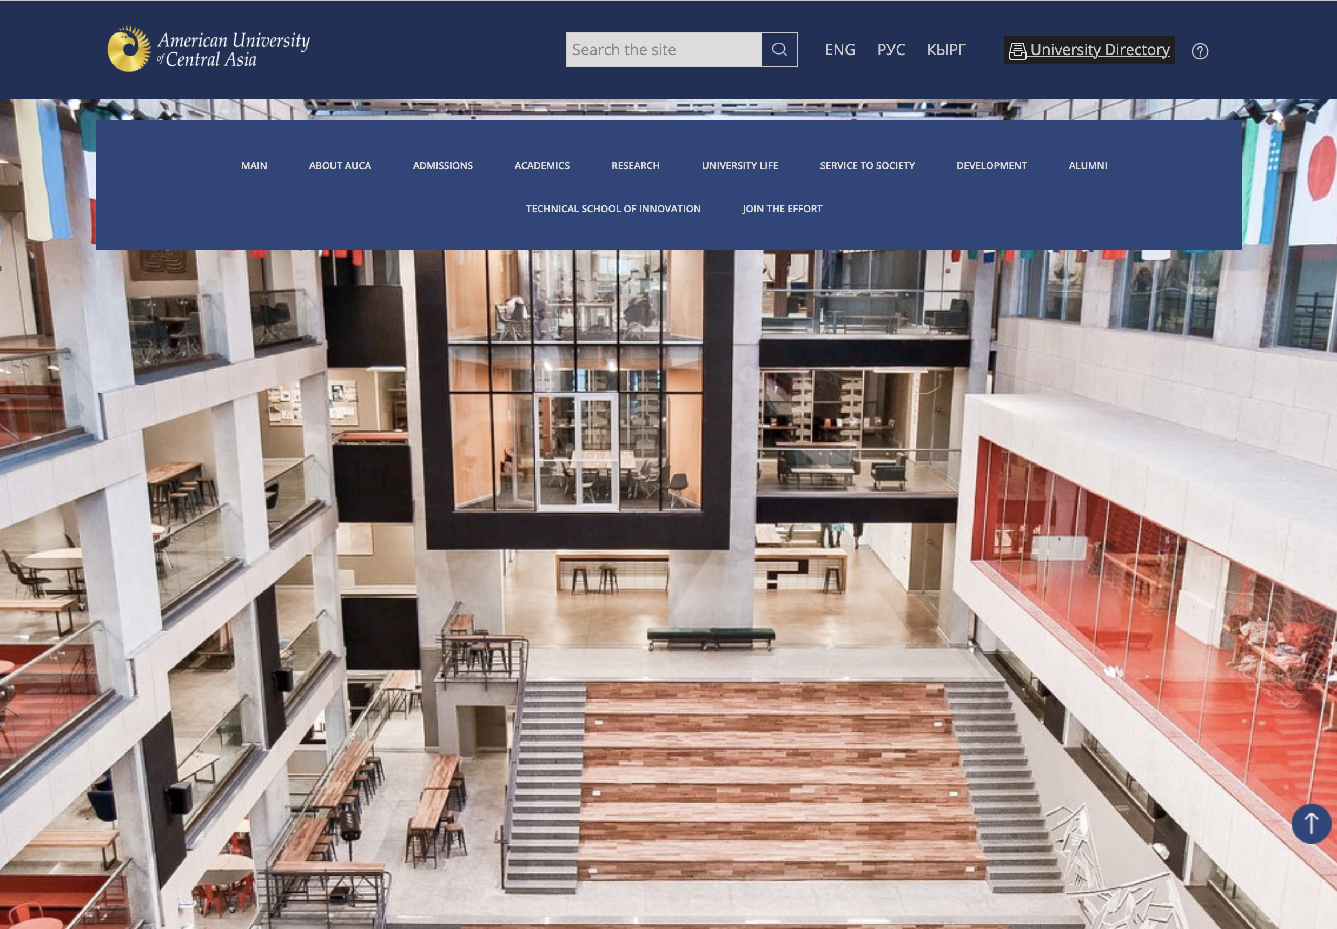


people in industry, education – information is the web
citations of no importance
journal of publication – irrelevant
site must be rich in content that can be taken freely without registration, password or cookies

Slide 5
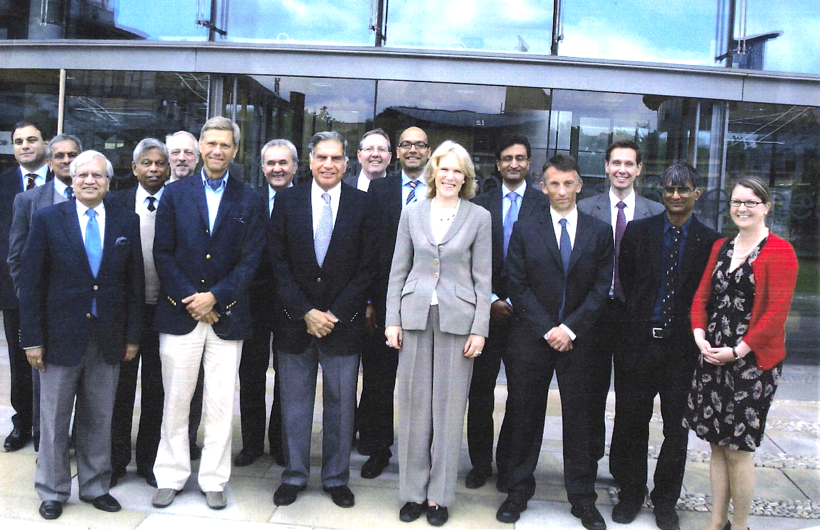
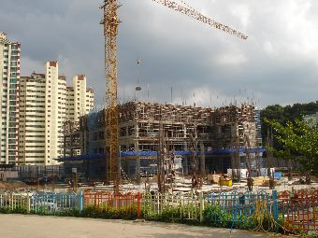
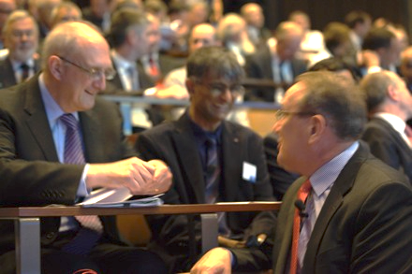
single, unsolicited e-mail
Tata Steel endowment
Russian Federation,
South Africa,
India, China, Taiwan
Japan
Argentina
Brazil
10-year project in South Korea
10-year project, SKF Sweden

Slide 6
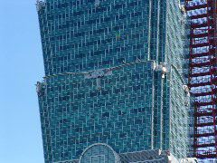
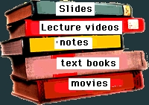



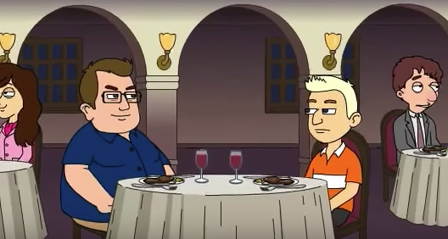
https://www.phase-trans.msm.cam.ac.uk
factual stories
book reviews,
reviews
no password
no registration
no cookies
calculations
stills
Q & A
worked examples

Slide 7
Metals and alloys
Crystallography
Metallography
Steels
Thermodynamics, phase diagrams
Mesoscale, multiscale modelling
Kinetics, microstructure modelling
Finite element analysis
Information theory, patterns, neural networks
Process modelling
Mathematical crystallography
Laboratory classes, seminars
+ related topics I do not teach but am interested in.
9 months, 2025
11.6 terabytes
428,289 unique visitors
(excluding robotic activity and videos)

Slide 8
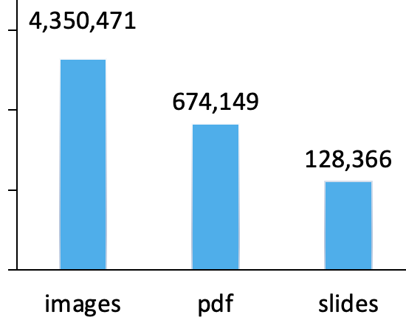
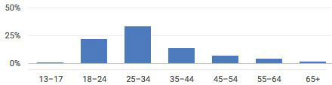
2025
(9 months)

Slide 9
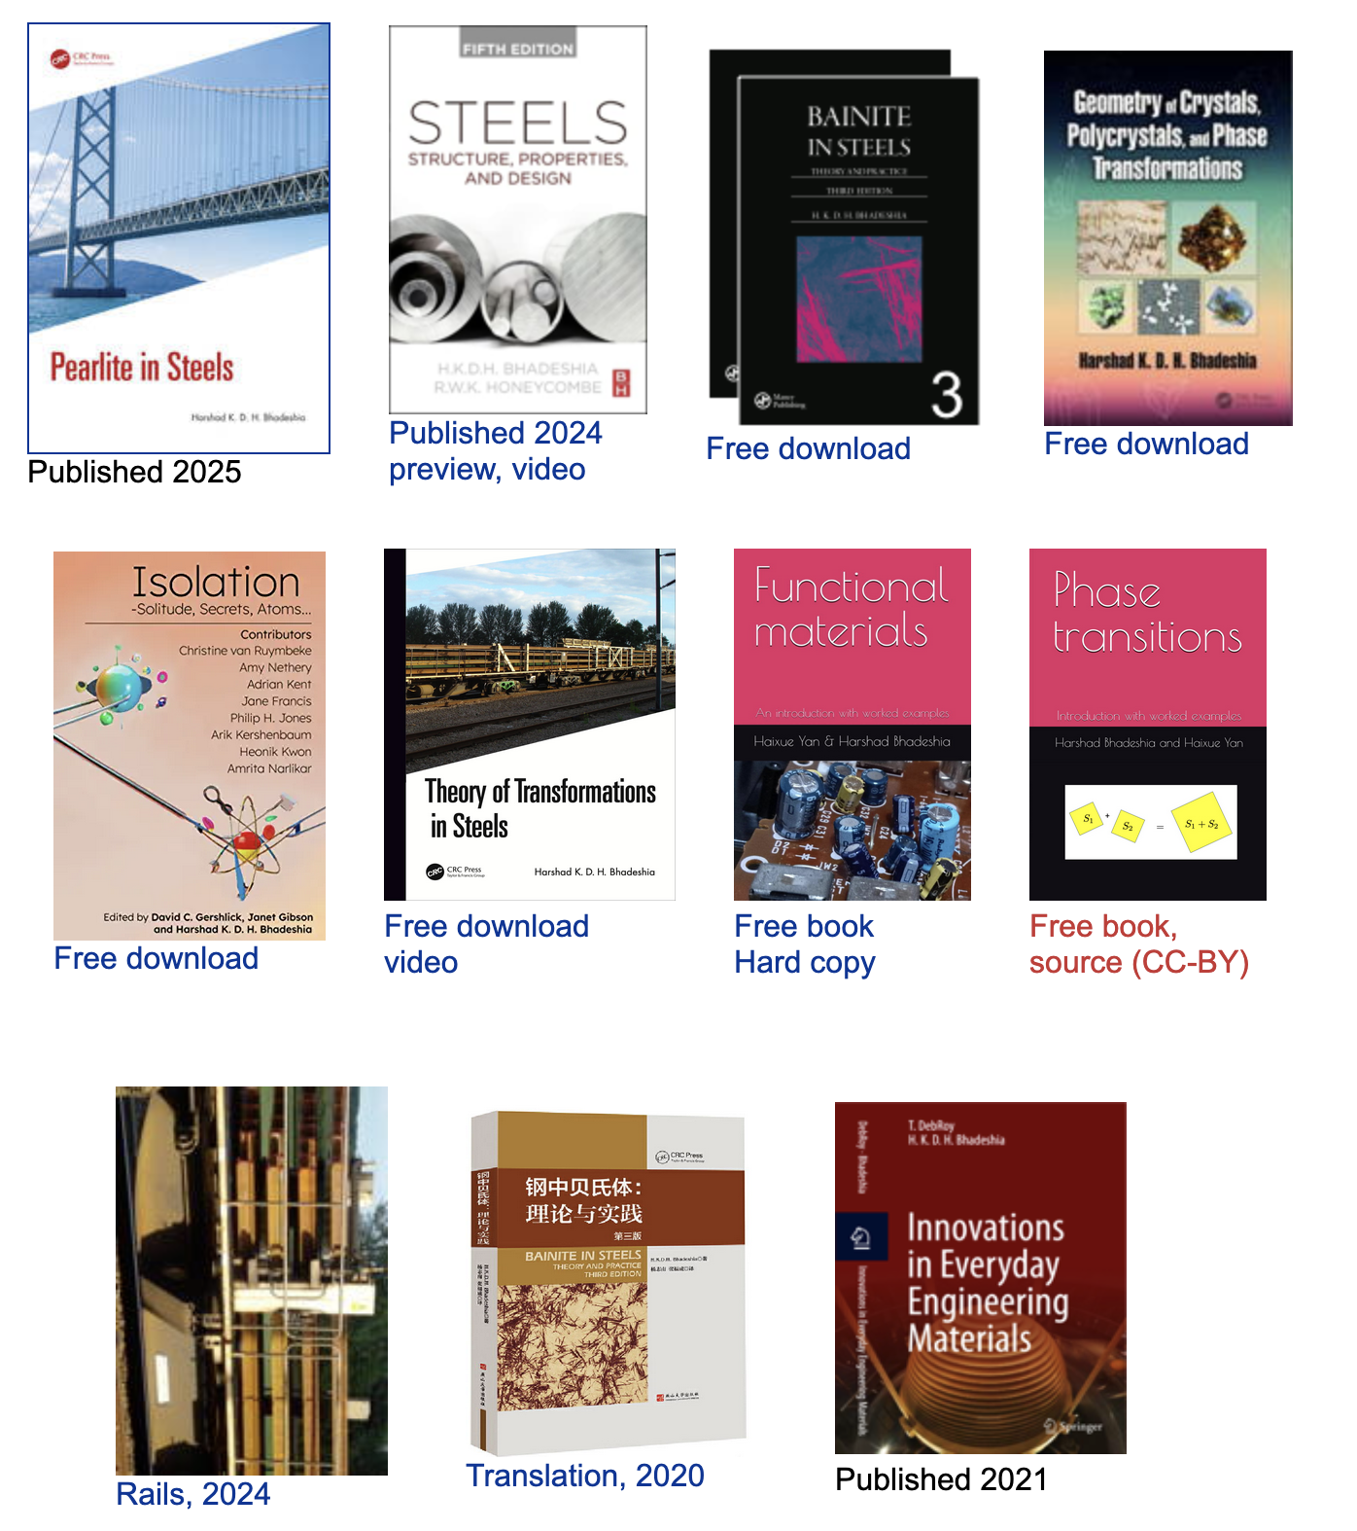
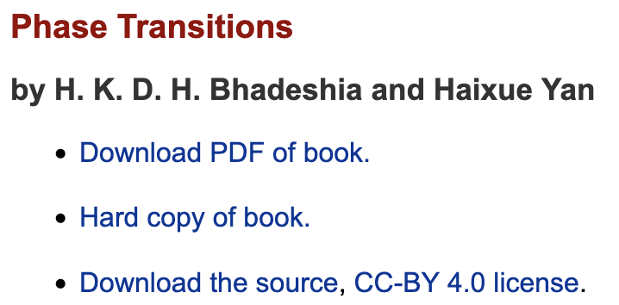

Slide 10
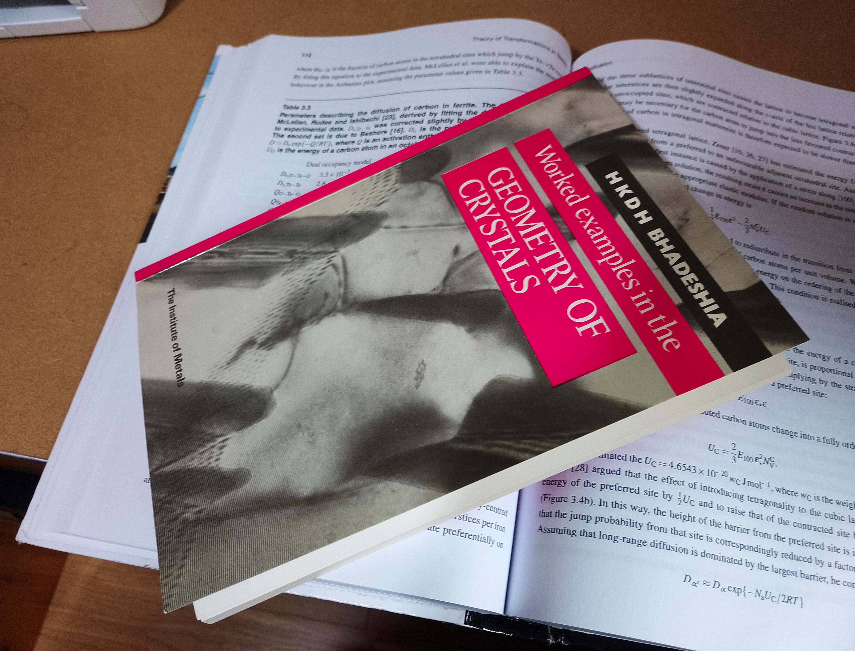
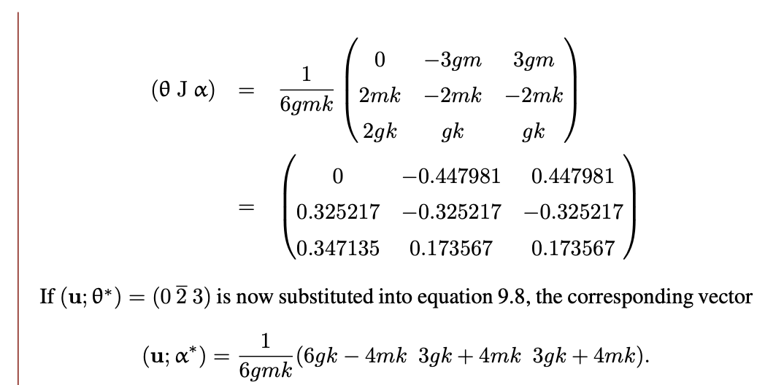

Mathematical crystallography (95 pages)
96,792 downloads

Slide 11
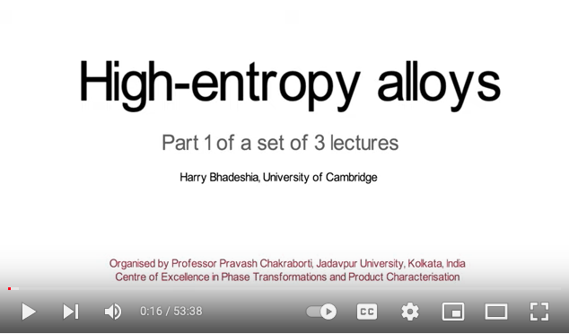
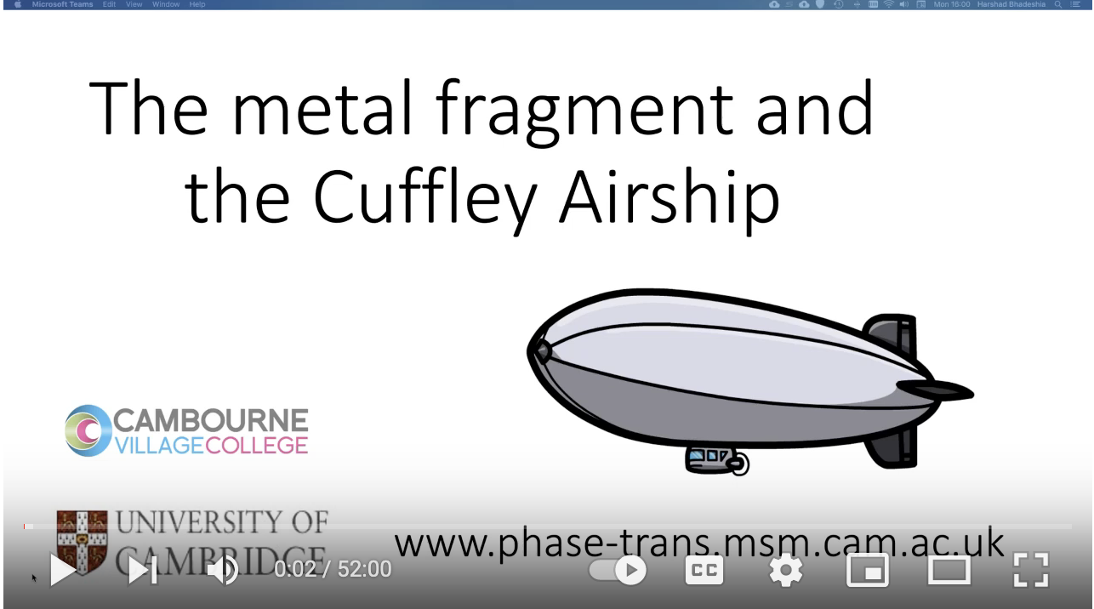
YouTube channel 2025 1,383 substantive videos 20,608 subscribers 5,270,492 views
Teacher at a primary school in Croydon. Would you have a few minutes to spare to answer some questions from our students?

Slide 12
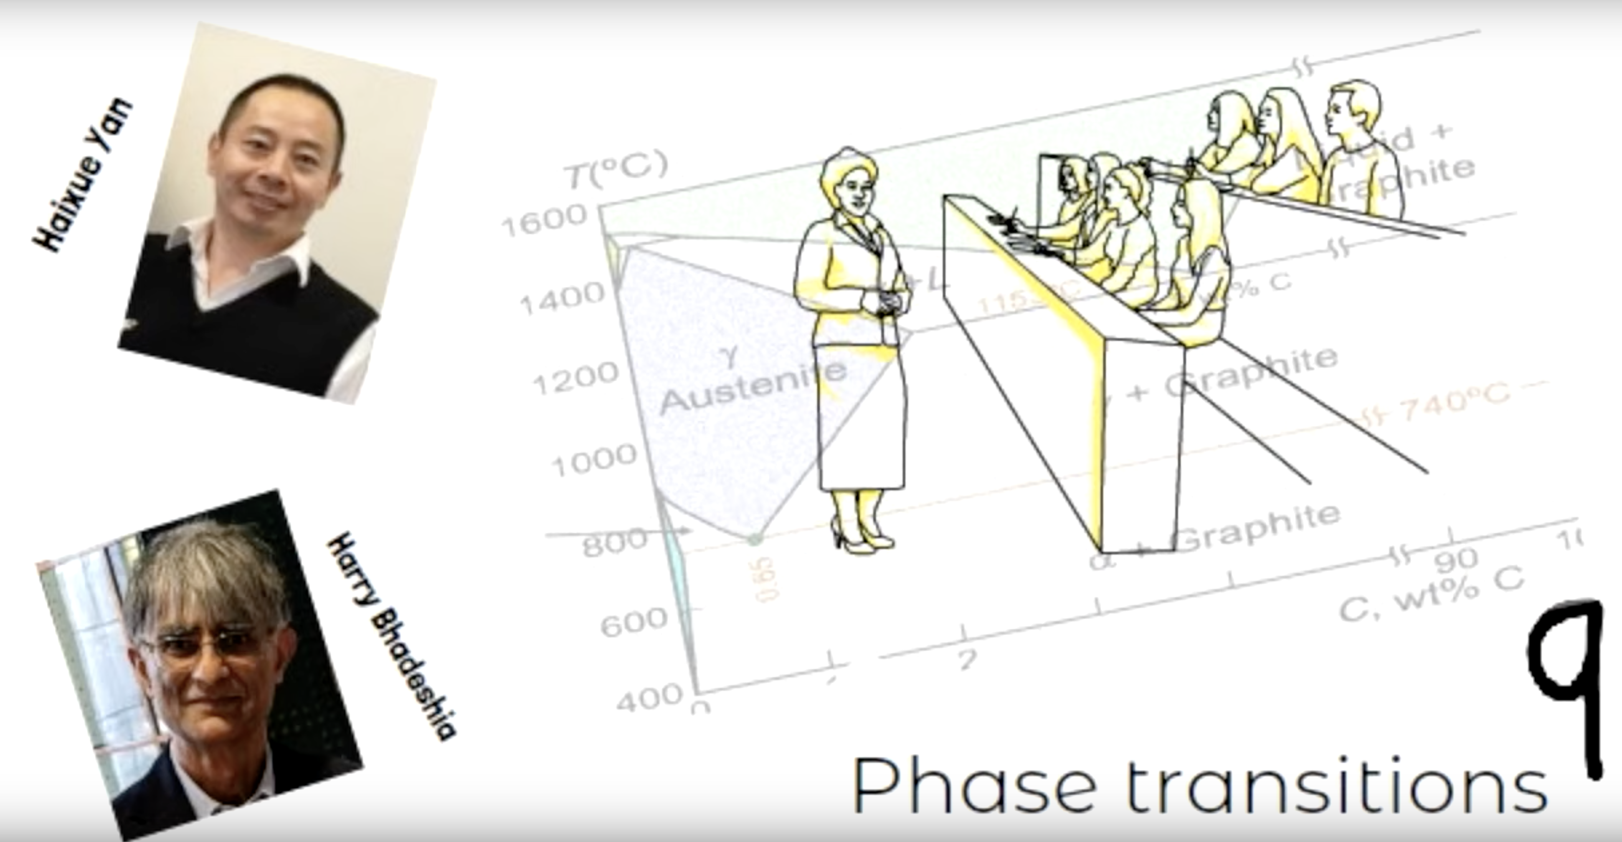
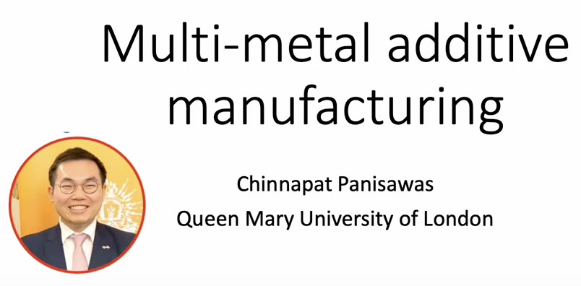
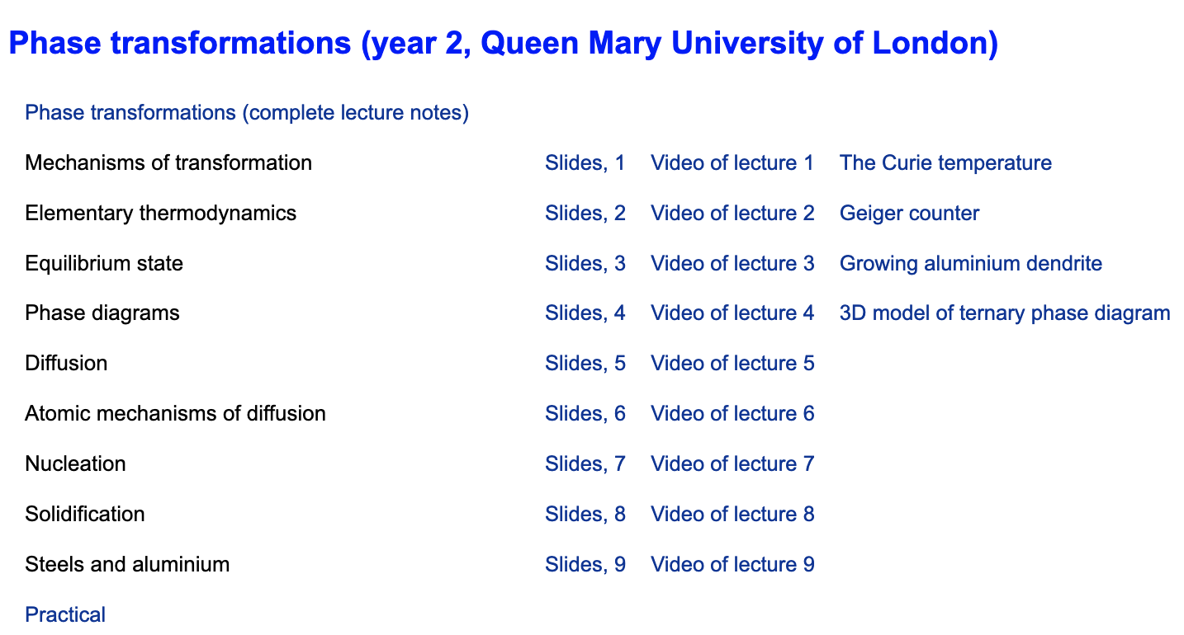
Make all activities free access, anywhere in world, at anytime
20552 views (9 lectures)
2466 views

Slide 13
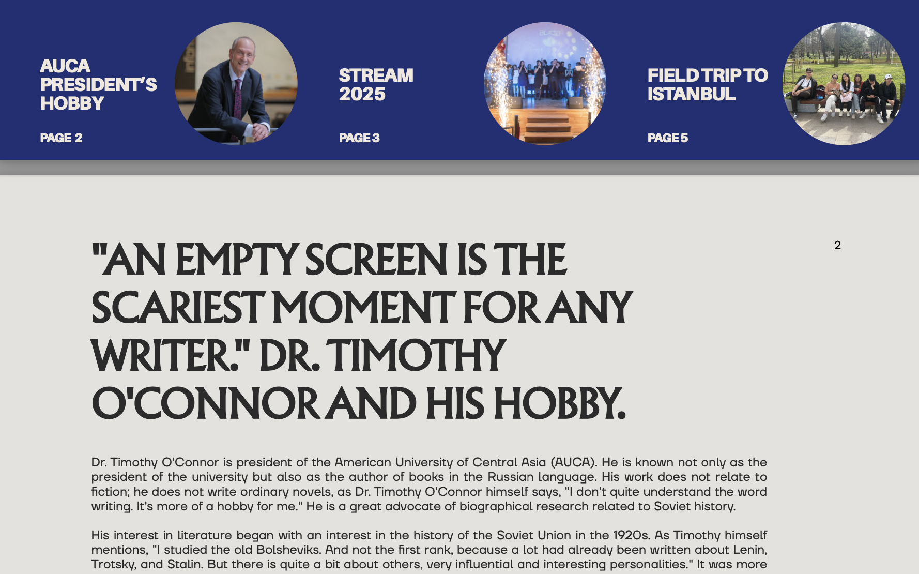


Kamilla Ismailova

Slide 14
Copyright
create own teaching materials
consistency of style & clarity
helps in composing books

Slide 15
You: build your site. Simplicity, content. YouTube channel.
…. generate new knowledge ….
…. engage with all ….
AUCA management
server space, trust staff to work independently without intervention from web master.

Slide 16
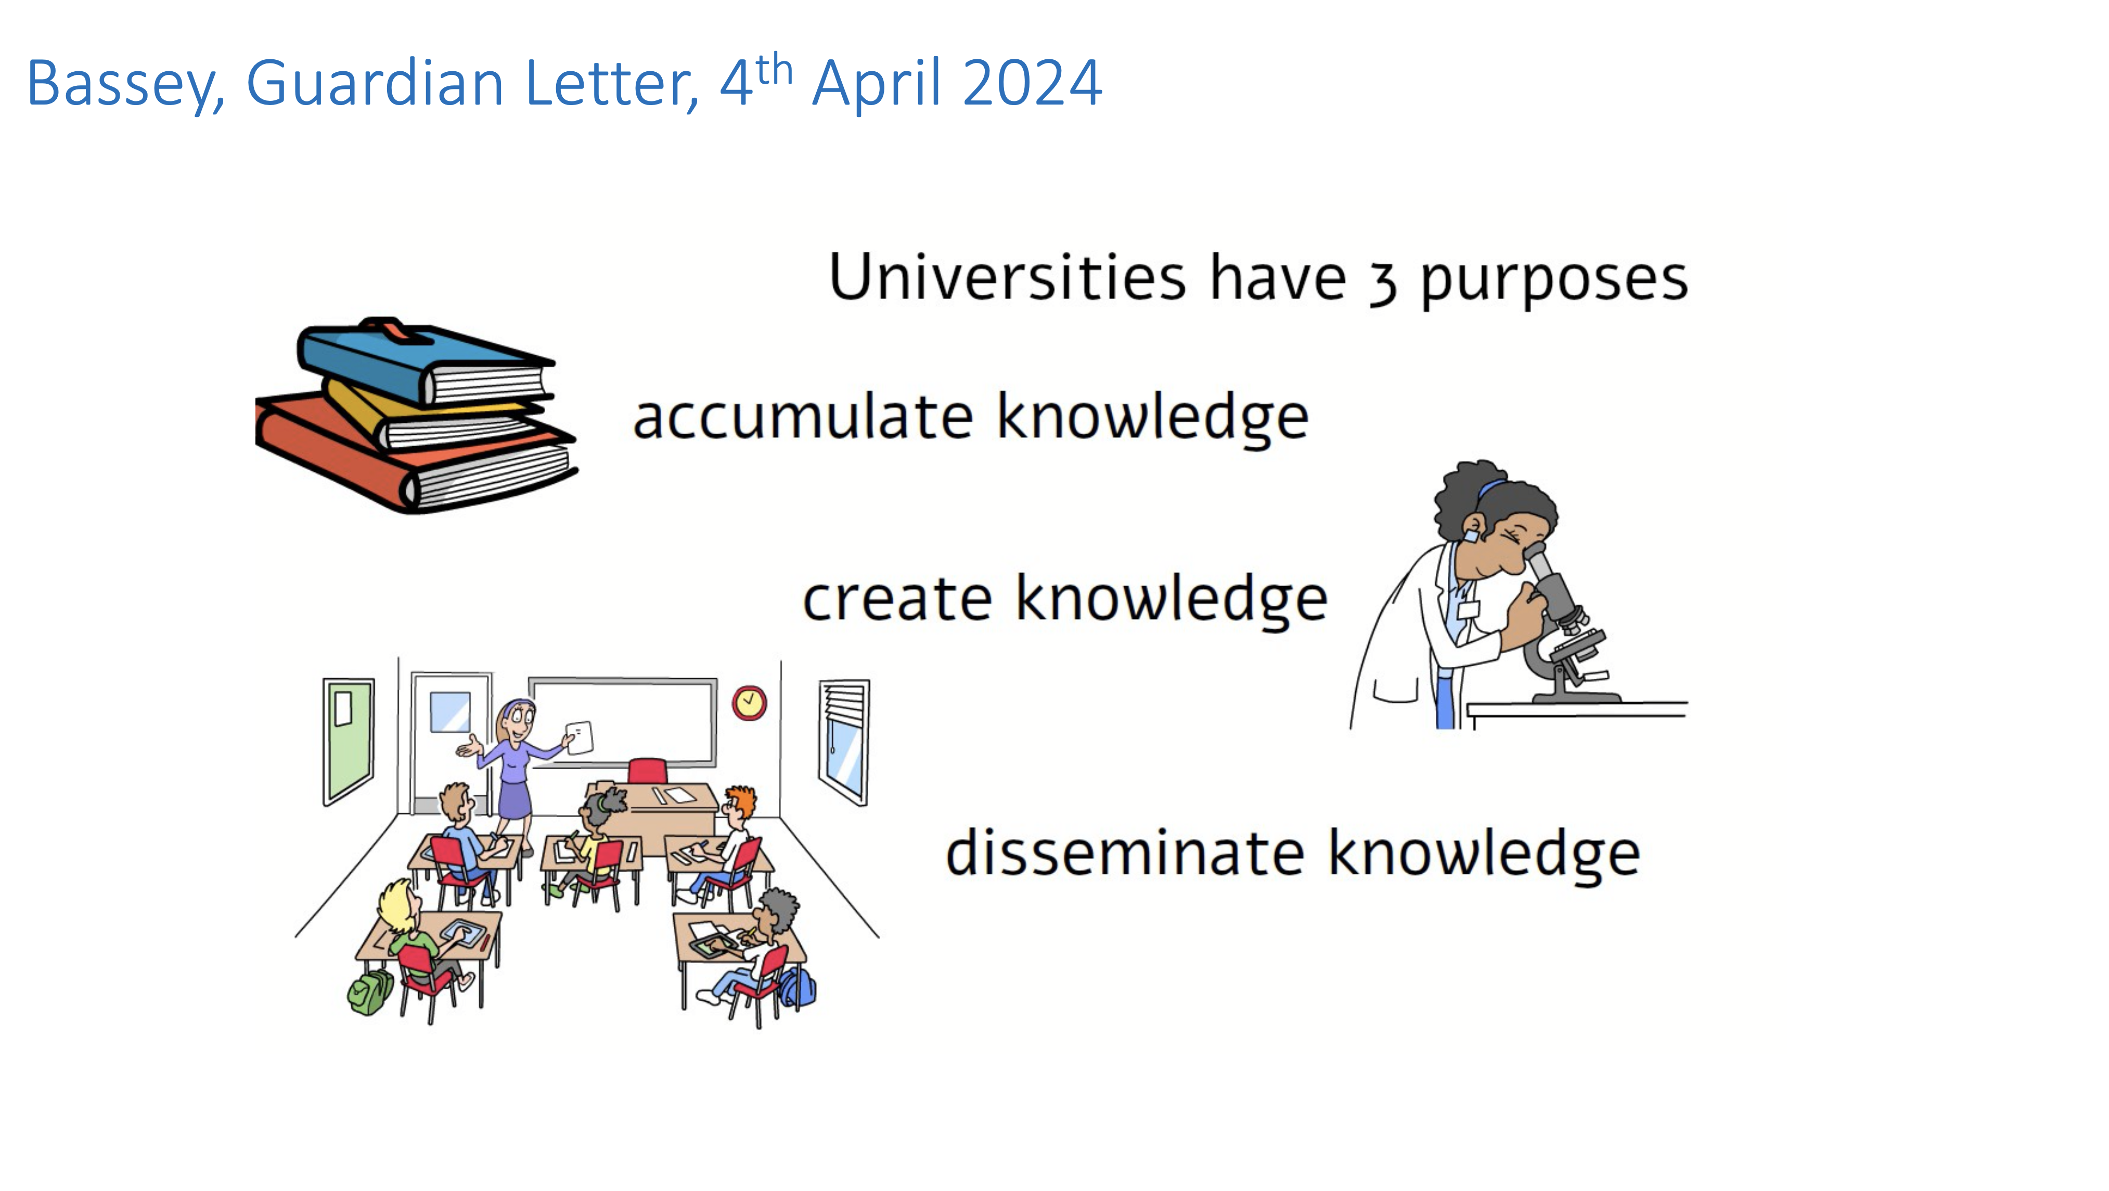
Transparency wins
(little additional effort)

