Slide 1
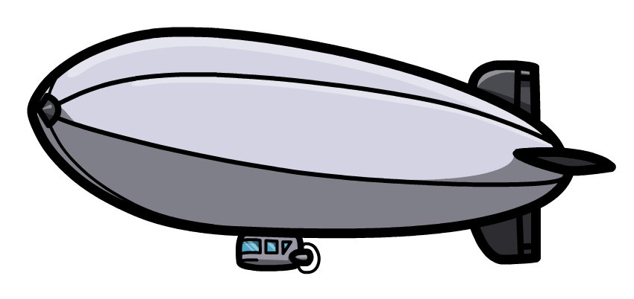


The metal fragment and the Cuffley Airship
www.phase-trans.msm.cam.ac.uk

Slide 2
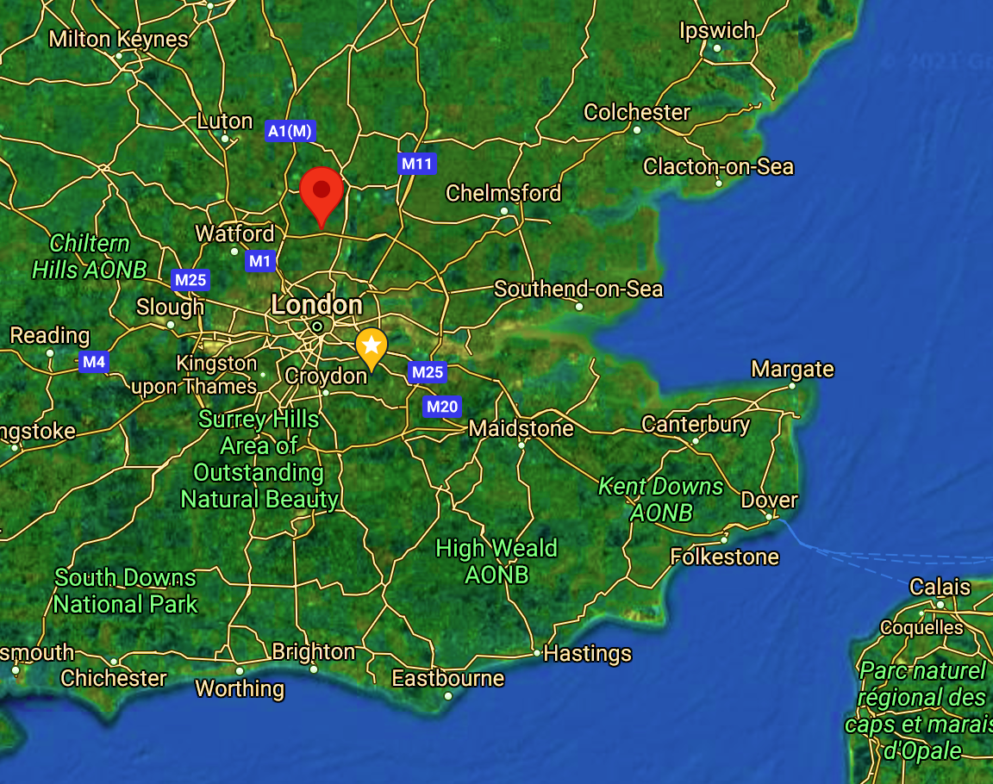
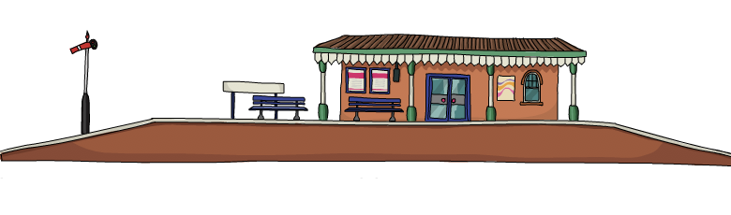
Cuffley is not far from London, nor from the Channel
1916
Population

Slide 3
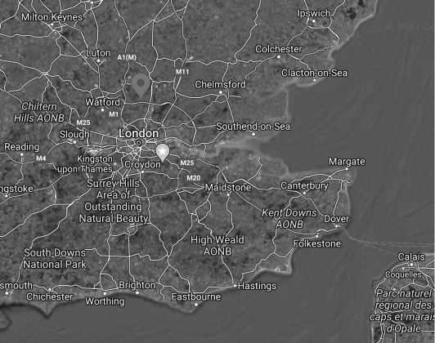
2003 invasion of Iraq
654,965 excess deaths
2.5% of population
(The Lancet, 2006)
Airship raids killed > 500
injured >1000
(https://www.bbc.co.uk/news/uk-england-27517166)

Slide 4
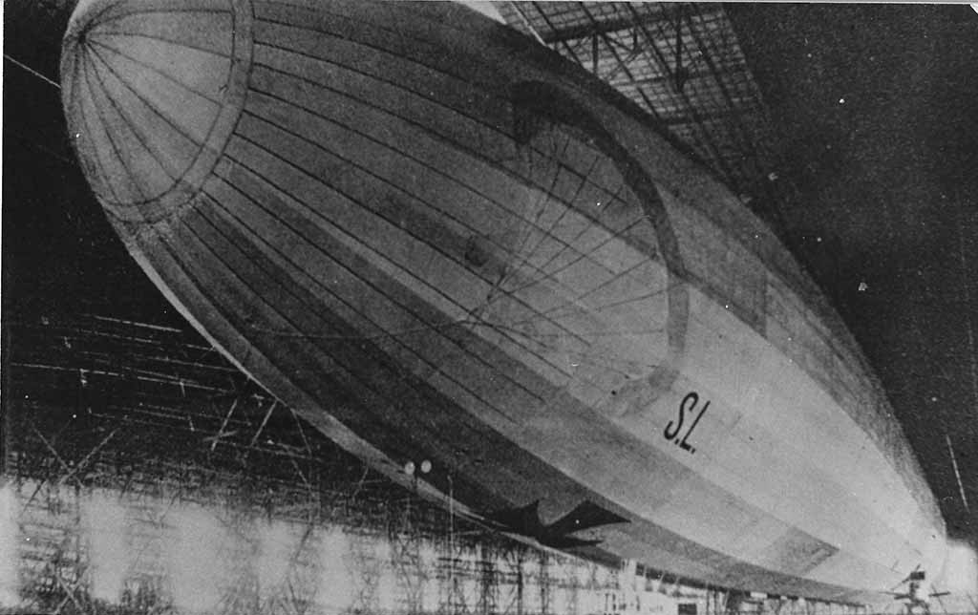
SL 11 airship under construction.
Approximate data:
174 m in length
20 m diameter
40000 m³ of H₂
Payload = 21000 kg
reproduced with permission of Cllr Peter Dace, Northshaw & Cuffley Parish Council
https://northawcuffleypc.org.uk/w-l-robinson-vc/

Slide 5

Fuel + oxygen + spark = fire
simply firing bullets at airship did not set them on fire in spite of the hydrogen within
combination of incendiary and explosive bullets necessary

Slide 6
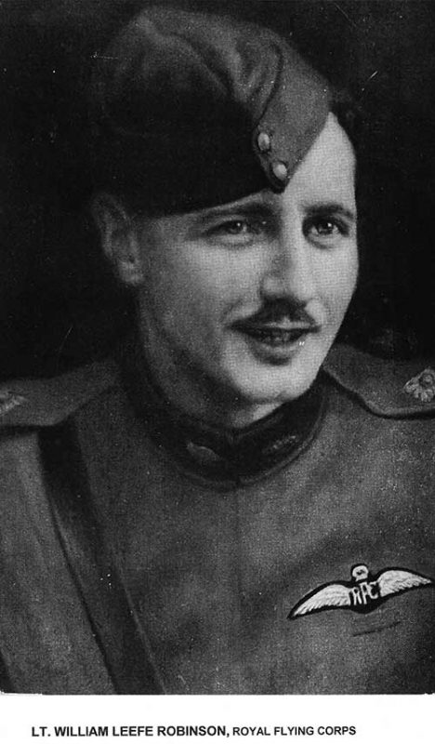
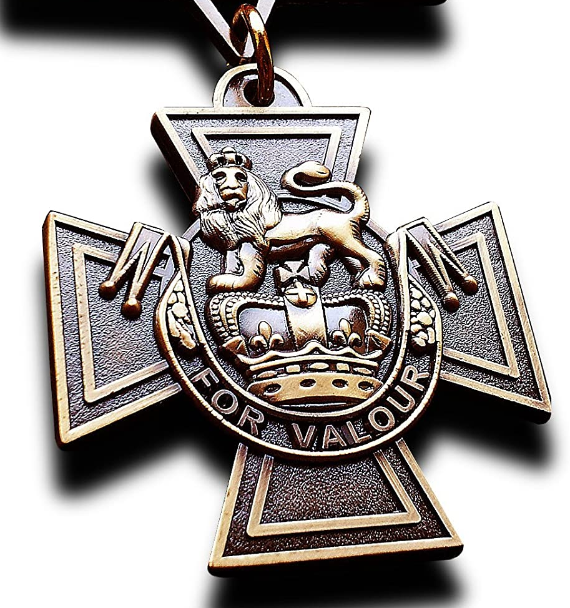
Lieutenant William Leefe Robinson 39th squadran, Royal Flying Corps
first to shoot down an airship on British soil
2/3 September 1916
2 days later, awarded the Victoria Cross
reproduced with permission of Cllr Peter Dace, Northshaw & Cuffley Parish Council
https://northawcuffleypc.org.uk/w-l-robinson-vc/

Slide 7
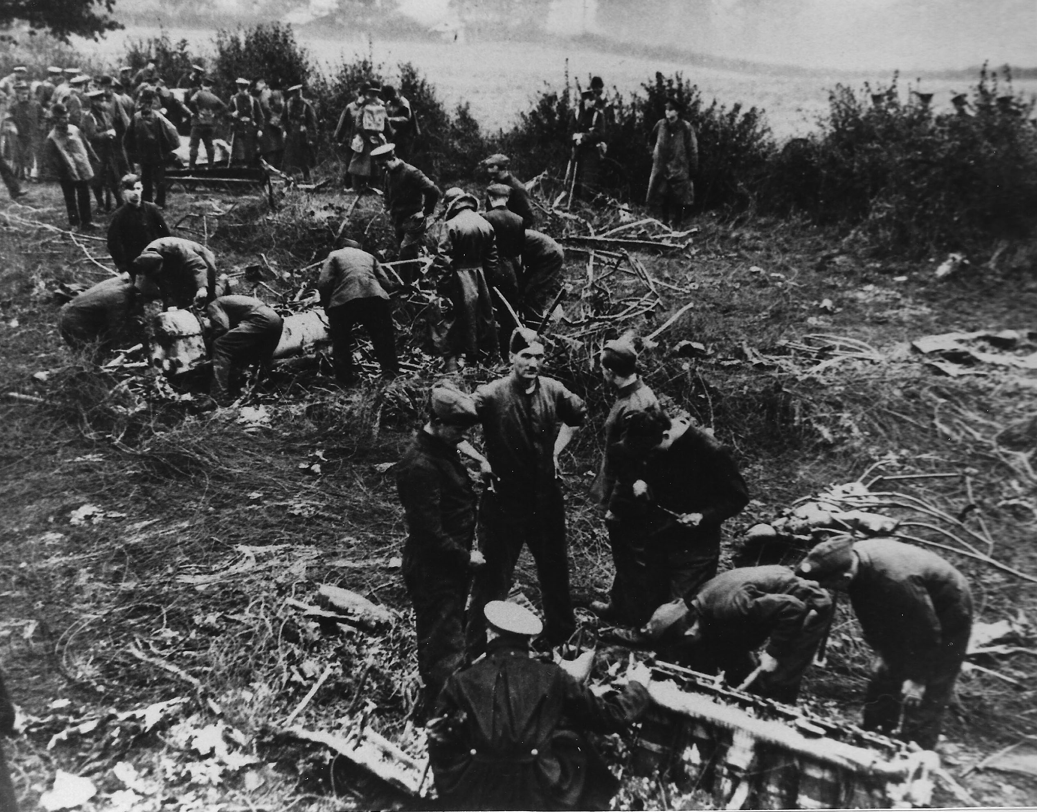
Royal Flying Corps personnel examining the debris from the
reproduced with permission of Cllr Peter Dace, Northshaw & Cuffley Parish Council
https://northawcuffleypc.org.uk/w-l-robinson-vc/

Slide 8
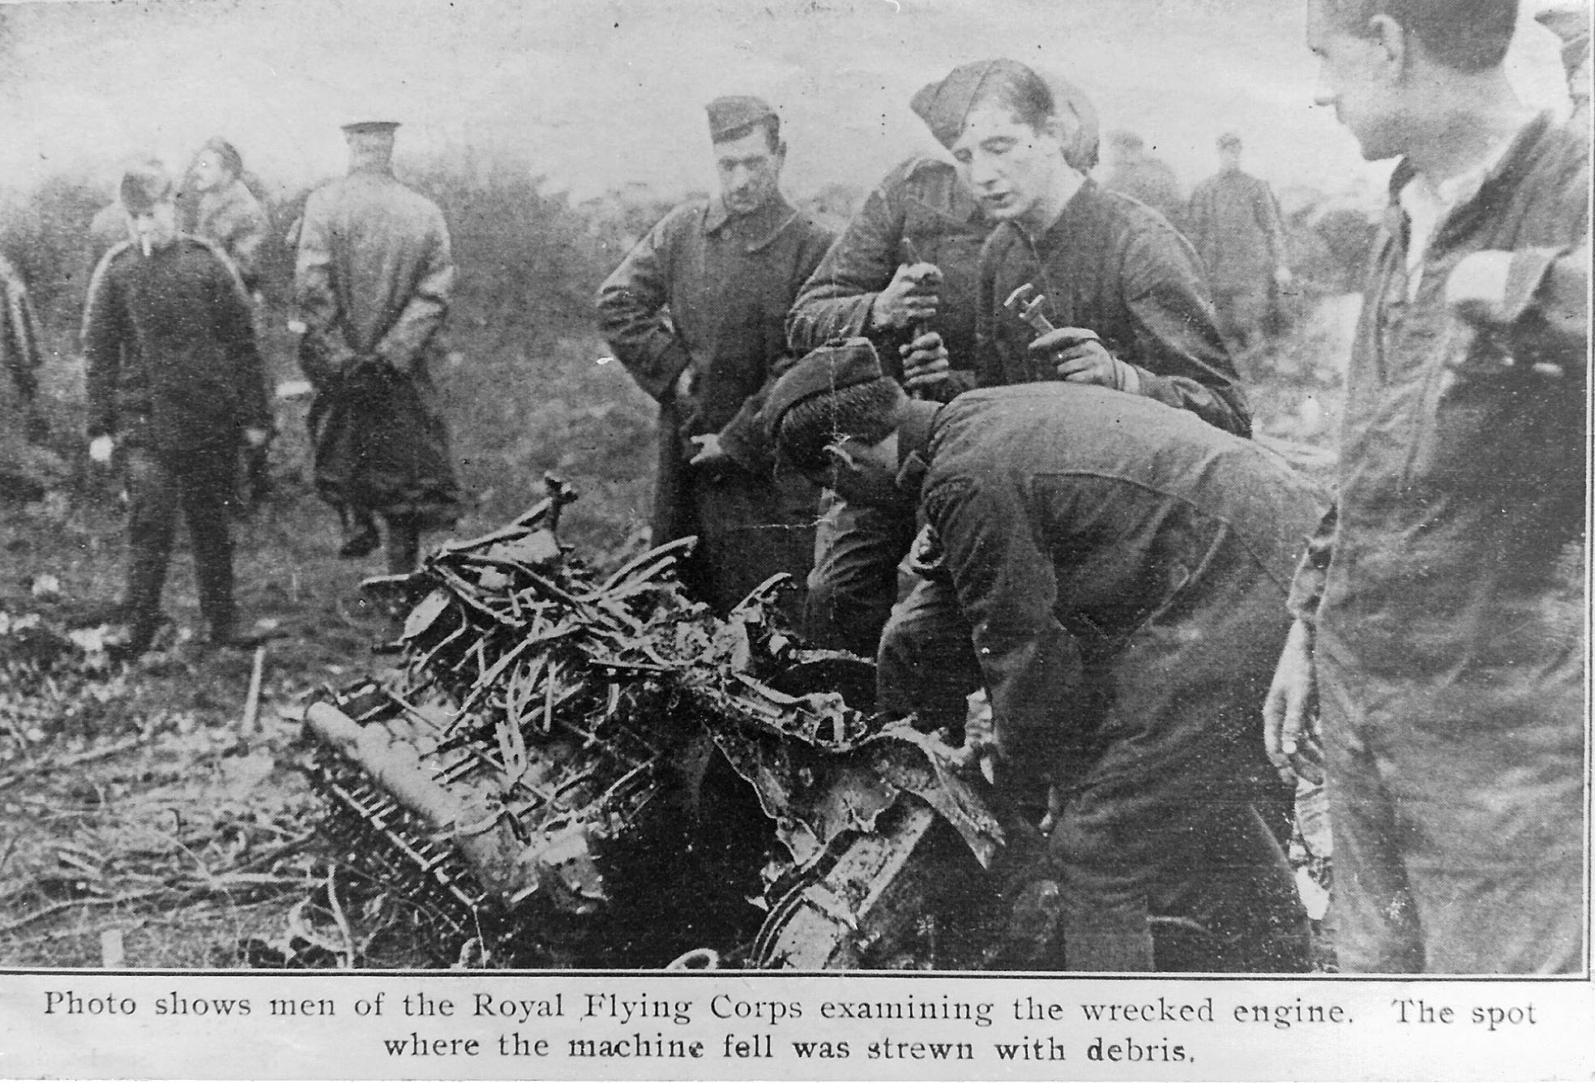
Royal Flying Corps personnel examining the engine from the
reproduced with permission of Cllr Peter Dace, Northshaw & Cuffley Parish Council
https://northawcuffleypc.org.uk/w-l-robinson-vc/

Slide 9
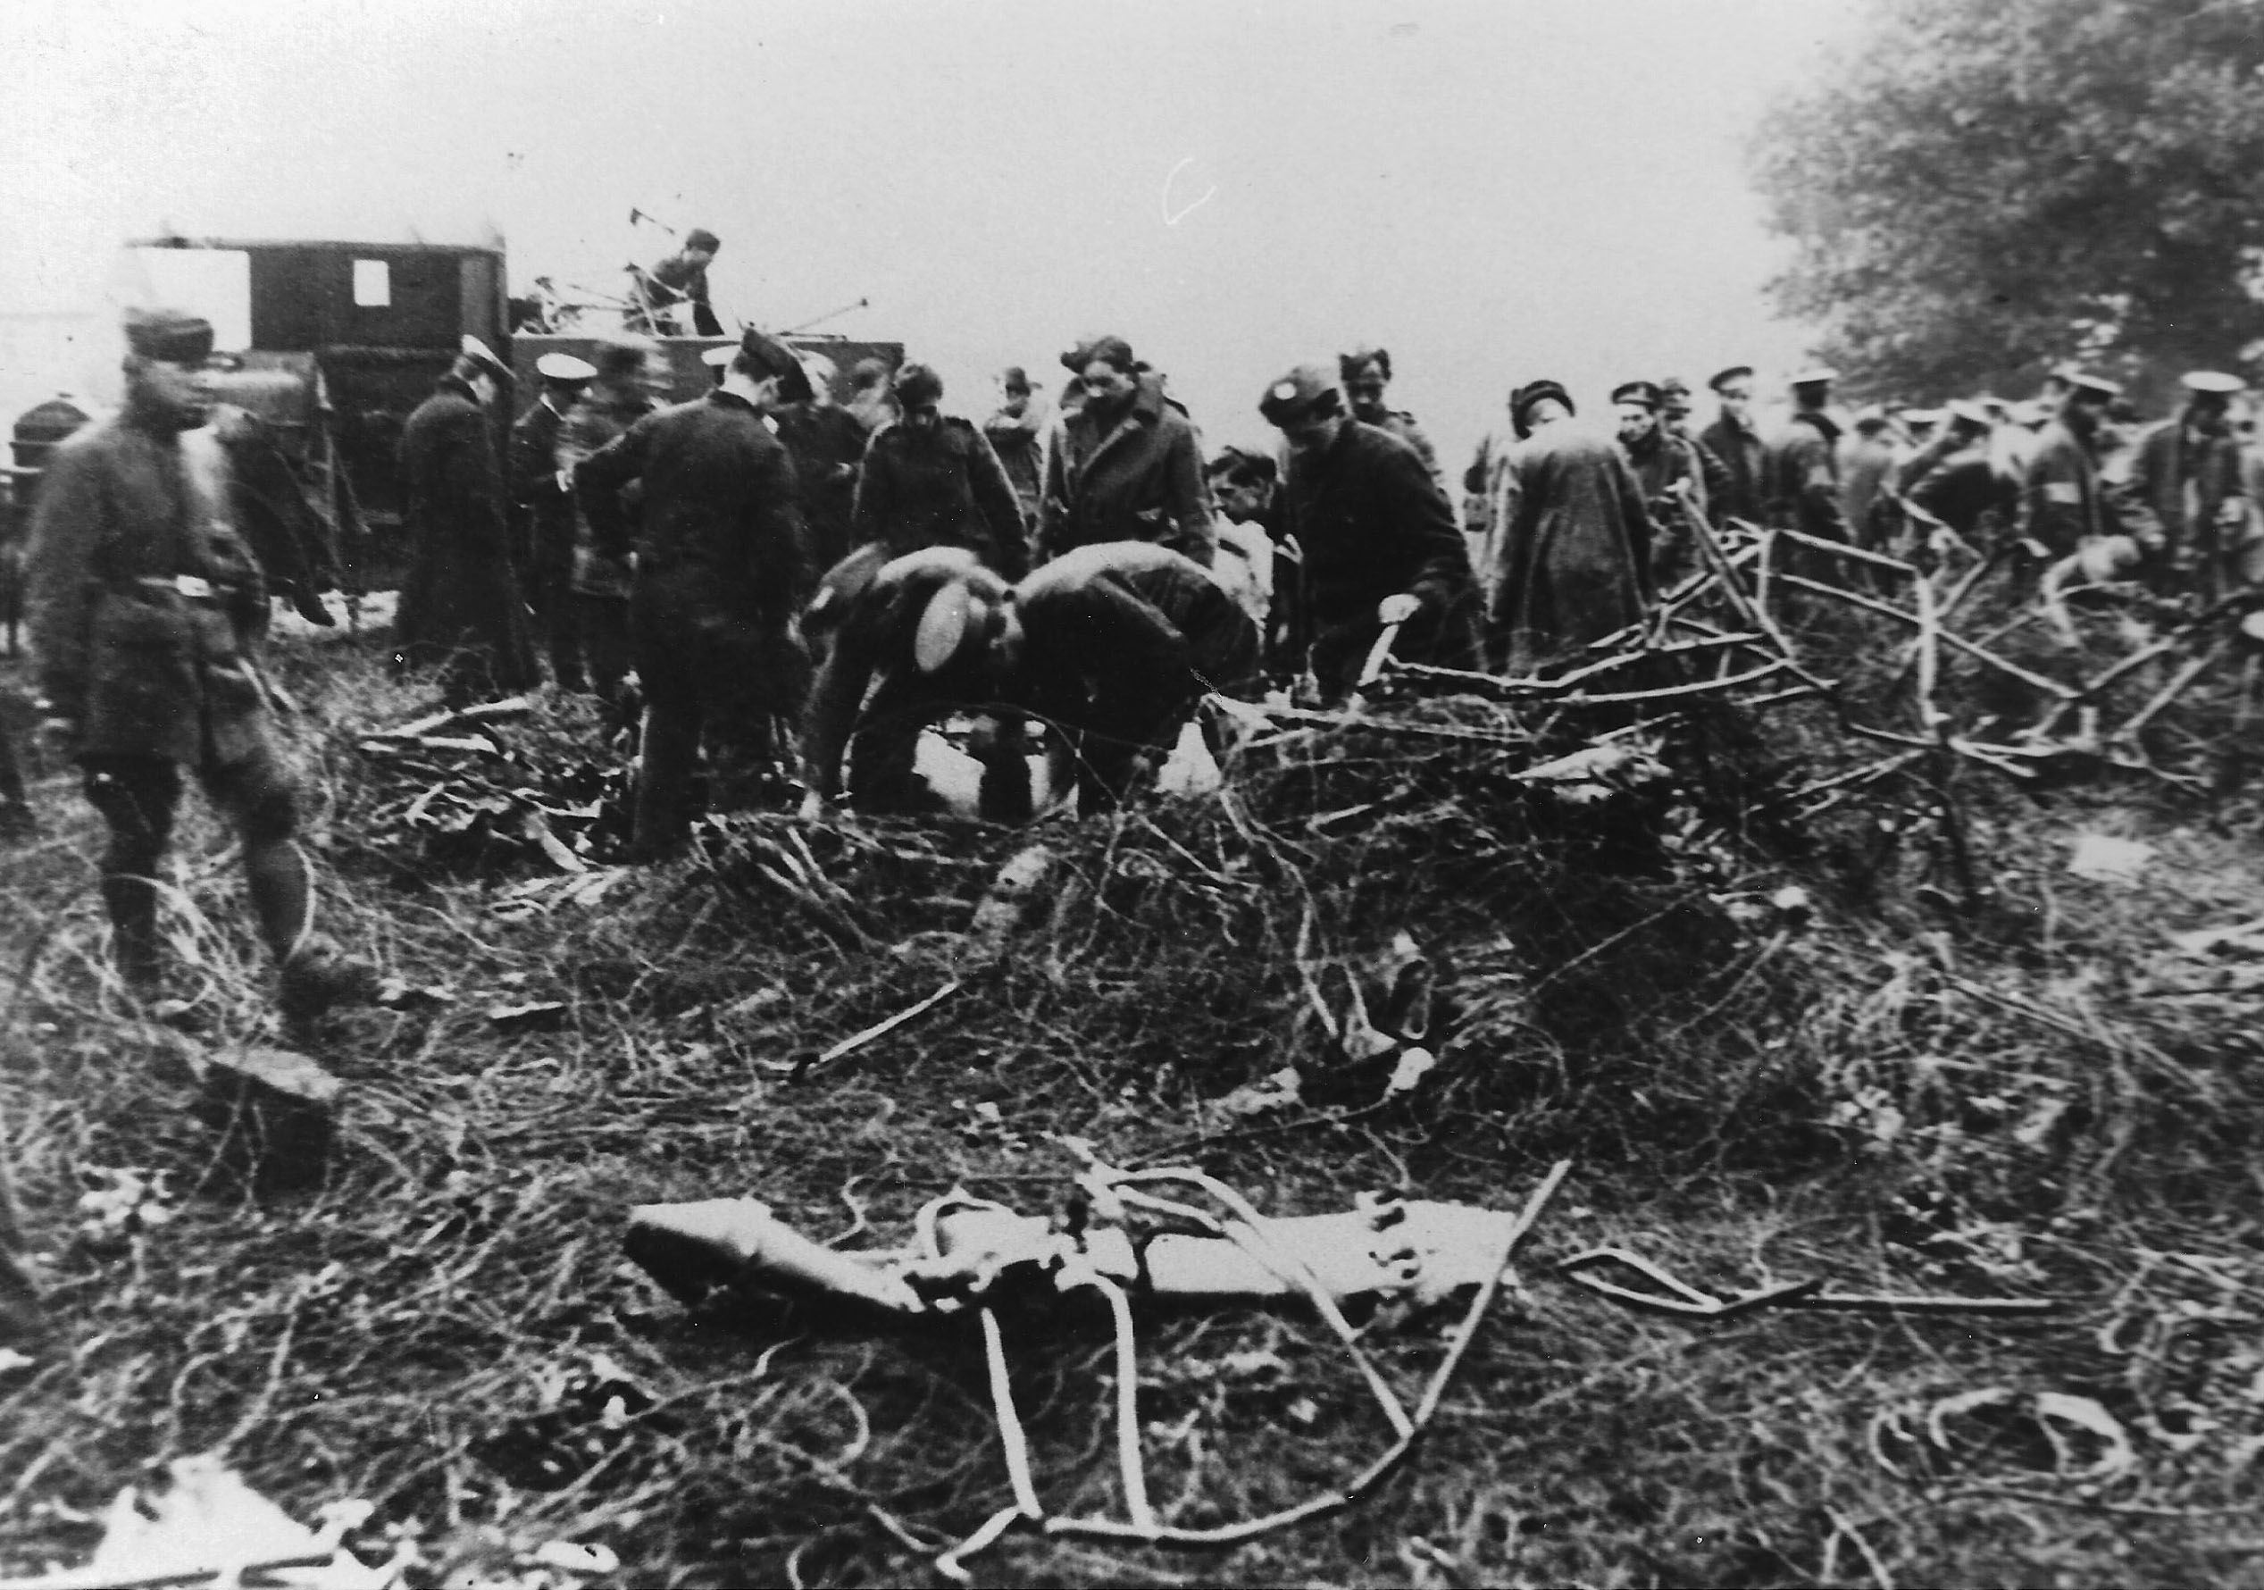
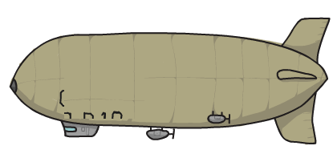
Wooden frame completely burnt, but reinforcing wire and metal from the gondolas and engine, recovered.
reproduced with permission of Cllr Peter Dace, Northshaw & Cuffley Parish Council
https://northawcuffleypc.org.uk/w-l-robinson-vc/

Slide 10
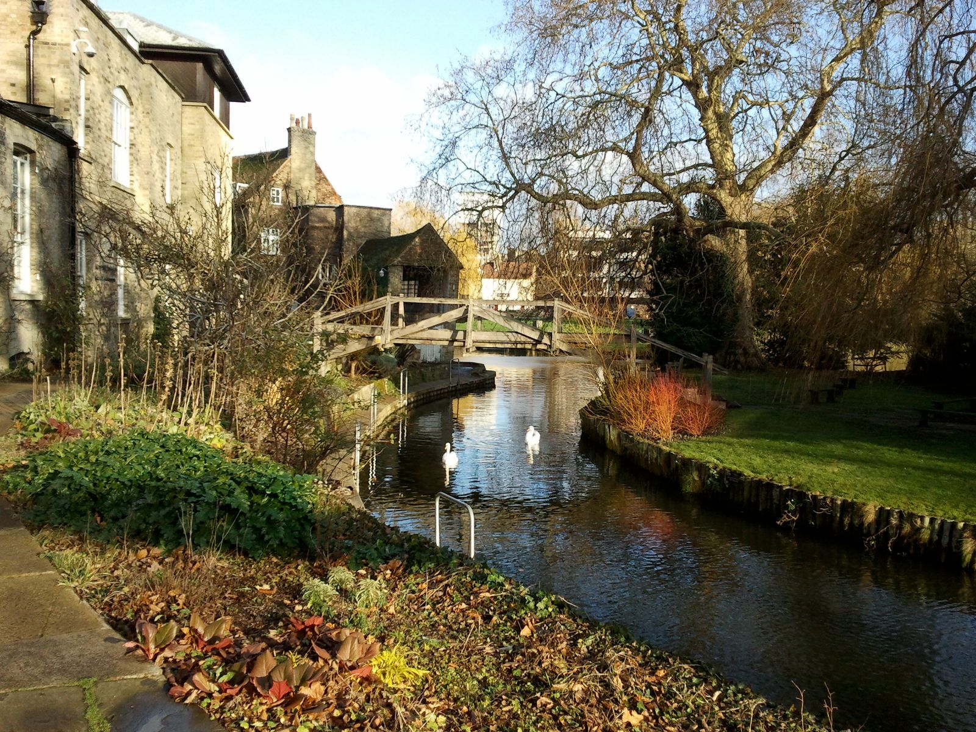
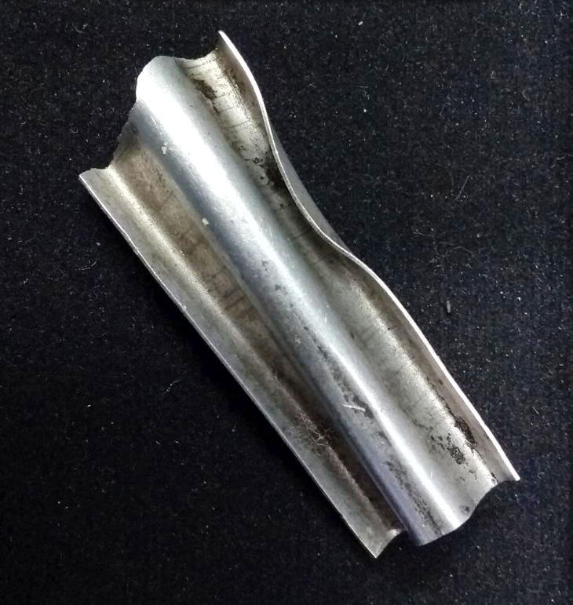
encounter with Michael Cook
about 3 cm in length
Darwin College

Slide 11
Unlike myself, Michael is an infrequent visitor for lunch at Darwin College. So he had been carrying the fragment for some time, tucked away in his jacket, until we finally met by chance and introduced ourselves.
The fragment was acquired originally by Michael’s mother’s uncle, apparently the first shooting down of an airship over Cuffley.

Slide 14
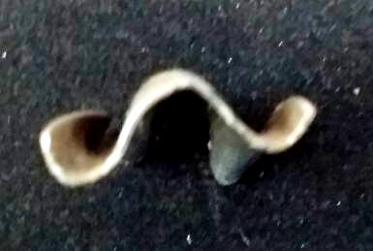
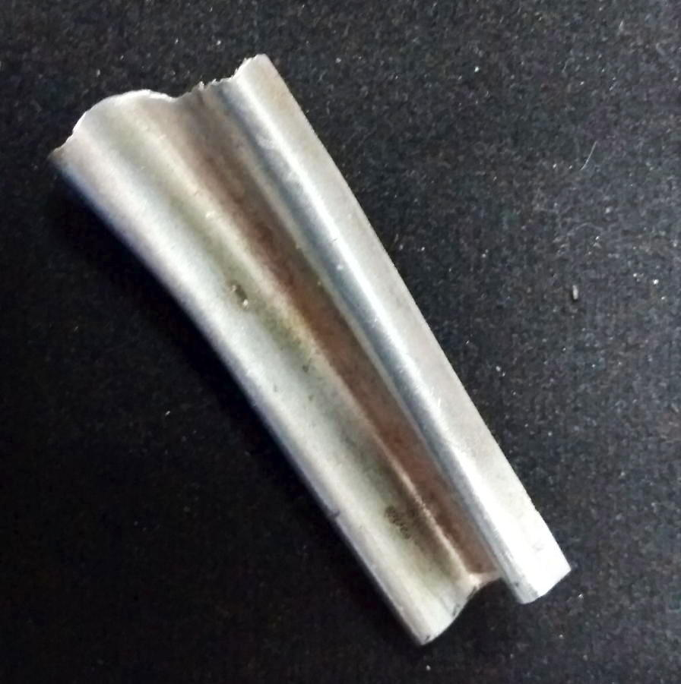
corrugated for engineered rigidity

Slide 15
Duralumin
an aluminium-(10Cu wt%...+Mg, Mn) alloy invented and patented by Alfred Wilm, a Berlin Chemist, in 1906
First produced in Düren (Prussian territory), hence, Duralumin (pronuounced douralumin)
Heat it to say 500°C, quench, leave. It hardens at room temperature over a period of days

Slide 16
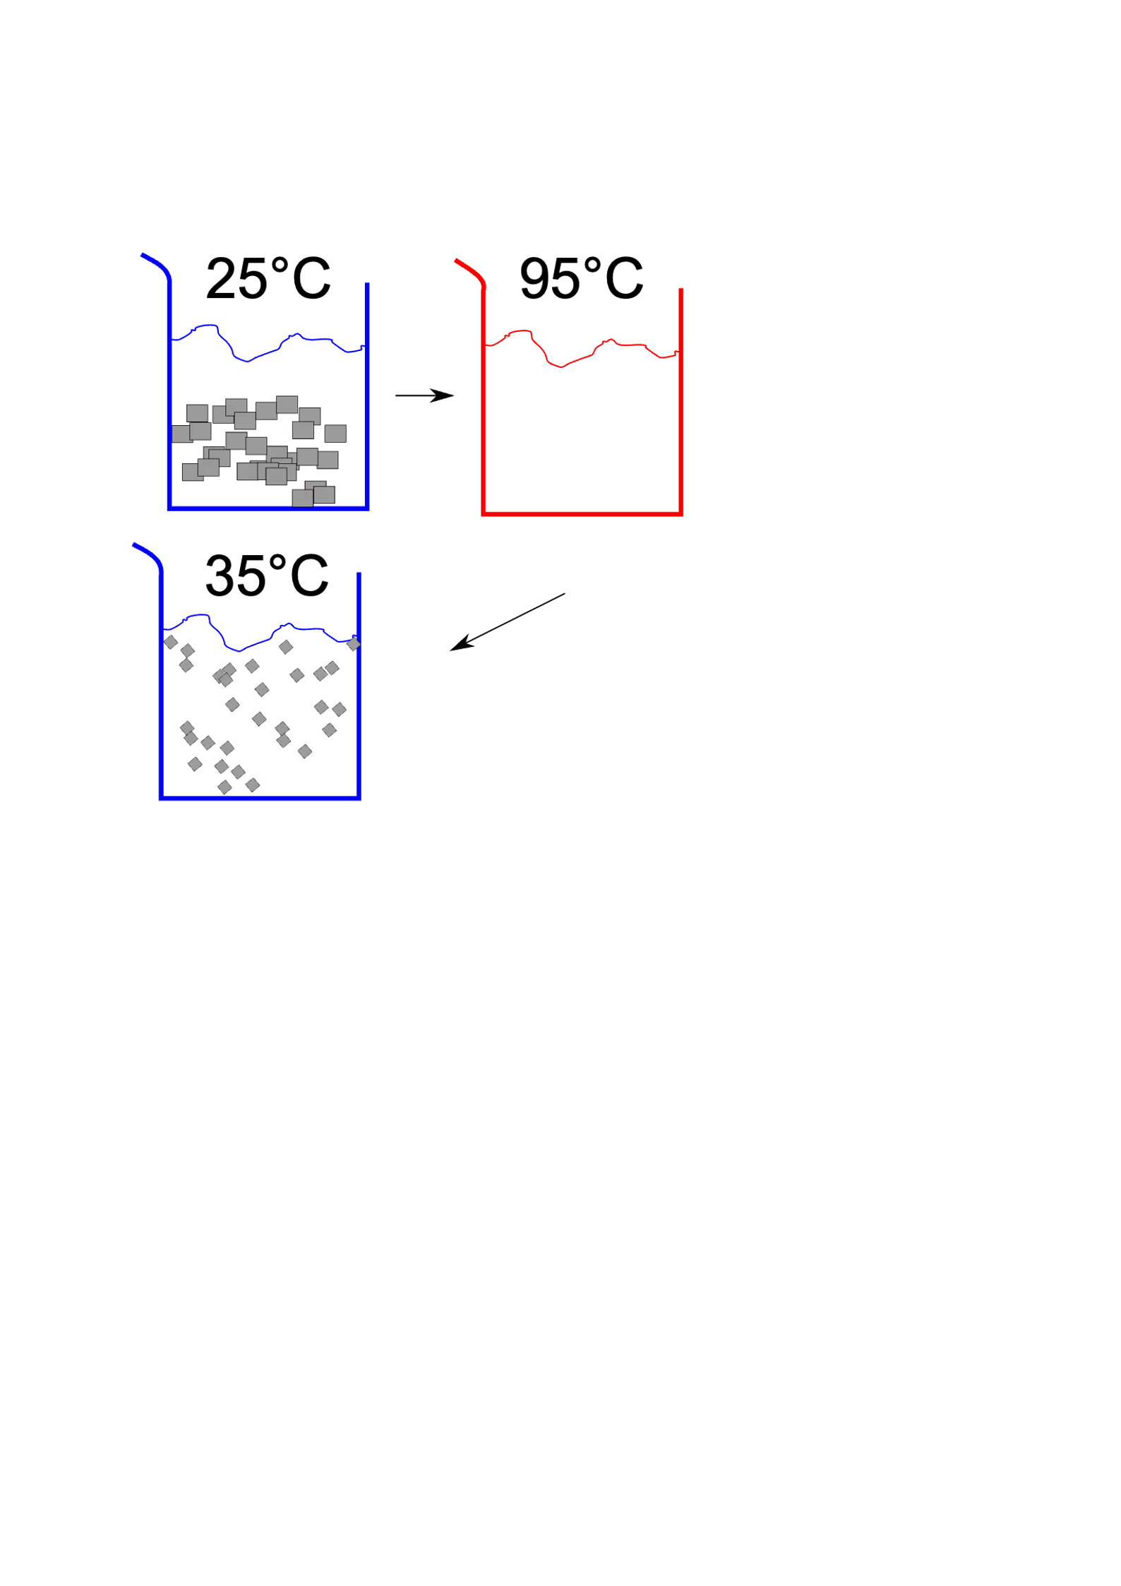
solution

Slide 17
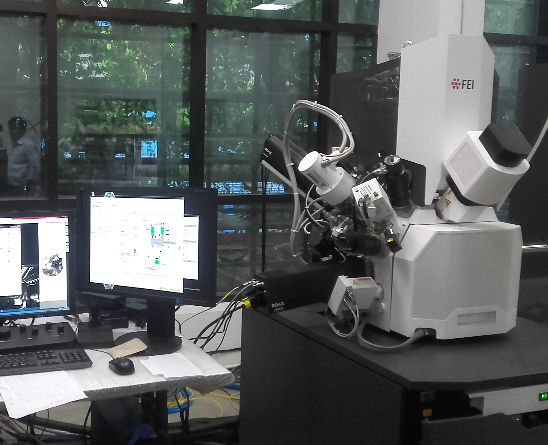
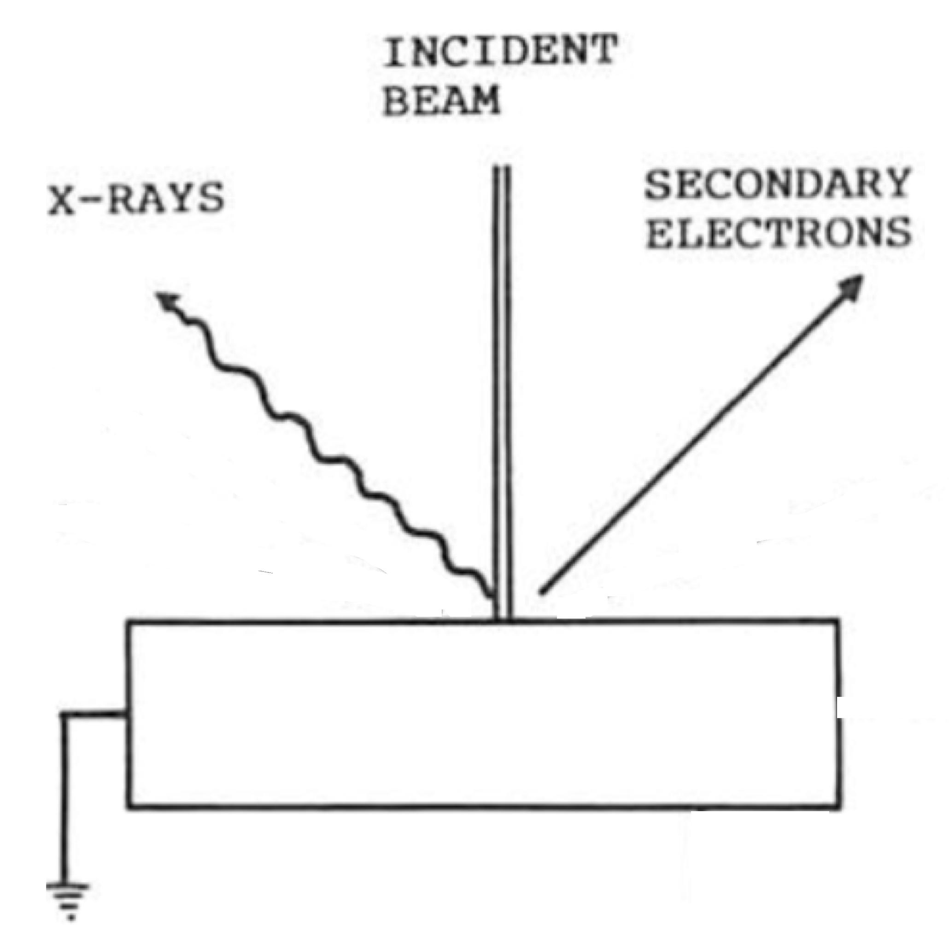

Slide 18

Microscopy & microanalysis
Ph.D. student, University of Cambridge
now at Tata Steel Laboratories, Jamshedpur, India

Slide 19
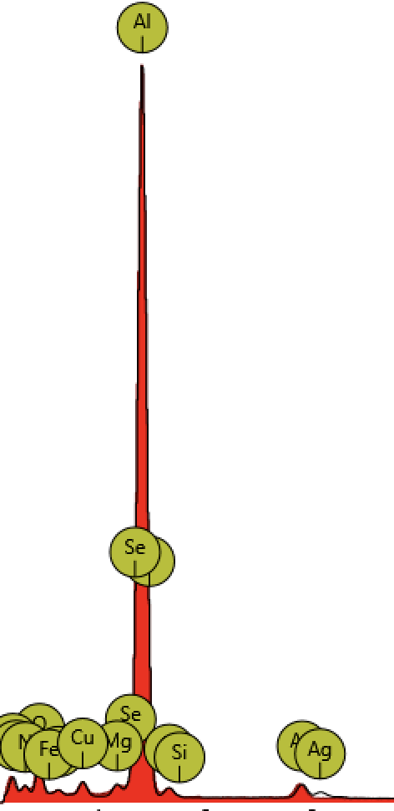
Microanalysis
Aluminium contains copper, magnesium and silver additions

Slide 20
Two manufacturers of airships
Wooden rigid-framework
metal components, several gas bags within
Duralumin rigid-metal framework
several gas bags within

Slide 21
Cuffley airship was SL11, not Zeppelin
“Duralumin .. used exclusively in Zeppelin Airships”, Cllr Peter Dace
“this is a fragment of typical Zeppelin framework, if local, it can only be from L31”, Raymond Rimell, author of The Airship V.C.
“Long conversation with Michael Cook, who is adamant that the piece is from the SL11, based on many family conversations over a long period of time”, Harry Bhdeshia

Slide 22
Imperial War Museum, Martin Anthony, Assistant Curator (First World War)
SL11. Being of wooden construction, very little was left after it burnt apart from a great deal of wire. Early press reports.... rings and bangles being made from the wire sold to raise money for the Red Cross. .... Cuffley became a popular place to visit. To satisfy visitors and to raise more money, I gather that the wreckage of other airships was also displayed at the Cuffley site when they were shot down in the following weeks or months (possibly including L31 and L32).
.... souvenirs from these other airships were also sold there. If Michael Cook’s mother’s uncle visited the Cuffley site more than three weeks after SL11 crashed, it is very possible that he saw some wreckage from a different airship that was made from duralamin.
For a long time there was some confusion about the identity of the airship shot down by William Leefe Robinson. I think this was probably caused by the displaying of other airship fragments at Cuffley.

Slide 23
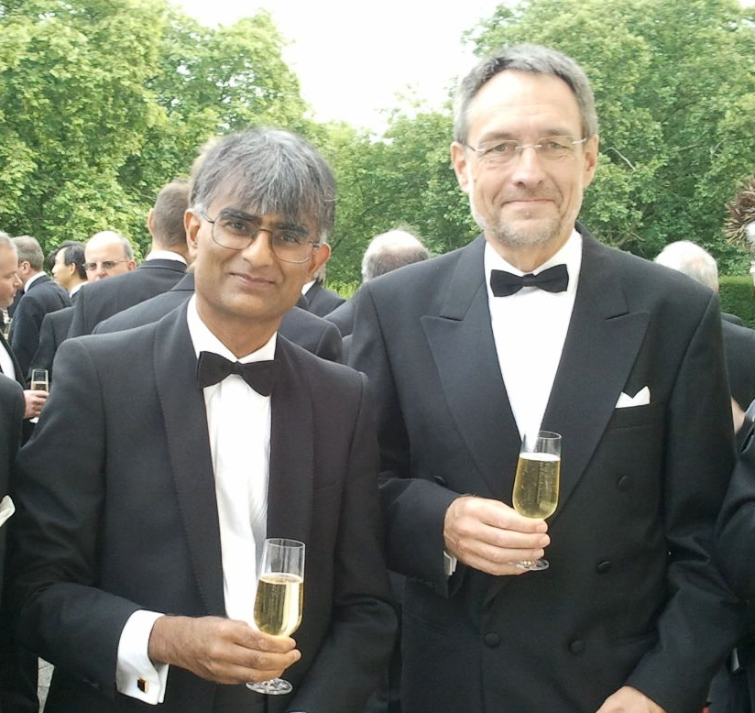
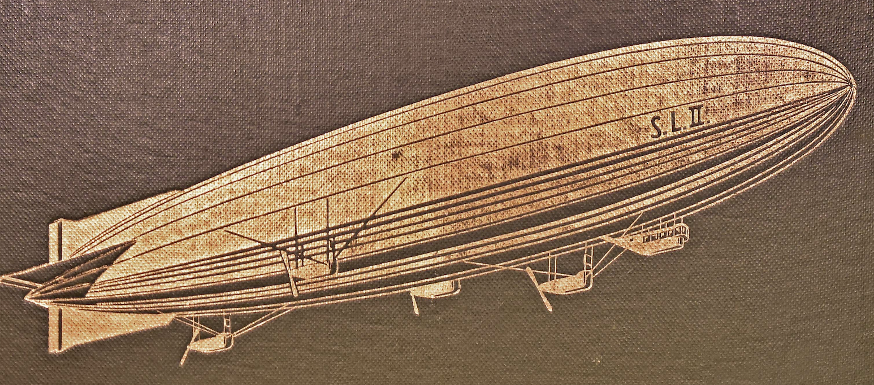
Professor Wolfgang Bleck, Aachen University
searched the German Archives

Slide 24
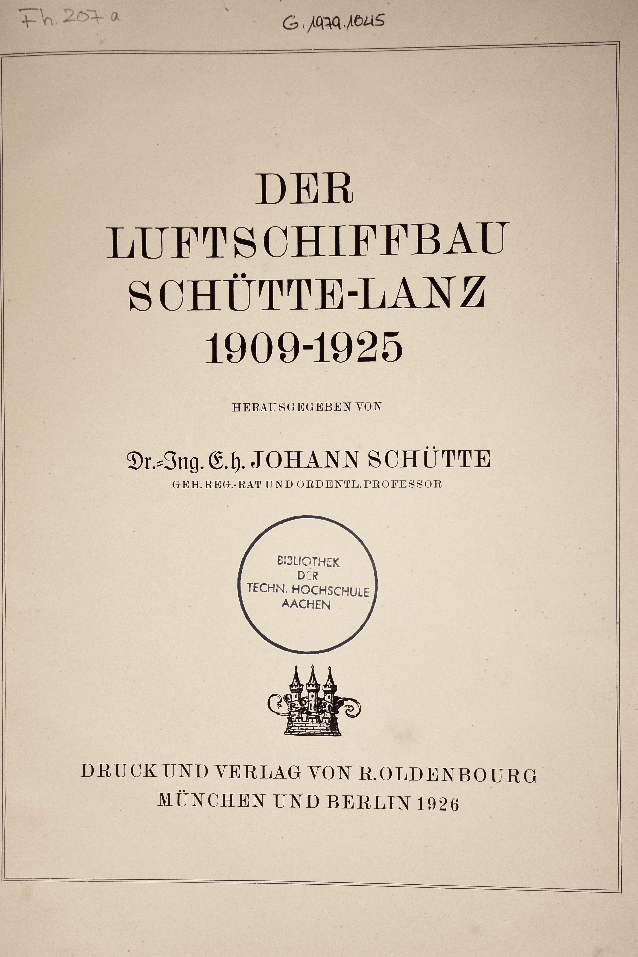
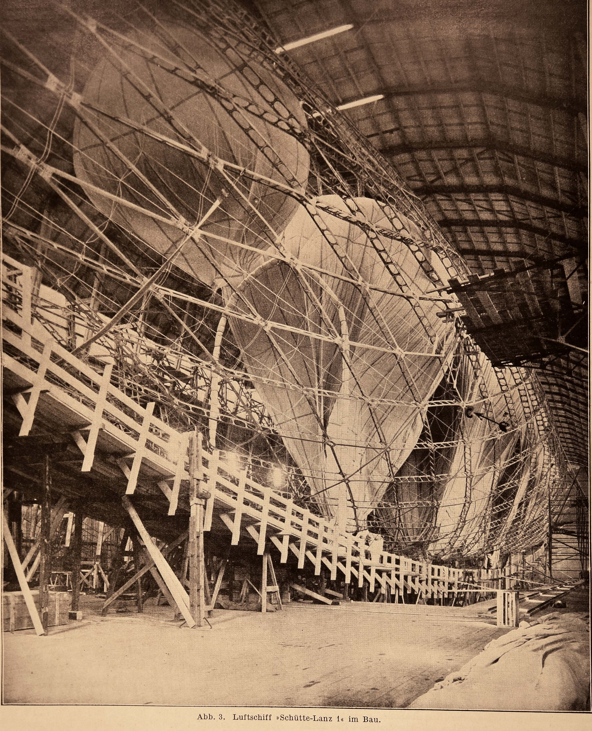
basic construction in wood
gondolas in steel

Slide 25
dissertation, University of Mannheim, 1987, by Dorothea Haaland, p. 253
SL11 construction completed August 1916
Between 24th, 31st August, two trips attempted to England but ended prematurely
On 2nd September 2000 kg of bombs dropped on London, then shot down.

Slide 26
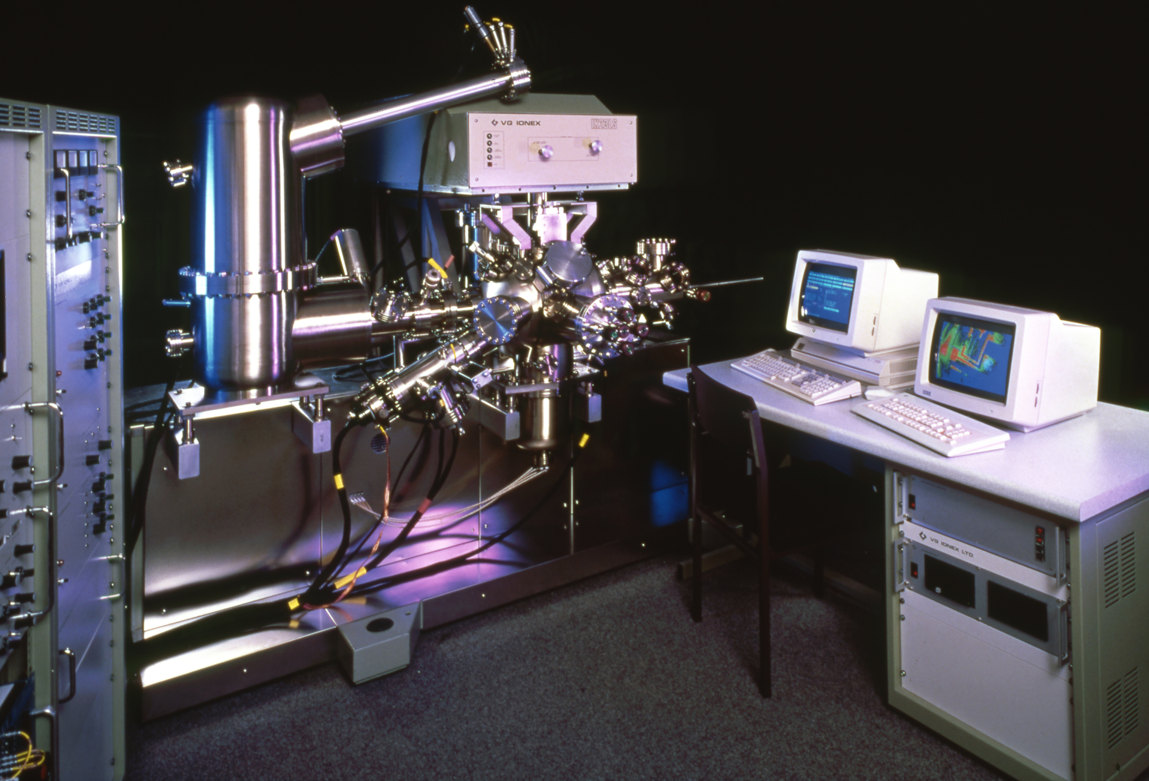
Bob Waugh

Slide 27
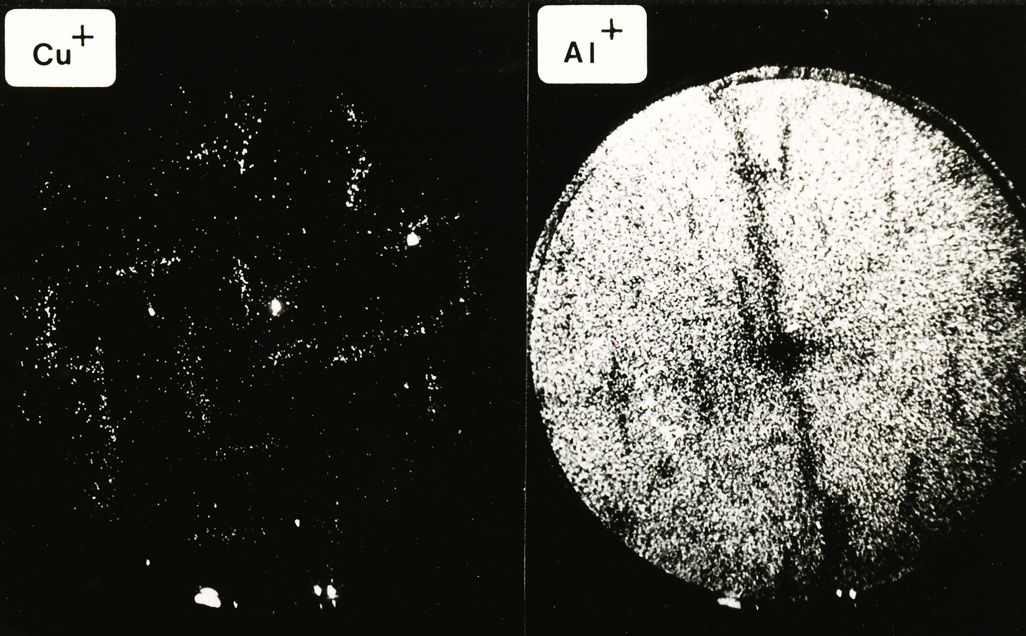
Bob Waugh

Slide 28
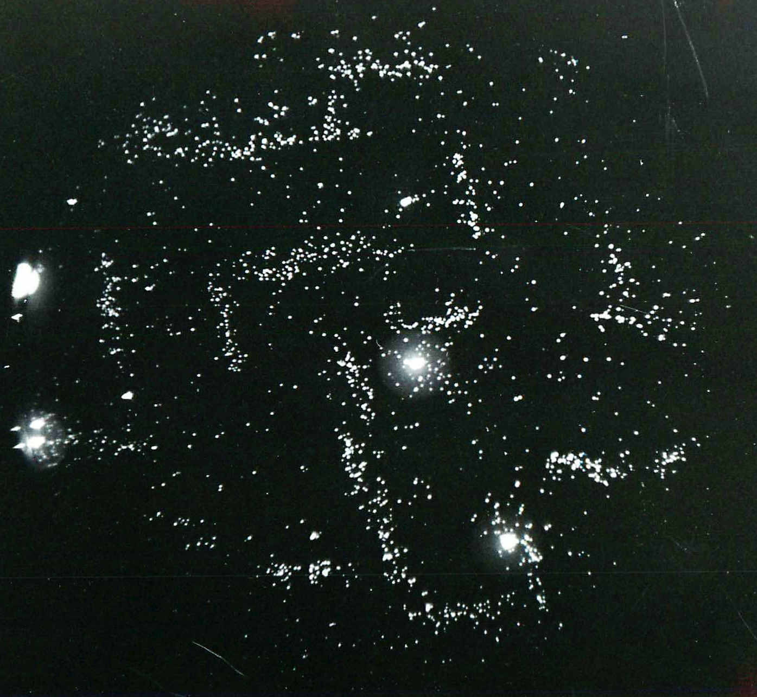
Thank you.
Bob Waugh

