Slide 1
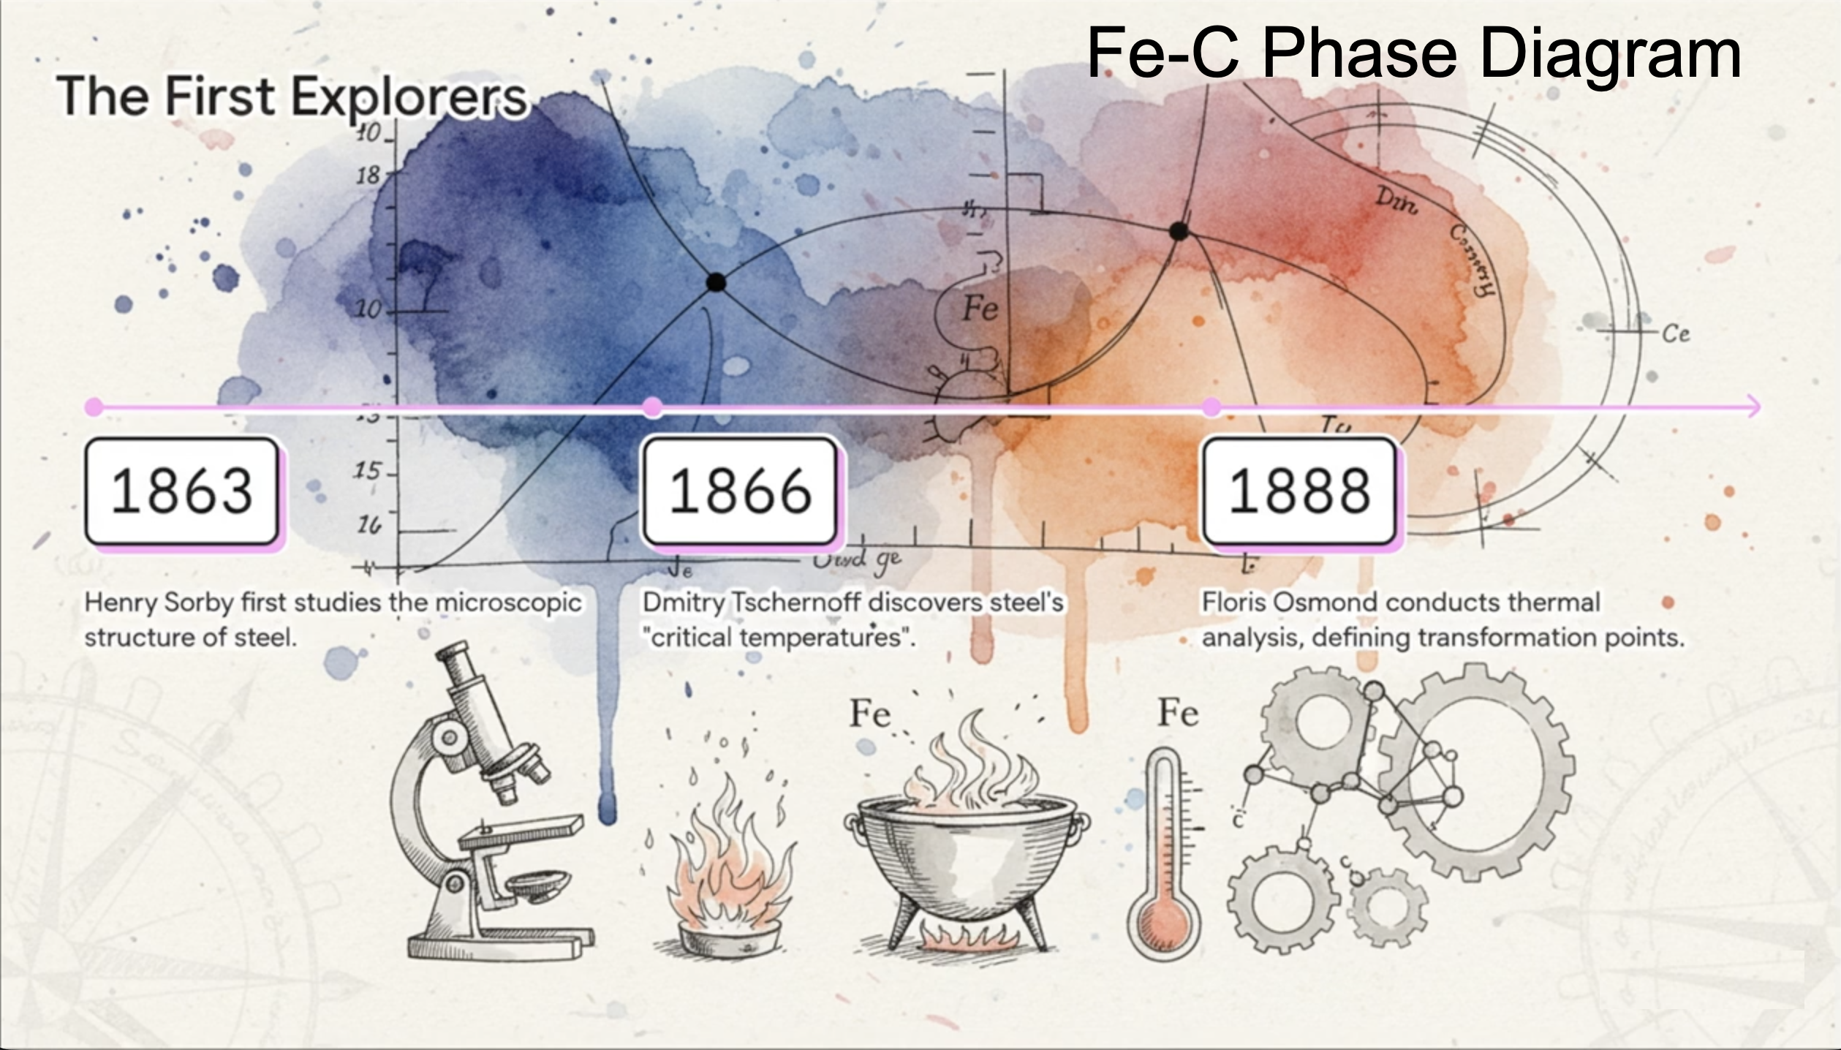

Slide 2
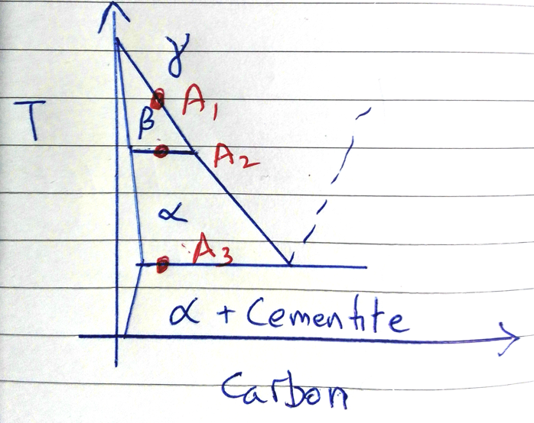

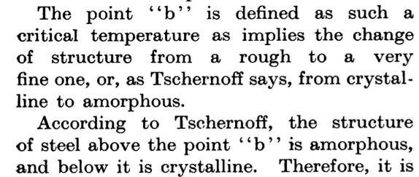
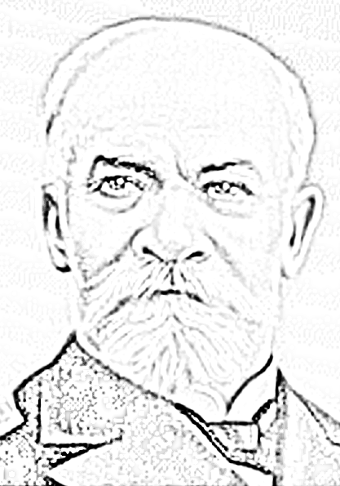
Дмитрий Константинович Чернов

Slide 3
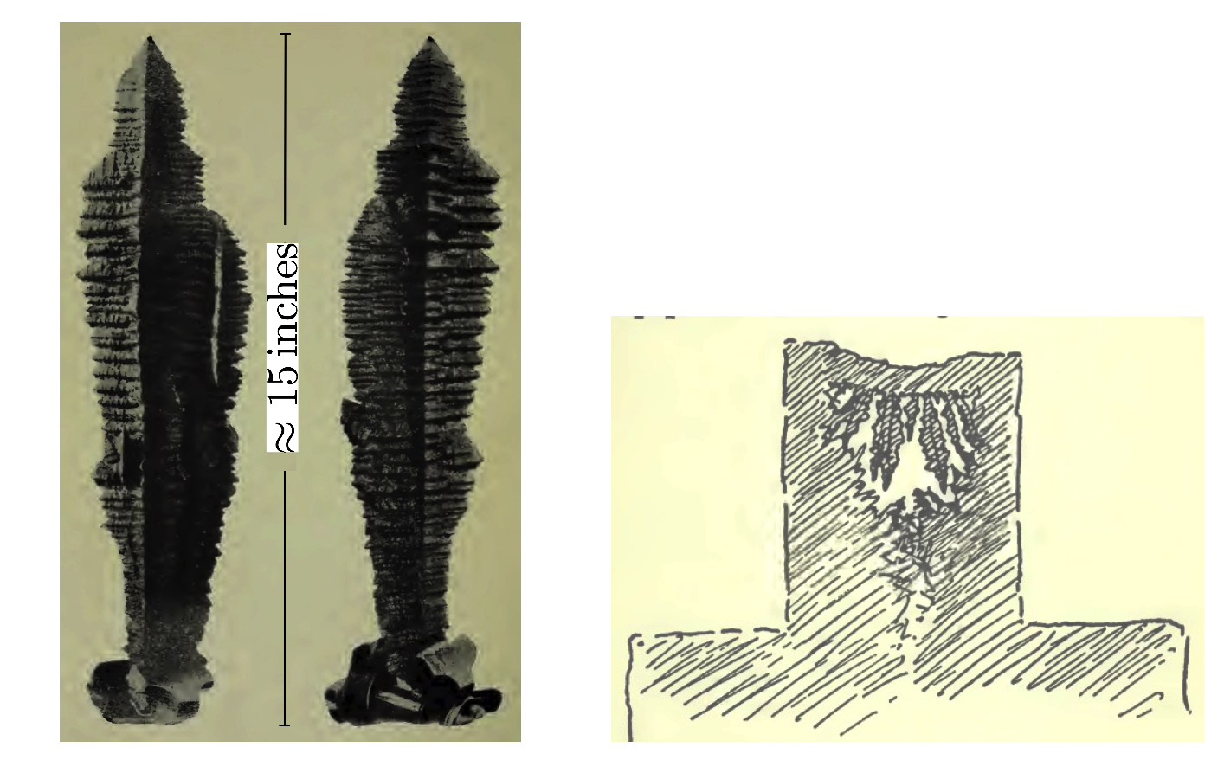
Nikolai Timofeevich Beliaev
Lectures at the Royal College of Mines
London, 1922
Damascus steel,
crystallisation,
Widmanstaetten structures,
steel making.
STEREOLOGY

Slide 4
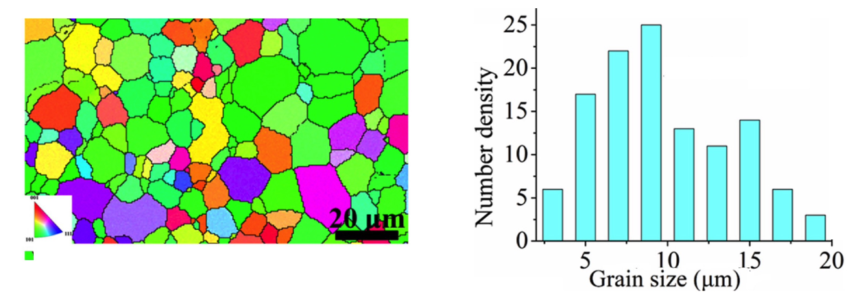
Disease

Slide 5
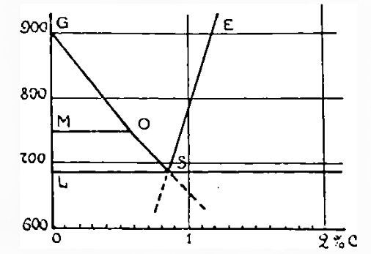
“Hultgren” extrapolation
Beliaev
Journal of the Iron and Steel Institute
105 (1922) 201-227

Slide 6
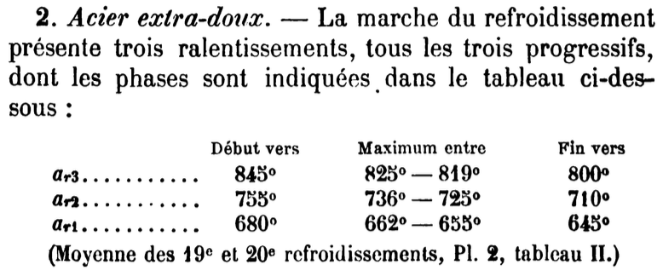
Floris Osmond, 1888, chuffage, refroidissment

Slide 7
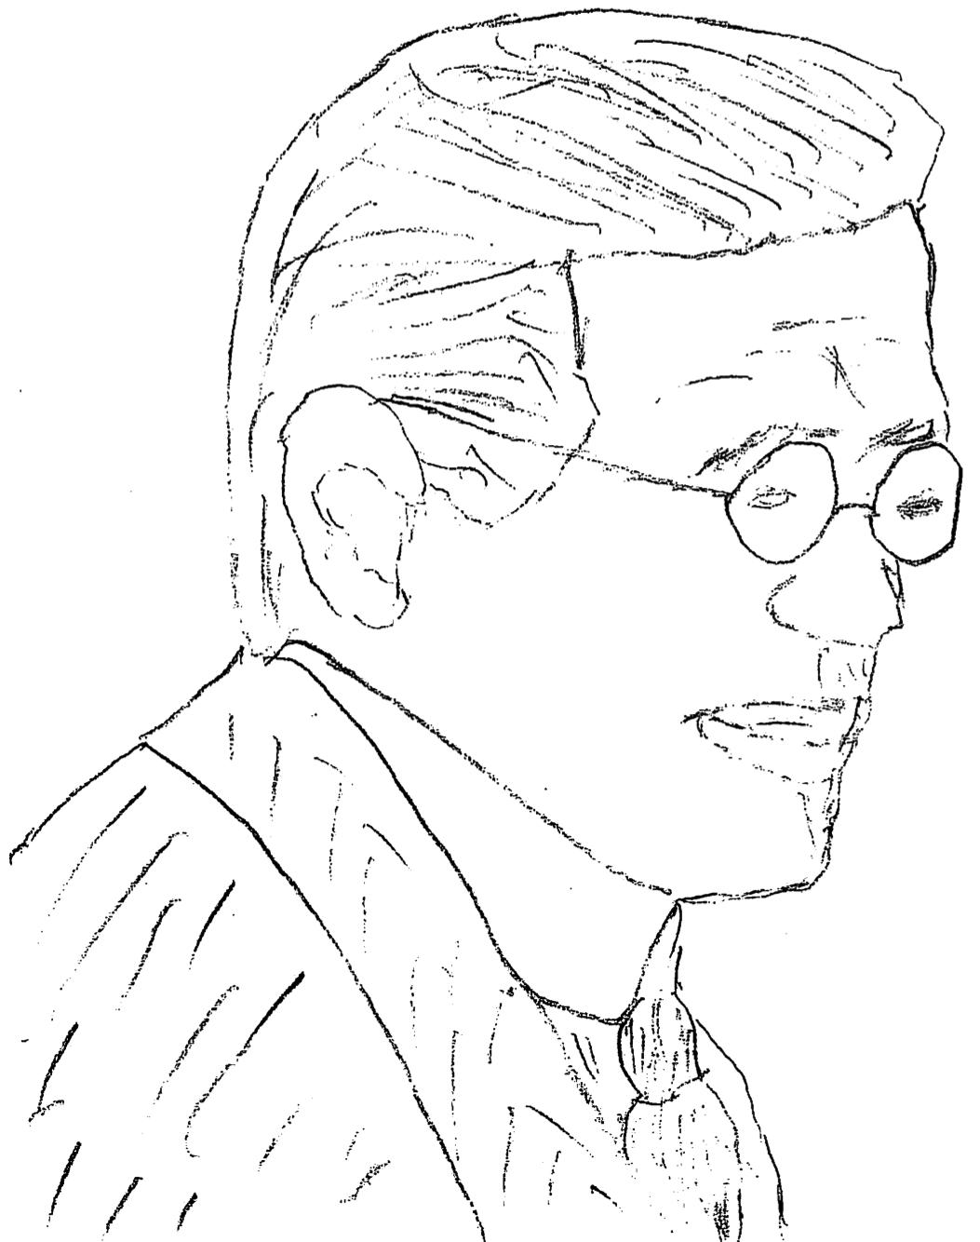
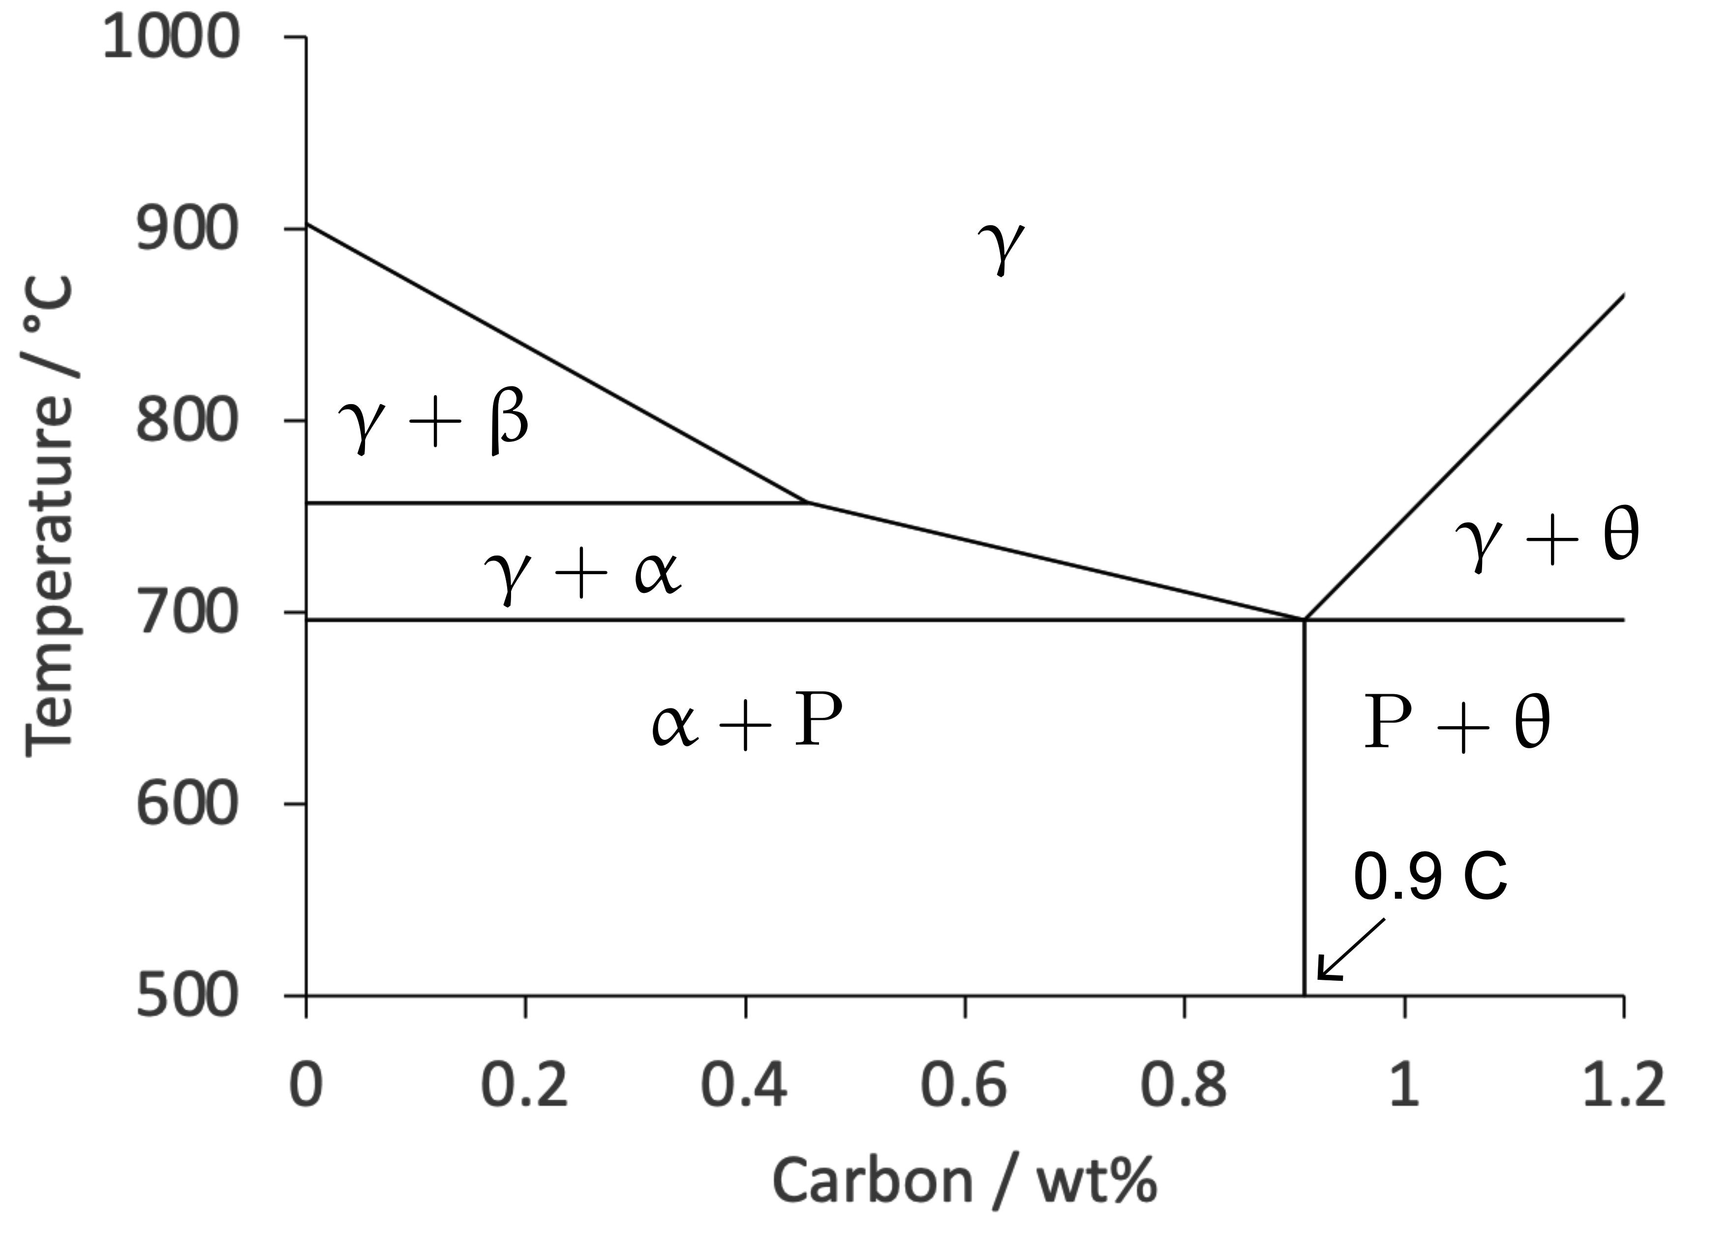
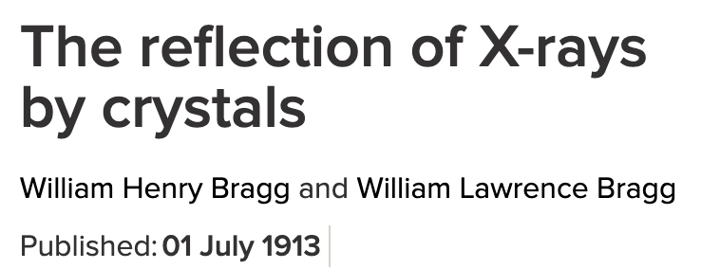
Cementite
6.01-7.38 Cwt%
Muller 1878
Fe₃C
Abel et al. 1883
Walter Rosenhain
Two lectures on steel: first lecture
Proc. Inst. Mech. Engng.
80 (1911) 241-275
Notes:
incorrect idea that β-iron (the non-magnetic form of α-iron above 770∘C) was an amorphous phase
At the boundaries, where grains of different orientation meet, there must be a neutral zone— a kind of “ no man’s land ”—where the crystal¬ line matter cannot assume the orientation of either of the grains.
This thin layer of crystalline matter, which is considered by Rosenhain as in an " amorphous ” state (20) would seem predestined to facilitate the appearance of the nuclei of the secondary depositions.

Slide 8
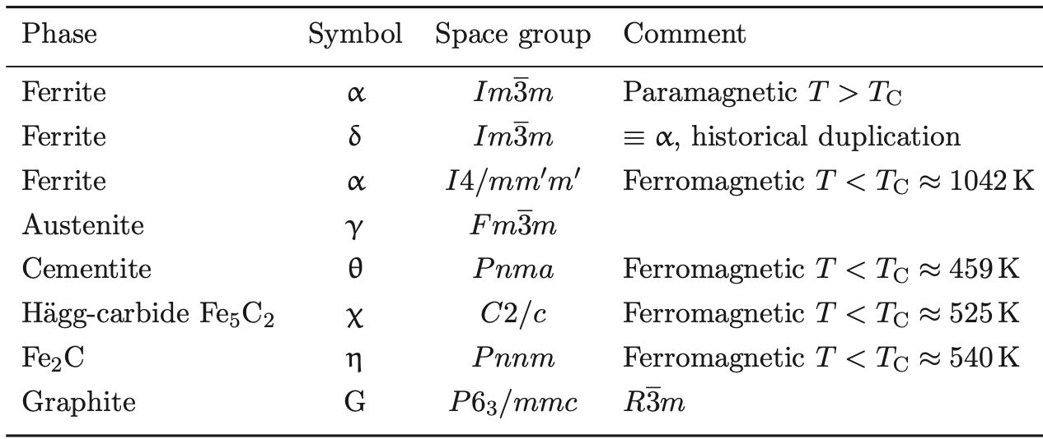

Slide 9
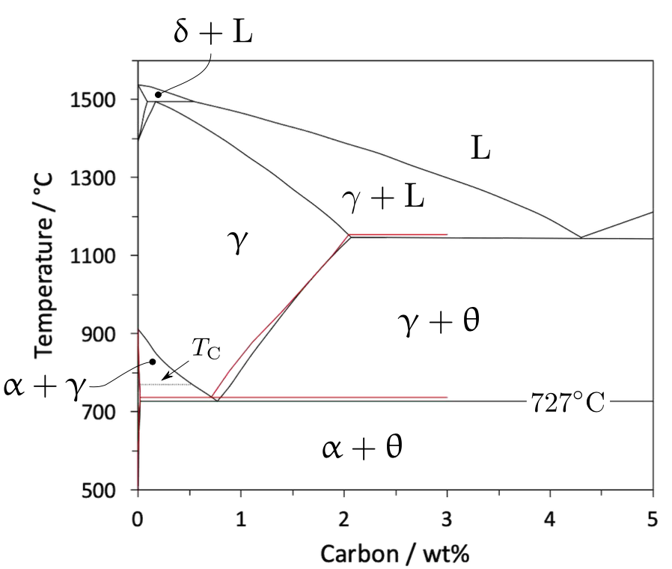
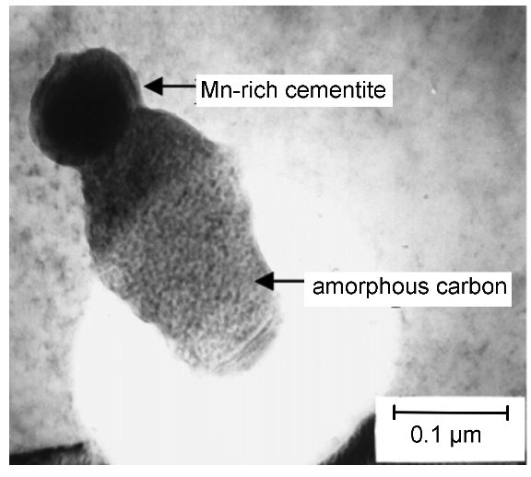
He, Daniels, Brown, Brydson, Edmonds
2007

Slide 10
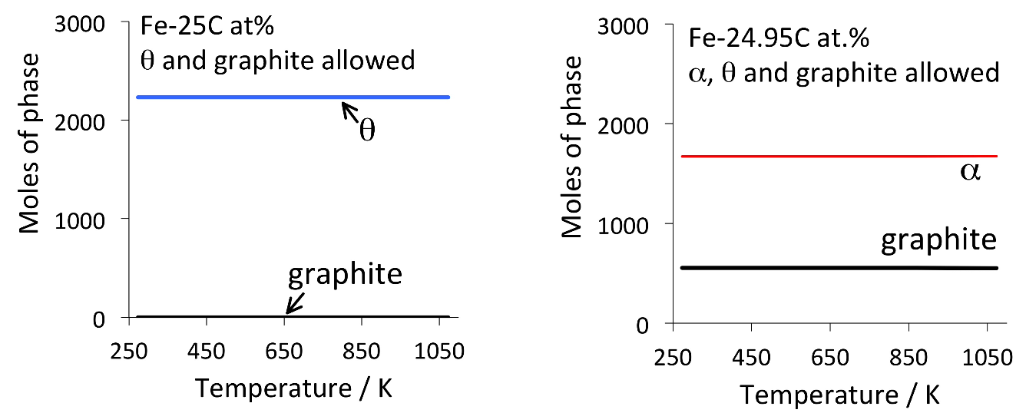

Slide 11
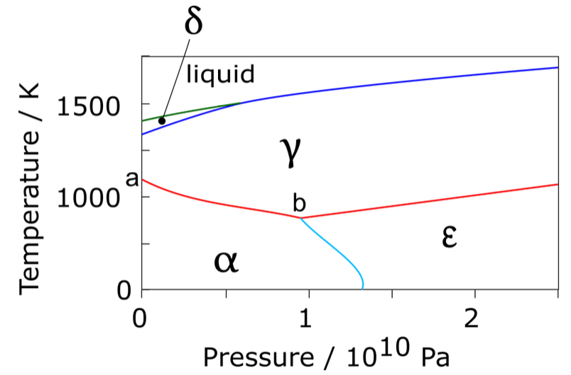
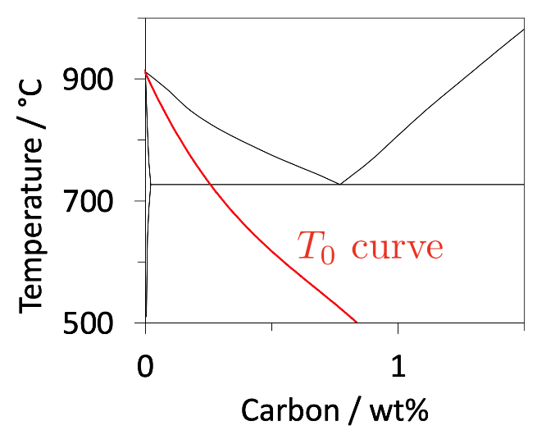
not sacrosanct

Slide 12
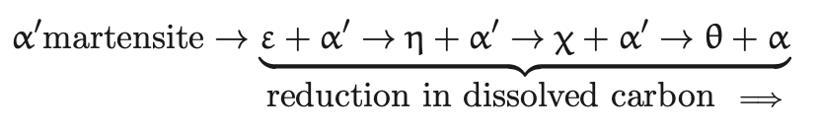
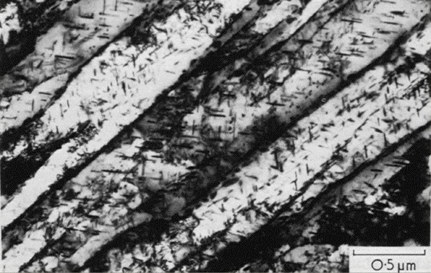
Temper martensite in Fe-C

Slide 13
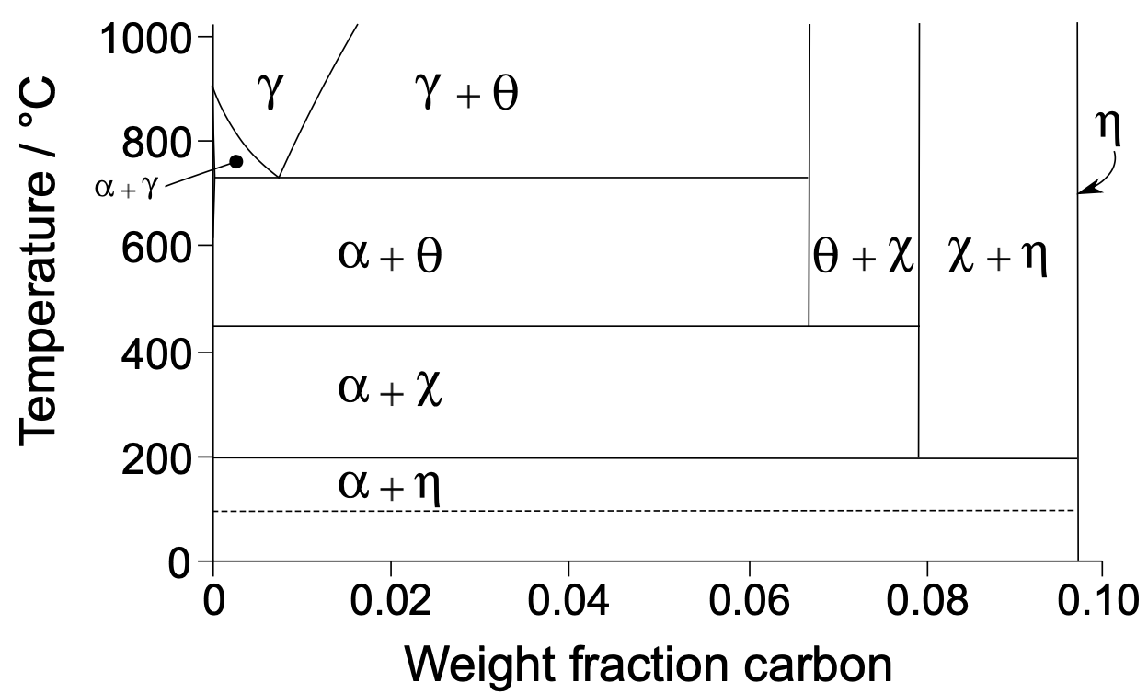

Slide 14
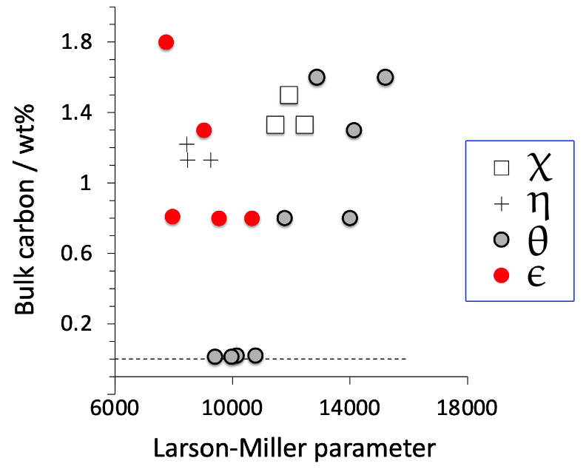
Cementite always
most stable phase
Other carbides absent at low carbon conentrations
Bhadeshia, Chintha, Lenka
(2019)

Slide 15
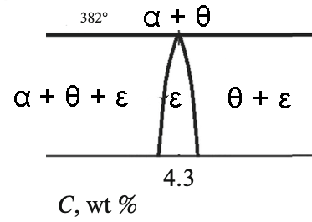
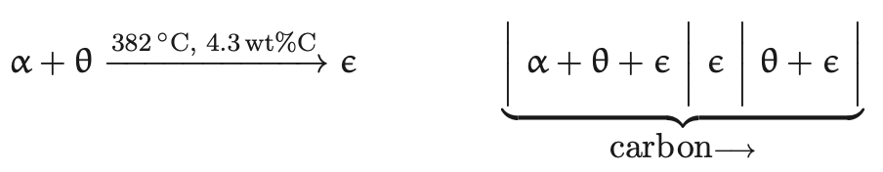
Peritectoid reaction
S V Davydov
Steel in Translation
2023

Slide 16
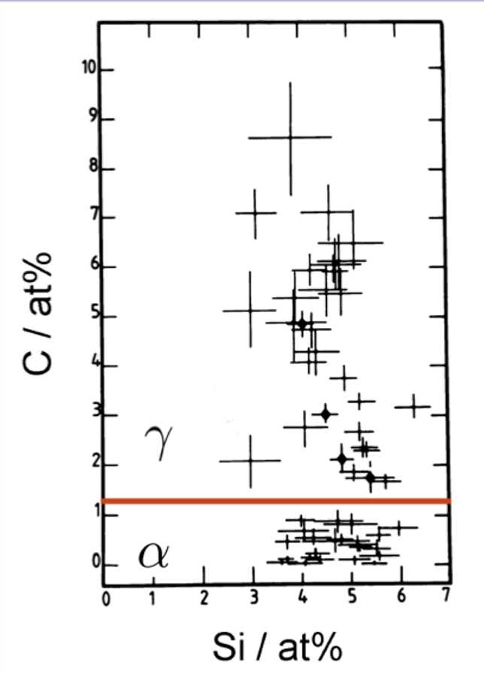
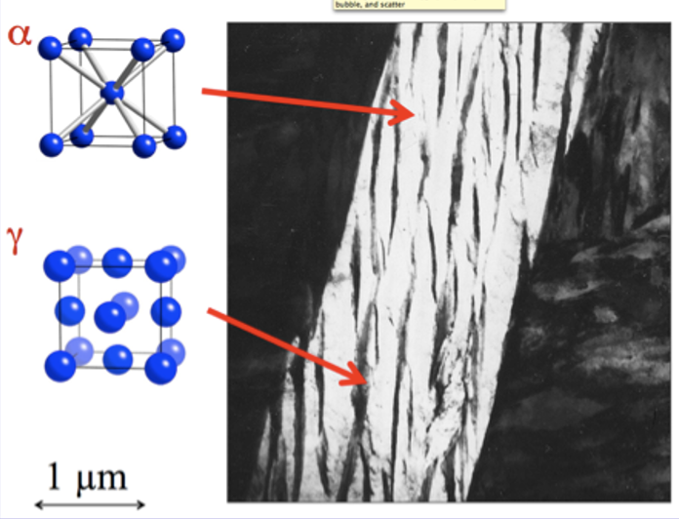
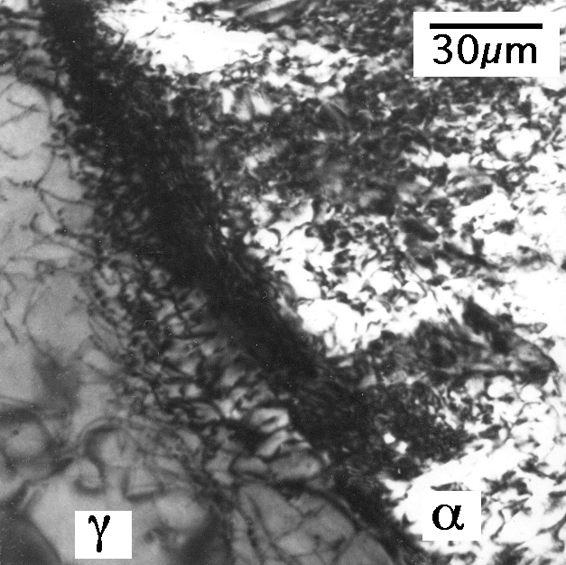
Bhadeshia, Waugh
Acta Metall. 30 (1982) 775

Slide 17
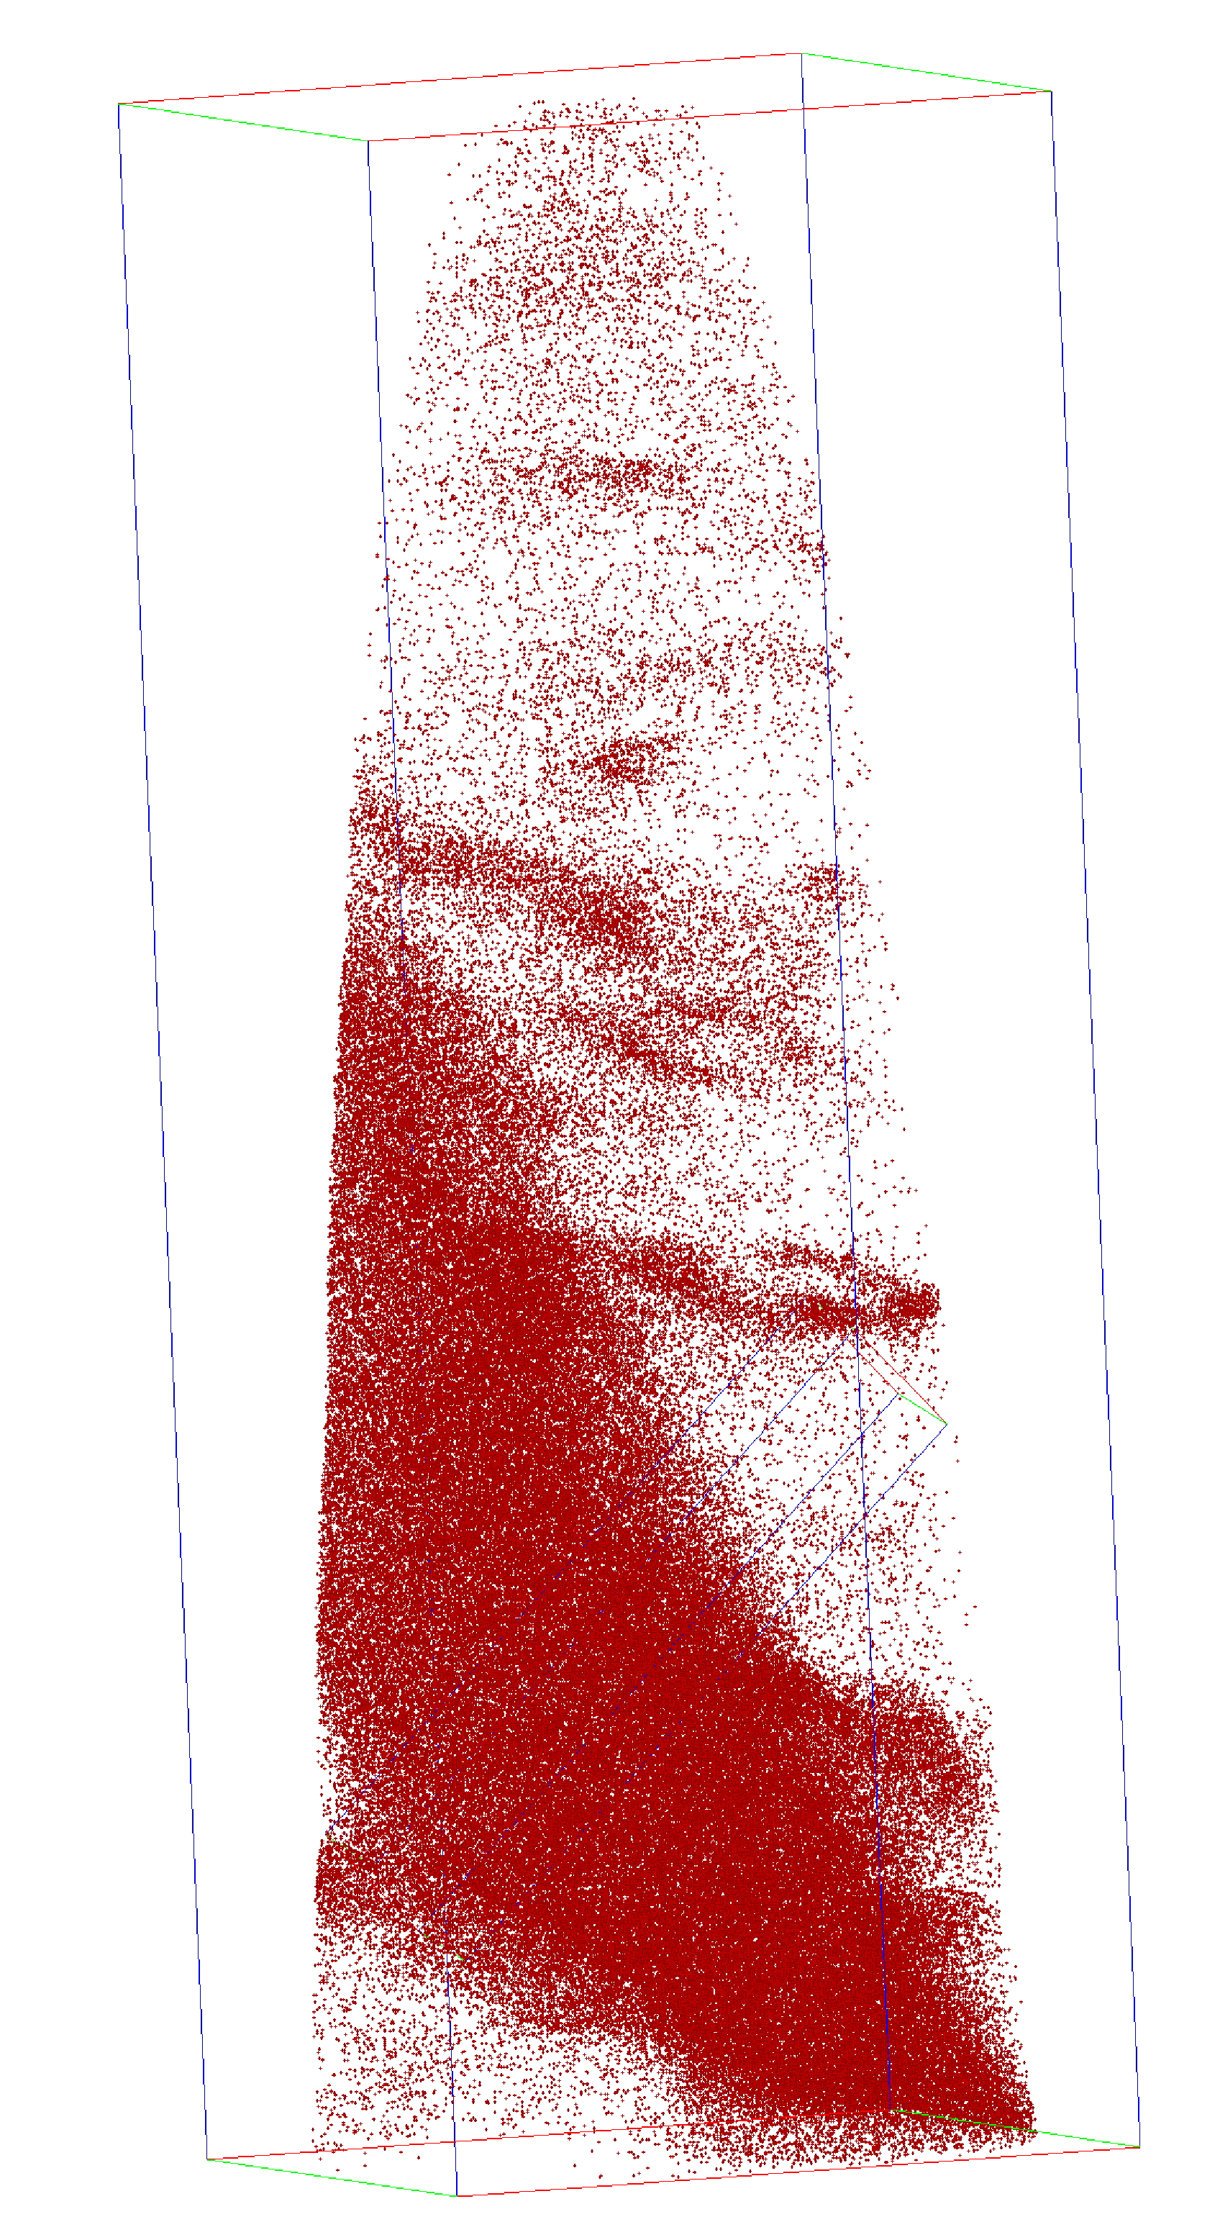
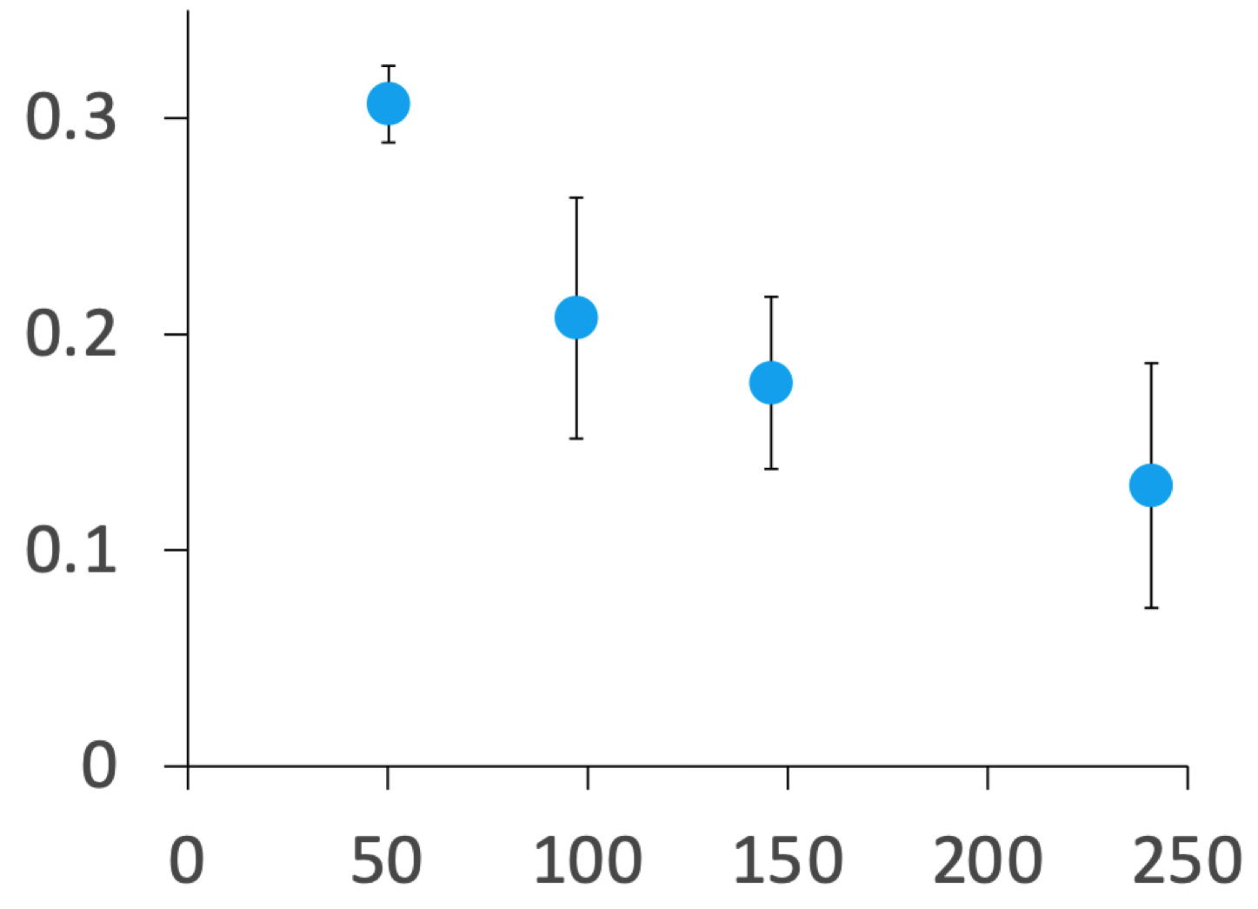
carbon concentration in solution in ferrite
Fe-1C-1.5Si-1.9Mn-1.3Cr-0.26Mo-0.1V wt%
Acta Mat. 91 (2015) 162
persistent carbon!
dislocation
Time during transformation at 200°C / hours
Caballero, Miller, Mateo, Cornide. J. Alloys & Compounds, (2012)

Slide 18
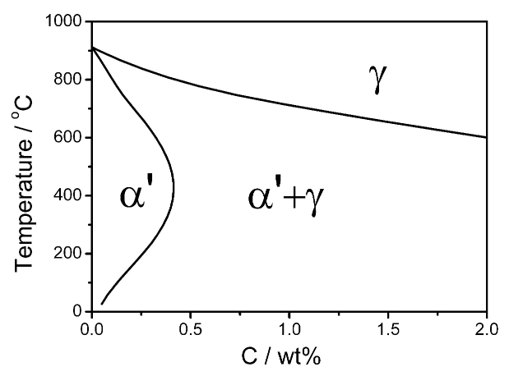
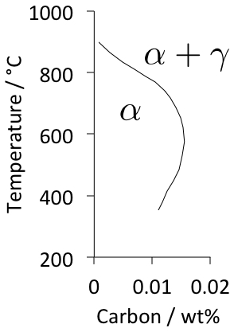
Jang, Suh, Bhadeshia, Scr. Mat. 68 (2012) 195

Slide 19
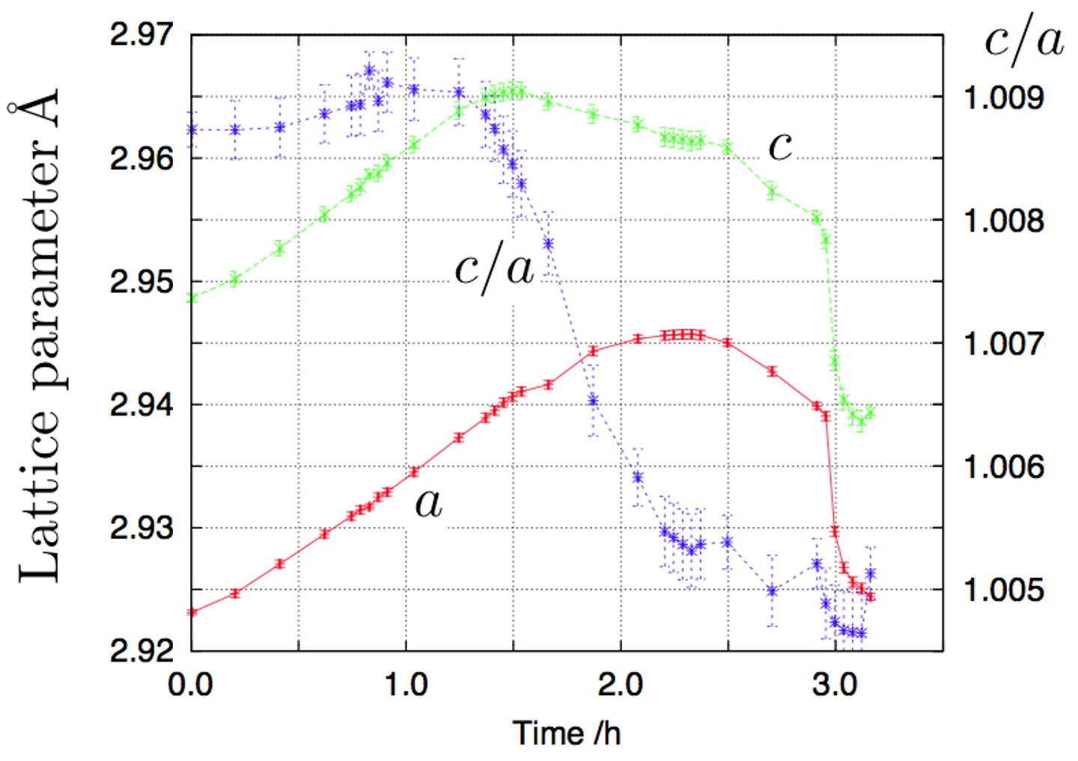
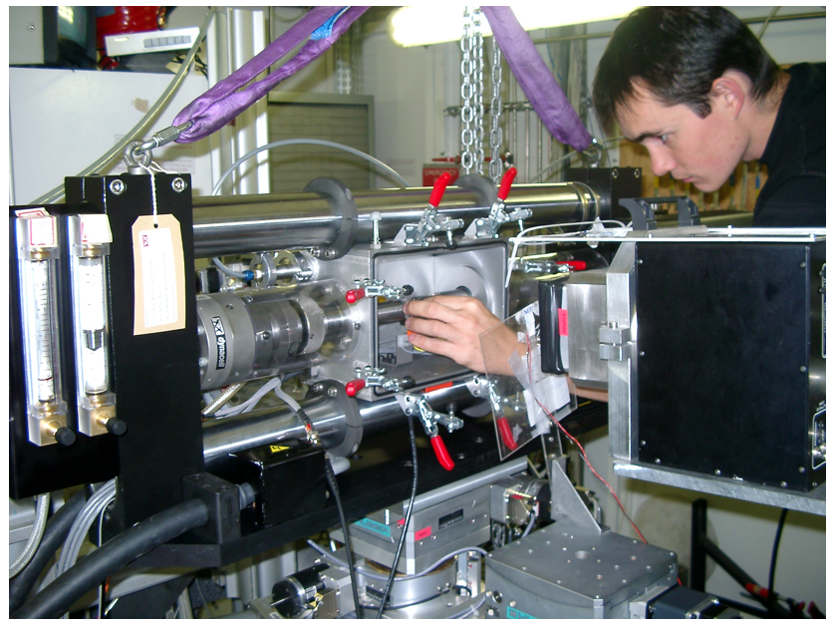
transformed to
bainite at 200°C →25°C
then heated from
25→600°C at 300°C h⁻¹
Hulme-Smith, Lonardelli, Dippel and Bhadeshia, Scr. Mat. 69 (2013) 409.

Slide 20
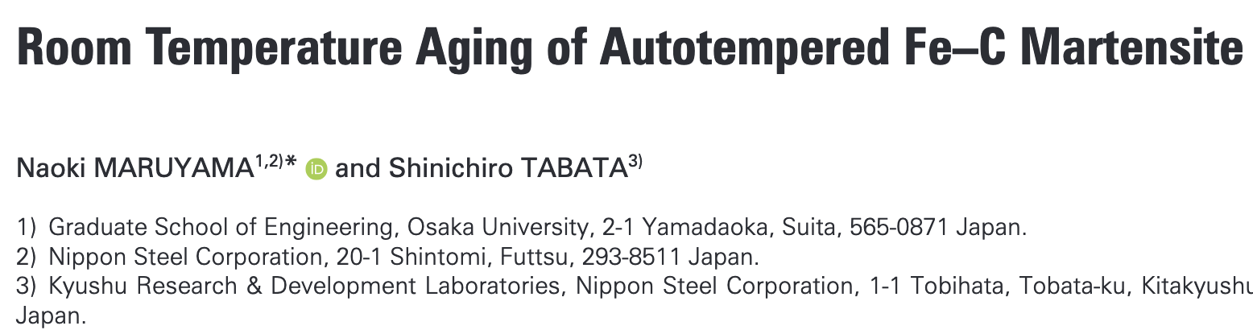
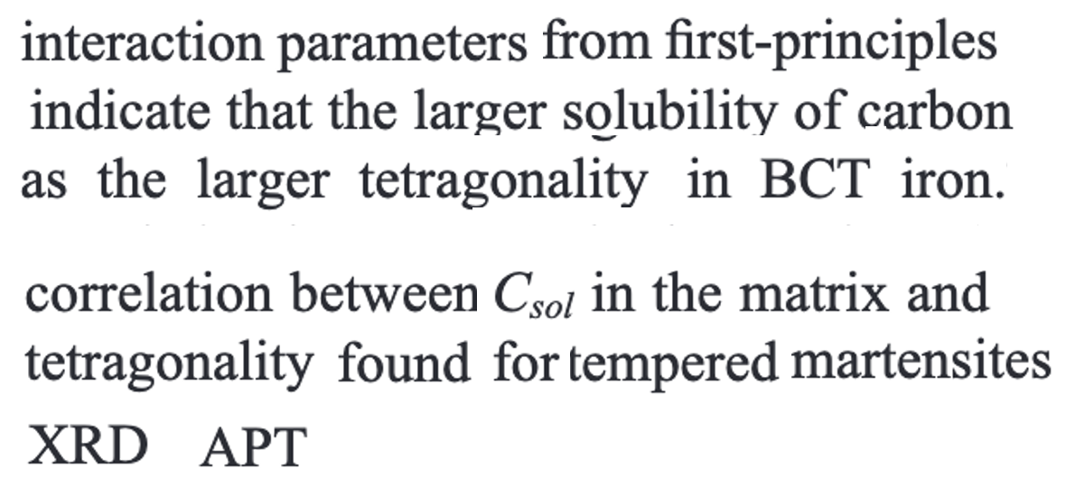

Slide 21
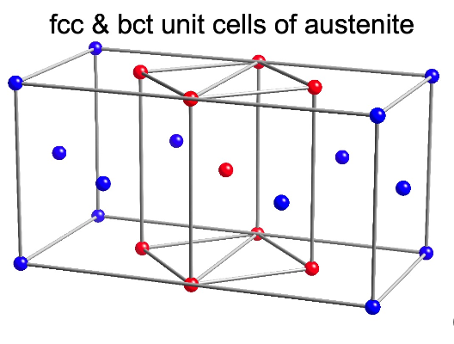
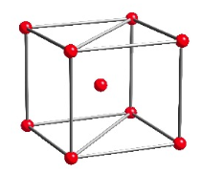
one interstice per
iron atom
x
x
x
x
three interstices per
iron atom

Slide 22

Conclusions

