Slide 1
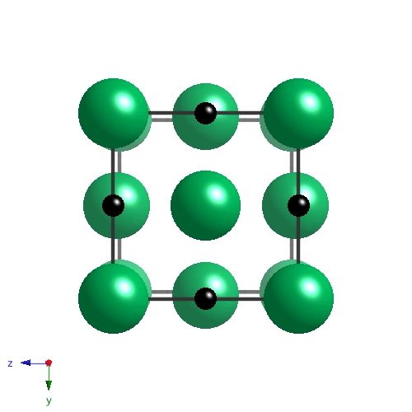


Kinetics of niobium carbide precipitation
www.phase-trans.msm.cam.ac.uk

Slide 2
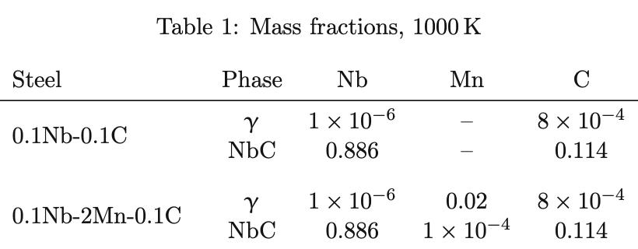
Equilibrium
50.12 Nb, 49.88 C at. %

Slide 3
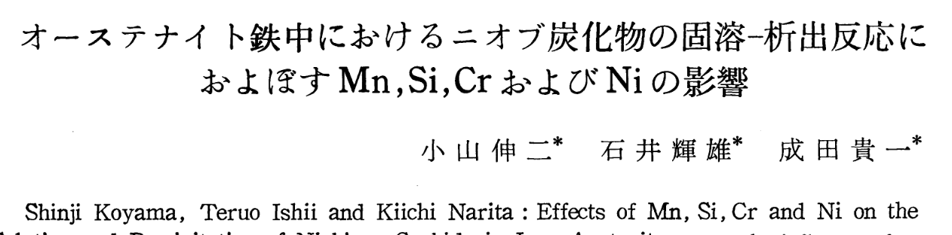
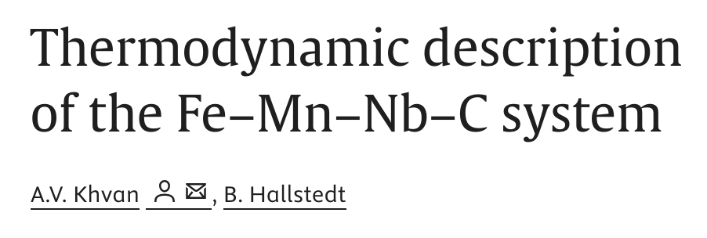
Journal of Japan Institute of Metals 35 (1971) 1089
CALPHAD 29 (2012) 62
Mn ↑ [Nb][C] in γ

Slide 4
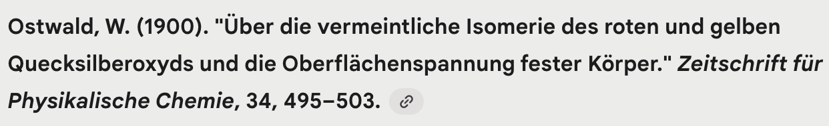
Smaller particles of mercuric oxide dissolve and their material redeposits on to larger ones, due to surface tension [interfacial energy]
Average size of `solid bodies’ increases

Slide 5
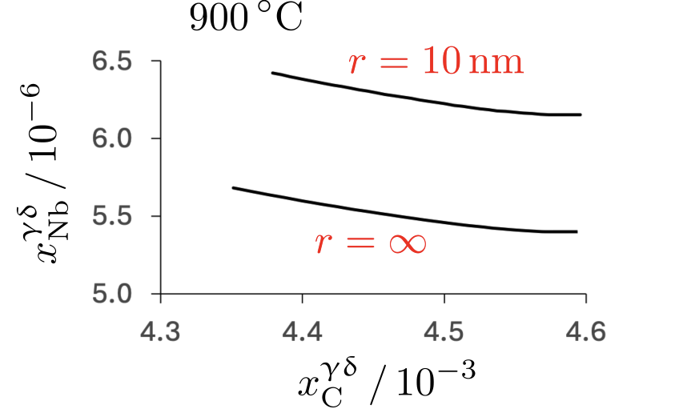
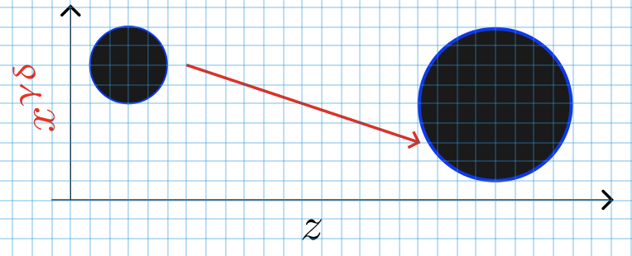
“Capillarity”
Small particle dissolves, large particle grows.
Total number of particles decreases.

Slide 6
Concept of local equilibrium

Slide 7
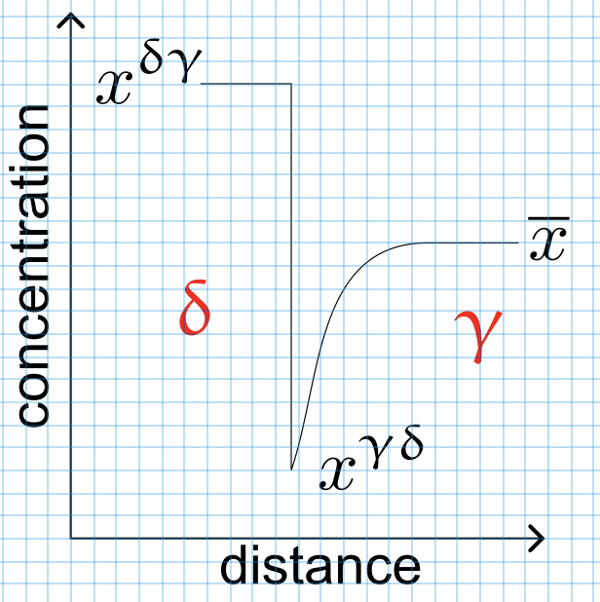
Concentrations at δ (NbC) / ϒ (austenite) junction
carbide absorbs Nb, C
austenite depletes in Nb, C

Slide 8
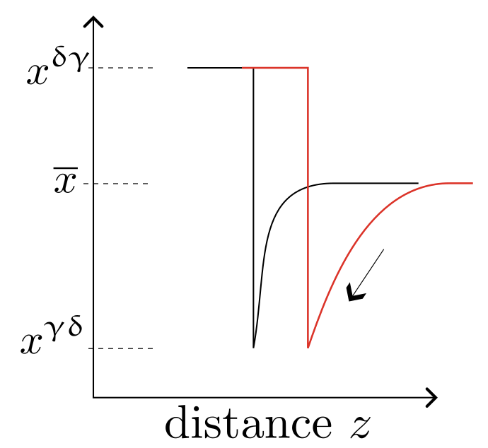

Slide 9
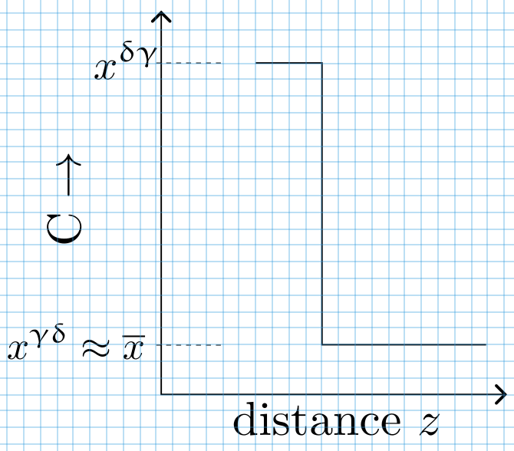
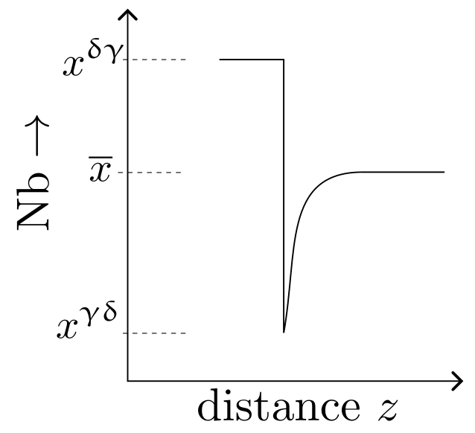

Slide 10
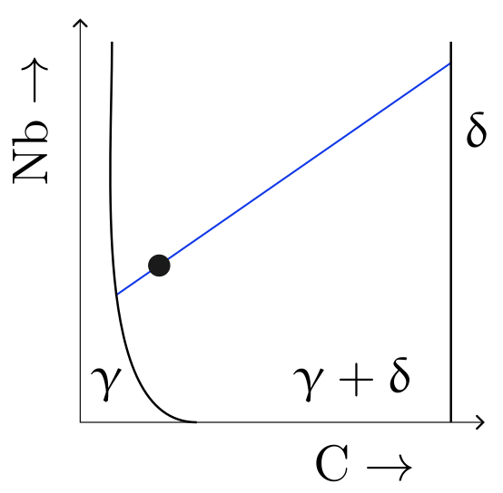
NbC
austenite

Slide 11
Precipitation
Nucleation
Growth
Impingement

Slide 12
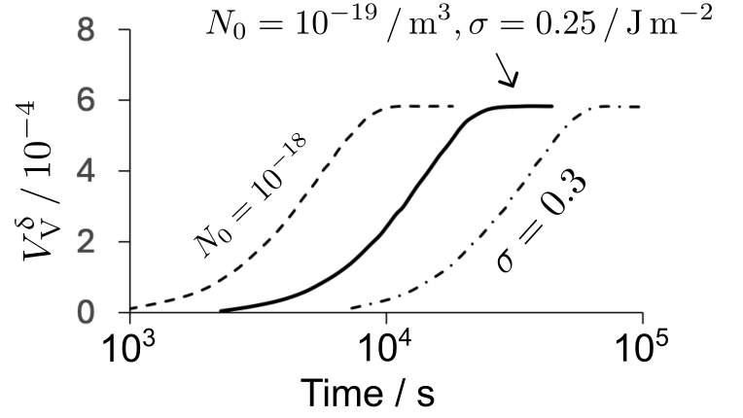
Fe-0.1C-0.05Nb wt%, 900°C
nucleation
+growth
+impingement = fraction

Slide 13
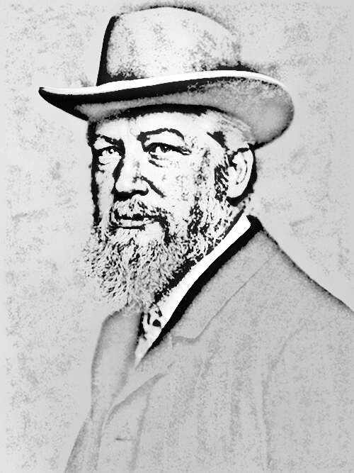
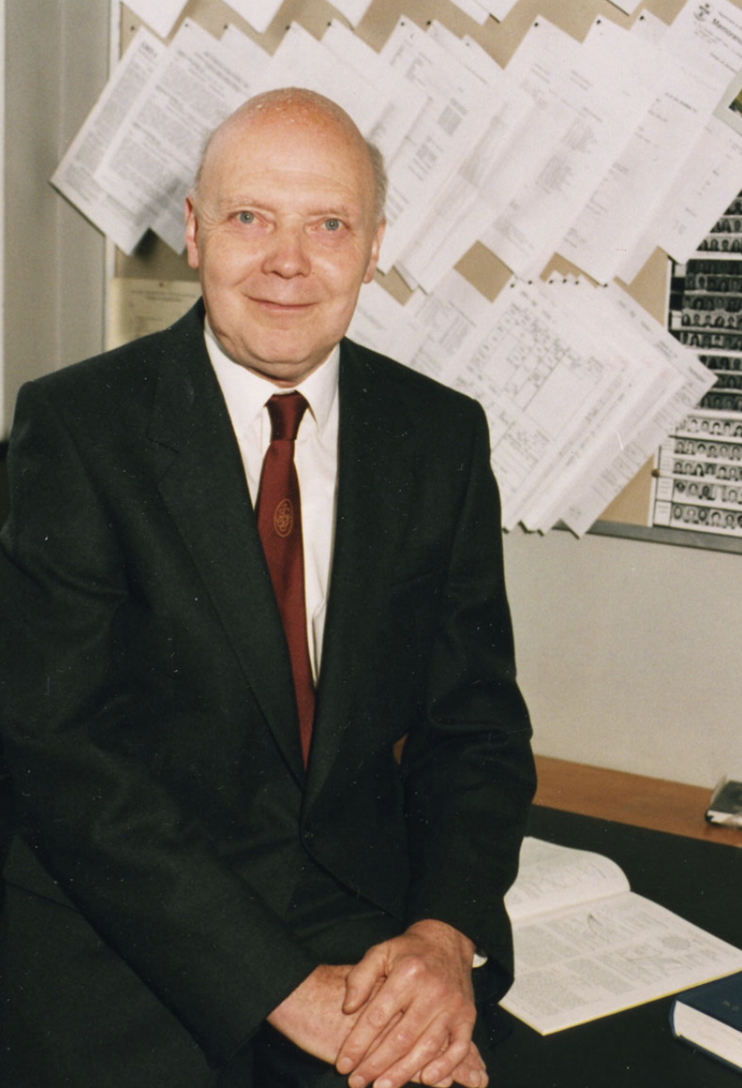
Wilhelm Friedrich Ostwald
Geofrey Wilson Greenwood

Slide 14
AERE UK: nuclear reactor in which fuel is fluid, helps heat extraction
Geoffrey Greenwood: uranium suspended in bismuth+Pb+Sn
blocking, agglomeration etc.
However, observed coarsening of particles isothermally.
Developed first theory based on Ostwald to treat a pattern of diffusion fluxes.
Lifshitz, Wagner, Slyozov
Biographical Memoirs of Fellows of the Royal Society. 2024 Apr 1;76:221-40.

Slide 15
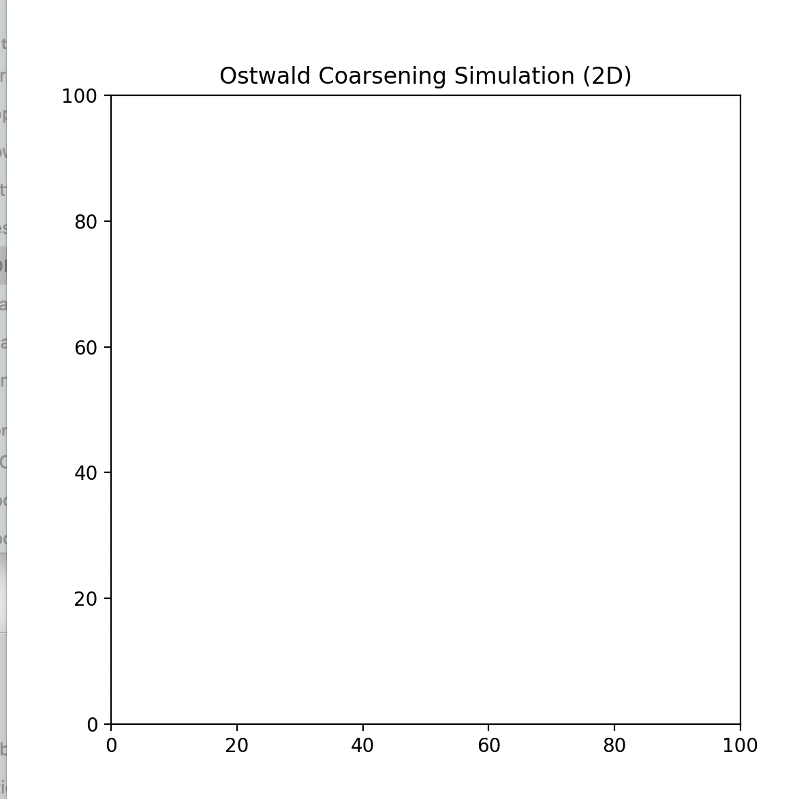
Small particles dissolve
Large particles grow
Area fraction ≅ constant
Number density decreases

Slide 16
α
time = t
time = t+∆t

Slide 17
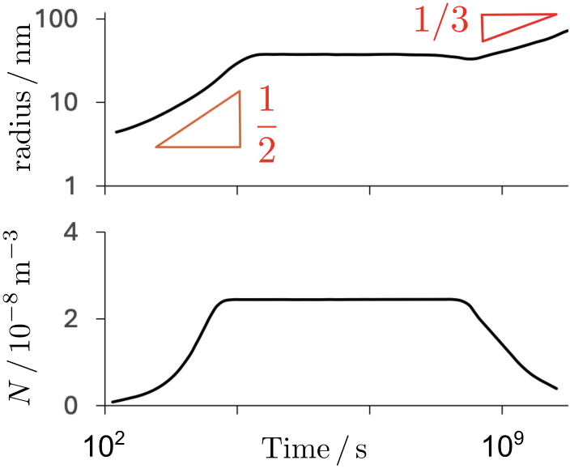
Coarsening follows
naturally

Slide 18
β
α
time = t
time = t+∆t

Slide 19
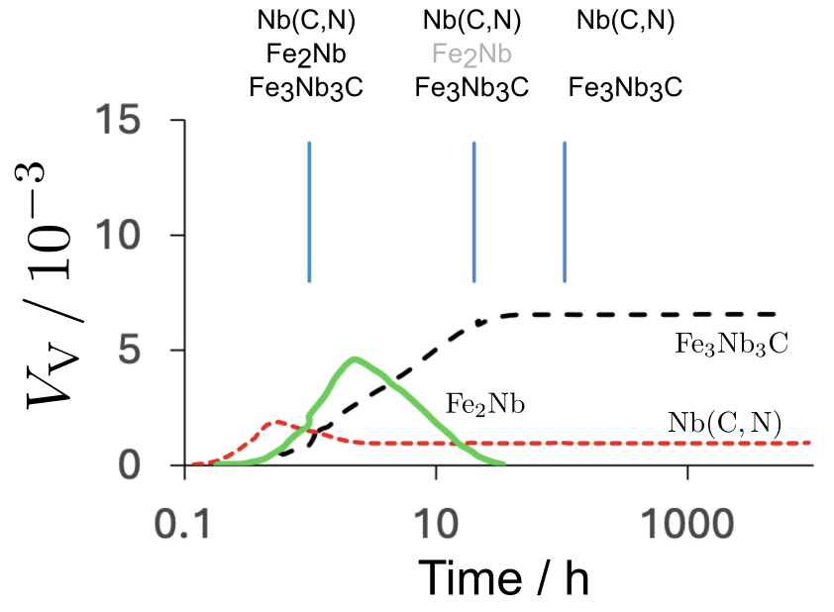

Slide 20
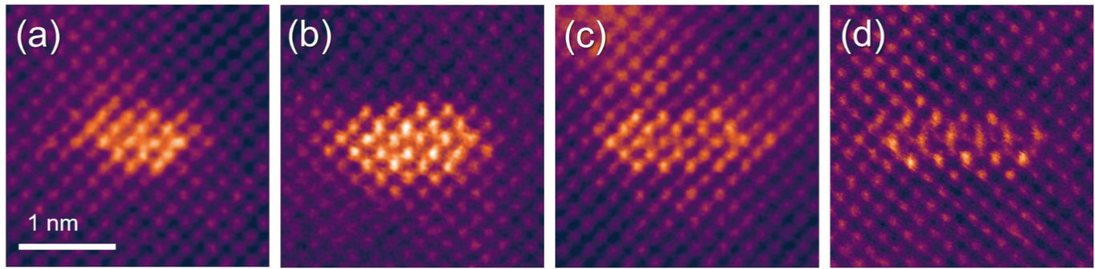

Interfacial energy per unit area
Jang, Kim
Scripta Mat. 243 (2024) 115967
0.06C-1.54Mn-0.2Si-0.0Al-0.07Nb,-0.04 V wt% 700°C, 5, 8, 11, 13 min ➔
Radis, Kozeschnik
Mod. Sim. Mat. Sci. Engng. 20 (2012) 055010

Slide 21
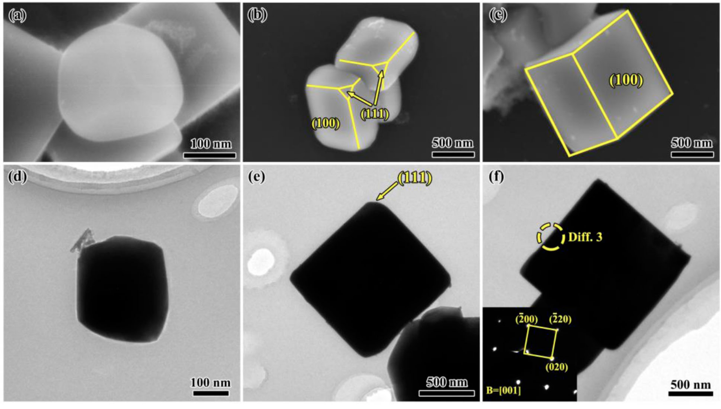
Pure Nb/cast-iron interface, annealed 1172°C
Bai, Zhong, Wei, Lv, Xu, Mat. Sci. Techn. 36 (2020) 1749
Notes:
It is not just the dislocation density that varies – topology of boundaries, deformation bands etc

Slide 22
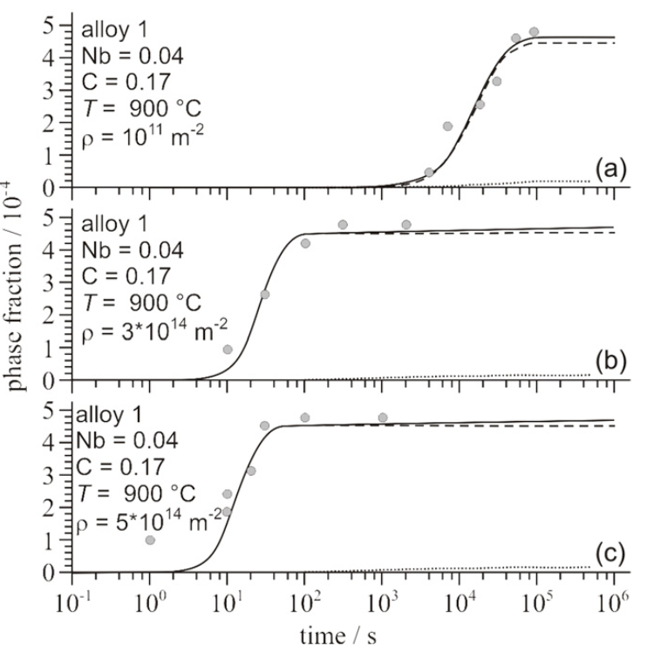
MatCalc, etc.
Radis, Kozeschnik
Mod. Sim. Mat. Sci. Engng. 20 (2012) 055010
Radis, Kozeschnik
Mod. Sim. Mat. Sci. Engng. 20 (2012) 055010

Slide 23
Use models creatively
Make predictions
Validate those predictions with your own experiments
Validate on all published data

Slide 24
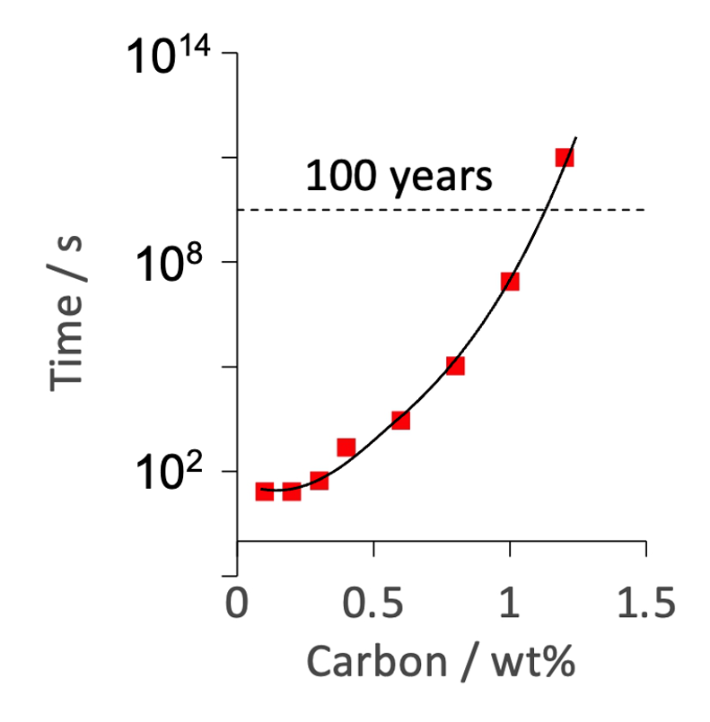
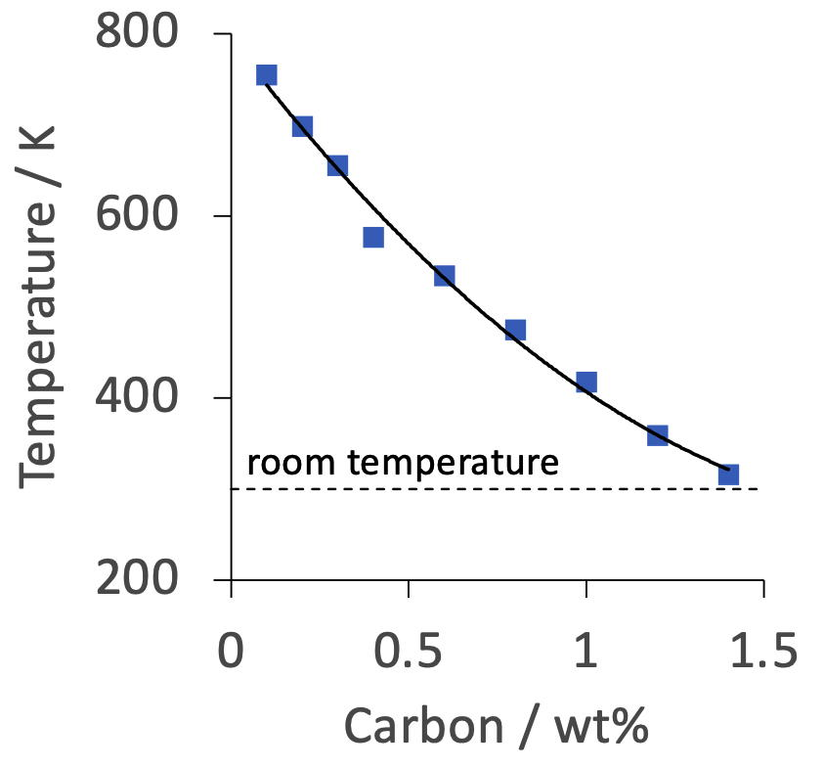
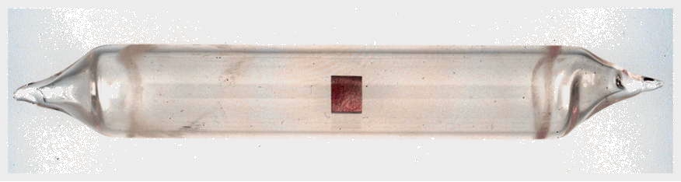
Best way forward?
2104
Notes:
Theoretical minimum

Slide 25
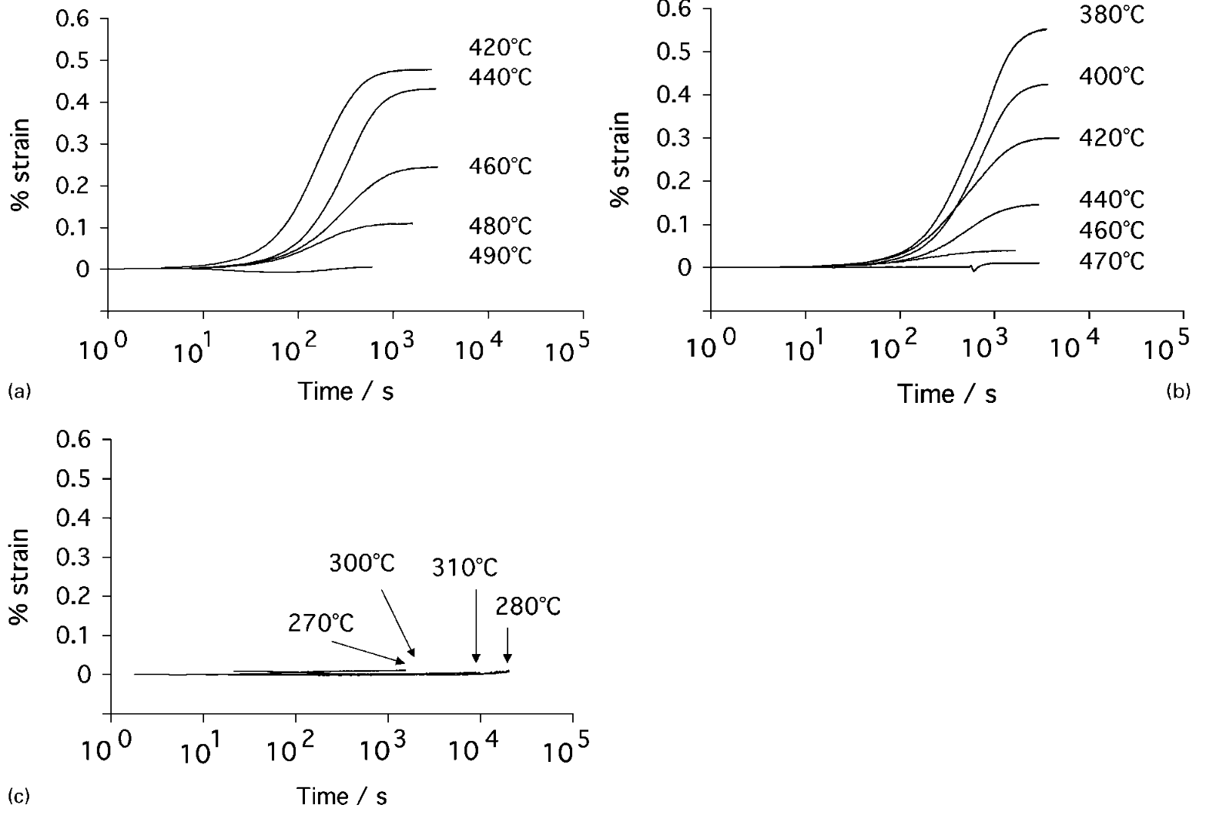
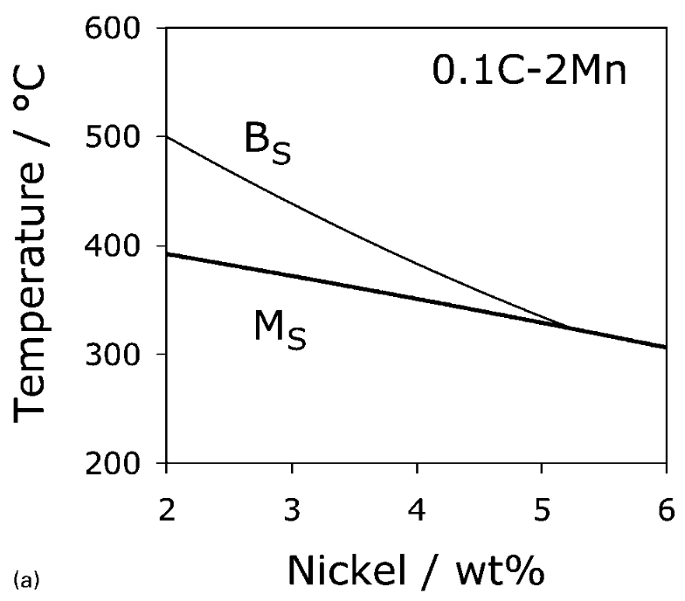

Slide 26
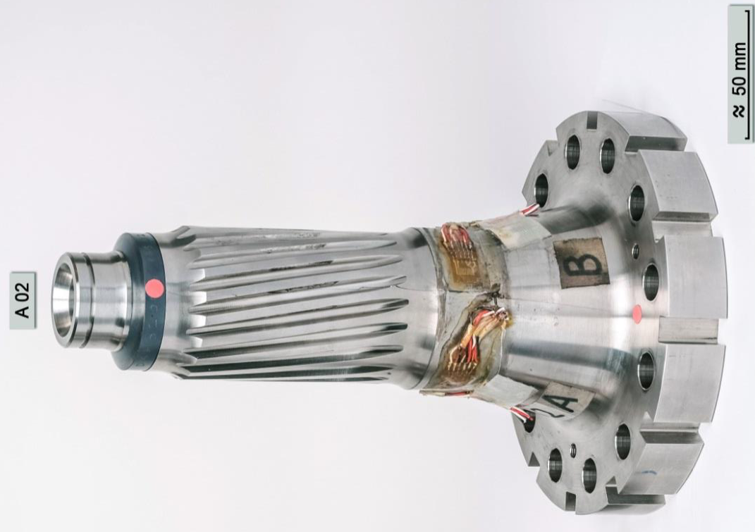
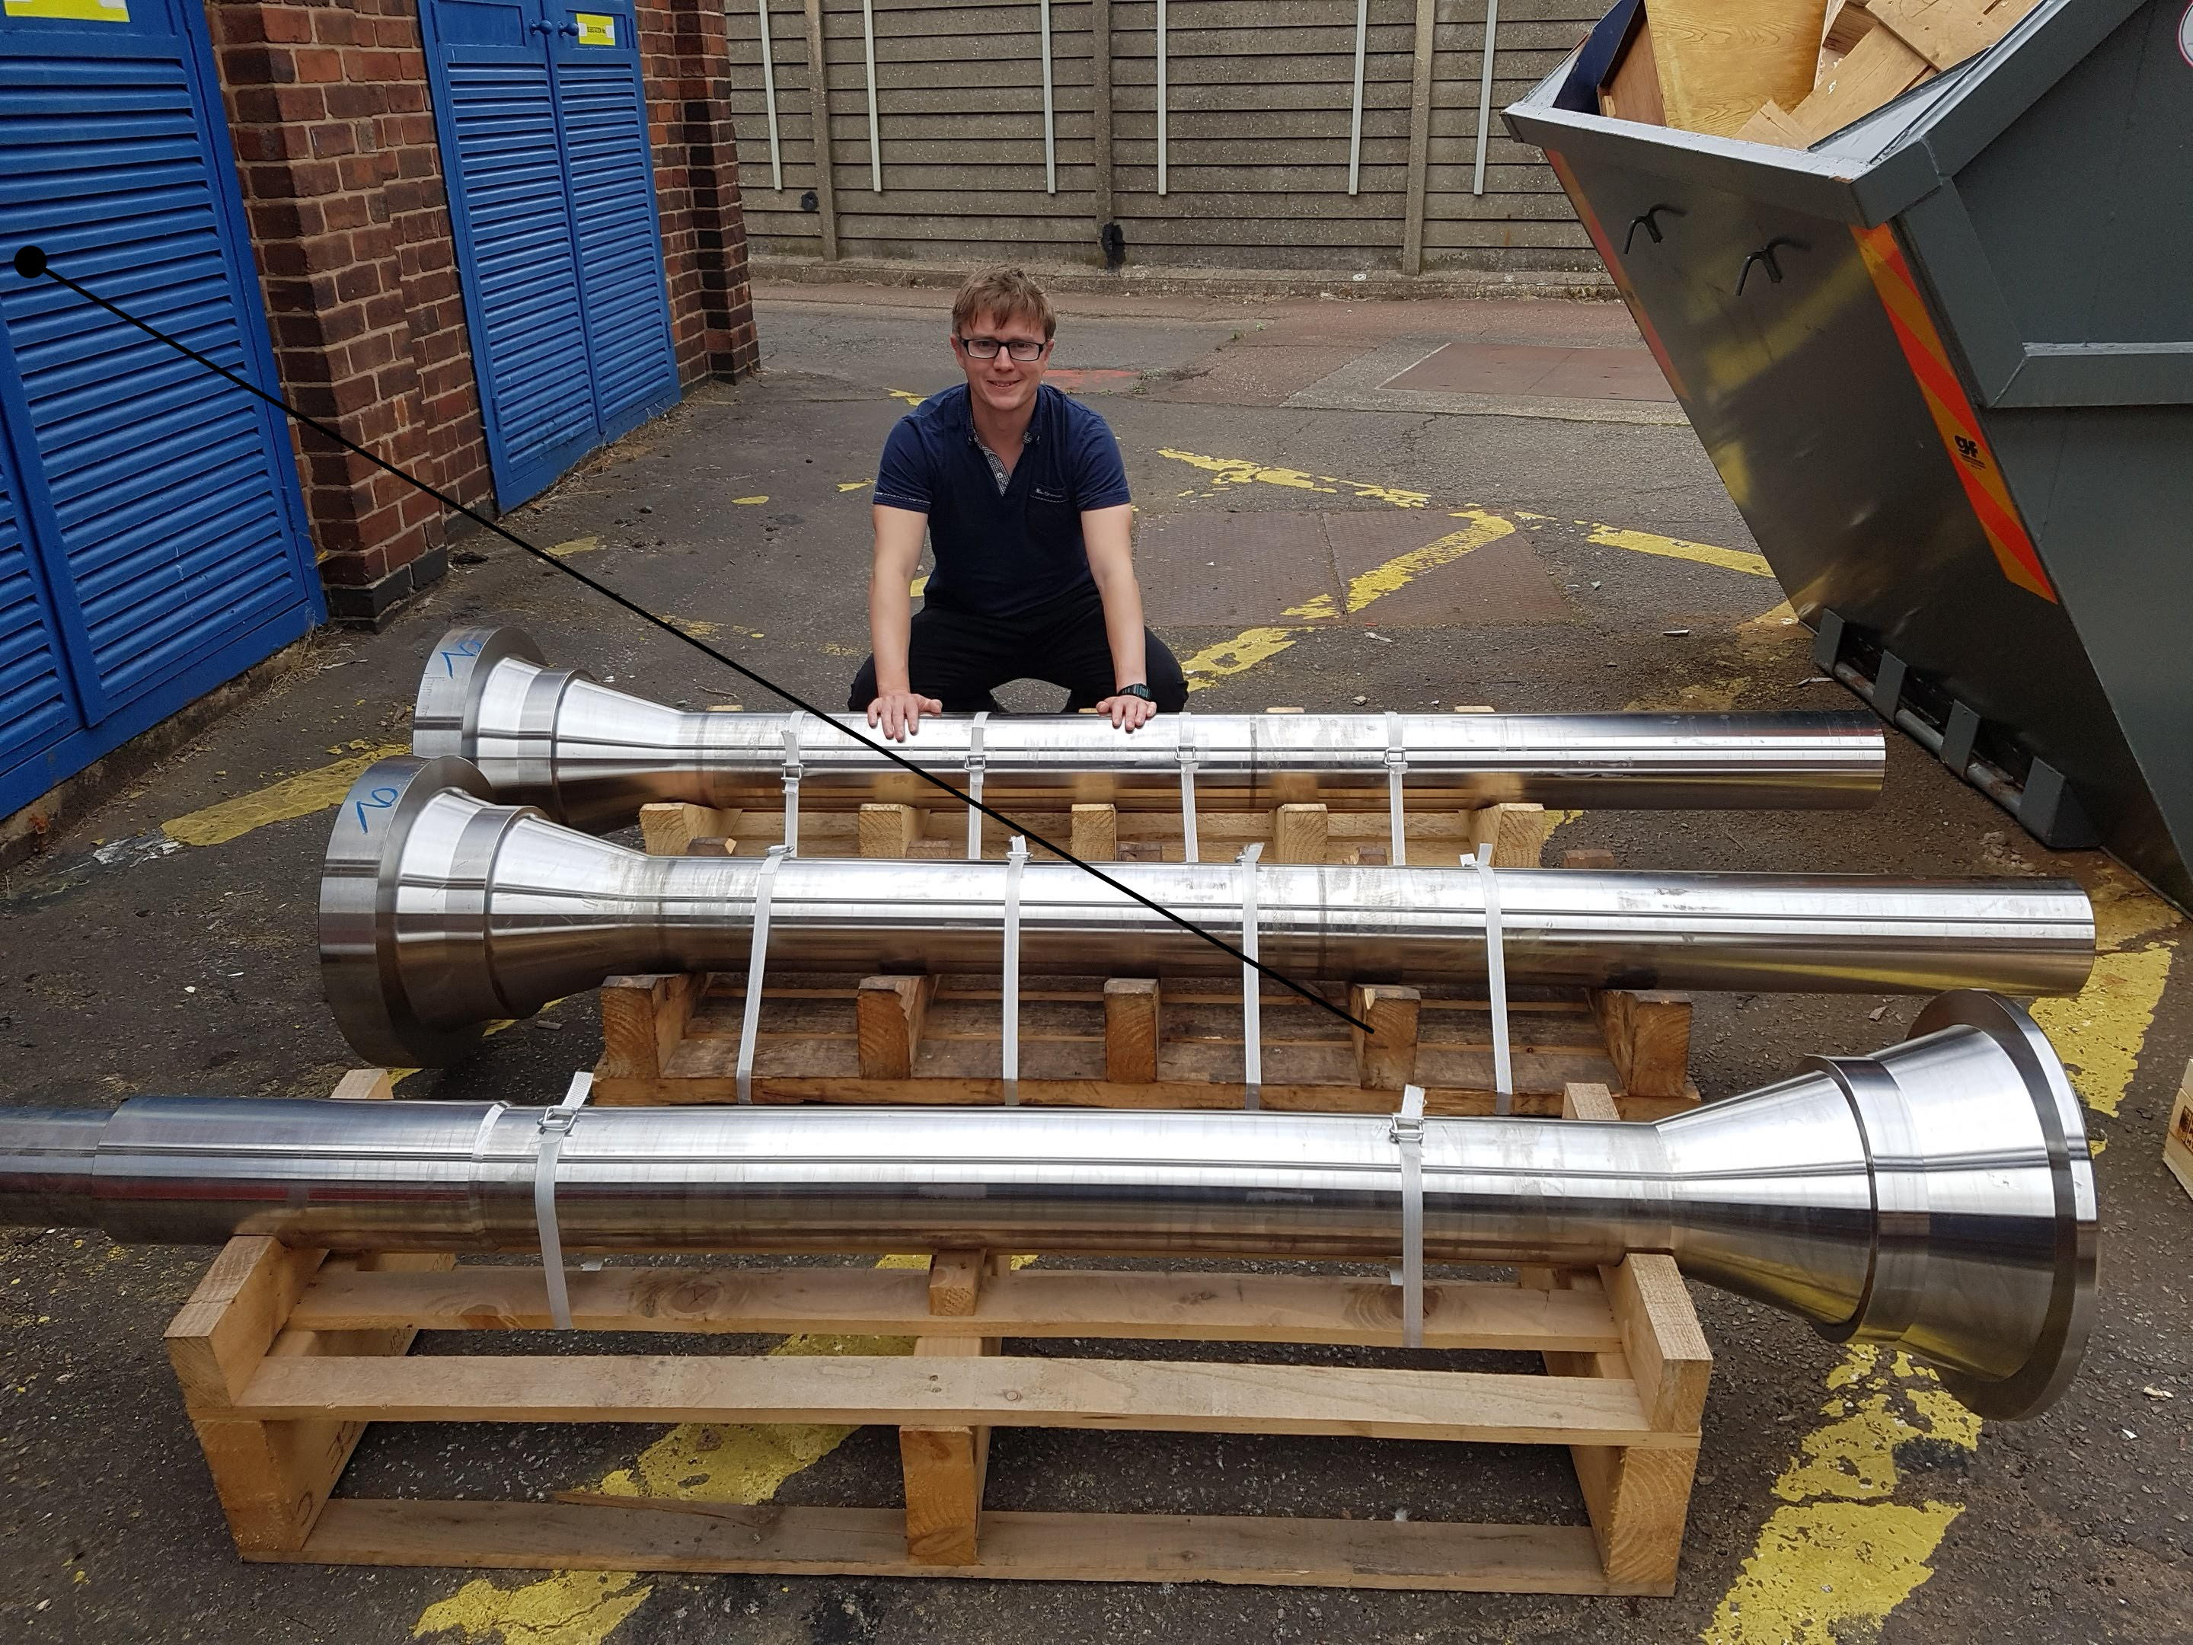
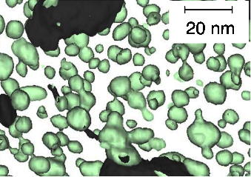
Paul Hill, Rolls-Royce

Slide 27
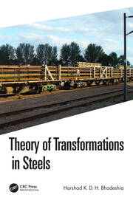
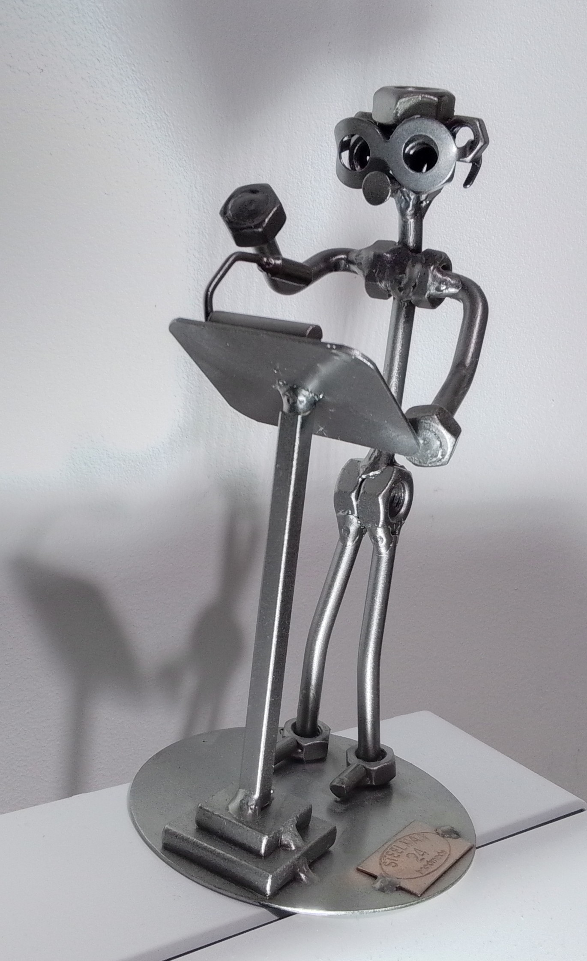
www.phase-trans.msm.cam.ac.uk

