Slide 1

Part IB
Materials Science and Metallurgy
Course A: Metals & Alloys
Professor Harry Bhadeshia
Lecture 1: Atomic Diffusion

Slide 2
Random motion of atoms
“Laws” of diffusion
Solutions to diffusion equations
How do atoms move in a solid?
Diffusion coefficient

Slide 3
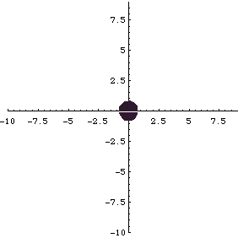
Random motion
J. Gaines and T. J. Lyons
University of Oxford

Slide 4
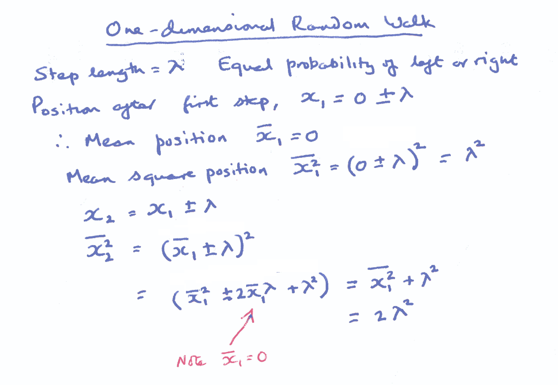

Slide 5
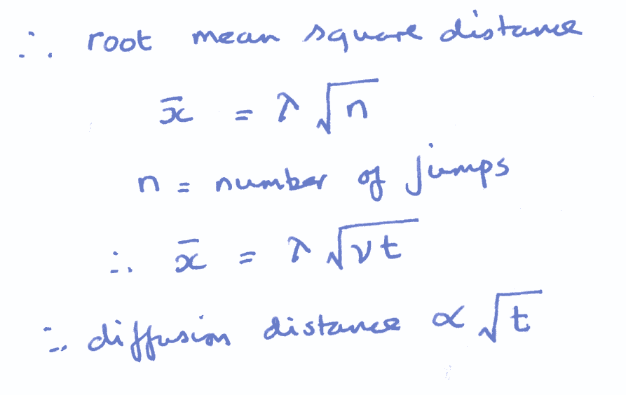

Slide 6
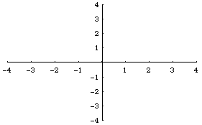
J. Gaines and T. J. Lyons
University of Oxford

Slide 7
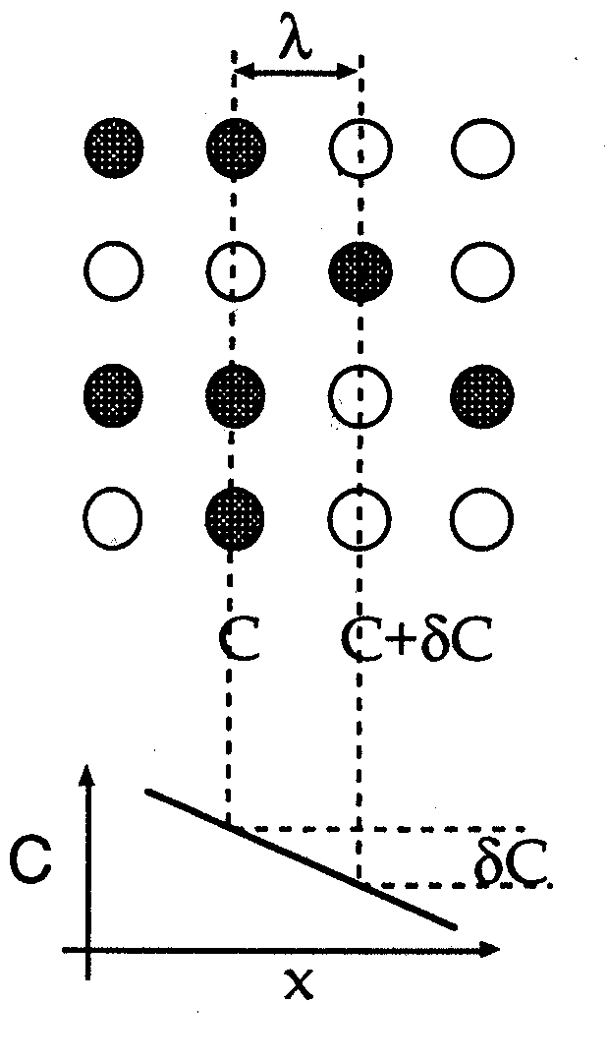
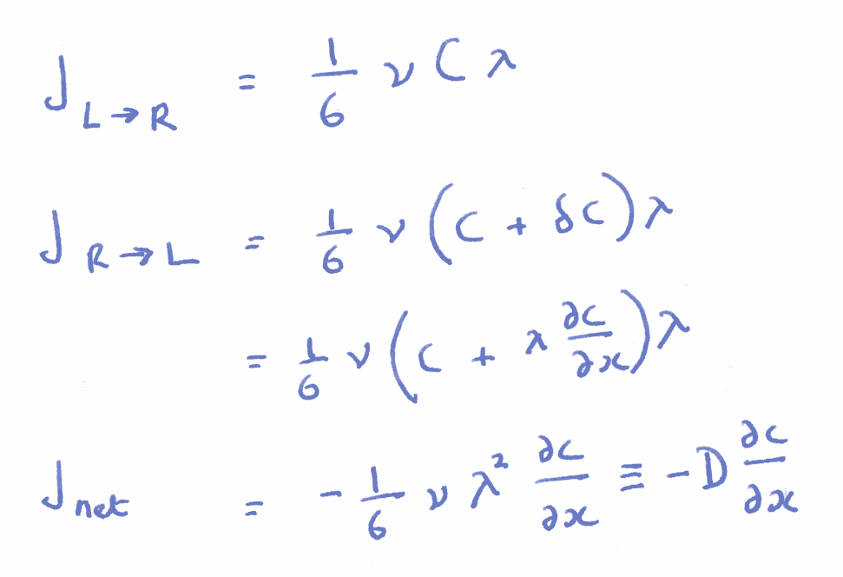
First law of diffusion

Slide 8
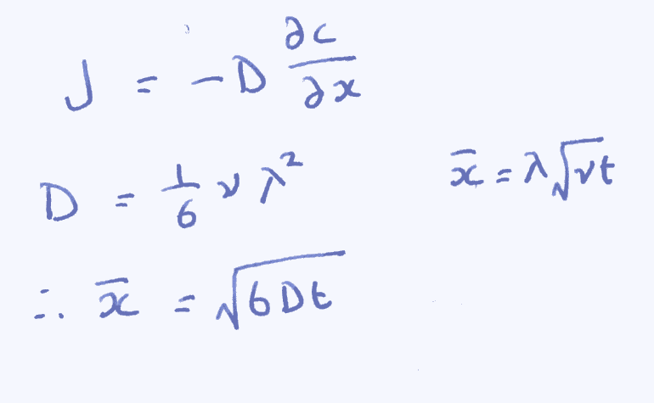

Slide 9
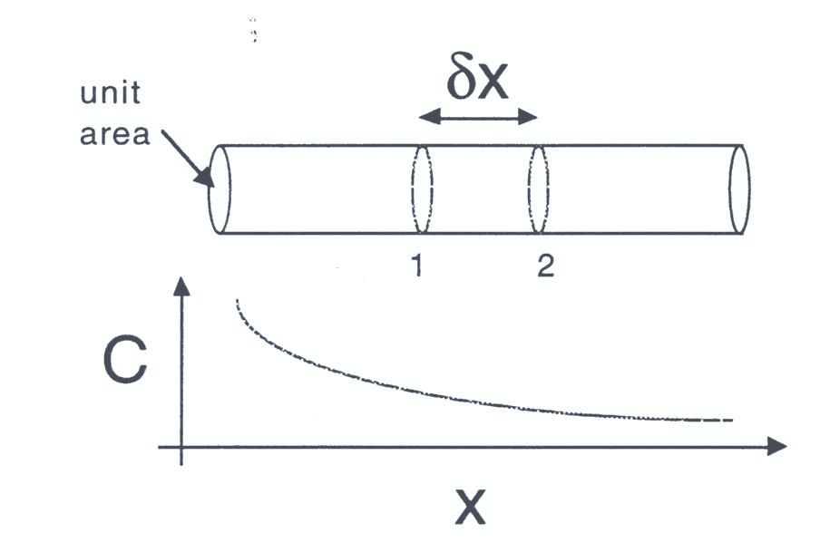
Second law of diffusion

Slide 10
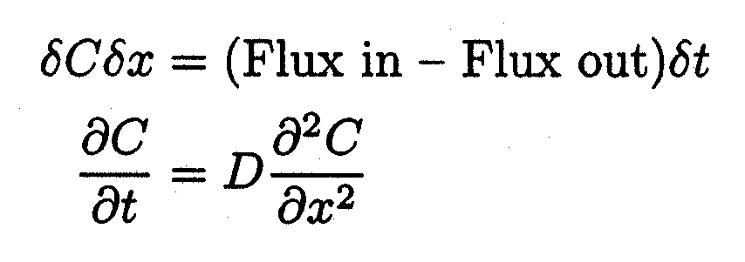
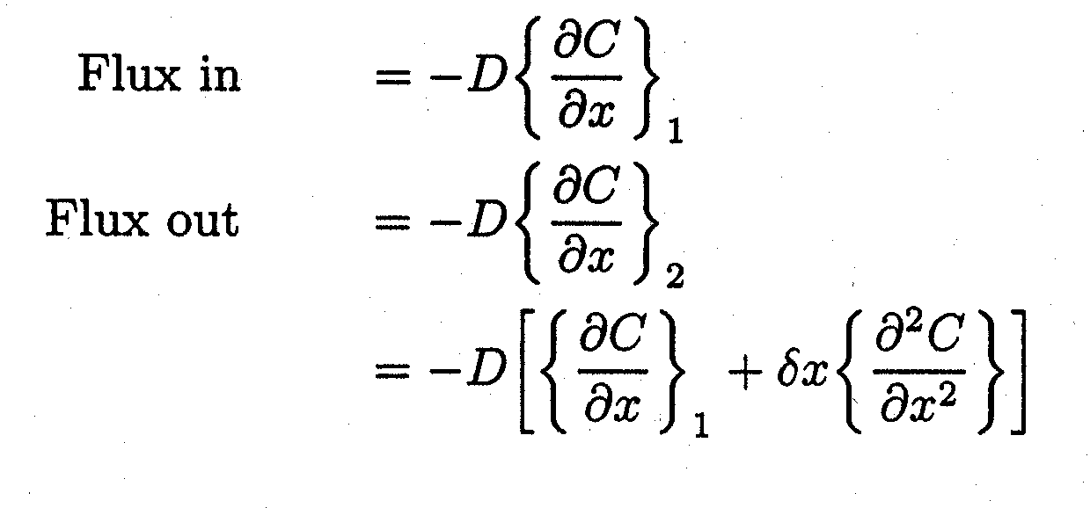

Slide 11
Random motion of atoms
“Laws” of diffusion
Solutions to diffusion equations
How do atoms move in a solid?
Diffusion coefficient

Slide 12
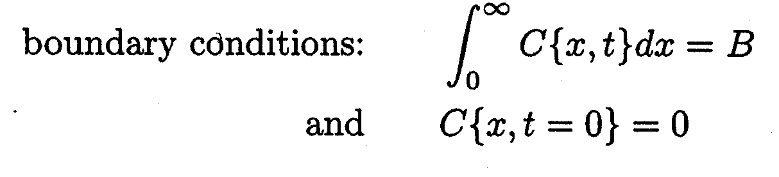
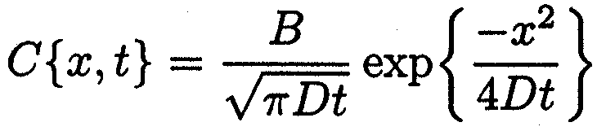
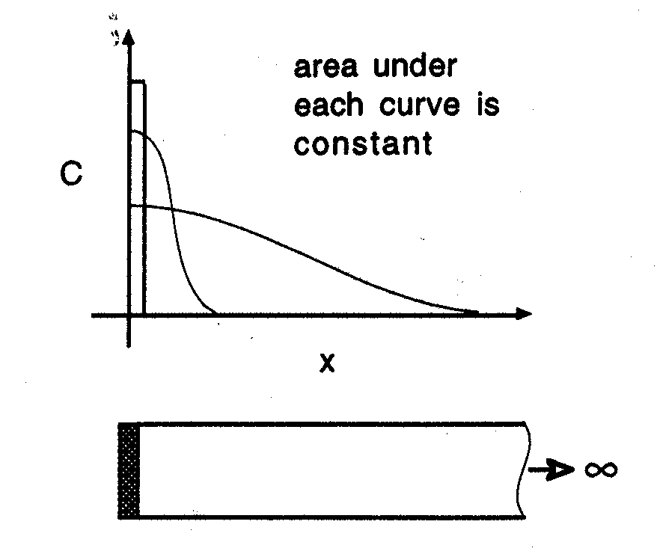
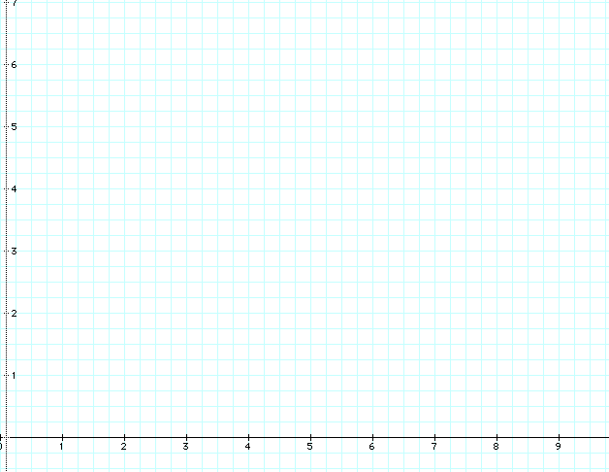

Slide 13
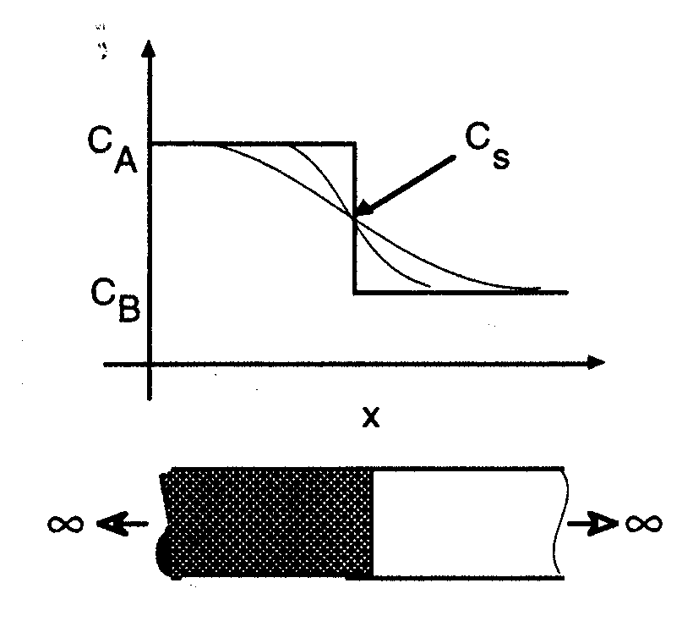
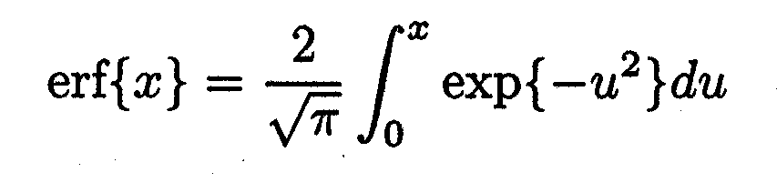

Slide 14
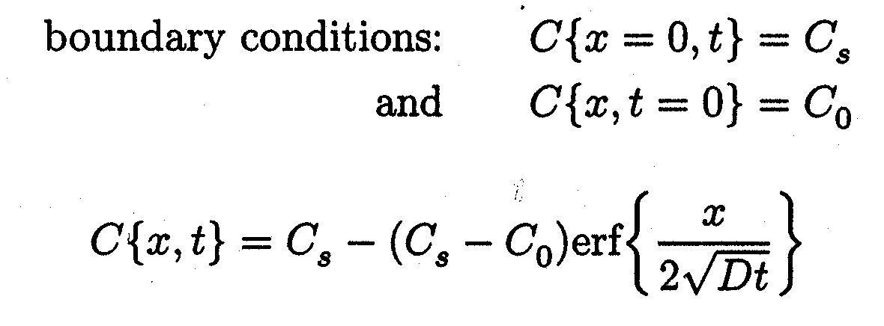

Slide 15
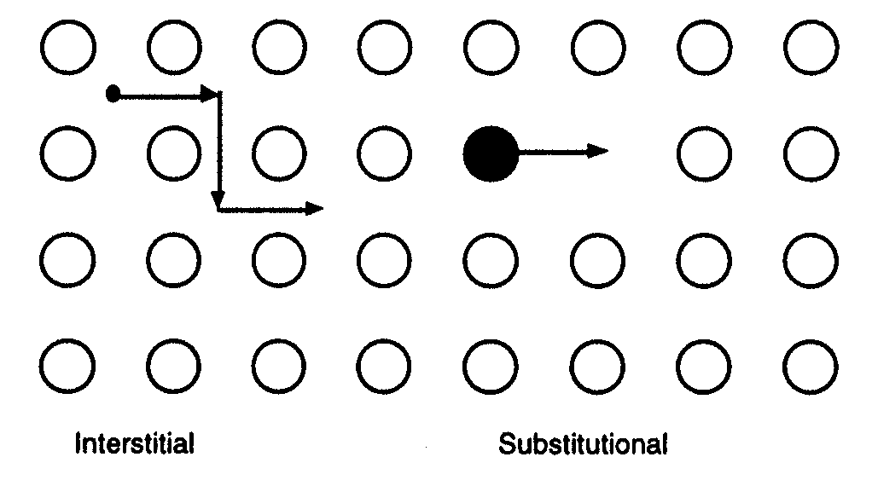
mechanism of diffusion

Slide 16

Self diffusion
Prof. H. Föll
Christian-Albrechts-University of Kiel

Slide 17
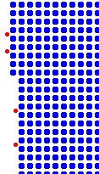
Interstitial diffusion
Prof. H. Föll
Christian-Albrechts-University of Kiel

Slide 18
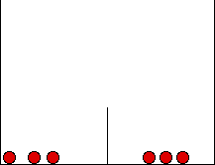
Diffusion Coefficient

Slide 19
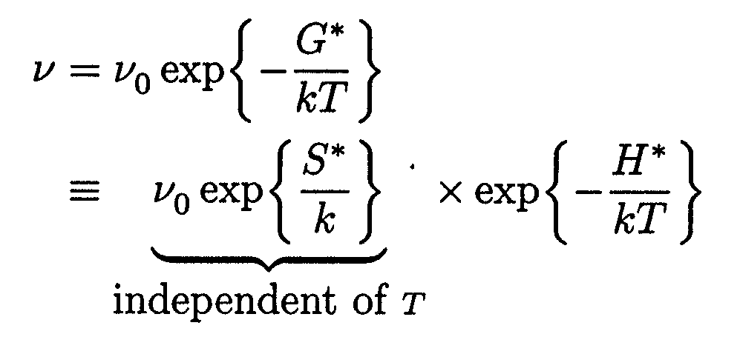
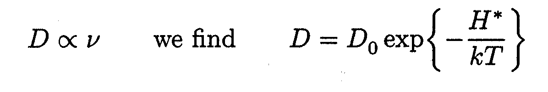

Slide 20
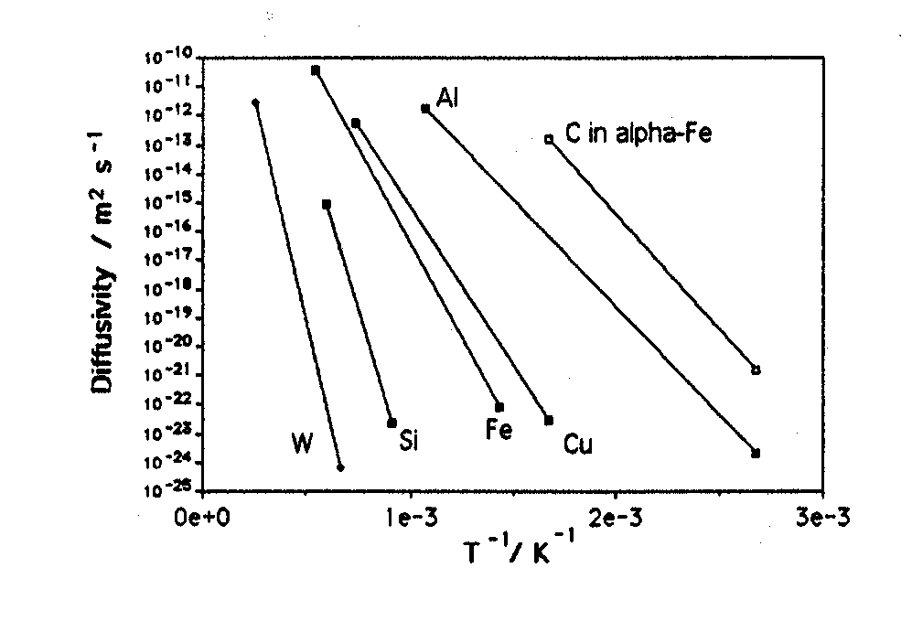

Slide 21
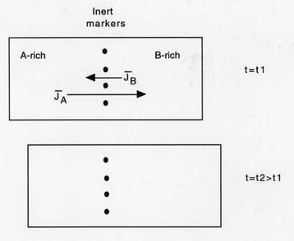
Mechanism

Slide 22
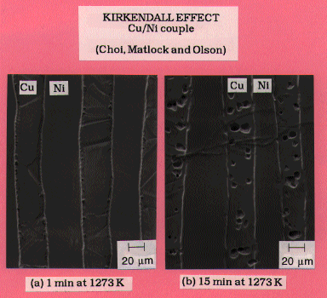

Slide 23
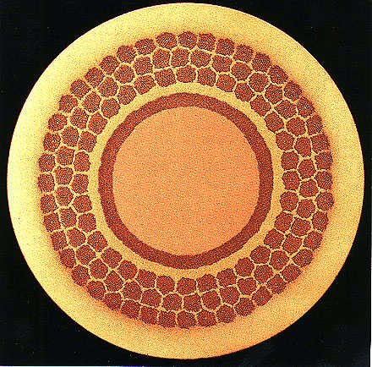

Slide 24
