Slide 1

Part IB
Materials Science and Metallurgy
Course A: Metals & Alloys
Professor Harry Bhadeshia
Lecture 11: Metallic Alloys

Slide 2
Transformation plasticity
TRIP-Steels
Dual-Phase Steels
Cast Irons
Aluminium alloys

Slide 3
DISPLACIVE
RECONSTRUCTIVE

Slide 4
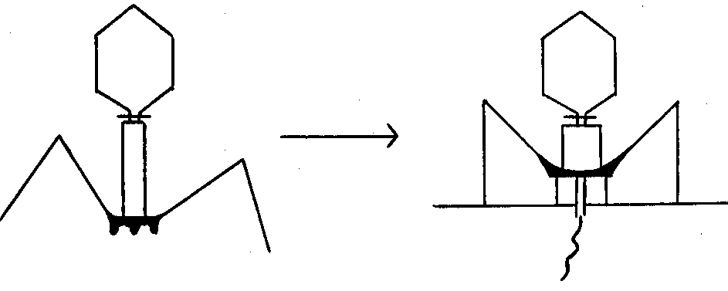
Olson and Hartman, 1982

Slide 5
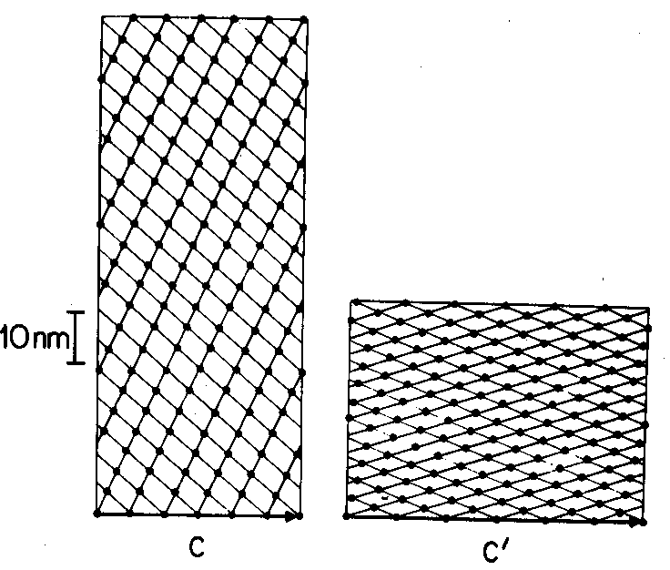
Olson and Hartman, 1982

Slide 6
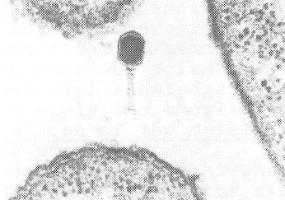
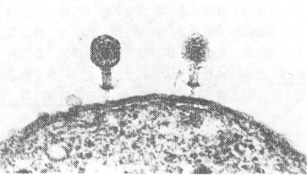
Olson and Hartman, 1982

Slide 7
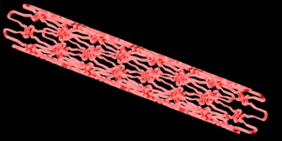
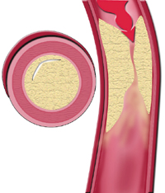

Slide 8


Slide 9
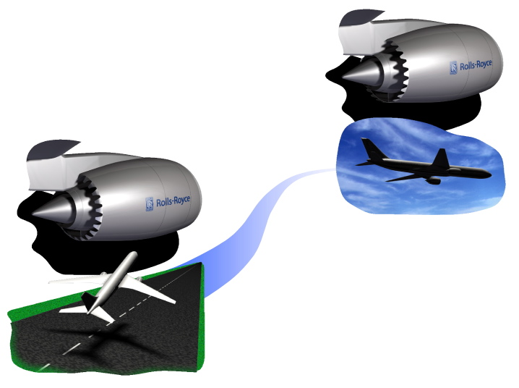
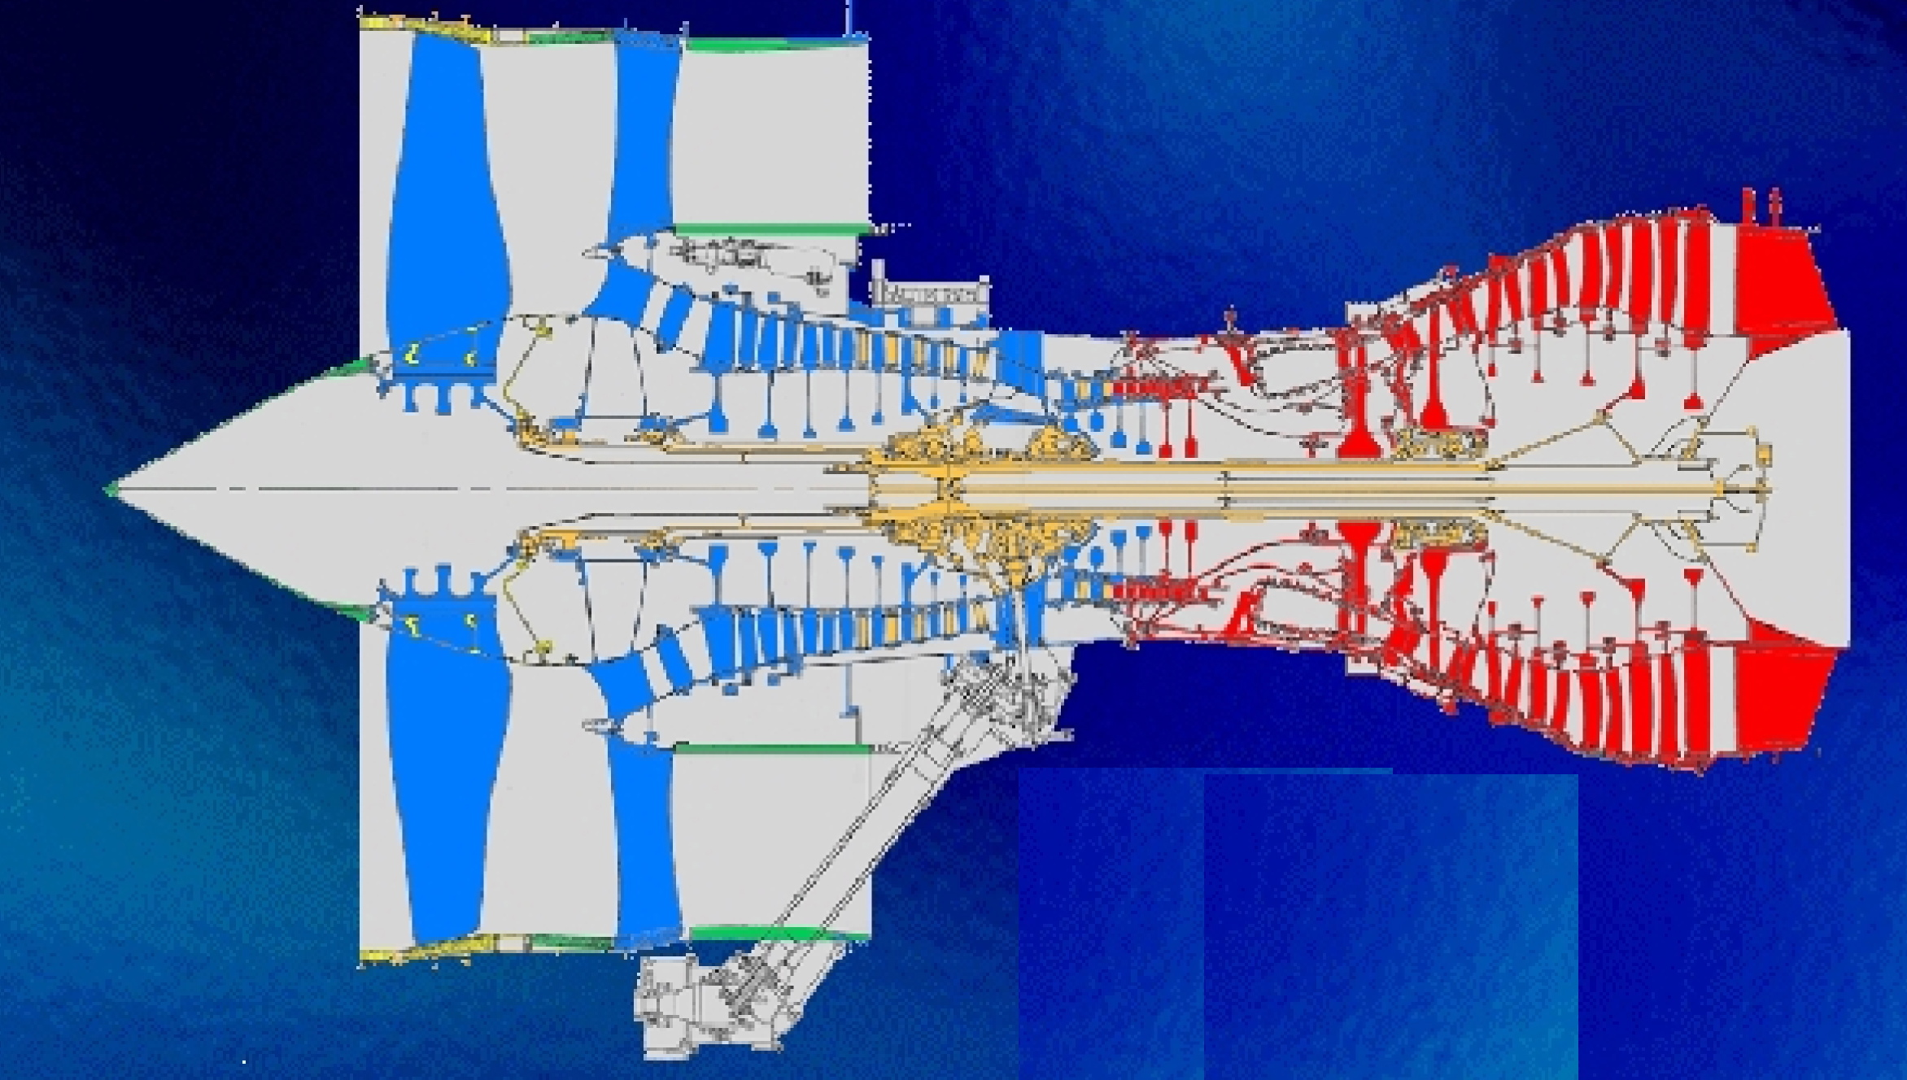

Slide 10
Displacive transformations can be induced by undercooling.
Martensitic transformation is a deformation accompanied by a change in crystal structure.
Therefore, martensite can be induced by stress.

Slide 11
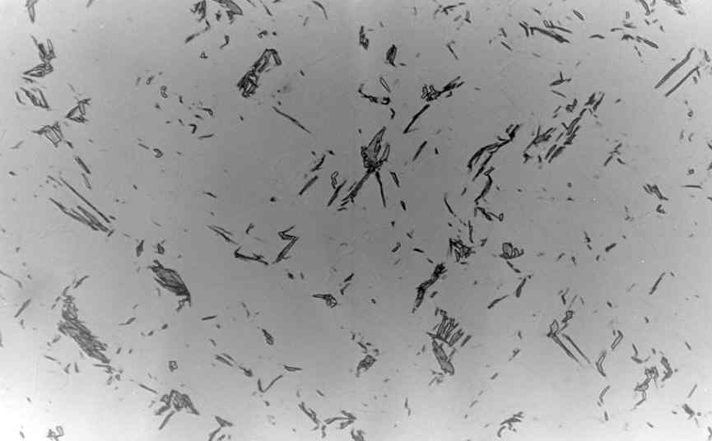
s
50 μm
Bhadeshia, 1982

Slide 12
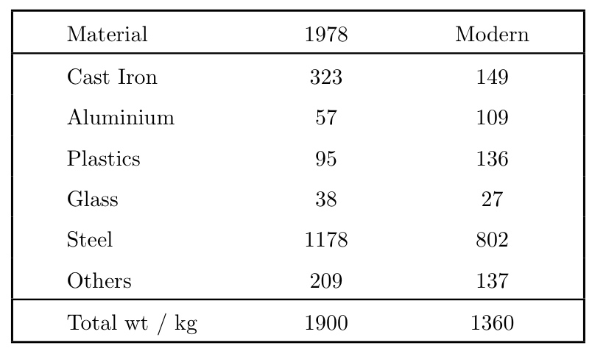

Slide 13
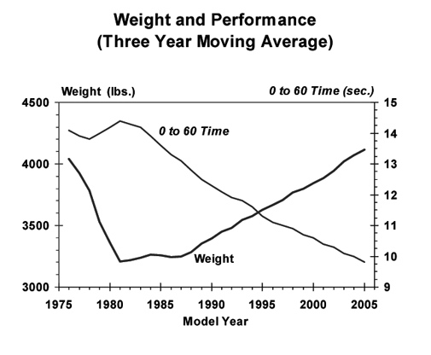

Slide 14
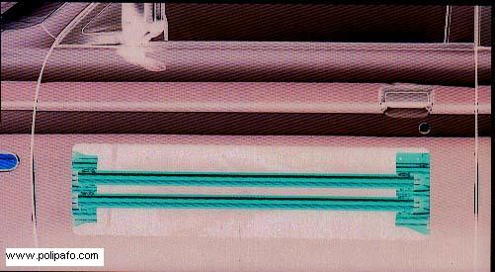
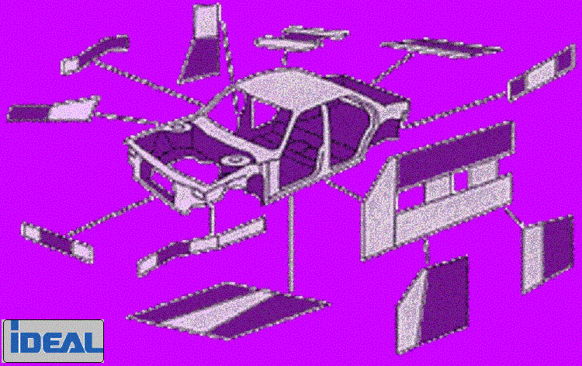
TRIP-Assisted Steels for Automobiles

Slide 15
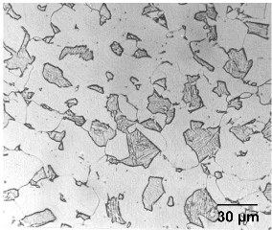
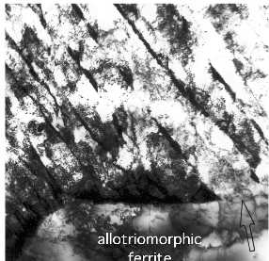
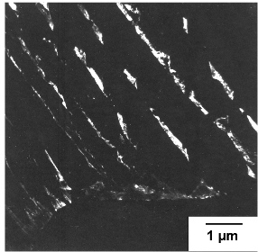
TRIP-assisted steel
Bhadeshia, Honeycombe, 2006

Slide 16
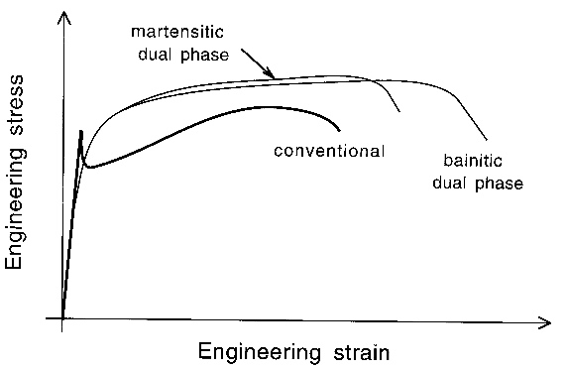

Slide 17
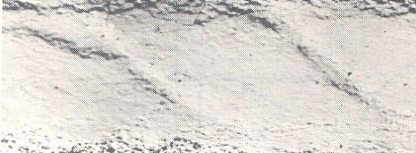
R. N. Parkins

Slide 18
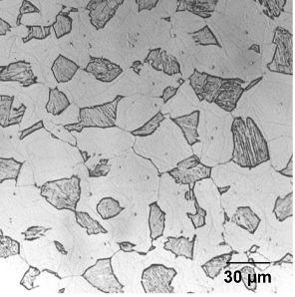
Dual-phase ferrite-martensite steels
Bhadeshia, Honeycombe, 2006

Slide 19
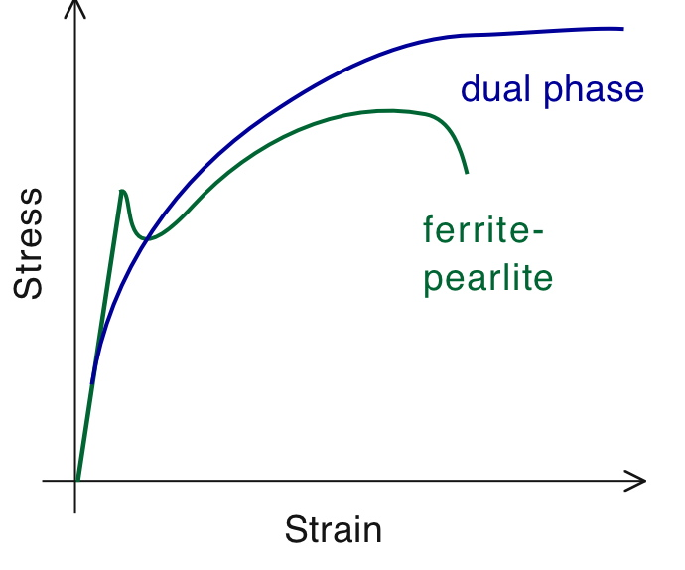

Slide 20
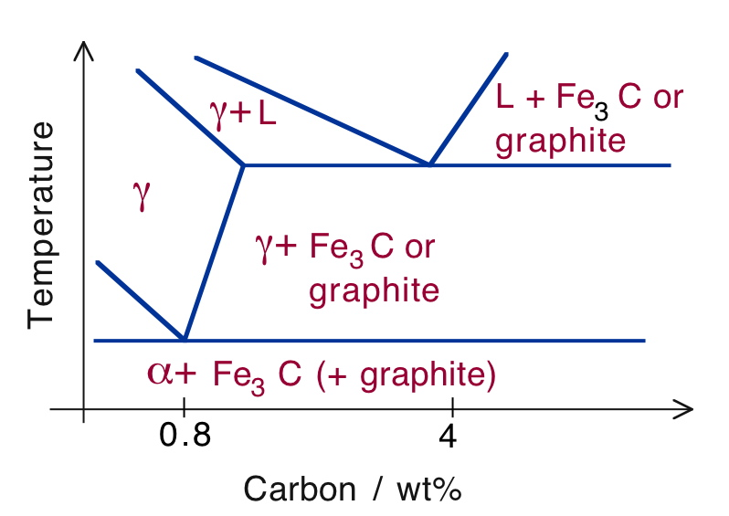

Slide 21
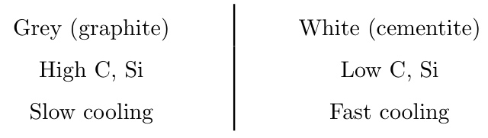

Slide 22
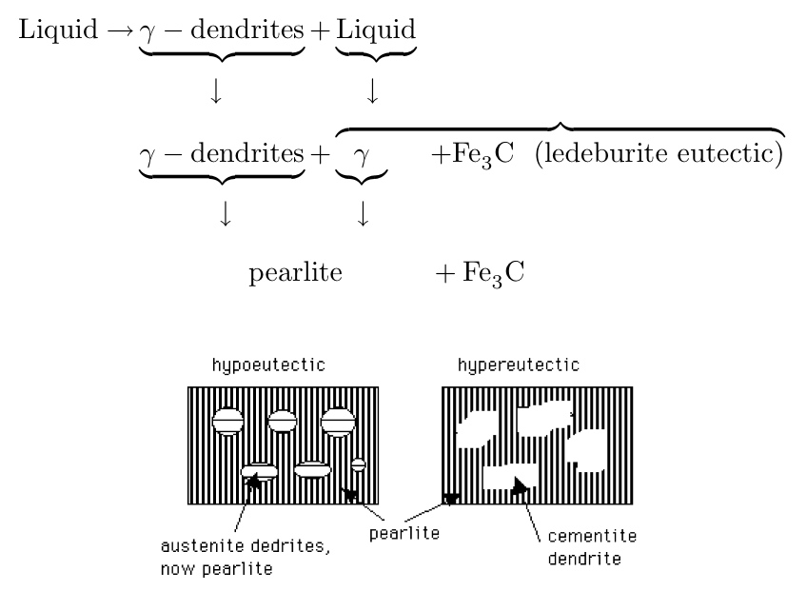

Slide 23
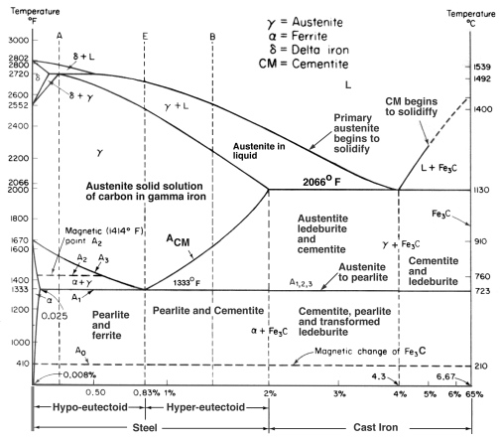

Slide 24
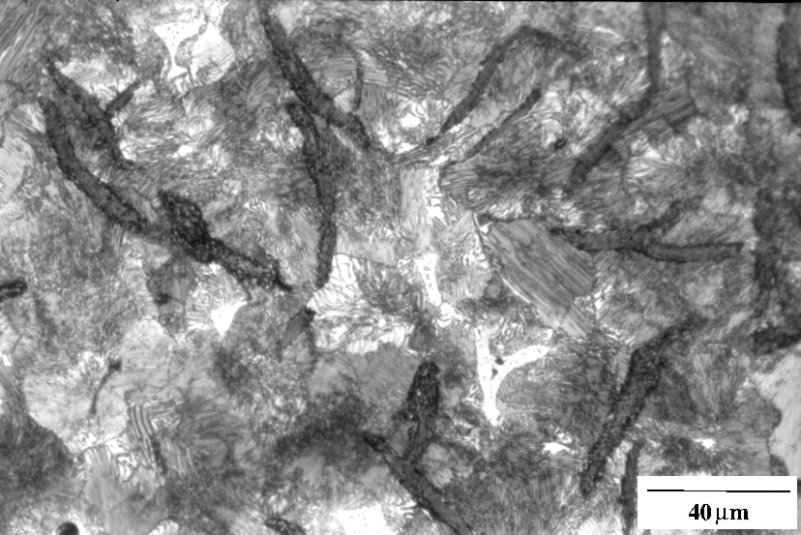
Flake graphite, grey cast-iron

Slide 25
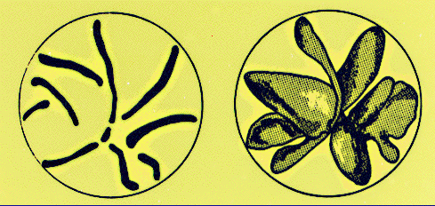
Three-dimensional shape of graphite (adapted from Underwood)

Slide 26
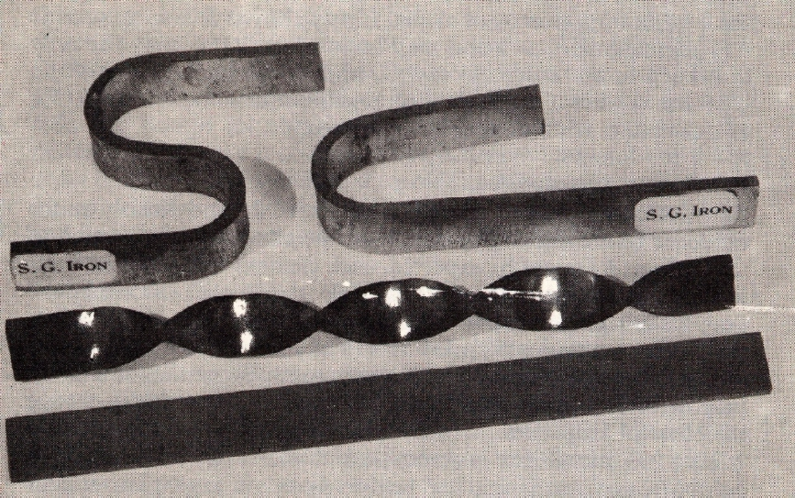

Slide 27
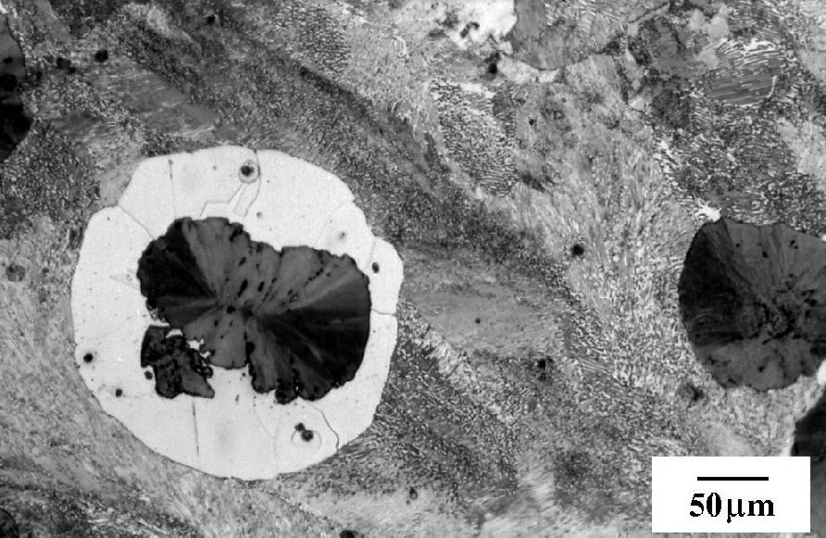
Spheroidal graphite cast-iron

Slide 28
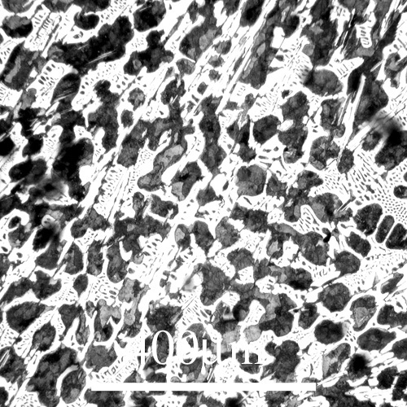
Hypoeutectic white cast-iron
DoITPoMS micrograph library

Slide 29
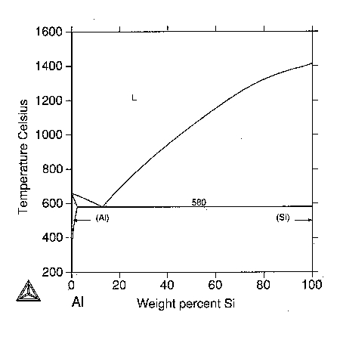

Slide 30
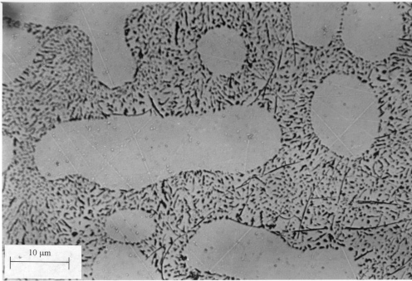

Slide 31
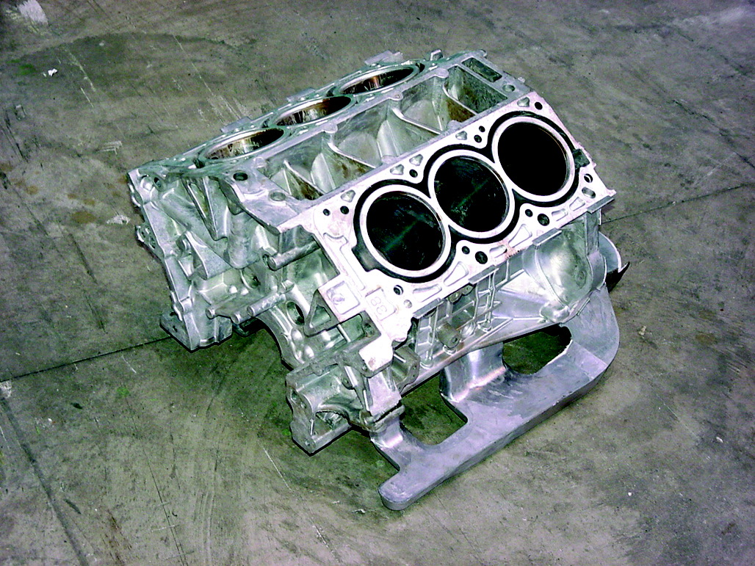

Slide 32
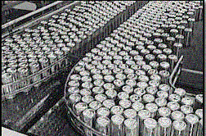
precipitation strengthening
solid solution strengthening
beverage cans Al-Mn or Al-Mn-Mg

Slide 33
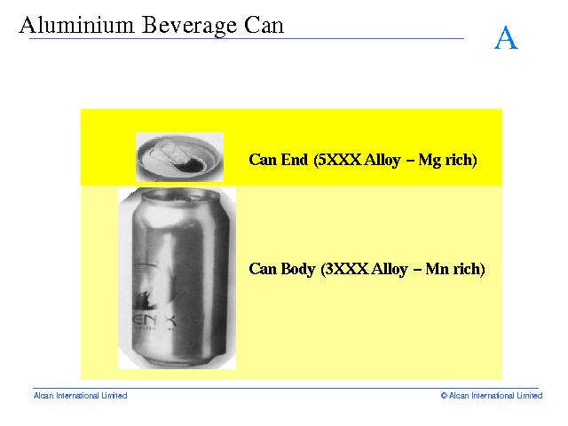

Slide 34
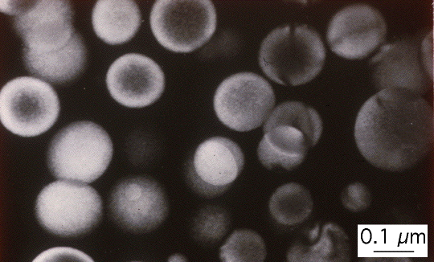
Aluminium-lithium alloys

Slide 35
