Slide 1

Part IB
Materials Science and Metallurgy
Course A: Metals & Alloys
Professor Harry Bhadeshia
Lecture 7: Recrystallisation, grain growth

Slide 2
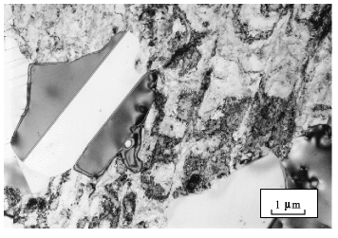

Slide 3
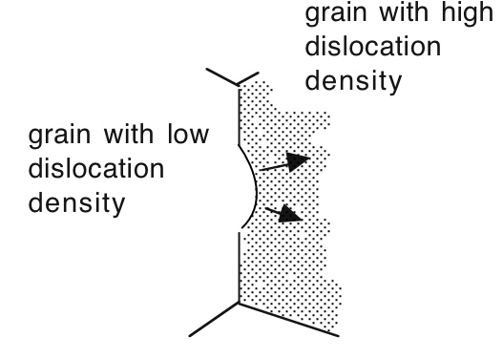

Slide 4

Ian Brough & John Humphreys
Al-0.1Mg wt% cold-rolled 50%

Slide 5
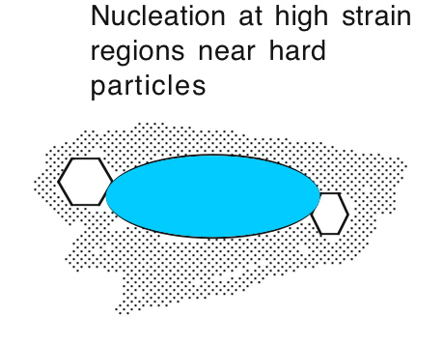

Slide 6
John Humphreys
Al-0.8Si wt% cold-rolled 60%
Acta Met. 25, 1323-1344. 1977

Slide 7
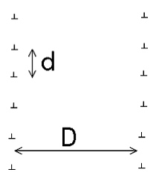





Slide 8
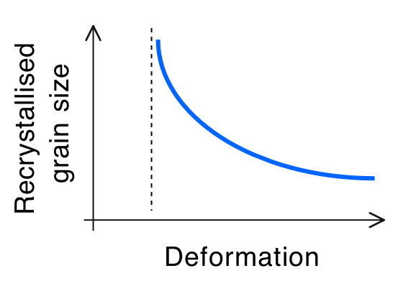

Slide 9
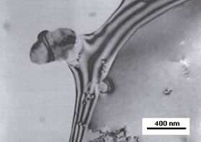

Slide 10
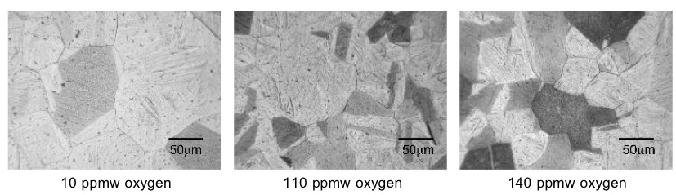
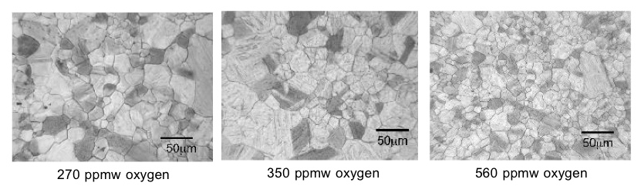
Terashima & Bhadeshia, 2006

Slide 11
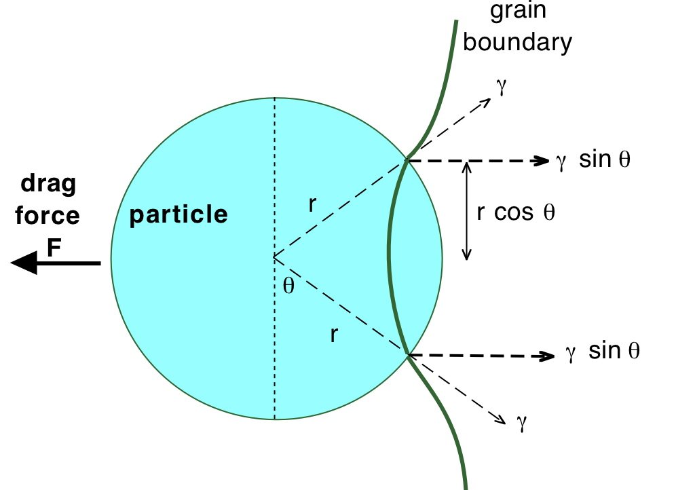

Slide 12



Slide 13
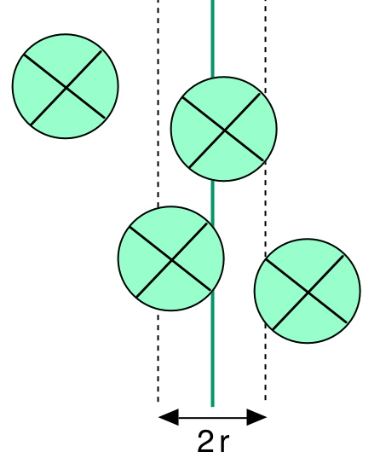



Slide 14


Slide 15





